Slide 1
Prof. V.F. Voino-Yasenetsky Krasnoyarsk State Medical University
Topic: Digestion of lipids. Intracellular fat metabolism. Metabolism of glycerol and fatty acids.
Lecture No. 7 on the discipline "biochemistry" for 2nd year students
Lecturer: Panina Yu.A.
Krasnoyarsk, 2023

Slide 2
lecture plan
Relevance of the topic.
Digestion of lipids in the gastrointestinal tract.
Lipolysis, its significance and regulation.
Lipogenesis, its significance and regulation.
Glycerol metabolism.
Oxidation and synthesis of fatty acids.
Ways of formation and using of acetyl-CoA.
Ketone bodies, their metabolism.
Conclusion

Slide 3
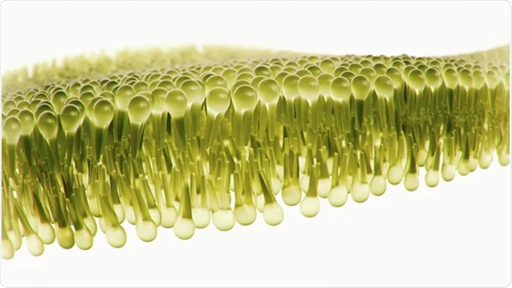
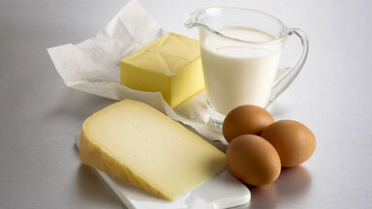
LIPID METABOLISM

Slide 4
RELEVANCE OF THE TOPIC
Biomedical significance
Fats are one of the important sources of energy for cells and tissues, and lipoids are biologically active substances and are part of cell membranes

Slide 5
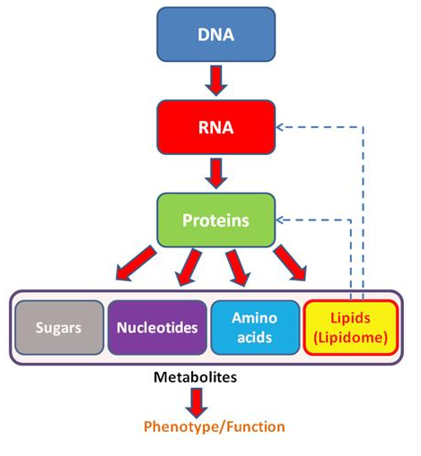
Lipidomics
Lipidome - lipid profile (most often mass spectrum)
Lipidomics is subdivided into:
architecture / membrane lipidomics and
mediator lipidomics
Clinical lipidomics characterizes the lipid composition and concentration of all individual lipids in a sample

Slide 6
Lipidomics

Slide 8
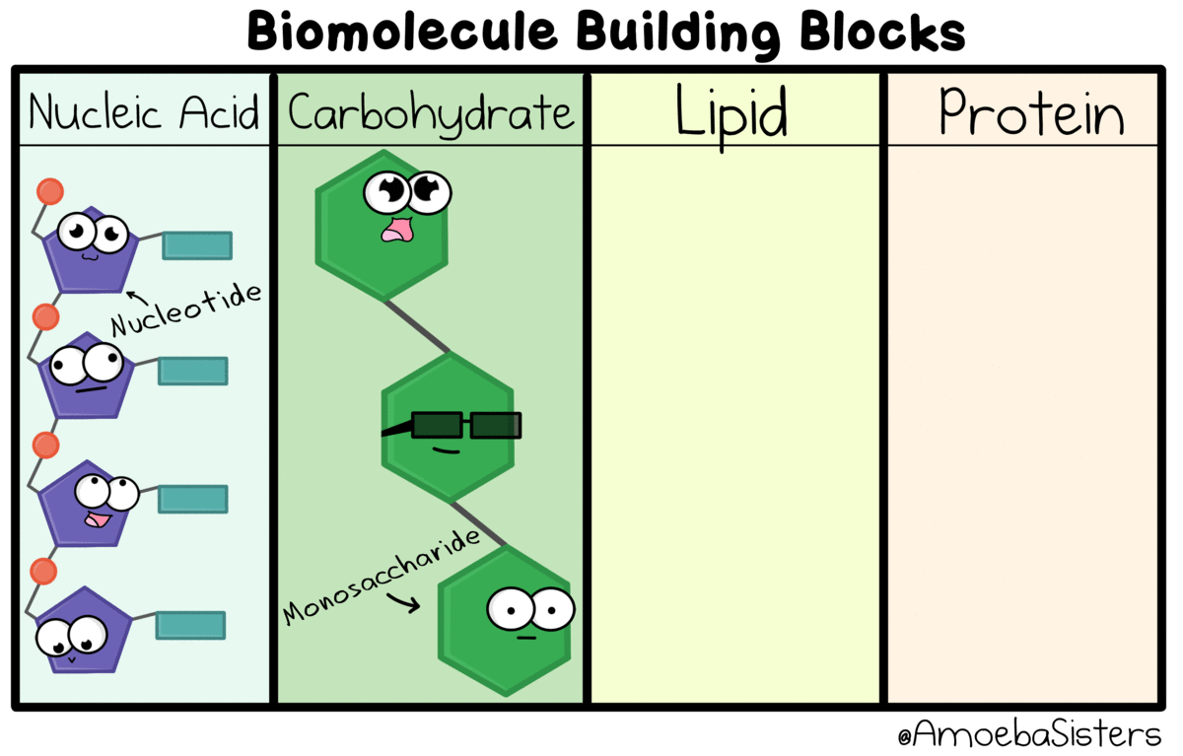

Slide 9
Lipids are organic substances of a hydrophobic nature, insoluble in water, but readily soluble in non-polar organic solvents: chloroform, ether, acetone, benzene, etc.
Most lipids contain fatty acids associated with alcohols with glycerol or cholesterol by ester bonds, with the amino alcohol sphingosine - with an amide bond.

Slide 10
BIOLOGICAL FUNCTIONS OF FATS
ENERGY
When 1 g of fat is oxidized, 38.9 kJ of energy is released
STRUCTURE
Are part of the cell (fatty inclusions)
SOURCES OF ENDOGENOUS WATER
Oxidation of 100 g of fat releases 107 ml of H2O
STORAGE
Fat depots - "energy canned food" for later
THERMAL REGULATOR
brown fat creates up to 30% of all heat in the body
fats do not conduct heat well (heat insulators - protection against hypothermia)
PROTECTIVE
protect organs from damage (near the eyes, a perirenal fat capsule, visceral fat "amortizes" internal organs during body movements, etc)

Slide 11
Biological functions of lipoids
STRUCTURE
Are a part of cell membranes (PL, GL), determine the properties of cells
TRANSPORTATION
Lipoproteins - carriers of lipids and fat-soluble vitamins
PARTICIPATION IN SYNTHESIS OF BIOLOGICALLY ACTIVE SUBSTANCES
THROMBOPLASTIN AND NERVOUS TISSUE MYELIN
BILE ACIDS
VITAMIN D
hormones
REGULATORY
Cholesterol - a source of steroid hormones, some fatty acids - eicosanoids

Slide 13
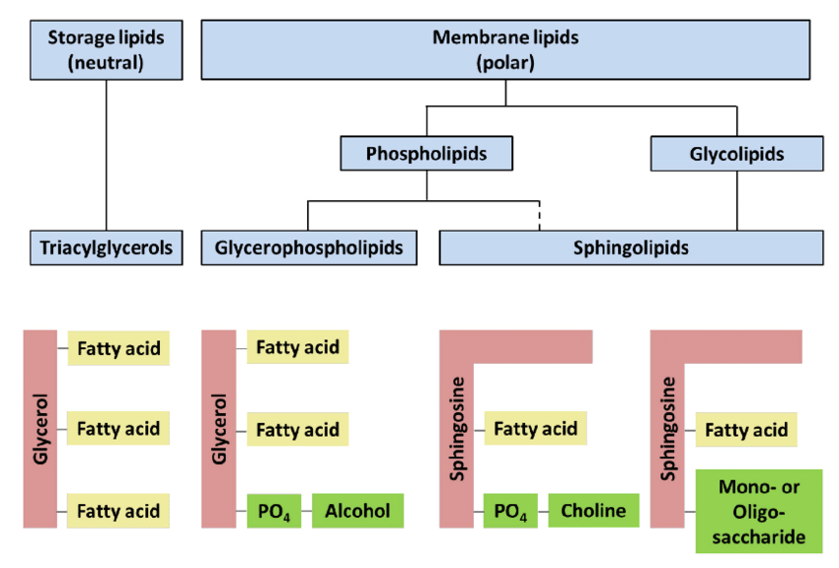

Slide 17
Regulation of fat digestion
Hormone-like substance | Place of secretion | Targets of action | Effects on the digestion of fats
Cholecystokinin (Pancreozymin) | I-cells of the mucous membrane of the duodenum and proximal part of jejunum | gall bladder | stimulates its contraction, but relaxation of the sphincter of Oddi
 |  | exocrine pancreatic cells | stimulates the secretion of digestive enzymes, including pancreatic lipase
Cholecystokinin secretion stimulants: gastrin-releasing peptide; proteins, fats entering the small intestine from the stomach as part of the chyme, especially with the presence of long-chain fatty acids (fried foods), constituents of choleretic herbs (alkaloids, protopin, sanguinarine, essential oils, etc.), acids (but not carbohydrates)
Secretin | S-cells of the mucous membrane of the small intestine | pancreas | stimulates the secretion of bicarbonate (HCO3-) into pancreatic juice
Prosecretin is converted to secretin by the action of gastric hydrochloric acid (stimulating role at pH <4). Stimulants of production are also fatty acids, ethanol, spice components, bile acids

Slide 18
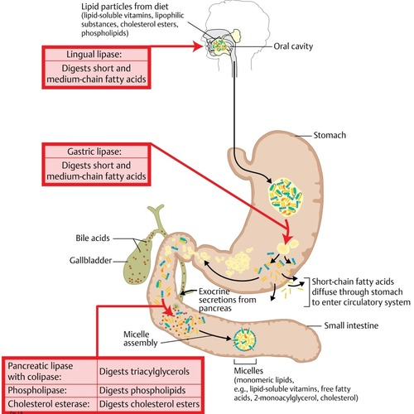
Stages of digestion and absorption of fats
1. Emulsification of fats (TAG).
2. Hydrolysis of TAG, PL and CS esters under the influence of gastrointestinal enzymes.
3. Formation of micelles and their absorption into enterocytes.
4. Resynthesis of TAG, PL and CS esters in enterocytes.
5. Collected in transport forms (chylomicrons) and carried throughout the body.

Slide 19
https://openoregon.pressbooks.pub/nutritionscience/chapter/5d-digestion-absorption-lipids/

Slide 20
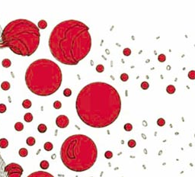
Emulsification of fats
Emulsification of fats consists in the physical breakdown of fat droplets into small particles, since water-soluble enzymes can only act on the surface of the droplet:
begins in the stomach with mixing fats with other products of digestion of gastric contents.
The main stage of emulsification occurs in the duodenum under the influence of bile (contains a large amount of bile acids, salts and phospholipid - lecithin. These components, in particular lecithin, are extremely important for the emulsification of fats. Polar particles (places where water ionization occurs) bile salts and lecithin molecules are readily soluble in water, while the majority of these molecules are readily soluble in fats

Slide 21
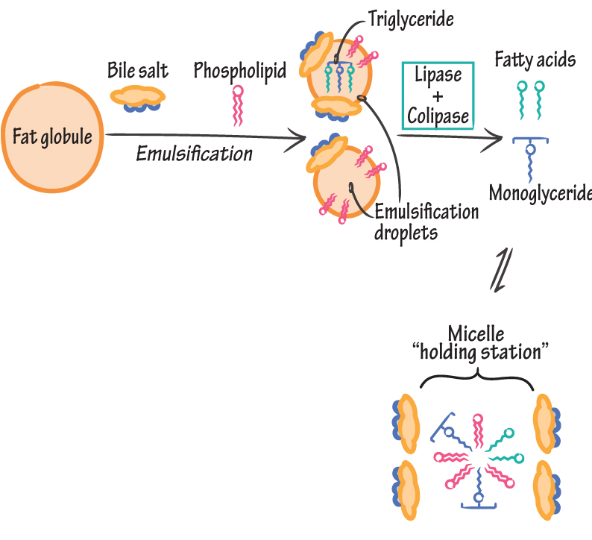
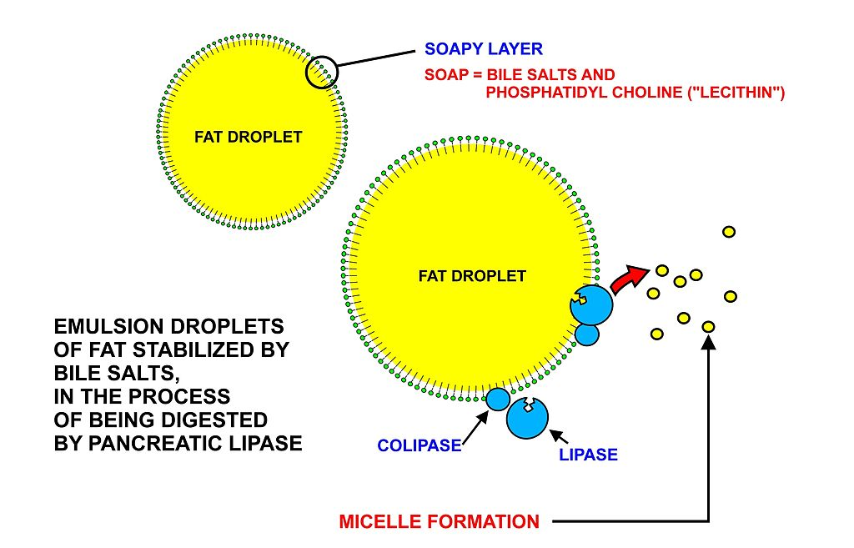
Emulsification of fats and formation of micelles
https://www.drawittoknowit.com/course/biochemistry/glossary/physiological-process/fat-emulsification

Slide 22
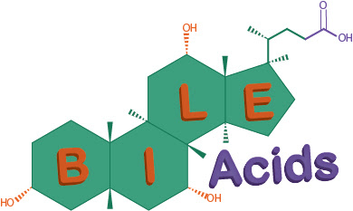
Functions of bile acids
Activate pancreatic lipase.
Emulsifies fat.
Useful for absorption of fat digestion products.

Slide 24
Features in children
For infants, fat is the main source of energy, while for adults with a normal diet, glucose is the main source of energy.
As a result, impaired digestion and absorption of fats in children is more dangerous than in adults.

Slide 25
Gastrointestinal lipases
1) Lingual lipase
- formed by the root of the tongue;
- stands out in active form;
- optimum pH 4 - 4.5;
- stable in an acidic environment, therefore it acts for 1-2 hours in the stomach;
- important in infants, because acts on emulsified fats containing short and medium length fatty acids (milk fats).
- activity in adults is extremely low.

Slide 26
Gastrointestinal lipases
2) Gastric lipase
- is formed in active form;
- optimum pH 5.0 (active at a pH value characteristic of the gastric juice of children);
important in infants;
lipase hydrolyzes fats, cleaving mainly fatty acids at the third carbon atom of glycerol;
inactive in adults (pH of gastric juice is ∼1.5).

Slide 27
Gastrointestinal lipases
3) Pancreatic lipase
- is formed in the pancreas in an inactive form;
- optimum pH 8-9;
- for activation, bile acids and colipase are required (peptide with Mw 10 kDA); colipase makes lipase resistant to the action of trypsin;
- is the main lipase that breaks down emulsified fats;
- the products of its action are fatty acids and 2-monoacylglycerols (2-monoacylglycerols).

Slide 29
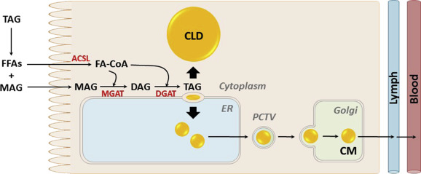
Resynthesis of fats in enterocytes

Slide 30
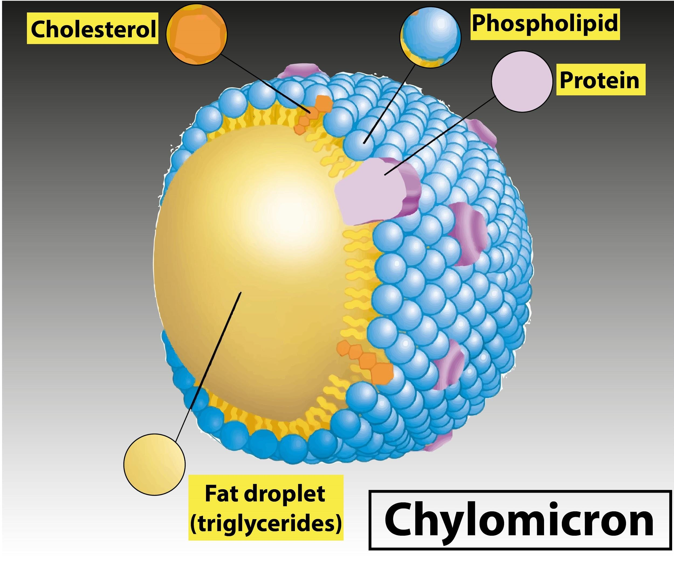
The resulting fat is packed into special protein "containers" - chylomicrons - necessary for its transfer to various organs and tissues.

Slide 31
Lipolysis
Lipolysis is the breakdown of fat into glycerol and fatty acids.
It is catalyzed by triglyceride lipase, diglyceride lipase and monoglyceride lipase, which act on TG, DG and MG, respectively.
Triglyceride lipase is a lipolysis limiting enzyme. It has two forms: phosphorylated (active) and non-phosphorylated (inactive). The transformation of an inactive form into an active one occurs under the influence of protein kinase. Protein kinase, in turn, is activated as a result of cAMP attachment to its allosteric centers.

Slide 32
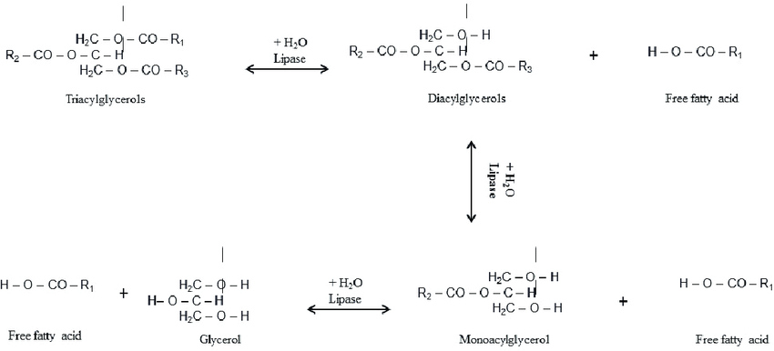
Lipolysis

Slide 33
Regulation of lipolysis
Activate lipolysis:
CA, glucagon, growth hormon, ACTH, thyroxin, pituitary lipotropin, cAMP
Inhibits:
insulin

Slide 34
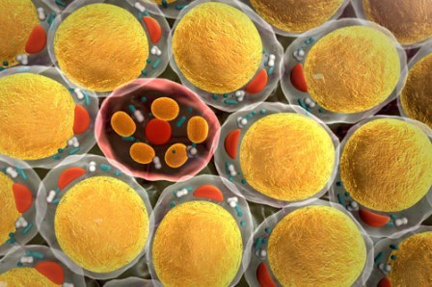
Lipogenesis
Lipogenesis is the synthesis of fat.

Slide 35
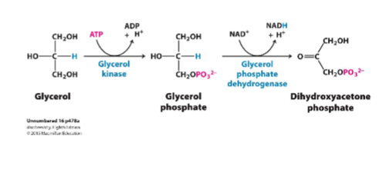
Glycerol activation
Liver
Adipose tissue

Slide 36
Fatty acid activation

Slide 37
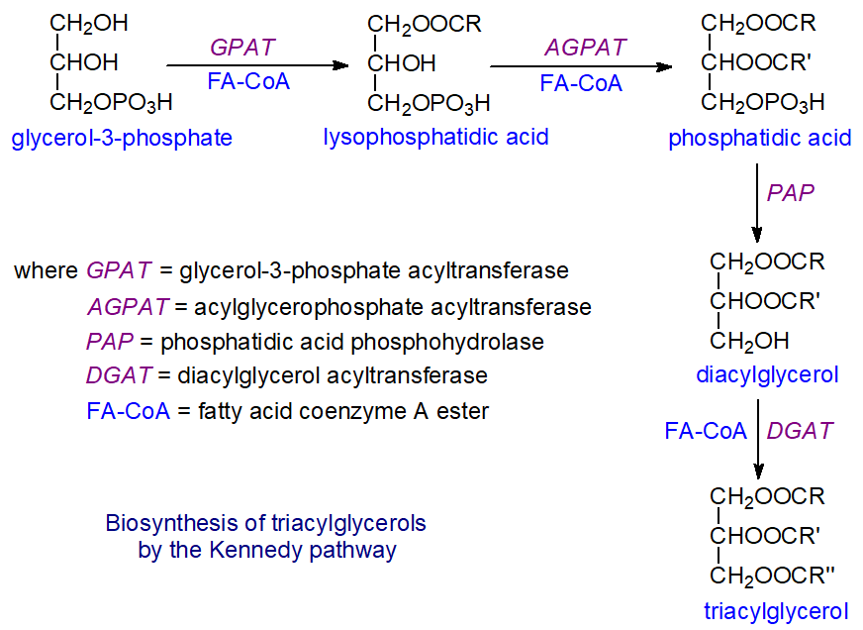
Lipogenesis

Slide 38
Regulation of lipogenesis
Activate:
insulin, estrogens and ATP
Inhibit:
CA, growth hormone, thyroid hormones, ACTH, ADP

Slide 41
Glycerol metabolism
Depending on the type of tissue it enters into, glycerol can:
oxidize to CO2 and H2O with the formation of 21 (according to other sources - 22-23) ATP;
used in the synthesis of lipids (TG and PL);
used for the synthesis of glucose in gluconeogenesis.

Slide 42
https://sfamjournals.onlinelibrary.wiley.com/doi/full/10.1111/1751-7915.13400

Slide 43
Обмен глицерина
Decomposition of glycerol
cytosolic
Mg2+
Glycerol kinase
Glycerol – 3 phosphate dehydrogenase
ATP ADP
NAD⁺ NADH +H+
Glycerol
Glycerol – 3 phosphate
Glyceraldehyde 3 phosphate
Reactions of glycolysis
Pyruvate
Lactate
21 ATP

Slide 44
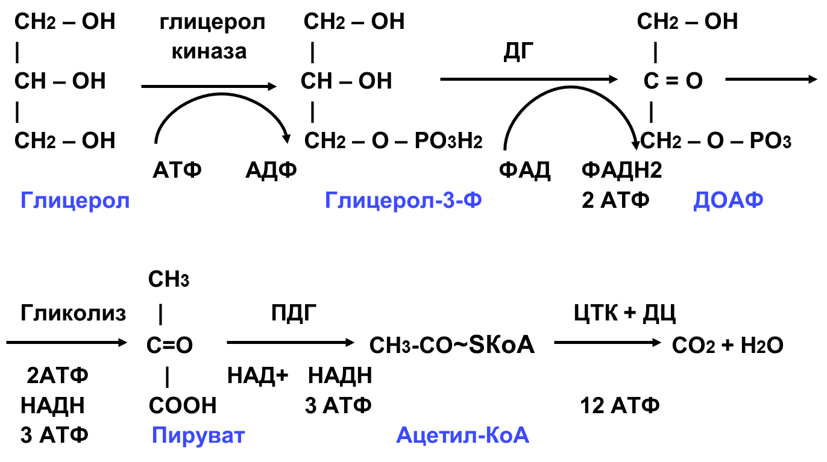
Oxidation of glycerol:
Glycerol kinase
Mitochondrial
DH
ATP ADP
FAD FADH2
Glycerol 3 phosphate
2 ATP
Dihydroxyacetone phosphate
Glycerol
+ Pi
( Н₃РО₄ )
НОН
Glycolysis
PDH
KC +ETC
CoA
2 ATP
+
NADH + H+
NADH + H+
3 ATP
12 ATP
+
3 ATP
Pyruvate
Acetyl Coa
+ Н~SCоА
СО₂

Slide 45
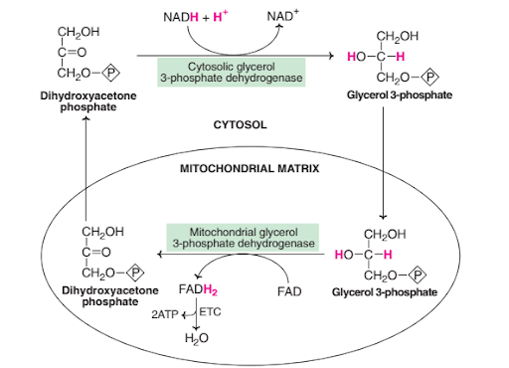
Glycerophosphate shuttle
http://biocheminfo.com/2020/04/20/shuttle-pathways-glycerophosphate-shuttle-and-malate-aspartate-shuttle/

Slide 46
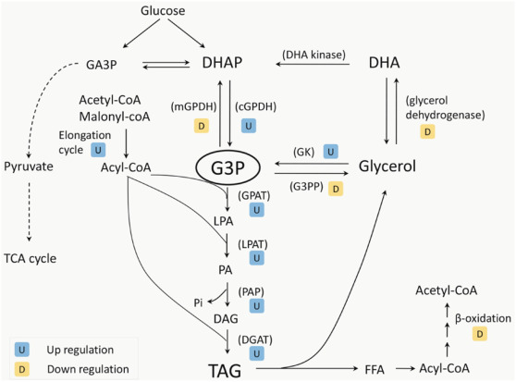
Glycerol synthesis:
https://www.sciencedirect.com/science/article/abs/pii/S0163782717300139

Slide 48
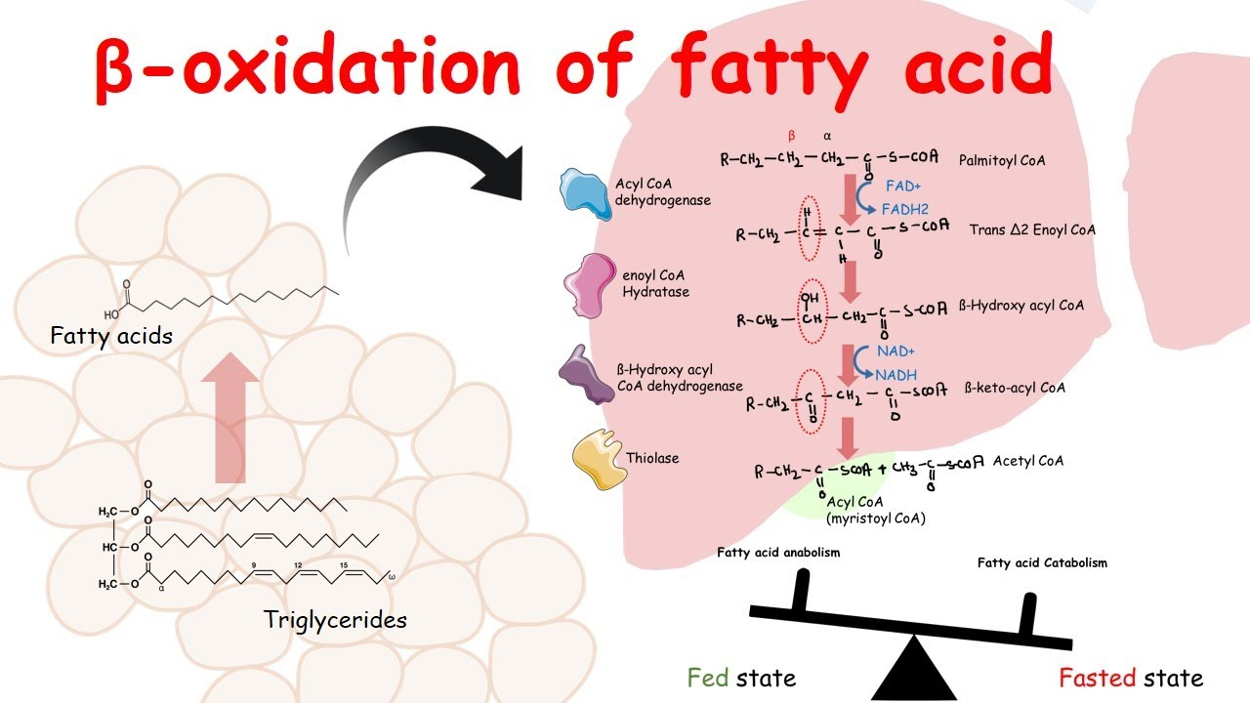
Oxidation of fatty acids
https://www.youtube.com/watch?v=UcfKaQzPHrM&ab_channel=AnimatedbiologyWitharpan

Slide 49
Oxidation of fatty acids
1. Fatty acid activation
The active form of fatty acids acyl-CoA is formed in the cytosol under the action of acyl-CoA synthetase.
Fatty acid+ НSCоА + АТP acyl-CoA + АМP + РР
acyl-CoA synthetase

Slide 50
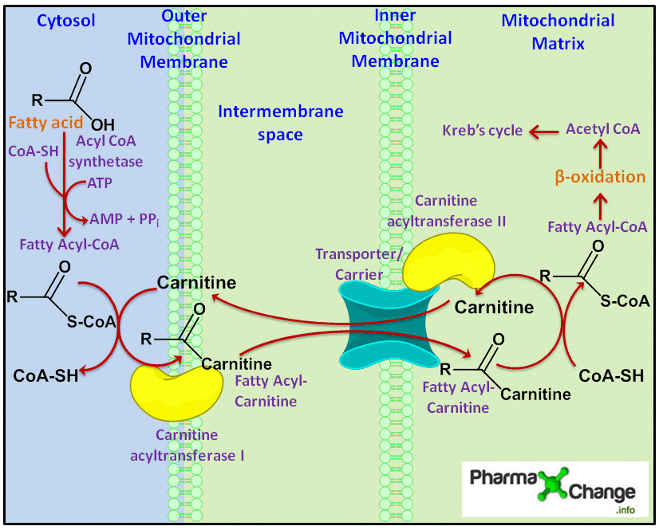
Oxidation of fatty acids
2. Transfer of fatty acids into mitochondria
https://pharmaxchange.info/2013/10/activation-and-transportation-of-fatty-acids-to-the-mitochondria-via-the-carnitine-shuttle-with-animation/

Slide 51
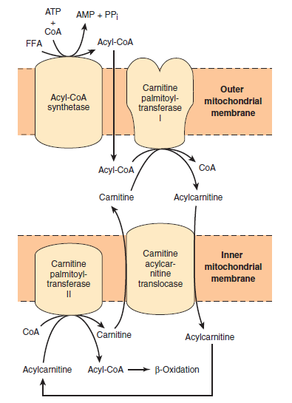
The intensity of FA entry into the mitochondrial matrix depends on the ratio
the amount of malonyl-CoA / acyl-CoA. The higher the concentration of malonyl-CoA in the cell, the lower the rate of transfer of fatty acids into the mitochondrial matrix, since malonyl-CoA is an allosteric inhibitor of CAT1, and acyl-CoA is its activator
https://www.quora.com/How-fatty-acids-transported-across-the-mitochondrial-membrane

Slide 52
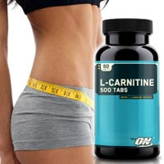
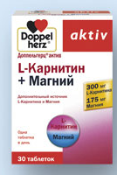
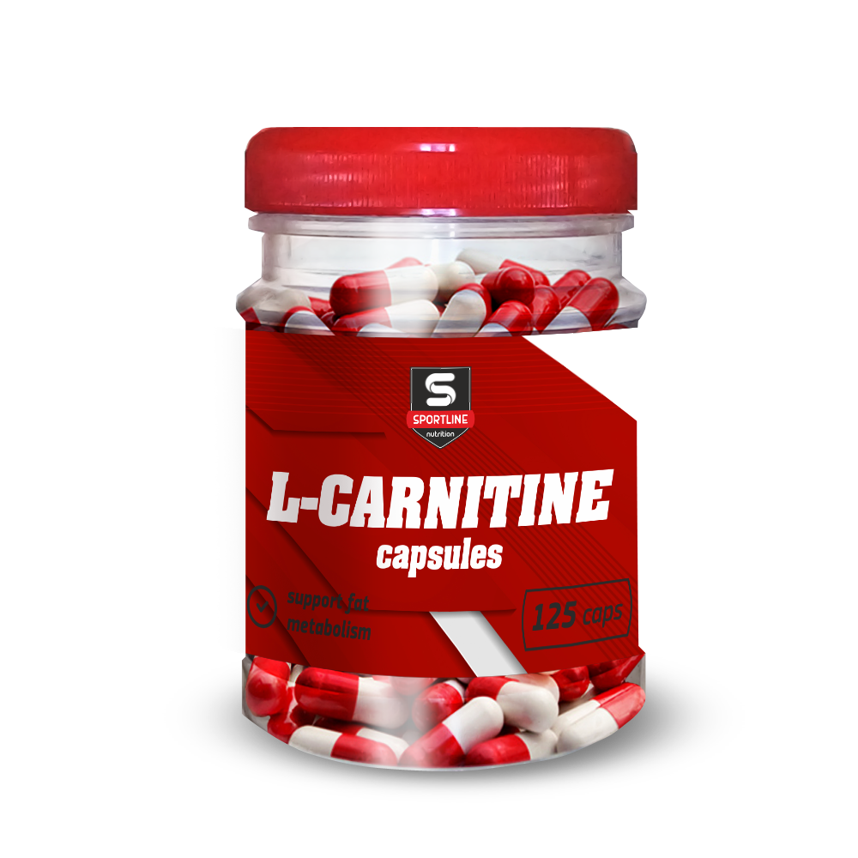
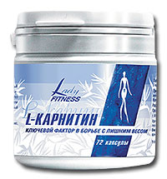
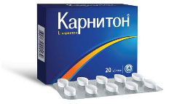

Slide 53
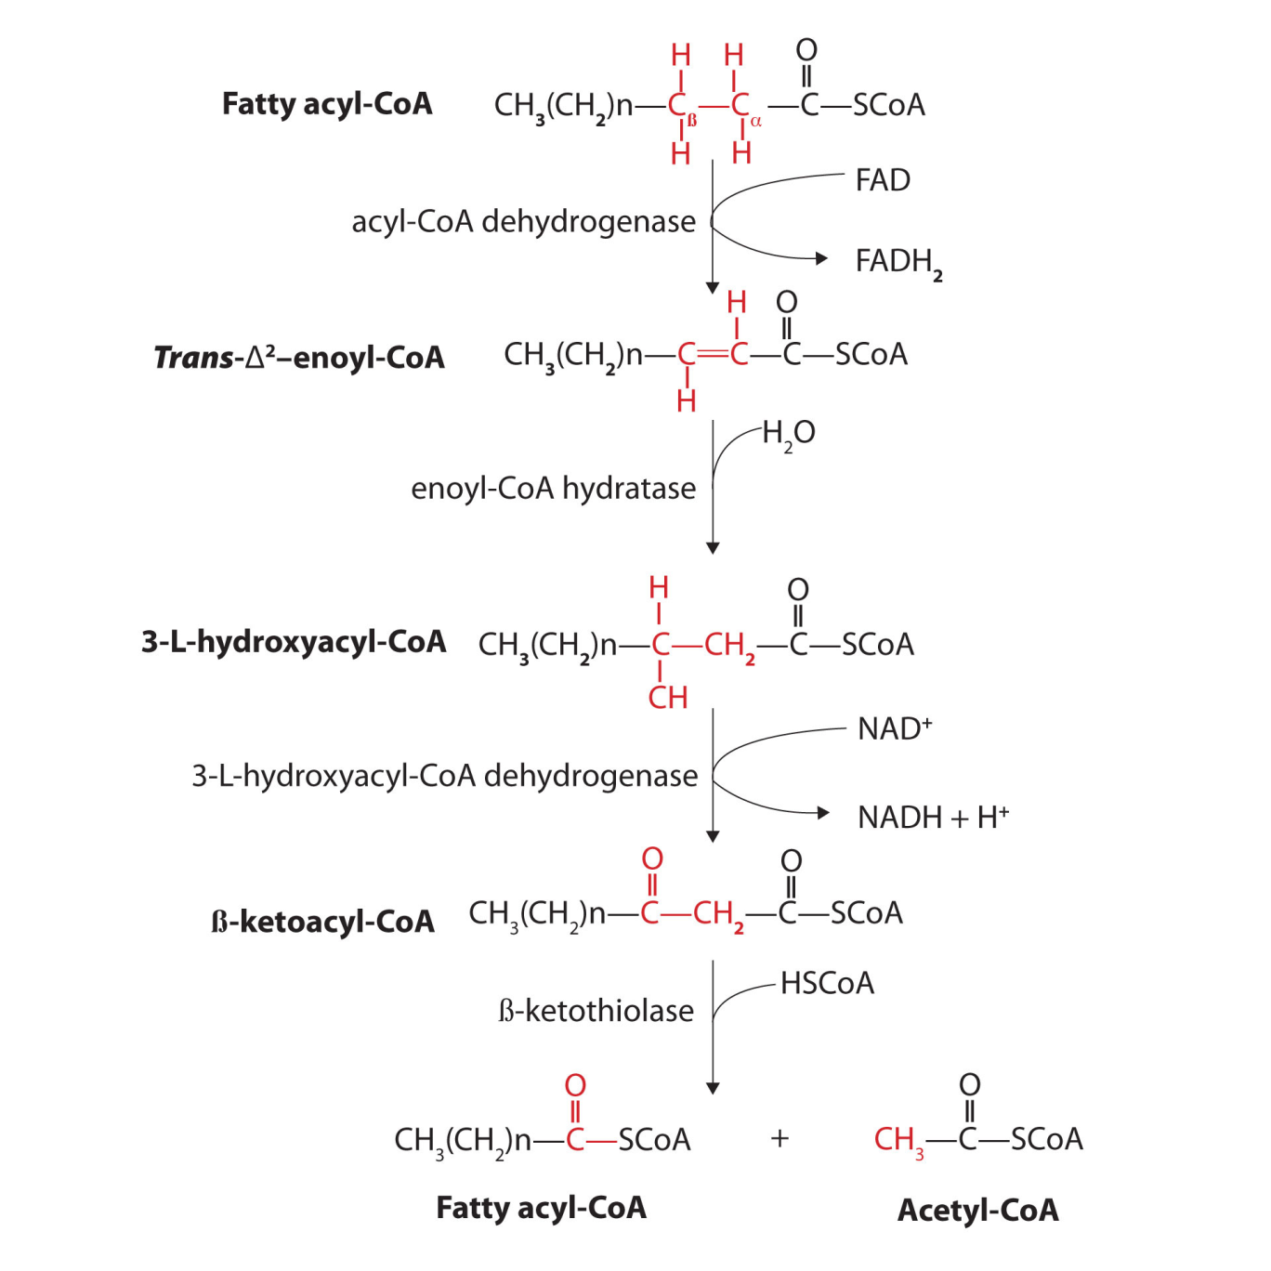
3.Progress of β-oxidation reactions of fatty acids
https://saylordotorg.github.io/text_the-basics-of-general-organic-and-biological-chemistry/s23-06-stage-ii-of-lipid-catabolism.html

Slide 54
https://www.youtube.com/watch?v=xW1xQKlJOvw&ab_channel=MikeBirkhead

Slide 55
https://slidetodoc.com/fatty-acid-catabolism-oxidation-beta-oxidation-of-fatty/

Slide 56
Regulation of β-oxidation of fatty acids
- The key process is the entry of fatty acids into the mitochondria;
- carnitinacyltransferase-1 is an allosteric enzyme, in the liver the allosteric inhibitor of which is malonyl-CoA;
- activate β-oxidation of catecholamines, growth hormone, glucagon;
- insulin inhibits the oxidation of fatty acids.
- the rate of β-oxidation depends on the ratio of ATP / ADP and NADH / NAD +

Slide 58
Fatty acid synthesis
It occurs mainly in adipose tissue, mammary gland and liver.
The site of synthesis of fatty acids is the cytoplasm.
For the synthesis of fatty acids, acetyl-CoA, ATP, NADPH are required.
The synthesis of fatty acids occurs cyclically. At the beginning of each cycle, malonyl-CoA is formed from acetyl-CoA and carbon dioxide with the consumption of ATP.
The transfer of acetyl-CoA into the cytoplasm occurs in the composition of citrate, which is formed in mitochondria under the action of citrate synthase using oxaloacetate.
For the synthesis of one C16 molecule, 8 acetyl-CoA molecules (of which 7 pass the stage of malonyl-CoA formation), 7 ATP and 14 NADPH are required.

Slide 60
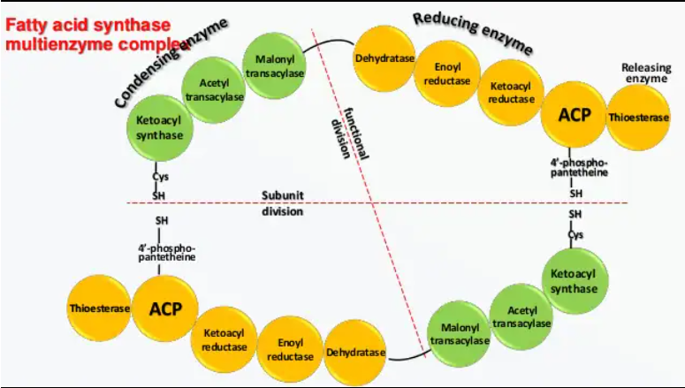
Multi-enzyme complexes
Fatty acid synthase (synonym palmitate synthase) - a number of enzymes associated with an acyl-transporting protein
Mammalian fatty acid synthases are dimeric proteins and consist of two identical polypeptide chains. Each monomer contains 3 catalytic domains at the N-terminus (ketoacyl synthase (KS), malonyl acetyltransferase (MAT) and dehydratase (DH)) and 4 domains at the C-terminus (enoyl reductase (ER), ketoacyl reductase (KR), acyl-carrying protein (ACP) and thioesterase (TE)). These two structural clusters are separated by a large central region (about 600 amino acids)

Slide 61
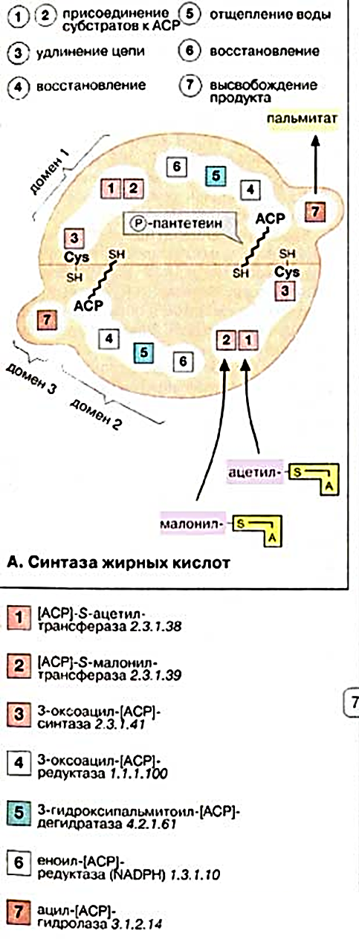
Multi-enzyme complexes
The activity of the multienzyme complex is spatially distributed over the three most important domains:
-Domain 1 catalyzes the transfer of substrates acetyl-CoA and malonyl-CoA [ACP] -S-acetyltransferase [1] and [ACP] -S-malonyltransferase [2] and the subsequent condensation of both partners by 3-oxoacyl- [ACP] -synthase [3 ],
-Domain 2 restores the growing fatty acid chain using 3-oxoacyl [ACP] reductase [4], 3-hydroxyacyl [ACP] dehydratase [5] and enoyl [ACP] reductase [6].
-Domain 3 after seven cycles of chain lengthening catalyzes the release of the finished product using acyl- [ACP] -hydrolase [7].

Slide 62
https://www.drawittoknowit.com/course/biochemistry/glossary/biochemical-pathway/fatty-acid-biosynthesis

Slide 65
Fatty acid synthesis reactions
At every turn
Acetyl CoA carboxylase
*
O
O
НООС
CH₂
C
CH₃
C
+
CO₂
~ S-CоА
~ S-CоА
Acetyl CoA
Malonyl-CoA
АТP
АDP+Н₃РО₄
1st loop:
O
O
CO₂
CH₃
C
~ S-CоА
НООС
CH₂
C
+
~ S-CоА
Acetyl CoA
Malonyl-CoA
НS-CоА
O
reductase
O
СН₃
С
C
CH₂
~ S-CоА
СН₃
C
СН
CH₂
~ S-CоА
O
NADPH+Н⁺
NADP⁺
OН
β-ketoacyl - CoA
β-hydroxyacyl - CoA

Slide 66
Fatty acid synthesis reactions
O
O
dehydratase
СН₃
СН
CH₂
C
~ S-CоА
СН₃
CH
~ S-CоА
СН
C
OН
НОН
β-hydroxyacyl - CoA
Enoyl - CoA
reductase
O
СН₃
СН₂
CH₂
C
~ S-CоА
NADPН+Н⁺
NADP⁺
Acyl - CoA (C4)
2nd loop:
O
O
CO₂
СН₃
СН₂
CH₂
C
НООС
CH₂
C
~ S-CоА
+
~ S-CоА
Acyl - CoA (C4)
Malonyl - CoA
НS-CоА

Slide 67
Fatty acid synthesis reactions
O
…
СН₂
С
CH₂
C
СН₃
CH₂
~ S-CоА
O
β-ketoacyl - CoA
O
…
СН₂
СН₂
CH₂
C
СН₃
CH₂
~ S-CоА
acyl - CoA (C6)

Slide 68
Formation of unsaturated fatty acids
Along with desaturation of fatty acids (formation of double bonds) in microsomes, their elongation (elongation) also occurs, and both of these processes can be combined and repeated.
Elongation of the fatty acid chain occurs by sequential addition of bicarbon fragments to the corresponding acyl-CoA with the participation of malonyl-CoA and NADPH. The enzymatic system that catalyzes the elongation of fatty acids is called elongase.
The scheme shows the pathways of the conversion of palmitic acid in the reactions of desaturation and elongation.

Slide 69
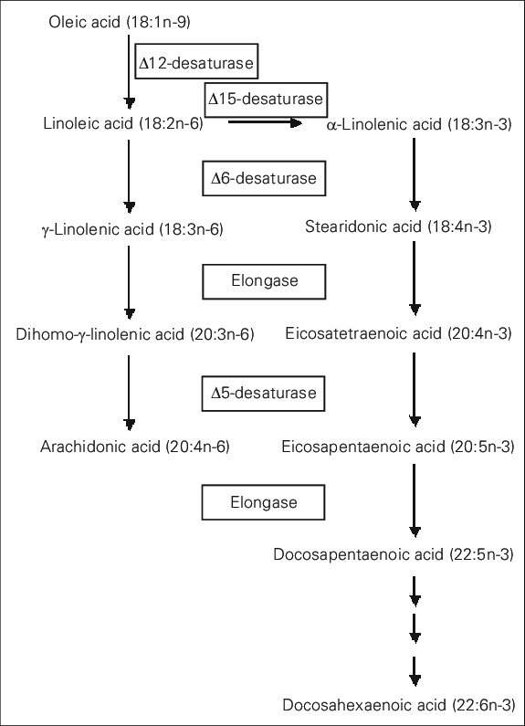
Formation of unsaturated fatty acids

Slide 70
Regulation of fatty acid synthesis
The limiting enzyme is acetyl-CoAcarboxylase.
- allosteric activators - ATP and citrate;
- inhibitors - long chain fatty acids;
- insulin, estrogens activate;
- catecholamines and stress inhibit the synthesis of fatty acids.

Slide 71
http://anitapopescu.me/projects/Notes/10-FA-Synthesis.html

Slide 72
Pathways for the formation of acetyl-CoA
1. From pyruvate during the pyruvate dehydrogenase reaction.
This path is predominant in short-term and strenuous muscular work.
2. β-oxidation of fatty acids.
This path prevails:
with prolonged muscle work,
in the cold
when fasting,
pregnancy,
- diabetes mellitus.

Slide 73
Ways of using acetyl-CoA
Acetyl-CoA is oxidized in the Krebs cycle.
Used in the synthesis of fatty acids.
Used for the synthesis of cholesterol and ketone bodies
The way of using acetyl-CoA depends on the energy supply of the cell and the body's need for these substances.

Slide 74
Ketone bodies
Ketone bodies are understood as three substances:
Acetoacetate
β-hydroxybutyrate
Acetone
Ketone bodies are formed in the liver
СН₃
С
CH₂
СООН
O
СН₃
СН
CH₂
СООН
OН
СН₃
С
CH₃
O

Slide 76
Functions of ketone bodies
Energy. Skeletal and cardiac muscles, the brain and other extra-hepatic tissues provide a significant proportion of their energy requirements through the catabolism of ketone bodies. The liver cannot oxidize ketone bodies.
Ketone bodies are essential for the formation of the myelin sheaths of the nerves and the white matter of the brain.

Slide 78
Synthesis of ketone bodies
O
O
thiolase
O
CH₃
C
+
CH₂
C
~ S-CоА
CH₃
C
~ S-CоА
СН₃
С
~ S-CоА
Acetyl-CoA
Acetyl-CoA
НS-CоА
O
+ НОН
acetoacetyl - CoA
*
O
HMG-CoA synthase
СН₃
O
НООС
СН₂
CH₂
C
+
~ S-CоА
+
CH₃
C
С
~ S-CоА
Acetyl-CoA
Н ~ S-CоА
OН
β-hydroxy-butyrate-DH
β-Hydroxy β-methylglutaryl-CoA
HMG-CoA-lyase
СН₃
С
CH₂
СООН
СН₃
СН
CH₂
СООН
O
O
OН
NADН+Н⁺
NAD⁺
CH₃
C
acetoacetate
~ S-CоА
β-hydroxybutyrate
Acetyl-CoA
СН₃
С
CH₃
CО₂
O
acetone

Slide 79
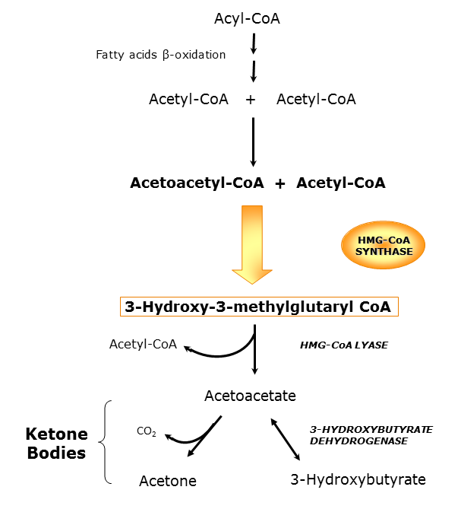
https://www.researchgate.net/figure/Ketone-bodies-synthesis-pathway_fig1_221920035

Slide 80
Synthesis of ketone bodies
There is a second way to synthesize ketone bodies:
formed by condensation of two molecules of acetyl-CoA acetoacetyl-CoA is able to split off Coenzyme A with the formation of free acetoacetic acid.
The process is catalyzed by the enzyme acetoacetyl-CoA hydrolase (deacylase); however, this pathway is not essential in the synthesis of acetoacetic acid, since the deacylase activity in the liver is low.

Slide 81
Regulation of the synthesis of ketone bodies
The key enzyme is HMG-CoA synthase
Catecholamines, glucagon, growth hormone enhance the synthesis of ketone bodies.
Reduces the synthesis of insulin.
The activity of HMG-CoA synthase increases when fatty acids enter the liver hepatocytes.
The synthesis of HMG-CoA synthase increases with an increase in the concentration of fatty acids in the blood.

Slide 82
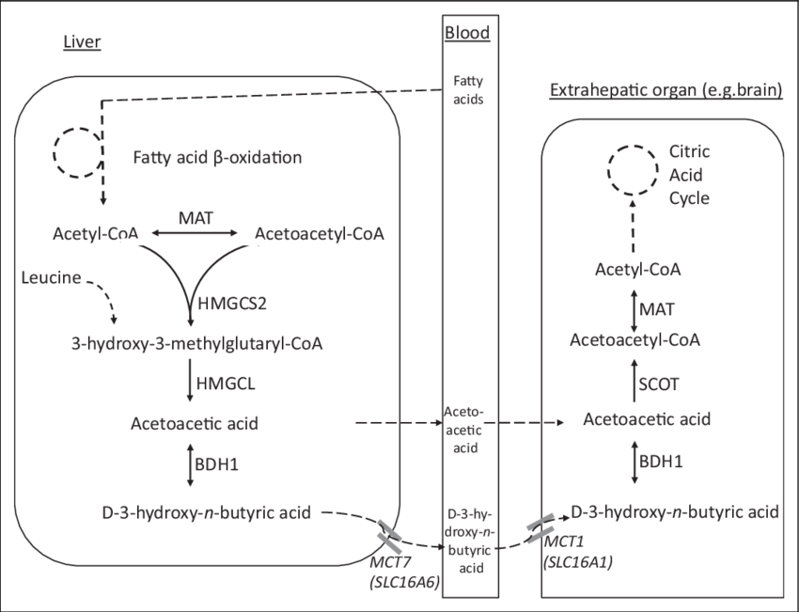
Metabolism of ketone bodies
https://www.researchgate.net/figure/Ketone-body-metabolism-and-transport-Schematic-view-of-the-enzymes-and-transporters-of_fig1_324802864

Slide 83
Ketone bodies catabolism
It is known that in peripheral tissues 3-hydroxybutyrate (β-hydroxybutyric acid) can be oxidized to acetoacetate, and the latter is activated to form the corresponding CoA ester (acetoacetyl-CoA). Acetoacetate can be activated by transferring CoA with succinyl-CoA in a reaction catalyzed by a specific CoA transferase. The resulting acetoacetyl-CoA is further cleaved by thiolase to form 2 acetyl-CoA molecules, which are then included in the Krebs cycle.
It is possible that there is a second way of acetoacetate activation - this is the use of ATP and HS-KoA in the same way as in the activation of fatty acids:

Slide 84
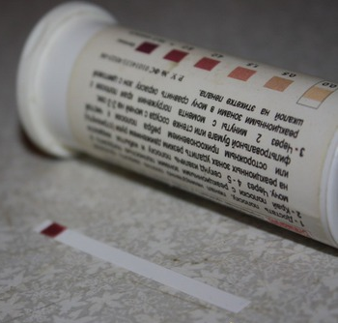
Ketosis
Ketosis is the accumulation of ketone bodies in the body. It is accompanied by hyperketonemia and ketonuria.
Distinguish:
1. physiological ketosis (occurs during fasting, prolonged muscle work and in newborns);
2.pathological ketosis (occurs with diabetes mellitus)

Slide 85
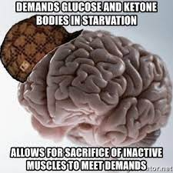

Slide 86
Conclusion
Lipids are necessary as structural components of all biomembranes, biologically active substances, additional sources of energy (in infants - the main source of energy).
Digestion of exogenous lipids mainly occurs in the intestine under the action of pancreatic enzymes, endogenous lipids - in lysosomes.
Lipolysis and lipogenesis are important as an additional source of energy "for later".
β-oxidation of fatty acid occurs in mitochondria after its transport across both membranes; when coupled with the Krebs cycle and the electron transport chain, it produces many ATP molecules.
Fatty acids are synthesized in the cytoplasm, at each loop the malonyl-CoA molecule is attached, this is how the synthesis takes place to palmitic acid, and then there is an alternation of elongation and desaturation.
The synthesis of ketone bodies from acetyl-CoA occurs in the liver during fasting, which provides energy to various organs and tissues, except for the liver itself.

Slide 87
Conclusion
5. Fatty acids are synthesized in the cytoplasm, at each loop the malonyl-CoA molecule is attached, this is how the synthesis takes place to palmitic acid, and then there is an alternation of elongation and desaturation.
6. The synthesis of ketone bodies from acetyl-CoA occurs in the liver during fasting, which provides energy to various organs and tissues, except for the liver itself.

Slide 88
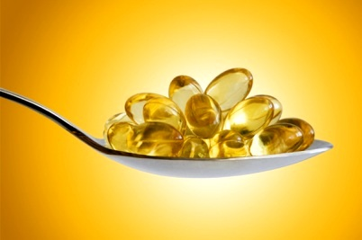
THANK YOU FOR THE ATTENTION!

Slide 89
Which types of gastrointerstinal lipases do you know?

