Slide 1
Prof. V.F. Voino-Yasenetsky Krasnoyarsk State Medical University
Topic: Electron transport chain. Oxidative phosphorylation
Lecture No. 4 on the discipline "biochemistry" for 2nd year students
Lecturer: Panina Yu.A.
Krasnoyarsk, 2023

Slide 2
Lecture plan:
Relevance of the topic.
Enzymes of the class of oxidoreductases.
Development of concepts of biological oxidation.
Electron transport chain, its structure.
Significance and regulation of the respiratory chain.
Substrate and oxidative phosphorylation. P / O ratio.
Non-phosphorylating (free) oxidation.
Age features of energy processes. Hypoenergetic states.
Conclusion

Slide 3
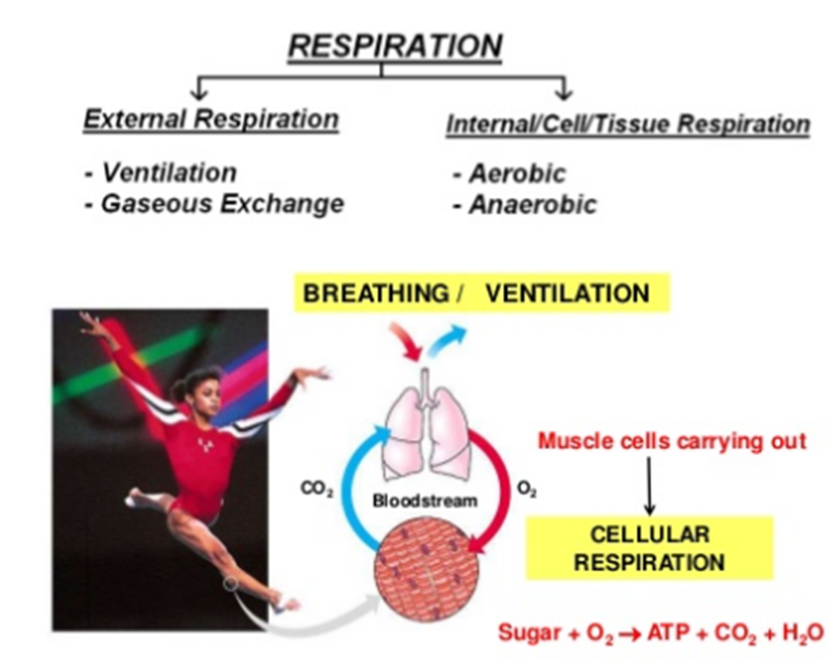
RELEVANCE OF THE TOPIC
Biomedical significance
life of an animal eukaryotic cell is impossible without cellular respiration

Slide 5
RELEVANCE OF THE TOPIC
Biomedical significance
https://content.openclass.com/eps/pearson-reader/api/item/ab914c98-1923-486b-bdb4-b9187be18b9e/1/file/silverthornHP7-071415-MJ-BO/OPS/img/9812222002.png

Slide 6
Subclasses of the class of oxidoreductases
Dehydrogenase - removal of H from the substrate
2. Reductase (hydrogenase) - attachment of H to the substrate
3. Oxygenase (hydroxylase) - the inclusion of O in the substrate
4. Oxidase - transfer of ē to О
5. Peroxidases and catalases - reactions of decomposition of hydrogen peroxide (it is as an acceptor ē)
SH₂ - 2H —> S
S + 2H —> SH₂
SH₂ + 1/2 O₂ —> SH-OH
SH₂ + 1/2 O₂ —> S + H₂O

Slide 7
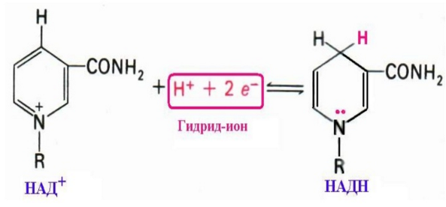
Dehydrogenase reactions
NAD+
NADH

Slide 8
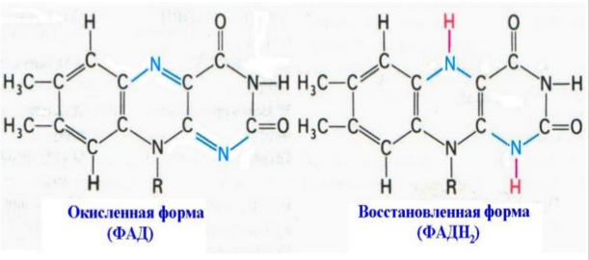
Dehydrogenase reactions
FAD
FADH2

Slide 9
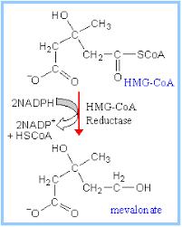
Subclasses of oxidoreductases
Hydrogenase (reductase) - attachment to the substrate of hydrogen
S + 2H —> SH₂

Slide 11
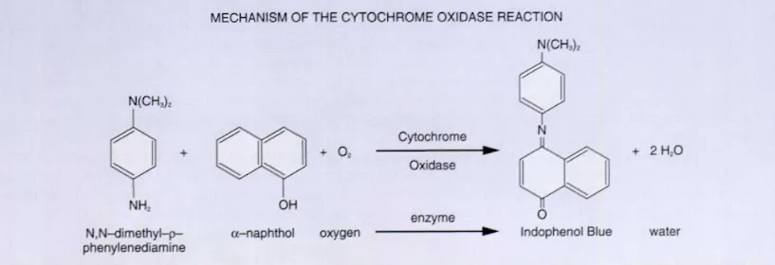

Slide 13
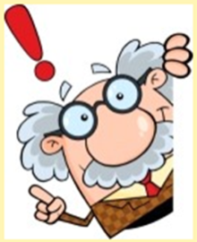
WAYS OF USING ATP
mechanical work (muscle contraction, movement of sperm, leukocytes);
osmotic work (active transport, i.e. movement against the concentration gradient);
chemical work (the use of ATP energy in biosynthetic processes and for the activation of substrates);
electrical work (generation of biocurrents);
hormonal signal transmission (ensuring the work of adenylate cyclase and protein kinase)

Slide 14
Development of the concept of biological oxidation
XVIII century (Antoine Lavoisier)
the presence of the identity of the combustion of organic substances outside the body and the respiration of animals: during respiration, as during combustion, oxygen is absorbed and CO2 and H2O are formed
however, the process of "burning" in the body is very slow and without flame
1897 (academician Alexei Nikolaevich Bach)
Compounds are easily oxidized (e.g., FA), interacting with oxygen to form peroxides
For the first time formulated the idea of the conjugation of redox processes during respiration
1911 (Vladimir Ivanovich Palladin)
Developed the concept of respiration as a system of enzymatic processes (the role of dehydrogenation is great)
Pointed out the important role of oxygen as a hydrogen acceptor in biological oxidation processes

Slide 15
Development of the concept of biological oxidation
Heinrich Wieland (1877 - 1957)
In the oxidation of alcohols, dehydrogenation alternates with hydrogenation
the concept of oxidation of substances by dehydrogenation (Palladin-Wieland theory)
1932 - Otto Warburg (1883 - 1970)
Found out that oxidation is not possible without iron
Discovered flavin enzymes
1930s - Vladimir Alexandrovich Engelhardt (1894 - 1984)
observed that ATP accumulates during tissue respiration
connection of tissue respiration with phosphate accumulation

Slide 16
Development of the concept of biological oxidation
Vladimir Aleksandrovich Belitser (1906 - 1988) and Tsybakova (?)
Introduced the concept of phosphorylation coefficient - the ratio of bound phosphate to absorbed oxygen
1957 - Albert Szent-Györgyi
Introduced the concept of "bioenergy" into science
1961-1966 - Peter Dennis Mitchell (1920 - 1992)
chemiosmotic theory of oxidative phosphorylation (transport of electrons across the conjugated mitochondrial membrane)
Nobel Prize in 1978

Slide 18
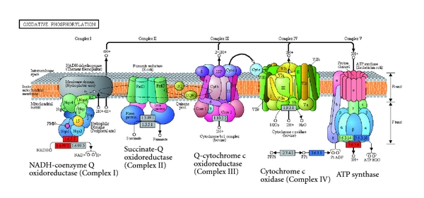
Respiratory chain (electron transport chain)
http://www.hindawi.com/journals/ijpro/2012/980829.fig.004.jpg

Slide 19
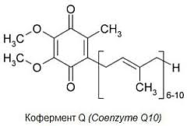
Carriers: ubiquinone and cytochrome C

Slide 20
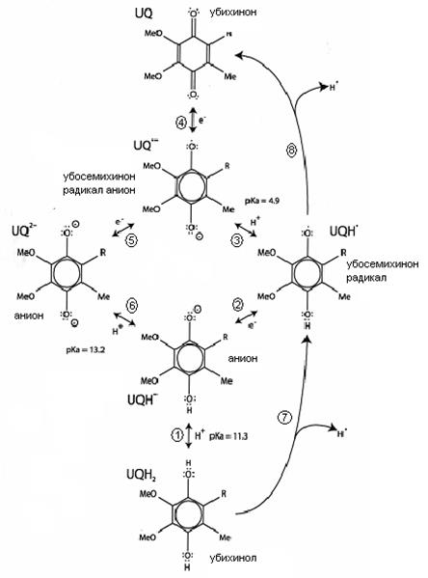
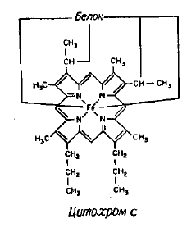
Carriers: ubiquinone and cytochrome C
http://www.bestreferat.ru/images/paper/55/12/9471255.jpeg
http://bmsi.ru/ckfinder/userfiles/images/03-03.png

Slide 22
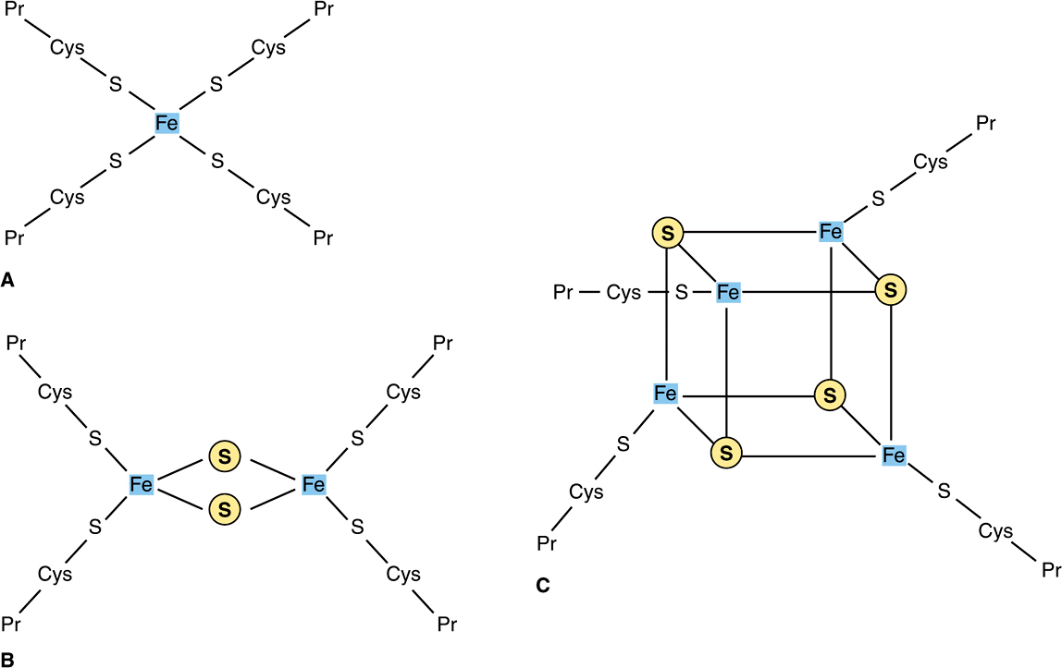
Cytochromes
https://basicmedicalkey.com/wp-content/uploads/2017/02/image01654.gif

Slide 24
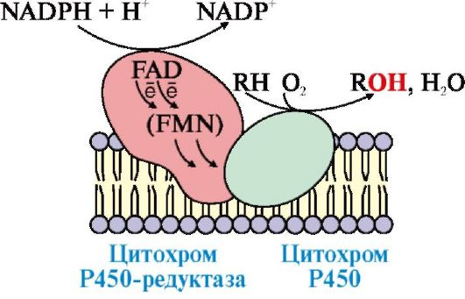
Cytochrome Р450

Slide 27
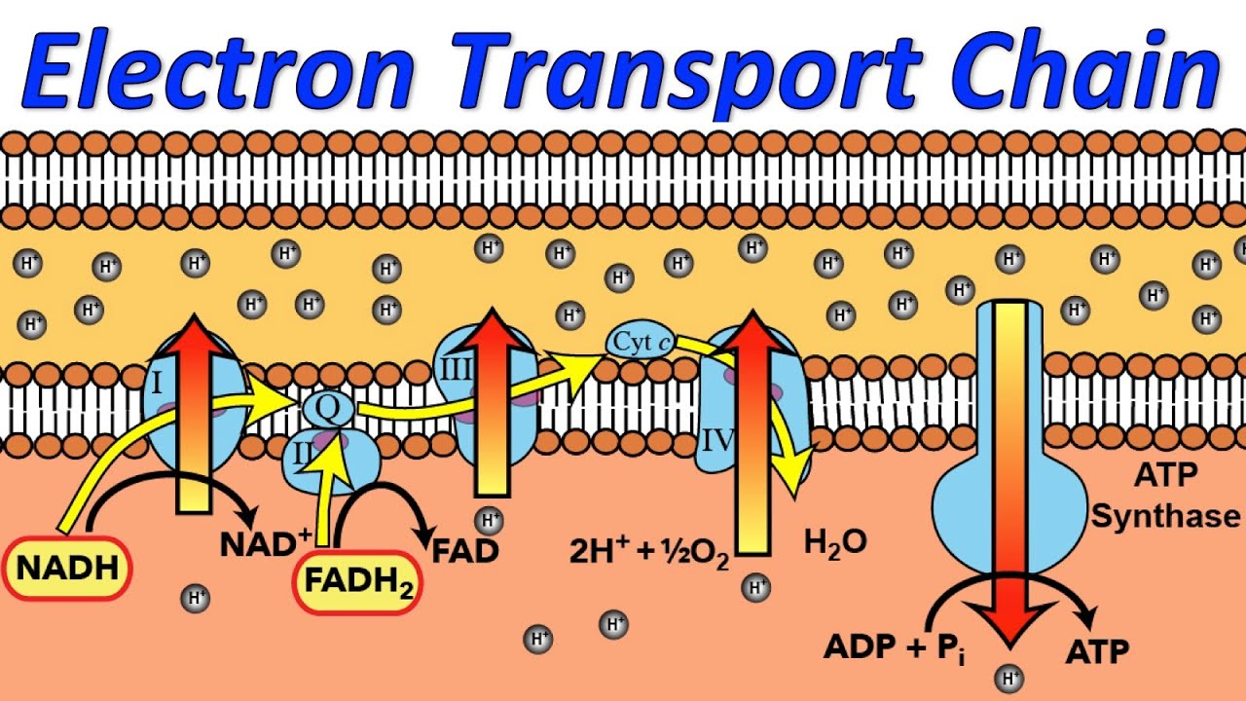

Slide 28
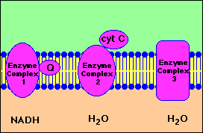
Indirect transfer to oxygen

Slide 30
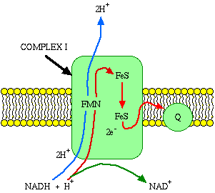
Complex I
NADH dehydrogenase, NADH: ubiquinone oxidoreductase, NADH-CoQ reductase
Consists of 26 protein subunits; cofactors (NAD, FMN, CoQ) and 20 iron atoms (not heminic), five of which are combined into iron-sulfur clusters.
The energy of 2 moving electrons of the first complex transfers four protons from M to IMS.
It is a metal flavoprotein (FP), oxidizes NAD-H, taking two electrons from it and transferring them to lipid-soluble ubiquinone (CoQ), which serves as a collector of reducing equivalents (supplied by substrates: succinate, choline, glycerol-3-phosphate, sarcosine, dimethylglycine , acyl-CoA) and diffuses inside the membrane to complex III.
NADH-DH
NADH+H
NAD+
ubiquinone
ubiquinol
(under aerobic conditions)
(under anaerobic conditions)

Slide 31
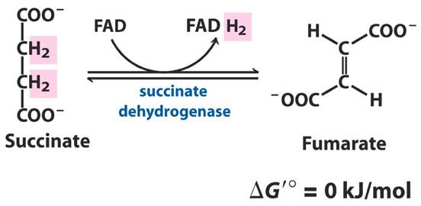
Complex II
Succinate dehydrogenase from KC, succinate-CoQ reductase
accepts H atoms from fatty acids;
does not pump protons, but provides entry into the chain of additional electrons due to the oxidation of succinate - catalyzes the reversible reaction of CK (conversion of succinate into fumarate)
The enzyme consists of 4 subunits with a pier. masses approx. 70, 30, 14 and 12 thousand and contains as oxidation-reduction. FAD (covalently associated with the heaviest subunit) and 3 Fe-S-cluster (associated with a subunit with a molecular weight of 30 thousand); one of the small subunits contains heme. The active center that binds succinate is localized on the heaviest subunit, and the center that binds ubiquinone is in the subunit with a pier. m. 12 thous.
CoQ
SDH
Succinate
FADH₂
FAD
Succinate DH
FADH₂
FAD
ubiquinone
ubiquinol
(under aerobic conditions)
(under anaerobic conditions)

Slide 32
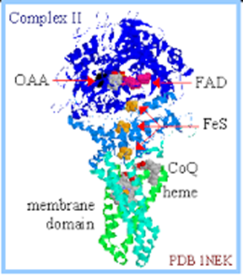
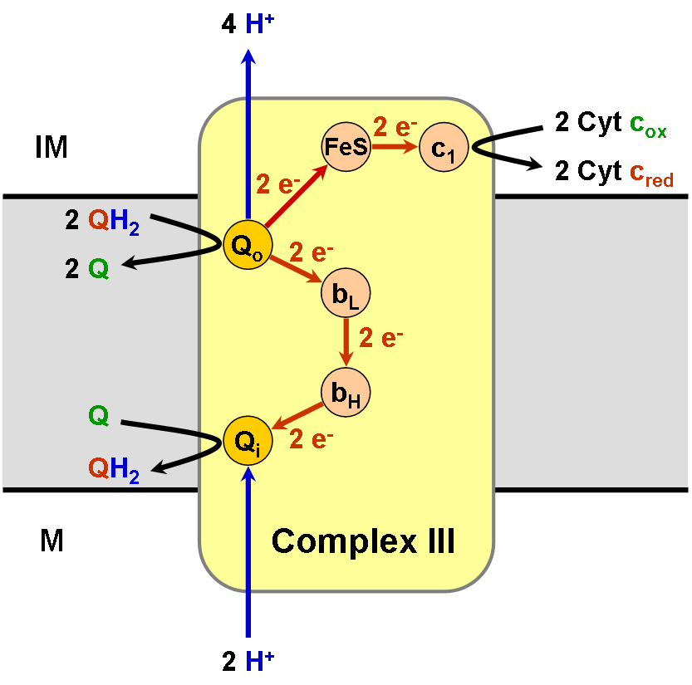
Complex II
Succinate dehydrogenase from KC, succinate-CoQ reductase

Slide 33
Complex III
Cytochrome bc1 complex, ubiquinol dehydrogenase, CoQH2-cytochrome-C reductase
Consists of 11 protein subunits; cofactors - (CoQ H2, three hemes) and one Fe-S cluster. The energy of the moving 2 electrons of the third complex transfers four protons from M to IMS.
Ubiquinol transfers electrons to complex III, which delivers them through two hemes b, one Fe / S center, and heme c1 to a small heme-containing cytochrome c protein.
transfers electrons from ubiquinone to two water-soluble cytochromes c located on the inner mitochondrial membrane. Ubiquinone transfers 2 electrons, and cytochromes transfer one electron per cycle. In this case, 2 protons of ubiquinone also pass there and are pumped over by the complex.
ē
DH
2Н⁺
2Н⁺
Cyt c
Cyt c₁
Fe-S
CoQ
Cyt b

Slide 34
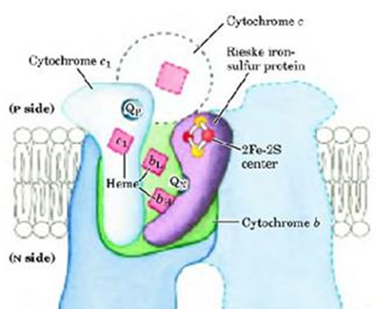
Complex III
Cytochrome bc1 complex, ubiquinol dehydrogenase, CoQH2-cytochrome-C reductase

Slide 35
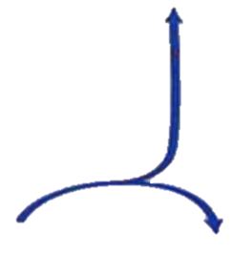
Complex IV
Cytochrome c-oxidase, cytochromes a-a3
Cytochrome c transfers electrons to complex IV (cytochrome c oxidase). Cytochrome c-oxidase contains two copper-containing centers (CuA and CuB) and hemes a and a3 for carrying out redox reactions, through which electrons finally enter oxygen. Energy of moving 2 electrons of the fourth complex
transfers two protons from M to IMS. When O2 is reduced, a strong main anion O2- is formed, which binds two protons and passes into water (each of the oxygen atoms adds two electrons and two protons and turns into a water molecule). The electron flux is coupled with the formed complexes I, III, and IV by a proton gradient.
ē
2Н⁺
Cyt c
(Cu-A, Cu-B)
Cyt a/a₃
½ O₂ + 1e
2Н⁺
+
O²⁻

Slide 36
Complex IV

Slide 37
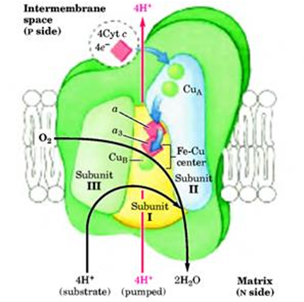
Complex IV
Cytochrome c-oxidase, cytochromes a-a3

Slide 38
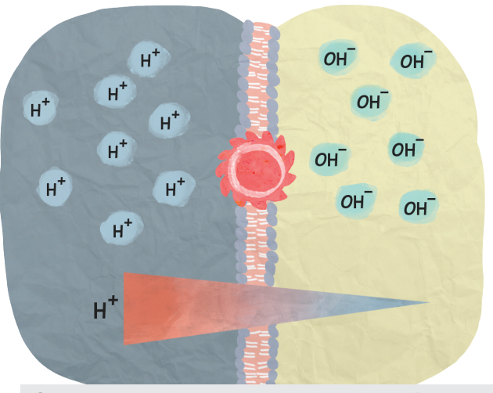
http://childrenscience.ru/courses/cellularrespiration/assets/kdl2_pager.pdf

Slide 39
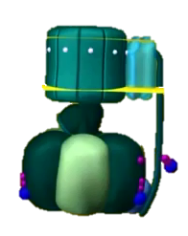
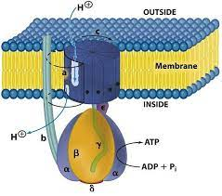
Complex V
ATP synthase
3Н⁺
АTP + Pi
АТP

Slide 40
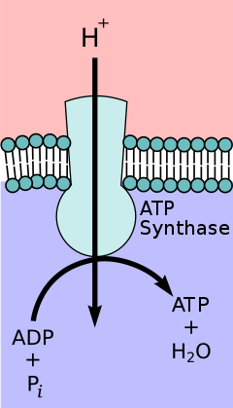
Complex V
ATP synthase
F1 is the catalytic part of the enzyme.
Fragment (oligomycin-sensitive)
is a proton channel, its function is channel-forming, through which the protons of hydrogen pumped out to the outside rush into the matrix.
When protons move, the F1-fragment is activated, which catalyzes the reaction of ATP synthesis from ADP and inorganic phosphate (catalytic function).
40% of the energy goes to the synthesis of ATP,
60% is released as heat.
F0
F1

Slide 41
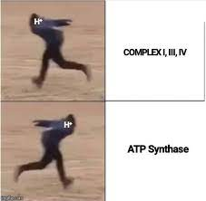

Slide 42
Electron transport chain importance
generation and storage (accumulation in the form of ATP) of energy
ROS generation (regulatory functions - transmission of growth signals, activation of uncoupling proteins, activation of mtDNA replication; pathological functions - oxidation of lipids and proteins, damage to mtDNA)

Slide 43
ETC activators and blockers (inhibitors)
Е complexes | Activators | Inhibitors
ETC in whole | ADP ("respiratory control") Hormones adrenaline, glucagon | ATP (according to the principle of "negative feedback")
Complex I (NАDН-DH) | - | barbiturates, rotenone
Complex II (succinate DH) | - | malonate, carboxin
Complex III (ubiquinol-DH) | - | antimycin A, stigmattelin
Complex IV (cytochrome oxidase) | - | cyanides, carbon monoxide, nitrogen oxide, hydrogen sulfide
Complex V (ATP synthase) | - | oligomycin (F0), atractyloside (F1)

Slide 45
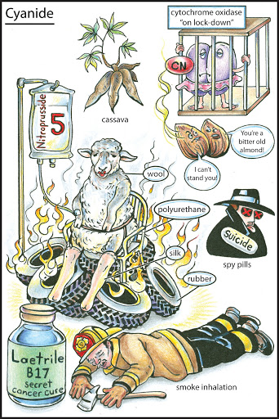
Cyanides and cytochrome oxidase
Cyanides are able to bind only with 3-valent iron, unlike carbon monoxide (it binds to both 2- and 3-valent iron, therefore it “attacks” both hemoglobin and cytochrome oxidase), therefore cyanides bind only to cytochrome oxidase, leading to high risk of death from complete blockage of the electron transport chain
https://i.pinimg.com/originals/2d/e5/96/2de596d9da2077ed9d290ecac7796d0d.jpg

Slide 46
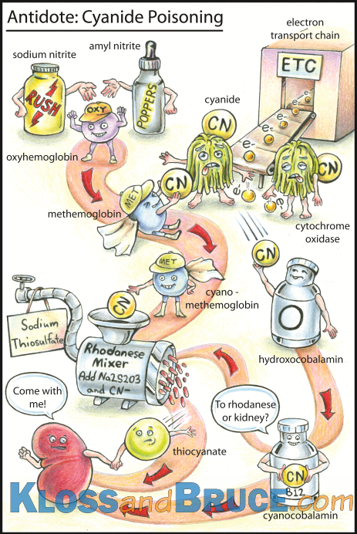
Cyanides and cytochrome oxidase
Hemoglobin can take a "hit" only when iron is in the 3-valent form (methemoglobin)
Therefore, when exposed to cyanides, it is necessary to act with oxidants that convert hemoglobin into methemoglobin and it "takes a hit", saving the body from imminent death
The antidote is also vitamin B12 in the form of hydroxycobalamin, which binds cyanides, turning into cyanocobalamin
https://i.pinimg.com/originals/8c/18/58/8c185837daaabbe9d6b0f437a12a044b.png

Slide 47
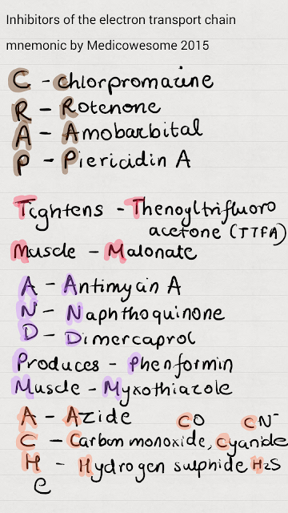
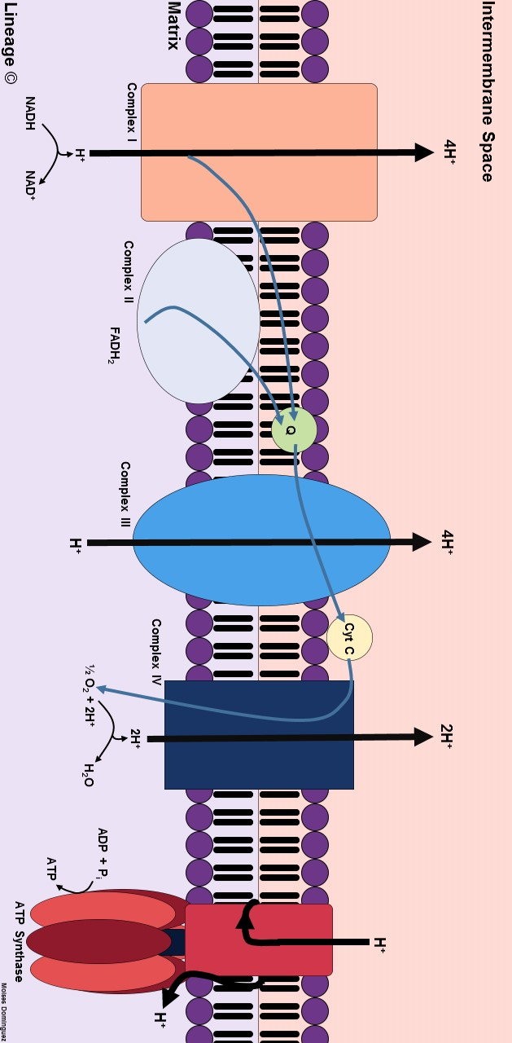

Slide 48
Simplified diagram and interfaces in the ETC

Slide 49
Uncoupling of the electron transmission chain

Slide 51
Uncouplers of ETC
substances that uncouple oxidation and phosphorylation in the electron transport chain (are carriers of hydrogen protons through the mitochondrial membrane bypassing the enzyme ATP synthase)
protonophores
ionophores
weak hydrophobic organic acids, which in the form of an anion (R-COO-) bind protons in the intermembrane space, diffuse through the membrane and dissociate in the matrix with the formation of protons
are able to integrate into the membrane, forming a channel through which protons and other monovalent cations - Na + or K + - can move. As a result, the proton potential is removed and the synthesis of ATP is disrupted.
free fatty acids,
thyroid hormones,
salicylates,
dicumarol,
2,4-dinitrophenol
valinomycin,
nigericin,
gramicidin

Slide 53
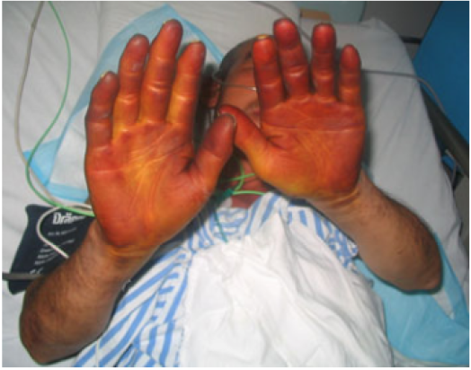
2,4-dinitrophenol - "explosive weight loss"
Dinitrophenol - yellow dust, upon contact with a molecule, workers in factories began to lose weight, constantly felt fatigue, pain and stomach, weakness, difficulty breathing. Most notably, they had fever as they lost weight. Sometimes after death they had a body temperature of 42-43 degrees. A yellow liquid came out with sweat on the face and palms. The autopsy did not reveal any obvious organ dysfunction.

Slide 54
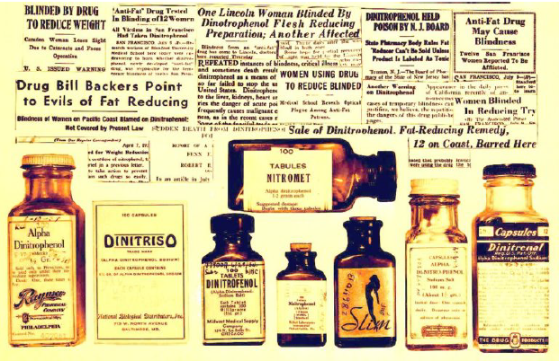
2,4-dinitrophenol - "explosive weight loss"
From 1933 to 1938, 2,4-dinitrophenol was used in the United States for weight loss. The result - a number of deaths from heat shock and one of the most high-profile cases of drug recalls from the market

Slide 55
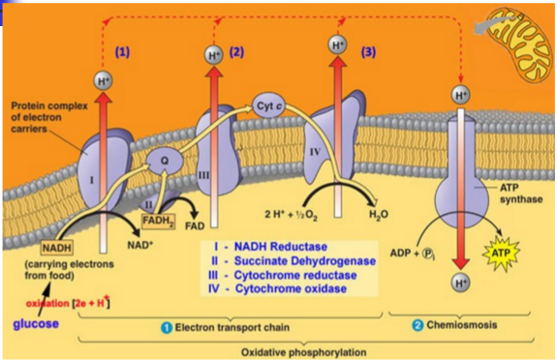
Phosphorylation
substrate
oxidative
ATP is synthesized by phosphorylation of ADP to ATP by the separation of phosphate from compounds with a high potential for phosphate transfer
ATP is synthesized due to the energy of transfer of electrons and protons along the carrier chain in the electron transport chain during oxidation
Krebs cycle,
glycolysis
ETC

Slide 56
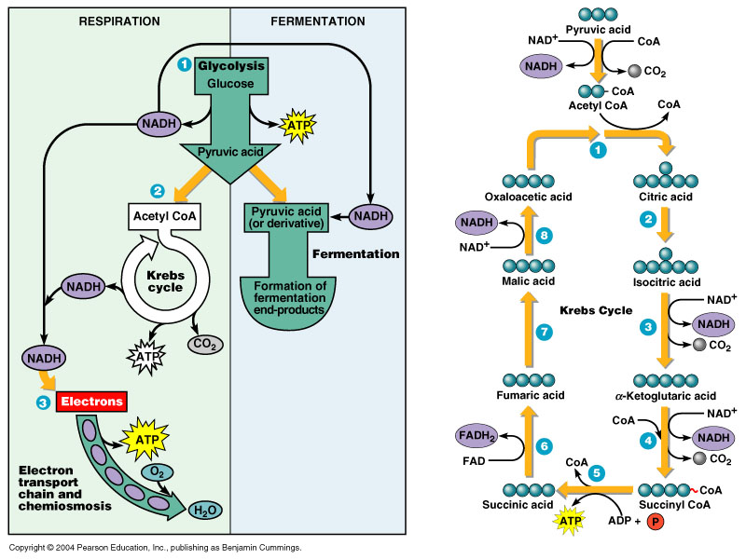
Oxidative phosphorylation - conjugation of KC and ETC

Slide 58
R / O ratio
is equal to the number of moles of ATP formed from ADP and H3P04, per 1 gram-atom of absorbed oxygen (allows you to estimate the conjugation of the electron transport chain)
For the NADH molecule
maximum 3 ATP molecules can be formed
(3 ADP + 3 Н3РО4 → 3 ATP)
Expenditure of 1 oxygen atom
(2 H + O → H2O)
P / O = 3/1 = 3
For the FADH2 molecule
maximum 2 ATP molecules can be formed
(2 ADP + 2 Н3РО4 → 2 ATP)
Expenditure of 1 oxygen atom
(2 H + O → H2O)
P / O = 2/1 = 2

Slide 60
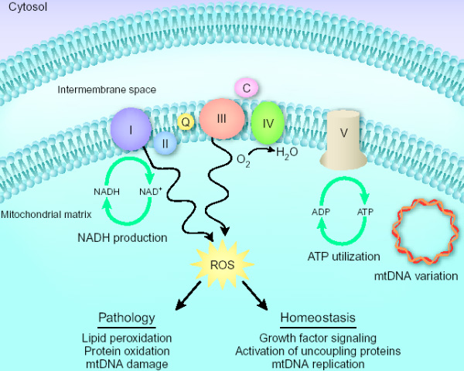
Electron transport chain - ROS production
Рис. из статьи Baughman & Mootha в Nature Genetics
http://elementy.ru/images/news/mitochondria_ros_600.jpg

Slide 64
Non-phosphorylating (free) oxidation
A state in which oxidation of substrates in the respiratory chain occurs, but ATP is not formed at the same time
- thermoregulation (brown fat: contains mitochondria adapted to generate heat - the content of respiratory enzymes is much higher than that of enzymes that phosphorylate ADP, therefore free oxidation processes prevail in them; there are many of them in newborns, in subsequent periods of life its number decreases;
- the formation of biologically important compounds (catecholamines, glucocorticosteroids, collagen, activation of vitamin D, etc.);
- neutralization of xenobiotics (poisons, toxins, drugs, household chemicals);
- in some pathological conditions (for example, with hyperfunction of the thyroid gland: the main symptoms of such conditions may be fatigue, fever, weight loss, despite increased appetite, increased breathing and heart rate).

Slide 65
Types of oxidation in the cell
Intramitochondrial
occurs on the inner membrane of mitochondria
performs an energy function
Extramitochondrial
proceeds in the cytosol, EPS, peroxisomes and on the outer membrane of mitochondria
participates in biosynthetic and detoxification processes

Slide 66
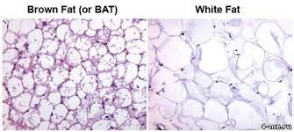
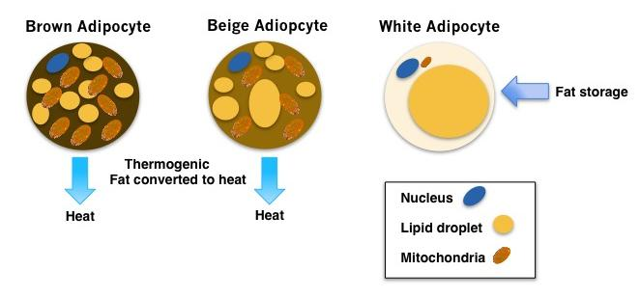

Slide 67
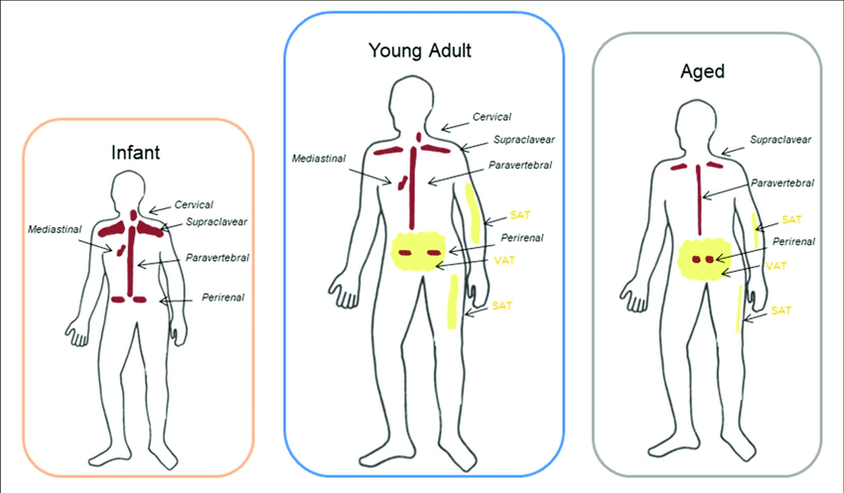
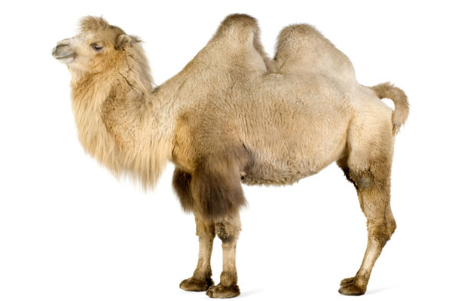
Brown fat
Brown fat has been studied by scientists for several years. Brown fat is a heat-generating type of fat that instead of storing energy, on the contrary, burns it. This ability of brown fat is of great importance for the normalization of weight.
Brown fat is a source of endogenous water.

Slide 68
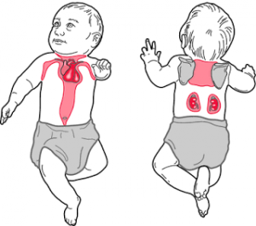
Brown fat
A newborn has an adequate supply of brown fat, which helps his body to keep warm. As you grow older, most of its storage in the body is lost. Brown fat is located in the neck area around the blood vessels (helps warm the blood).

Slide 69
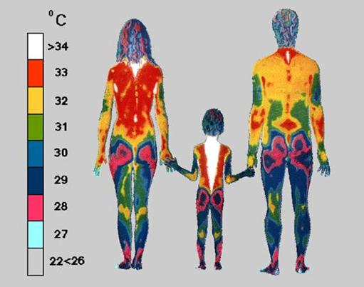
The distribution of temperature zones inside and on the surface of the human body is normal condition
https://2.bp.blogspot.com/-EYEpqp1aPD4/WMav__HOkPI/AAAAAAAANTI/dvlClsrT2eoWZ92nNp4Xo5YnPm8-EsP2gCLcB/s640/image038.jpg

Slide 70
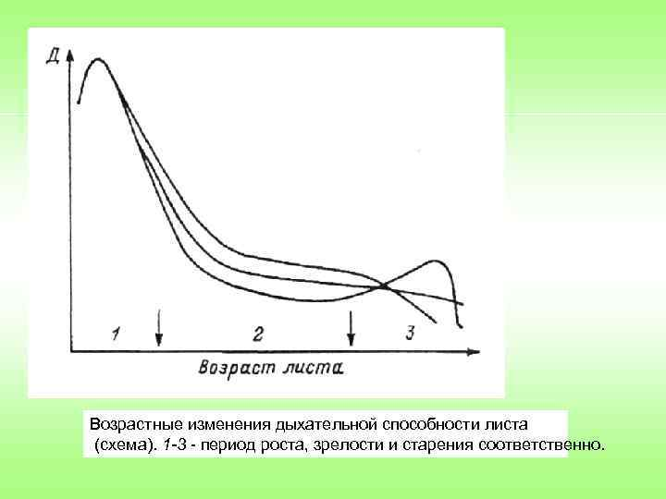
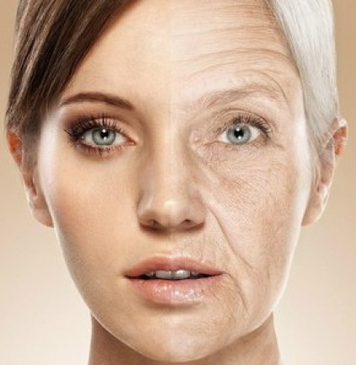
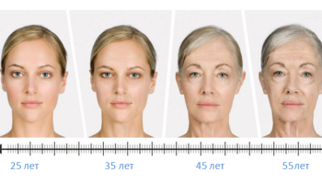
"Age" changes
- ↓ oxygen consumption and ↓ intensity of oxidative processes
- ↑ generation of reactive oxygen species with cell damage
http://present5.com/presentation/3/281193631_455900542.pdf-img/281193631_455900542.pdf-60.jpg
http://www.transferfaktory.ru/cont/img/starenie.jpg
https://superwoomen.ru/wp-content/uploads/2017/05/starenie-kozhi-lica-u-zhencshin-c350x200.png

Slide 71
Hypoenergetic states
- exogenous and / or endogenous hypovitaminosis - the rate and efficiency of oxidative reactions decreases. It usually occurs with a lack of vitamins - B1, B2, niacin, B6, pantothenic acid and ascorbic acid,
- protein deficiency in food - - the synthesis of all enzymes and enzymes of catabolism decreases, in particular,
-reduction of consumption of carbohydrates and lipids as the main sources of energy,
- oxygen deficiency - (hypoxia) - the absence of an electron acceptor, which causes an "overflow" of respiratory enzymes, an increase in the electrochemical gradient, the accumulation of NADH and FADH2 in the cell and the cessation of catabolism,
- iron deficiency - (a component of cytochromes, myoglobin and hemoglobin) and copper - (a component of cytochrome oxidase).

Slide 72
Body tissues
aerobic
anaerobic
brain, retina, heart, renal cortex, liver, mucous membrane of small intestine
skeletal muscle, red blood cells, peripheral nerves, renal medulla, bone, cartilage, connective tissue

Slide 73
Conclusion
The chemiosmotic theory of biological oxidation is modern: electron transport and ATP synthesis are combined by a proton gradient across the inner membrane (cristae) of mitochondria.
The respiratory chain plays an important role: it generates and stores ATP and generates ROS.
Disruption of the functioning of the CK and DC occurs in hypoenergetic states, mitochondrial and peroxisomal diseases, under the action of blockers and uncouplers of the respiratory chain, although in some cases the uncoupling of oxidation and phosphorylation also plays a physiological role - free (non-phosphorylating) oxidation (thermoregulation, formation of biologically important compounds, detoxification xenobiotics)

Slide 74
Литература по теме лекции:

Slide 75
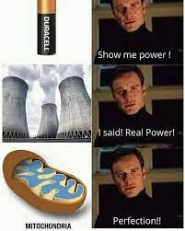
THANK YOU FOR THE ATTENTION!

Slide 76
QUESTION ABOUT THE LECTURE:
How many ATP molecules in the electron transport chain can a maximum of 1 FADH2 molecule give?

