Slide 1
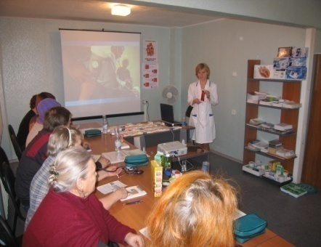
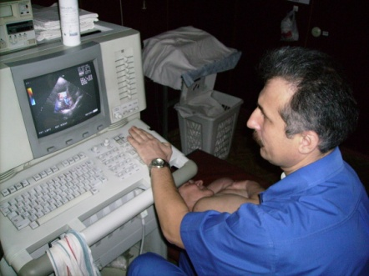
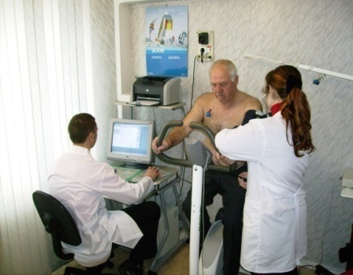
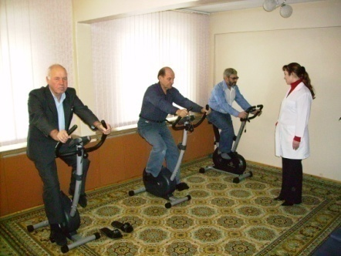
IHD: angina pectoris. Clinic. Diagnostics. Treatment. Prevention.
Chernova Anna
Professor of the Department of Course in Internal Medicine
of Krasnoyarsk State Medical University
Notes:
1
1

Slide 2
1. Definition of angina pectoris. 2. Etiology. 3. Clinical picture. 4. Classification. 5. Diagnostics. 6. Treatment. 7. Primary and secondary prevention.
Lecture plan

Slide 3
ANGINA PECTORIS
— is a clinical syndrome manifested by a feeling of discomfort or pain in the chest of a squeezing, pressing nature, which is most often localized behind the sternum and can radiate to the left arm, neck, lower jaw, and epigastric region.

Slide 4
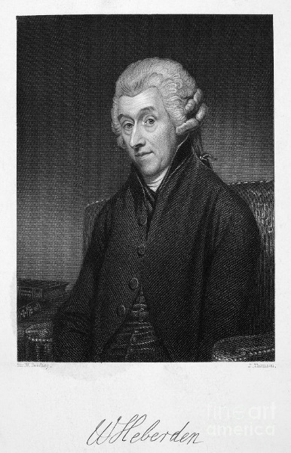
The first case of angina pectoris
English physician William Heberden described an attack of angina in details in 1768 for the first time. He associated angina pectoris with spasm of the coronary arteries. About 100 years later, Professor at the University of Vienna Hermann Nothnagel (1841-1905) called this disease “Angina pektoris” from the words “anchein” – ‘to crush’, ‘strangle’ and “pektoris” - chest. This is what this disease is now called in English-German literature.

Slide 5
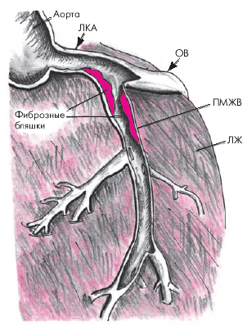
ETIOLOGY (cause of occurrence) of angina pectoris – atherosclerosis of the coronary arteries.
Coronary angiography reveals atherosclerosis with coronary artery stenosis of 50-75% or more in approximately 97-99% of patients with a typical clinical picture of angina pectoris.
In the remaining 1-3% of cases, the cause may be aortic stenosis, aortitis, coronaritis, vasospasm, anomalies of the coronary arteries, etc.

Slide 6
Scheme of atherogenesis (1)
Damage to the endothelium can occur under the influence of catecholamines (spasm), high blood pressure, traumatic, inflammatory (viruses, bacteria), degenerative (insulin, uric acid, homocysteine), allergic and other processes.
Due to their small size, LDL easily penetrates into the subendothelial space of damaged endothelium. These lipoproteins are very rich in cholesterol (C.) (60-70% of total C.) and therefore they are called atherogenic. The main route of removal of circulating LDL is uptake by hepatocyte receptors. With age, the number of receptors decreases. LDL is actively absorbed by monocytes, which also penetrate into the damaged area. Monocytes, loaded with С., turn into large foam cells - macrophages. Macroscopically, the endothelium in these areas initially appears as lipid stripes or lipid spots. Subsequently, plaques form in these areas, in the center of which there are foam cells rich in oxidized cholesterol.

Slide 7
Scheme of atherogenesis (2)
The involvement of platelets (PLTs) in atherogenesis has been suggested. Thus, PLTs adhere to the damaged endothelium under the influence of thrombin and ADP. Thromboxane A2 (TXA2) is released from the PLTs, a vasoconstrictor formed from fatty acids with thromb-aggregating properties. TXA2 causes contraction of endothelial cells and expansion of intercellular endothelial spaces. This exposes the basement membrane, and its collagen fibers stimulate PLTs aggregation. Platelet-derived growth factor (PDFG) is released from the PLTs, a strong mitogen for mesenchymal cells that causes chemotaxis of smooth muscle cells and their accumulation in the subendothelial space. Platelet-derived growth factor 4 (PDGF-4), beta-thromboglobulin, factor-3, ADP, serotonin and other vasoactive substances that increase blood clotting, form parietal thrombi on eroded plaques and thrombi inside the plaque when they rupture, causing coronary blood flow disorders are released from the PLTs.

Slide 8
Stable atherosclerotic plaque
Fibrous cap (SMC and matrix)
Intimal SMC (restorative phenotype)
Endothelial cells
Lipid core
Adventitia
SMC media (contractile phenotype)
Notes:
8
An atherosclerotic plaque is considered to be stable if the risk of rupture, with all its consequences, is low. Studies have identified a number of features that are common to stable plaques. These include:
A thick fibrous cap of uniform density that is able to confer mechanical stability on the overall structure by reducing circumferential tensile stress^{1,2}
A high VSMC and collagen content in the fibrous cap^{2,3}
A lipid-rich core that occupies less than 40% of the total volume of the plaque⁴
A relatively low infiltration of inflammatory cells (principally macrophages and T-lymphocytes)^{2–5}.
A stable atherosclerotic plaque is at low risk of rupture
Characteristic features of a stable plaque include a thick fibrous cap with a high VSMC and collagen content, a lipid-rich core that occupies a relatively small volume, and a low inflammatory cell content
References
1 Ross R. Atherosclerosis – an inflammatory disease. N Engl J Med 1999; 340: 115–126.
2 Weissberg P. Mechanisms modifying atherosclerotic disease – from lipids to vascular biology. Atherosclerosis 1999; 147 (suppl 1): S3–S10.
3 Rabbani R, Topol EJ. Strategies to achieve coronary arterial plaque stabilization. Cardiovasc Res 1999; 41: 402–417.
4 Davies MJ, Ho SY. Atherosclerosis: the process. In: Davies MJ, Ho SY. Atlas of Coronary Artery Disease. Lippincott-Raven, Philadelphia, USA, 1998: 23–61.
5 Kinlay S, Ganz P. Role of endothelial dysfunction in coronary artery disease and implications for therapy. Am J Cardiol 1997; 80: 11I–16I.
Slide 10: Characteristics of the stable atherosclerotic plaque

Slide 9
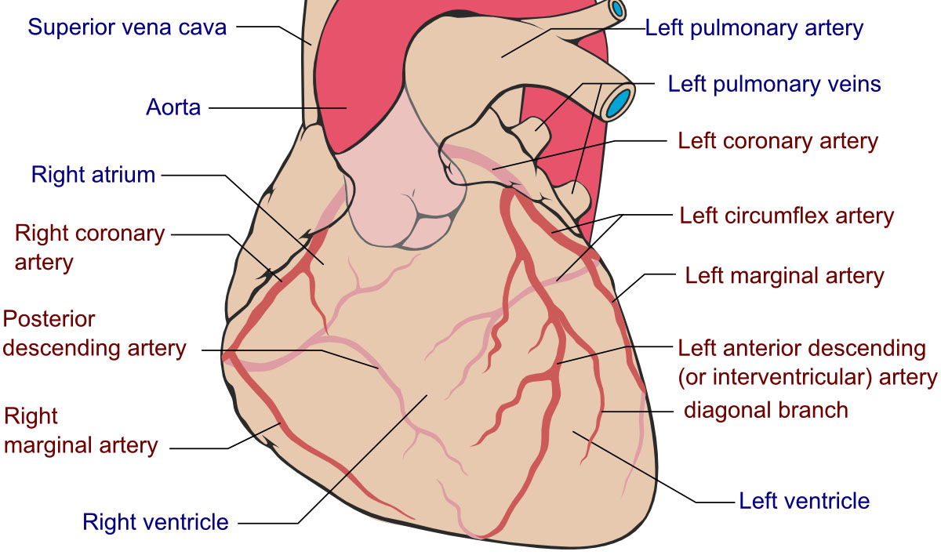

Slide 10
When the lumen of the coronary artery narrows in any area by 60-75%, during physical activity the patient begins to experience “anginal pain” due to a discrepancy between the myocardial oxygen needs and its delivery through the altered coronary arteries.

Slide 11
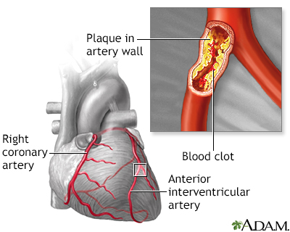
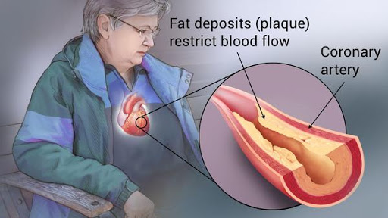
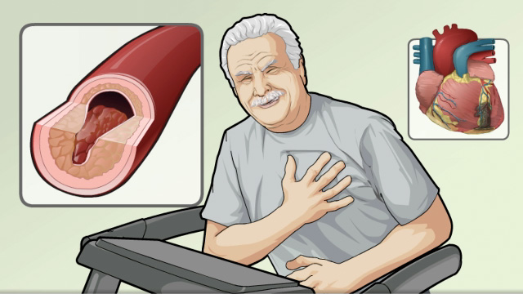
When the lumen of the coronary artery narrows in any area by 60-75%, during physical activity the patient begins to experience “anginal pain” due to a discrepancy between the myocardial oxygen needs and its delivery through the altered coronary arteries.

Slide 12
Risk factors contributing to the occurrence/progression of IHD
1. Heredity (IHD in relatives under 55 years of age in men, under 65 years of age in women).
2. Age: men - over 45 years, women - over 55 years.
3. Gender
4. Smoking.
5. Stress.
6. Overweight
(Waist circumference for men > 102 cm, for women > 88 cm)
7. Physical inactivity.
8. Hypercholesterolemia (TC > 5 mmol/l, > 200 mg/dl).
9. Hypertriglyceridemia (>1.7-2mmol/l,>180mg/dl).
10. Hypertension.
11. Hyperuricemia.
12. Early menopause

Slide 13
CONTRIBUTION OF THE 7 LEADING (MODIFIED) RISK FACTORS
DURING UNFAVORABLE COURSE OF IHD
%
40
35,5
35
30
25
23
20
17,1
12,9
12,5
15
11,9
9,0
10
5
0
Arterial pressure
Hyper-C
Smoking
Lack of vegetables, fruits in diet
Overweight
Alcohol
Hypodynamia
2
3
4
5
6
7
Global Programme on Evidence for Health Policy; WHO, World health Report, 2012.
Notes:
13
Данные слайда свидетельствуют о вкладе факторов риска в формирование преждевременной смертности населения в России, а соответственно и в формирование СН.
Величина вклада 7 ведущих факторов риска в преждевременную смертность населения нашей страны являются еще одним мощным аргументом в пользу того, что без эффективного управления сердечно-сосудистым риском мы не сможем справиться с бременем сердечно-сосудистой смертности.

Slide 14
The more risk factors, the more likely it is to develop IHD: if a patient smokes, the likelihood of developing IHD is three times greater than for non-smokers. If patient smokes and has high cholesterol, the likelihood of coronary artery disease increases six times. And if patient smokes, has high cholesterol and has hypertension, the likelihood of coronary artery disease increases twelve times.
Estrogens increase HDL-C and decrease LDL-C, while progesterone has the opposite effect.

Slide 15
Clinical manifestations of ANGINA PECTORIS

Slide 16
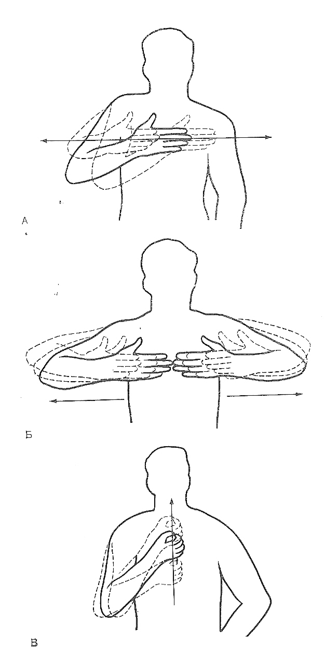
PAIN
Character – burning, squeezing, pressing.
Localization - behind the sternum, throughout the chest, less often in the heart area.
Irradiation - left arm or shoulder, epigastrium
Occurs (or intensifies) during physical activity and, conversely, goes away with rest
Treated with nitroglycerin (within 2-10 minutes) for stable angina

Slide 17
Canadian Heart Association classification (Campeau L, 1976),
Russian Clinical Recommendations “Stable IHD”, 2020
Functional Severity Classes of Stable Angina.
Functional class | Clinical manifestations
I | “Ordinary daily physical activity (walking or climbing stairs) does not cause angina.” Pain occurs only when performing very intense, or very fast, or prolonged physical activity.
II | “Slight limitation of normal physical activity”, which means the occurrence of angina when walking quickly or climbing stairs, after eating or in the cold, or in windy weather, or during emotional stress, or in the first few hours after waking up. Anginal pain occurs when walking > 500 m (two blocks) on level ground or when climbing more than one floor of stairs (2 flights of stairs) at a normal pace under normal conditions.
III | “Significant limitation of normal physical activity.” Angina occurs when walking quietly for a distance of one to two blocks, when walking up to (500 m) on level ground, or when climbing one flight of stairs at a normal pace under normal conditions.
IV | “The impossibility of performing any physical activity without the appearance of unpleasant sensations,” angina pectoris can also occur at rest.

Slide 18
Classification of unstable angina pectoris
1. New-onset angina (within 1 month).
2. Progressive angina. (worsening of the functional class of angina: I II, II III, III IV)
З. Prinzmetal's angina (vasospastic, variant).
4. Post-infarction angina (within 1 month).

Slide 19
Classification of unstable angina,
according to E. Braunwald:
1st class - new onset angina or worsening of existing angina within a month
2d class - angina at rest during the previous month
3d class - angina at rest for the next 48 hours.

Slide 20
Diagnosis of angina pectoris
1. Clinic
2. Risk factors for coronary artery disease.
3. Rest ECG
4. Bicycle ergometry or Treadmill test.
5. Daily ECG monitoring.
6. TEE
7. EchoCG.
8. Myocardial scintigraphy.
9. Coronary angiography
10. CT scan of the heart (coronary vessels)

Slide 21
Rest ECG
At rest, only during pain onset signs of ischemia can be detected: a decrease in the ST segment and the T wave of a transient nature; less often, a rise in the ST segment is noted. Sometimes there may be extrasystoles, which can only be an indirect sign of possible ischemic heart disease. At rest, we can identify signs of a previous myocardial infarction by correlating these signs with patient’s medical history. But most often, nothing is detected on a resting ECG with angina of effort.

Slide 22
Bicycle ergometry,
Treadmill test
Notes:
22
22

Slide 23
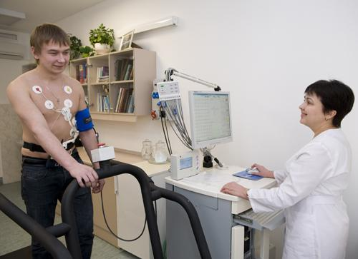
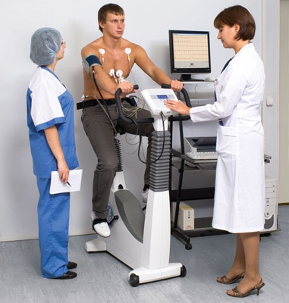
ECG during exercise
Stress tests provoke myocardial ischemia by increasing myocardial oxygen demand (Treadmill test, Bicycle ergometry). Load testing in the form of a treadmill test or bicycle ergometry is still the most common research method. This is a relatively simple and inexpensive method for detecting transient myocardial ischemia in patients with suspected or established coronary heart disease.
Notes:
23
23

Slide 24
Bicycle ergometry
Patient: ___________________________, 20 years old
The initial ECG showed sinus rhythm with a heart rate of 75 beats/min, no ST segment displacements were detected, and no rhythm disturbances were registered.
Stage I - Load - 50 Watt (300 kgm/min)
Load duration - 3 minutes
Stage II - Load - 75 Watt (450 kgm/min)
Load duration - 3 minutes
Stage III - Load - 100 Watt (600 kgm/min)
Load duration - 3 minutes
Stage IV - Load - 125 Watt (750 kgm/min)
Load duration - 3 minutes
Stage V - Load - 150 Watt (900 kgm/min)
Load duration - 3 minutes
Stage VI - Load - 175 Watt (1050 kgm/min)
Load duration – 3 minutes
W | W₀ | 50 Watt | 75 Watt | 100 Watt | 125 Watt | 150 Watt | 175 Watt
HR | 75 | 100 | 118 | 128 | 143 | 152 | 160
AP | 120/80 | 130/80 | 140/75 | 150/70 | 160/70 | 170/65 | 190/65
During the test, no ST segment displacements were detected, and no rhythm disturbances were registered.
Conclusion: Exercise tolerance is not reduced (it is high). Myocardial reserve is preserved. No rhythm disturbances or coronary insufficiency were detected.
Notes:
24
24

Slide 25
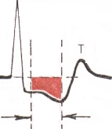
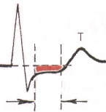
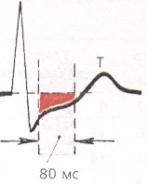
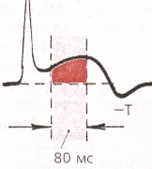
Electrocardiographic criteria for ischemia
Horizontal or downward decline in the ST segment of 1.0 mm or more from baseline for at least 80 ms from the junction point (J)
Slow, obliquely ascending decrease in the ST segment of 1.5 mm or more from baseline for at least 80 ms from the junction point (J)
ST segment elevation of 1.0 mm or more from baseline within 80 ms from junction point (J)
Notes:
25

Slide 26
Sensitivity 62% to 66%
determined by the percentage of true positive tests among patients with coronary atherosclerosis confirmed by coronary angiography
Specificity 84% to 89%
determined by the percentage of true negative tests among healthy individuals with unaffected coronary arteries
Notes:
26

Slide 27
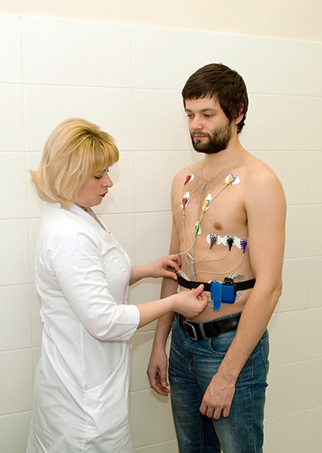
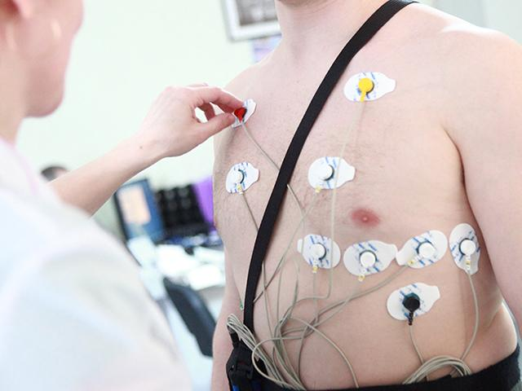
Daily ECG monitoring – recording ECG throughout the day.
Signs of ischemia may be identified when performing physical activity, similar to those with bicycle ergometry, accompanied by pain (or episodes of silent ischemia).

Slide 28
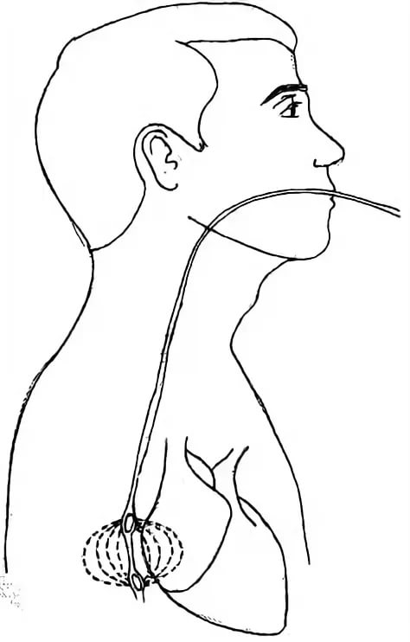
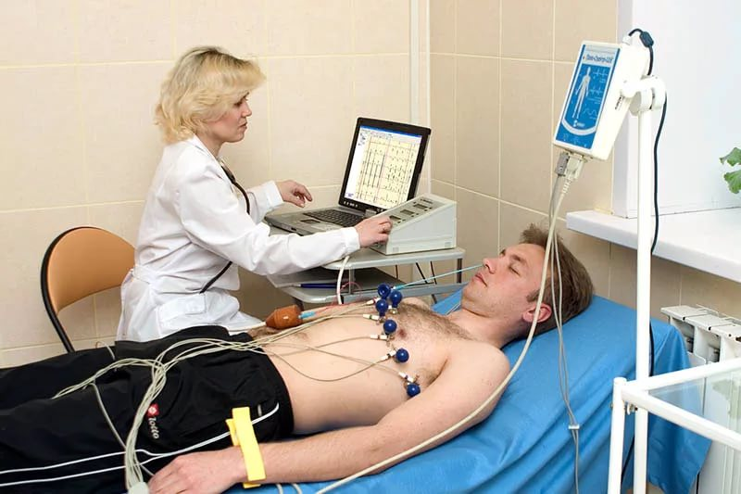
Transesophageal Left Atrium Stimulation
With an increase in heart rate, signs of ischemia similar to those with bicycle ergometry may appear.

Slide 29
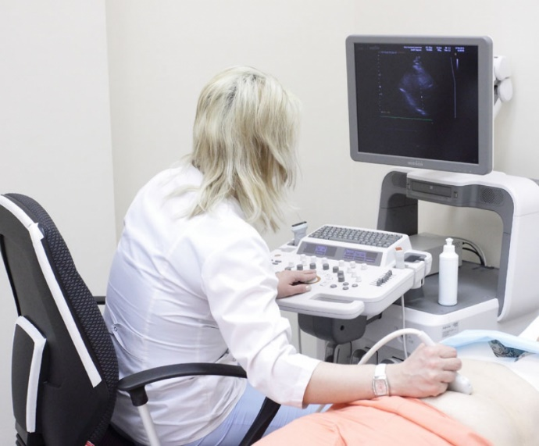
Echocardiography (EchoCG) – ultrasound examination of the heart and large vessels
Signs of atherosclerosis of the aorta can be detected, and with Doppler ultrasound of the proximal parts of the coronary arteries. Signs of cicatricial changes in the myocardium and cardiac aneurysm are revealed. When combining echocardiography and stress tests, it is possible to identify signs of dynamic disorders of local myocardial contractility.

Slide 30
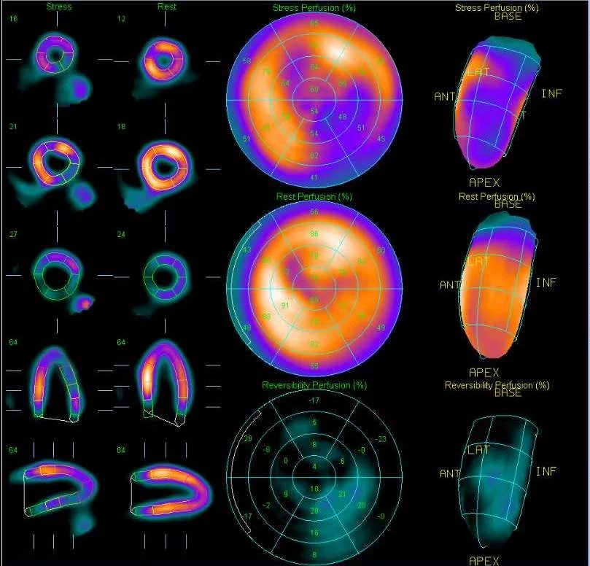
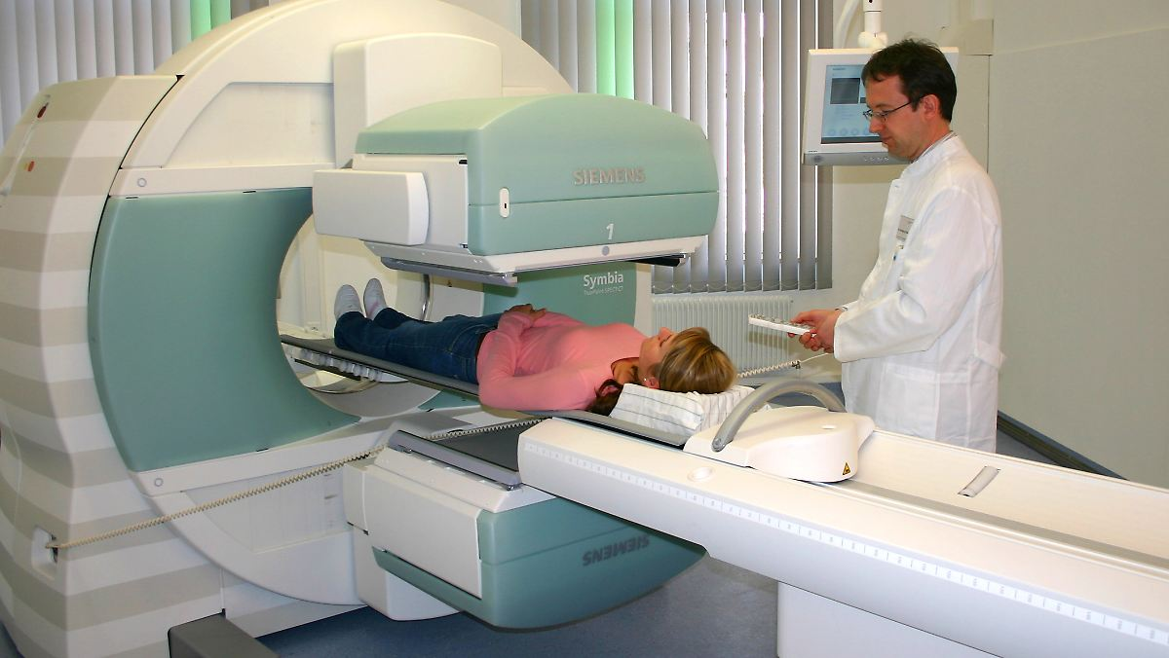
Myocardial scintigraphy
a method that allows you to study blood circulation in the coronary vessels through the injection of radioactive isotopes (thallium, technetium), which tend to accumulate in the myocardium. After this, a picture is taken showing the movement of radionuclides along the walls (cells) of the heart muscle.

Slide 31
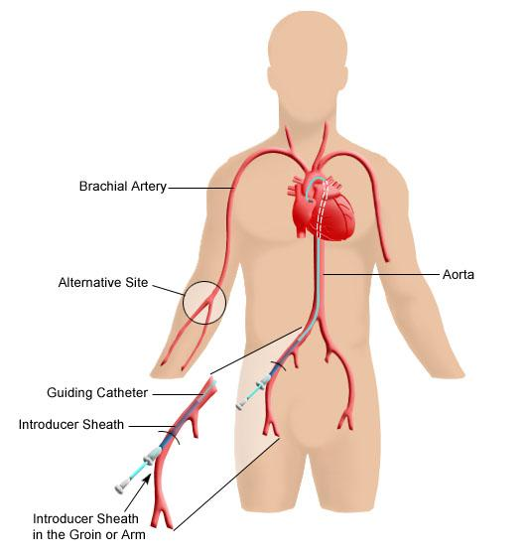
Coronary angiography
It is the “gold standard” of research for angina pectoris for its diagnosis and resolving the issue of revascularization methods. A narrowing of the coronary artery of more than 50% is considered significant. (if the coronary arteries are narrowed by more than 50%, the issue of revascularization with PTCA or CABG is considered).

Slide 33
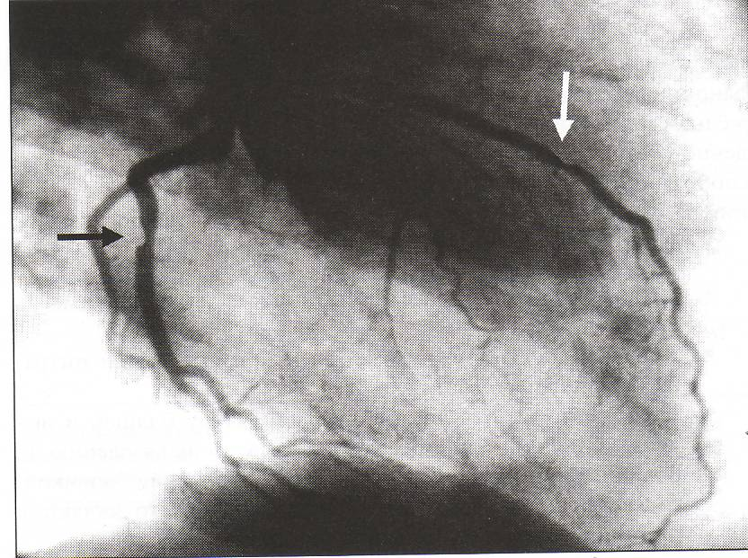
Stenosing atherosclerosis of the coronary arteries in angiographic examination

Slide 34
Diagnosis of angina pectoris
(real clinical practice)
1. Clinic.
2. Risk factors for coronary artery disease.
3. Resting ECG.
4. Bicycle ergometry or Treadmill test (if possible, performed on an outpatient basis).
5. Daily ECG monitoring.
6. Coronary angiography.

Slide 35
Differential diagnosis of angina
1. Heart disease
1.1. Myocardial infarction
1.2. Сongenital abnormality
1.3. Myocarditis, pericarditis, endocarditis
1.4. Hypertonic disease
1.5. Idiopathic cardiopathy
1.6. Arrhythmias
1.7. Dilated cardiomyopathy
1.8. Functional cardiopathy: Neurocirculatory dystonia (vegetative-vascular dystonia), menopause, thyrotoxicosis, etc.
2. Lung diseases
2.1. Pleurisy
2.2. Pleuropneumonia
2.3. Lungs' cancer
2.4. Pneumothorax
2.5. TELA

Slide 36
Differential diagnosis of angina
3. Gastrointestinal diseases
3.1. Esophagitis
3.2. Esophageal carcinoma
3.3. Hiatal hernia
3.4. Gastritis
3.5. Peptic ulcer
3.6. Cholecystitis
4. Difficult cell diseases
4.1. Tietz disease
4.2. Myositis
4.3. Herpes zoster
4.4. Anterior chest wall syndrome
4.5 Shoulder-scapular hyperarthritis
5. Spinal disease
5.1. Osteochondrosis
5.2. Disc herniation
5.3. Intercostal neuralgia
5.4. Ankylosing spondylitis
5.5. Rachiocampsis

Slide 37
Treatment of an attack of angina
Relief of angina pectoris attack: fast-acting forms of nitrates are used for these purposes.
Nitroglycerin - 0.5 - 1 mg sublingually
Isosorbide dinitrate - 5-10 mg sublingually
These drugs are also used in the form of a spray (nitrospray, isoket-spray - 1.25 mg)
1-3 oral irrigations at intervals of 30 seconds.
The duration of action of nitrospray -3O min, isoket spray (isosorbide dinitrate) - 1.5 hours.
They can be used to prevent angina before exercise.

Slide 38
Treatment of ANGINA
Medication:
1. Statins
2. Antiplatelet agents
3. β-blockers
4. ACE inhibitors
5. Nitrates
6. Calcium antagonists
7. Cytoprotectors
Surgery:
1. PTCA (percutaneous transluminal coronary angioplasty) + STENTING.
2. CABG (coronary artery bypass grafting)

Slide 39
Drug Treatment of Angina Pectoris

Slide 40
1. STATINS

Slide 41
Statins used in Russia
- Fluvastatin
- Pravastatin
- Lovastatin
- Simvastatin
- Pitavastatin
- Atorvastatin
- Rosuvastatin
Notes:
41

Slide 42
Effects of statins in the body:
I. Lipid-lowering effects:
1. Reduce the level of total cholesterol (TC).
2. Reduce the level of low-density lipoprotein cholesterol (LDL C)
3. Increase the level of high density lipoprotein cholesterol (HDL C)
4. Reduce triglyceride (TG) levels.
II. Non-lipid (pleiotropic) effects:
1. Improvement of endothelial function (increased production of vasodilators - NO and prostacyclin).
2. Suppression of inflammation in the vascular wall.
3. Suppression of macrophage activity (stabilizing effect on atherosclerotic plaque).
4. Reduced platelet aggregation.
5. Decrease in the proliferative activity of smooth muscle cells of the vascular wall.

Slide 43
Optimal values of lipid parameters (in mmol/l) depending on the risk category
Lipid parameters | Low risk patients | Moderate risk patients | High risk patients | Extremele high risk patients
TC | ≤ 5,0 | ≤ 4,5 | ≤ 4,0 | ≤ 3,5
LDL C* | ≤ 3,0 | ≤ 2,6 | ≤ 1,8 | ≤ 1,4
HDL C** | M >1,0 W >1,2 | М >1,0 W >1,2 | М >1,0 W >1,2 | М >1,0 W >1,2
TG | ≤ 1,7 | ≤ 1,7 | ≤ 1,7 | ≤ 1,7

Slide 44
Differentiation by CVD risk
Very high risk category:
1. Established CVD of atherosclerotic origin based on clinical data or equivalent imaging results. Established CVD includes previous ACS (MI or unstable angina), stable angina, coronary revascularization (PCI, CABG or other arterial revascularization), stroke and TIA, PAD. Atherosclerotic CVD clearly documented by imaging includes changes that are proven predictors of clinical events, such as significant plaque on coronary angiography or CT (multivessel coronary disease with evidence of >50% stenosis of two major epicardial arteries) or on ultrasound study of the carotid arteries.
2. Diabetes with target organ damage or in the presence of at least three main risk factors, or long-term type 1 diabetes with early onset (>20 years).
3. Severe CKD (eGFR <30 ml/min/1.73 m2).
4. 10-year risk of fatal CVD events ≥10% according to the SCORE scale.
5. FH in the presence of CVD of atherosclerotic origin or other significant risk factors.
Диагностика и коррекция нарушений липидного обмена с целью профилактики и лечения атеросклероза.
Российские рекомендации, V пересмотр, "Атеросклероз и дислипидемии" 2012; 9: 5-51
Notes:
44

Slide 45
EUROPEAN CARDIOVASCULAR RISK FACTOR SCORE (SCORE) 1
Women
Age
Men
Non-smoking
Smoking
Non-smoking
Smoking
180
160
140
120
7
8
9
10
12
13
15
17
19
22
14
16
19
22
26
26
30
35
41
47
Risk on the SCORE scale is considered:
Very high if
patient data projections
on the SCORE card it is > 10%;
High - if located
within 5-10% and
Low if <5%.
An estimate of 5% or more requires prevention of life-threatening conditions (myocardial infarction and stroke)
using statins 2
5
5
6
7
8
9
10
12
13
16
65
9
11
13
15
16
18
21
25
29
34
3
3
4
5
6
6
7
8
9
11
6
8
9
11
13
13
15
17
20
24
2
2
3
3
4
4
5
5
6
7
4
5
6
7
9
9
10
12
14
17
180
160
140
120
4
4
5
6
7
8
9
10
11
13
9
11
13
15
18
18
21
24
28
33
3
3
3
4
5
5
6
7
8
9
60
6
7
9
10
12
12
14
17
20
24
2
2
2
3
3
3
4
5
5
6
4
5
6
7
9
8
10
12
14
17
RATE
1
1
2
2
2
2
3
3
4
4
3
3
4
5
6
6
7
8
10
12
180
160
140
120
2
2
3
3
4
4
6
5
6
7
6
7
8
10
12
12
13
15
19
22
15% and higher
10%–14 5%–9%
3%–4%
2%
1%
<1%
1
2
2
2
3
3
3
4
4
5
55
4
5
6
7
8
8
9
11
13
16
1
1
1
1
2
2
2
2
3
3
3
3
4
5
6
5
6
8
9
11
1
1
2
2
2
2
2
3
3
4
4
4
5
6
8
1
1
1
1
1
1
180
160
140
120
1
1
1
2
2
2
2
3
3
4
4
4
5
6
7
7
8
10
12
14
1
1
1
1
1
1
2
2
2
3
50
2
3
3
4
5
5
6
7
8
10
0
1
1
1
1
1
1
1
1
2
2
2
2
3
3
3
4
5
6
7
10-year risk of fatal CVD in a population group
with high CVD risk
0
0
1
1
1
1
1
1
1
1
1
1
2
2
2
2
3
3
4
5
Systolic blood pressure
180
160
140
120
0
0
0
0
0
0
0
0
1
1
1
1
1
2
2
2
2
3
3
4
0
0
0
0
0
0
0
0
0
0
40
1
1
1
1
1
1
2
2
2
3
0
0
0
0
0
0
0
0
0
0
0
1
1
1
1
1
1
1
2
2
0
0
0
0
0
0
0
0
0
0
0
0
1
1
1
1
1
1
1
1
© 2003 ESC
4 5 6 7 8
4 5 6 7 8
4 5 6 7 8
4 5 6 7 8
Холестерин ммоль
200 250 300
Воспроизводится с разрешения
1.De Backer et al. Eur Heart J. 2003;24:1601-1610.
2.Giusepe Mancia et al.2007 Guidelines for the management of arterial hypertension European Heart Journal(2007) 28, 1462-1536
мг/дл
Notes:
45
45
Оценка системного коронарного риска (ОЦЕНКА) составляет таблицу расчета 10-летнего риска летального ССЗ. Отдельные таблицы применяются для стран с высоким риском и низким риском. Таблица высокого риска должна применяться во всех Европейских странах, за исключением тех, которые рассматриваются как регионах низкого риска. Странами низкого риска являются Бельгия, Франция, Греция, Италия, Люксембург, Испания, Швейцария и Португалия. Поскольку таблица предполагает летальный исход СС явления, предельная величина для наличия высокого риска определяется в пределах ≥5%. Таблица может использоваться для того, чтобы дать представление о воздействии изменений от одной категории риска к другой, например, когда человек прекращает курить.^{1, 2}
References
De Backer G, Ambrosioni E, Borch-Johnsen K, et al. European guidelines on cardiovascular disease prevention in clinical practice: Third Joint Task Force of European and other Societies on Cardiovascular Disease Prevention in Clinical Practice (constituted by representatives of eight societies and by invited experts). Eur J Cardiovasc Prev Rehabil. 2003;10(suppl 1):S1-S78.
De Backer G, Ambrosioni E, Borch-Johnsen K, et al, for the Third Joint Task Force of European and Other Societies on Cardiovascular Disease Prevention in Clinical Practice. European guidelines on cardiovascular disease prevention in clinical practice. Eur Heart J. 2003;24:1601-1610.

Slide 46
High risk category
1. Significant increase in any risk factor, in particular, TC >8 mmol/l (>310 mg/dl), LDL cholesterol >4.9 mmol/l (>190 mg/dl) or blood pressure ≥180/110 mm Hg .st.
2. Patients with FH without other significant risk factors.
3. Patients with diabetes (without target organ damage with a diabetes duration of ≥10 years or in the presence of another risk factor).
4. Patients with moderate CKD (eGFR 30-59 ml/min/1.73 m2).
5. Patients with a 10-year risk of fatal CVD events ≥5% and <10% on the SCORE scale.
Диагностика и коррекция нарушений липидного обмена с целью профилактики и лечения атеросклероза.
Российские рекомендации, V пересмотр, "Атеросклероз и дислипидемии" 2012; 9: 5-51
Notes:
46

Slide 47
Moderate risk category
1. Young patients with diabetes (type 1 diabetes <35 years, type 2 diabetes <50 years) with a duration of diabetes <10 years, in the absence of other risk factors.
2. 10-year risk of fatal CVD events ≥1% and <5% according to the SCORE scale.
Диагностика и коррекция нарушений липидного обмена с целью профилактики и лечения атеросклероза.
Российские рекомендации, V пересмотр, "Атеросклероз и дислипидемии" 2012; 9: 5-51
Notes:
47

Slide 48
Low risk category
1. According to the SCORE scale, the 10-year risk of death from CVD is <1%
Диагностика и коррекция нарушений липидного обмена с целью профилактики и лечения атеросклероза.
Российские рекомендации, V пересмотр, "Атеросклероз и дислипидемии" 2012; 9: 5-51
Notes:
48

Slide 49
2. β-blockers

Slide 50
β-blockers
Mechanism of action:
Heart rate decreases (to 50-55 per minute) and blood pressure at rest.
Their growth decreases under load.
This reduces the myocardium need for oxygen.
Diastole lengthens, which increases coronary perfusion time.

Slide 51
CLASSIFICATION
1. Non-selective β-blockers (β1 and β2 blockers):
propranolol (anaprilin, obzidan)
sotalol (sotalex)
carvedilol (dilatrend)
2. Selective β-blockers (β1-blockers)
atenolol (atenosan, hypotene)
metoprolol (betaloc ZOK, corvitol, egilok)
betaxolol (locren)
bisoprolol (concor)
nebivolol (nebilet)

Slide 52
Contraindications
Absolute:
- bronchial asthma or severe obstructive respiratory failure
- CHF without tachycardia
- bradycardia with heart rate less than 50 per minute.
- AV block 2-3 degrees
- Sick sinus syndrome
- Arterial pressure less than 100 per minute.
Relative:
- insulin-dependent diabetes
- severe obliterating atherosclerosis of lower extremities’ vessels
- peptic ulcer of the stomach and duodenum in the acute stage
Abrupt cessation of taking beta-blockers is contraindicated because leads to an increase in heart rate.
Not only destabilization of heart is possible, but also the development of MI or sudden death from ventricular fibrillation.

Slide 53
Antiplatelet agents

Slide 54
CLASSIFICATION OF ANTIPLATELET DRUGS
1. Cyclooxyginase inhibitors
Aspirin (Aspirin-cardio, ThromboASS, Cardiomagnyl)
2. Thienopyridines (irreversibly block P2Y12 platelet receptors)
Ticlopidine (Ticlid)
Clopidogrel (Plavix, Egitromb, Zilt)
Prasugrel
3. Reversible blockers of P2Y12 platelet receptors
Ticagrelor (Brilinta)
4. Blockers of glycoprotein IIb/IIIa platelet receptors
(used IV only during PCI (Percutaneous Coronary Intervention))
Abciximab (Reopro)
Tirofiban
Integrilin
Eptifibatide

Slide 55
Prescription of antiplatelet drugs:
1. Angina pectoris:
aspirin 75-150 mg/day (lifelong)
or
clopidogrel 75 mg/day (if taking aspirin is not possible).
2. PCI (Percutaneous Coronary Intervention) with installation of a coronary stent
Dual antiplatelet therapy (aspirin + clopidogrel (or ticagrelor)) is carried out for 12 months, then aspirin only:
In case of instable angina, before PCI, the patient is given a single loading dose of drugs (aspirin and clopidogrel/ticagrelor), and then both drugs are taken by patients in a therapeutic dose.
ASPIRIN loading dose 150-300 mg once, then 75-150 mg/day,
CLOPIDOGREL loading dose 300 mg (with planned PCI - 600 mg) once, then 75 mg/day,
TICAGRELOR loading dose 180 mg once, then 90 mg 2 times a day.

Slide 56
ACE inhibitors

Slide 57
Mechanism of action of ACE inhibitors
Antitensinogen
Kinins
(bradykinin)
Angiotensin I
Angiotensin
transforming
enzyme
(kininase II)
Angiotensin II
Inactive
peptides
APF
Inhibitors
Aldosterone

Slide 58
Classification of ACE inhibitors (Opie, 1999)
CLASS I | Lipophilic drugs captopril (capoten)
CLASS II sub-class IIA sub-class IIB | Lipophilic prodrugs: drugs, active metabolites are excreted primarily through the kidneys: enalapril (Renitec, Enap, Ednit... perindopril (Prestarium) Quinapril (Accupro) drugs, active metabolites have two main elimination routes: ramipril (tritace, hartil) spirapril (quadropril) fosinopril (monopril)
CLASS III | Hydrophilic drugs: lisinopril (Diroton)

Slide 59
Surgical treatment of ANGINA

Slide 60
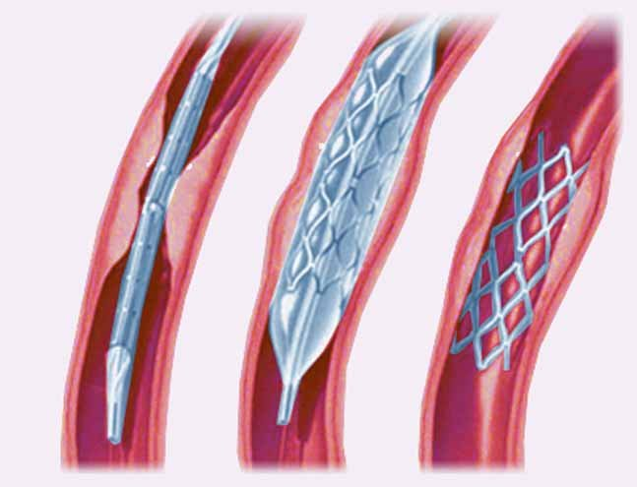
PCI (percutaneous coronary intervention)
Notes:
60
60

Slide 61
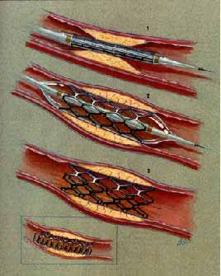
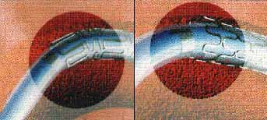

Slide 62
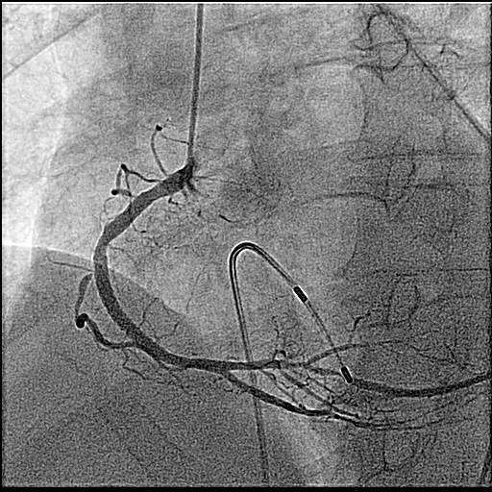
Direct stenting of coronary arteries
TIMI III
stenosis 90%
TIMI III
stenosis 0%
^{stents}
before surgery
after surgery

Slide 63
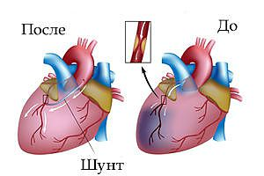
Coronary artery bypass surgery
Notes:
63
63

Slide 64
Prevention of
ANGINA
(primary and secondary)

Slide 65
Risk factors contributing to the occurrence/progression of IHD
1. Heredity (IHD in relatives under 55 years of age in men, under 65 years of age in women).
2. Age: men - over 45 years, women - over 55 years.
3. Arterial hypertension
4. Dyslipidemia (hypercholesterolemia, hypertriglyceridemia).
5. Smoking.
6. Unhealthy diet
7. Overweight
8. Low physical activity
9. Stress.

Slide 66
Risk factors contributing to the occurrence of coronary heart disease
Risk factor | Possibility of correction
1. Heredity | -
2. Age | -
3. Arterial hypertension | +
4. Dyslipidemia | +
5. Smoking | +
6. Unhealthy diet | +
7. Overweight | +
8. Low physical activity | +
9. Stress | ±

Slide 67
CONTRIBUTION OF THE 7 TOP RISK FACTORS
IN PREMATURE MORTALITY (RUSSIA)
%
40
35,5
35
30
25
23
20
17,1
12,9
12,5
15
11,9
9,0
10
5
0
Arterial pressure
Hyper-C
Smoking
Lack of vegetables, fruits in diet
Overweight
Alcohol
Hypodynamia
2
3
4
5
6
7
Global Programme on Evidence for Health Policy; WHO, World health Report, 2012.
Notes:
67
Данные слайда свидетельствуют о вкладе факторов риска в формирование преждевременной смертности населения в России, а соответственно и в формирование СН.
Величина вклада 7 ведущих факторов риска в преждевременную смертность населения нашей страны являются еще одним мощным аргументом в пользу того, что без эффективного управления сердечно-сосудистым риском мы не сможем справиться с бременем сердечно-сосудистой смертности.

Slide 68
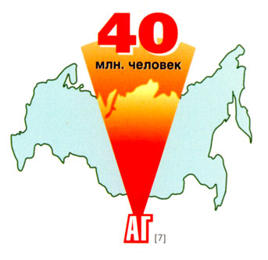
Prevalence of hypertension in Russia
More than 40 million suffer from ARTERIAL HYPERTENSION
С.А.Шальнова, 2007г.

Slide 69
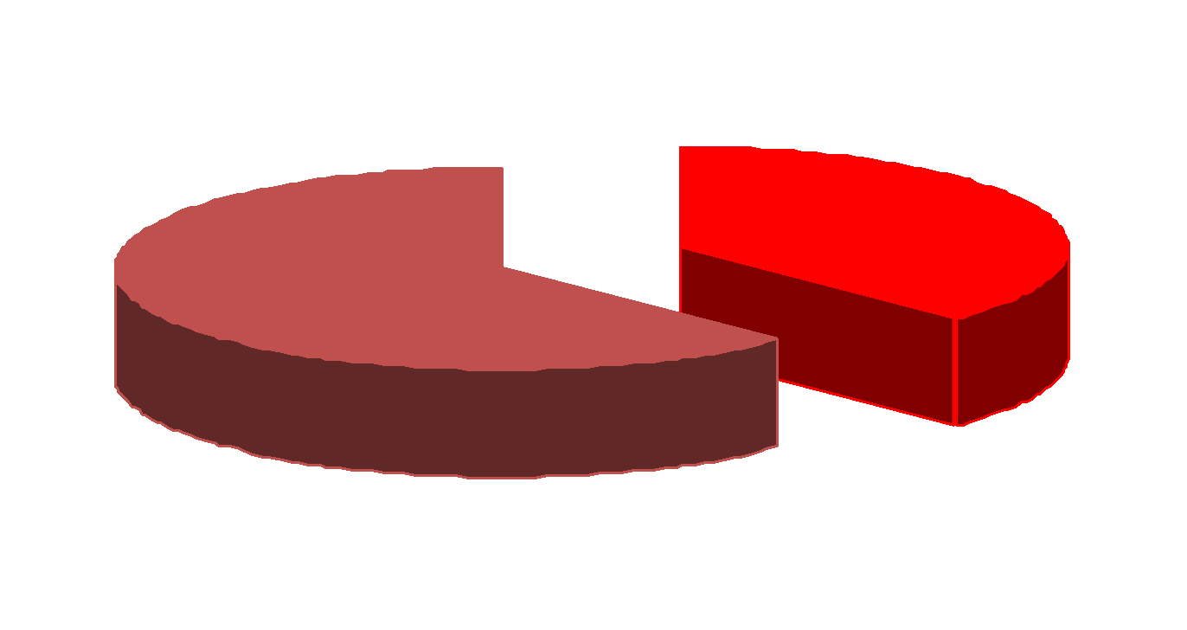
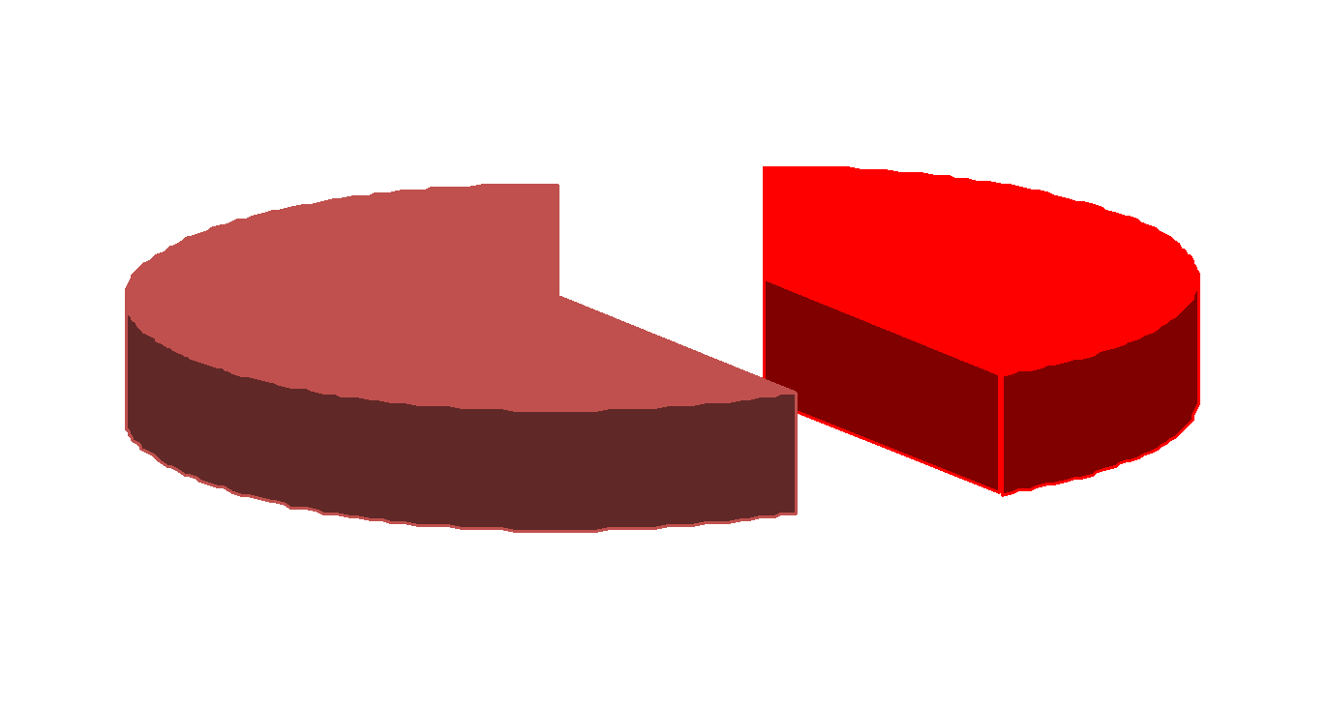
Prevalence of arterial hypertension in Russia
2007
Men Women
36,5%
39,5%
НЦПМ,С.А.Шальнова, 2007

Slide 70
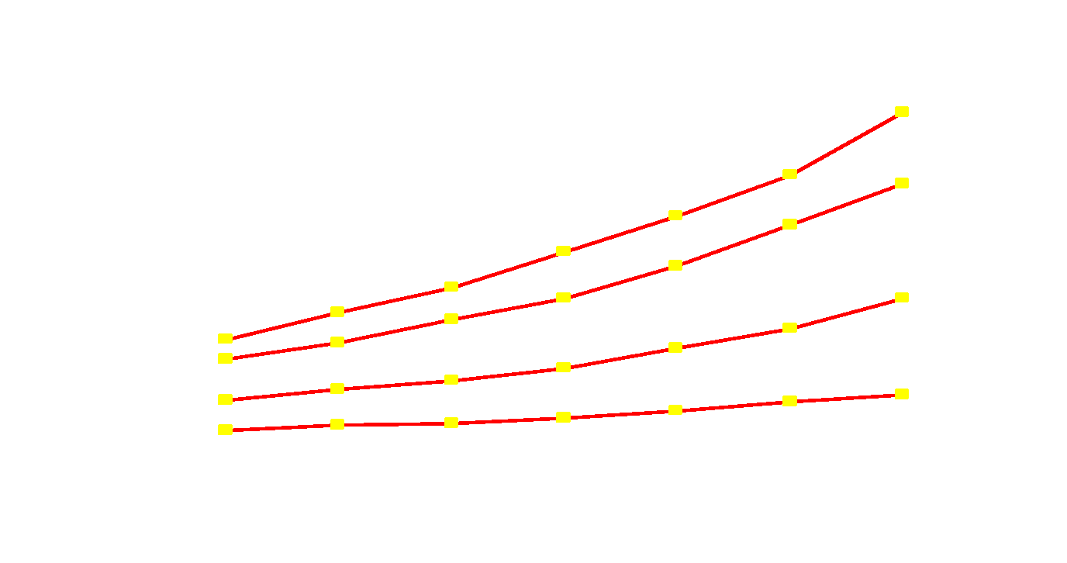
Hypertension is a major risk factor for coronary artery disease
Framingham study (N=5209)
Age (y.o)
70
60
Probability of CVD (1000s)
50
40
Shurtleff D. 1974;US DHEW, Pub no (NIH) 74-599, sec 30; Castelli WP. Am J Med. 1984;76:4-12.
Notes:
70
Large epidemiologic studies illustrate the risk associated with hypertension and elevated TC levels.
The Framingham Heart Study is a large epidemiologic study initiated in 1949 that examined the impact of CV risk factors on CHD in 5209 randomly selected American men and women. At entry, the large majority of patients were free of CVD.
A clear, curvilinear relationship was observed between SBP and subsequent development of CVD.
A strong relationship between TC levels and the rate of CHD was apparent by the sixth year of follow-up in the Framingham study. The incidence of CHD in male subjects aged 30-49 years with TC levels of >7.6 mmol/L (>295 mg/dL) was approximately 6 times that of subjects with TC levels of between 5.3 and 6.0 mmol/L (205-234 mg/dL).
Today’s guidelines for hypertension and lipid management are based largely on data from large epidemiologic trials like the Framingham study. These data have unequivocally shown the benefit of managing these risk factors.

Slide 71
The link between cholesterol levels and mortality
35
North Europe
30
25
USA
Mortality from ischemic heart disease/1000 men
20
15
10
South Europe
Serbia
Mediterranean
5
Japan
0
2.60
3.25
3.90
4.50
5.15
5.80
6.45
7.10
7.75
8.40
9.05
Serum TC (mmol/l)
(Адаптировано из Verschuren et al., 1995)
Notes:
71
Twenty-five year follow-up data from the Seven Countries study¹ show that serum total cholesterol levels are linearly related to CHD mortality across cultures. The relative increase in CHD mortality rates with a given increase in cholesterol are similar. However, the large between-country difference in CHD mortality rates at a given cholesterol level indicates that other factors, such as diet, also play a role in the development of CHD. The link between high cholesterol levels and increased incidence of CHD has also been shown in the prospective part of the Multiple Risk Intervention study.²
In epidemiological studies, measurements of serum cholesterol have been routinely used. The relationship between cholesterol levels and the incidence of CHD is almost entirely dependent on low-density lipoprotein (LDL) cholesterol, the main carrier of cholesterol and a major atherogenic lipoprotein.³
Results from the Framingham study ⁴ during 26 years of observation show that men have twice the incidence of CHD mortality and morbidity of women. This difference tends to diminish during the later years, after the menopause. Other factors that influence susceptibility to CHD include ethnic background and social class. ⁵⁻⁷
References
1. Verschuren WM et al. J Am Med Assoc 1995;274(2):131–6.
2. Martin MJ et al. Lancet 1986;ii:933–6.
3. Kannel WB et al. In Proceeding of Golden Jubilee International Congress, Minnesota, 1980. Eds Loan MS, Holman RT.Oxford, Pergamon Press 1982;339–48.
4. Lerner DJ, Kannel WB. Am Heart J 1986;11(2):383–90.
5. Rosamond WD et al. N Engl J Med 1998;339:861–7.
6. Goff DC et al. Circulation 1997;95:1433–40.
7. Poulter N. In Cardiovascular Disease: Risk Factors and Intervention. Eds: Poulter N, Sever P, Thom S. Radcliffe Medical Press, Oxford, 1993.

Slide 72
Optimal values of lipid parameters (in mmol/l) depending on the risk category
Lipid parameters | Low risk patients | Moderate risk patients | High risk patients | Extremele high risk patients
TC | ≤ 5,0 | ≤ 4,5 | ≤ 4,0 | ≤ 3,5
LDL C* | ≤ 3,0 | ≤ 2,6 | ≤ 1,8 | ≤ 1,4
HDL C** | M >1,0 W >1,2 | М >1,0 W >1,2 | М >1,0 W >1,2 | М >1,0 W >1,2
TG | ≤ 1,7 | ≤ 1,7 | ≤ 1,7 | ≤ 1,7

Slide 73
EUROPEAN CARDIOVASCULAR RISK FACTOR SCORE (SCORE) 1
Women
Age
Men
Non-smoking
Smoking
Non-smoking
Smoking
180
160
140
120
7
8
9
10
12
13
15
17
19
22
14
16
19
22
26
26
30
35
41
47
Risk on the SCORE scale is considered:
Very high if
patient data projections
on the SCORE card it is > 10%;
High - if located
within 5-10% and
Low if <5%.
An estimate of 5% or more requires prevention of life-threatening conditions (myocardial infarction and stroke)
using statins 2
5
5
6
7
8
9
10
12
13
16
65
9
11
13
15
16
18
21
25
29
34
3
3
4
5
6
6
7
8
9
11
6
8
9
11
13
13
15
17
20
24
2
2
3
3
4
4
5
5
6
7
4
5
6
7
9
9
10
12
14
17
180
160
140
120
4
4
5
6
7
8
9
10
11
13
9
11
13
15
18
18
21
24
28
33
3
3
3
4
5
5
6
7
8
9
60
6
7
9
10
12
12
14
17
20
24
2
2
2
3
3
3
4
5
5
6
4
5
6
7
9
8
10
12
14
17
RATE
1
1
2
2
2
2
3
3
4
4
3
3
4
5
6
6
7
8
10
12
180
160
140
120
2
2
3
3
4
4
6
5
6
7
6
7
8
10
12
12
13
15
19
22
15% and higher
10%–14 5%–9%
3%–4%
2%
1%
<1%
1
2
2
2
3
3
3
4
4
5
55
4
5
6
7
8
8
9
11
13
16
1
1
1
1
2
2
2
2
3
3
3
3
4
5
6
5
6
8
9
11
1
1
2
2
2
2
2
3
3
4
4
4
5
6
8
1
1
1
1
1
1
180
160
140
120
1
1
1
2
2
2
2
3
3
4
4
4
5
6
7
7
8
10
12
14
1
1
1
1
1
1
2
2
2
3
50
2
3
3
4
5
5
6
7
8
10
0
1
1
1
1
1
1
1
1
2
2
2
2
3
3
3
4
5
6
7
10-year risk of fatal CVD in a population group
with high CVD risk
0
0
1
1
1
1
1
1
1
1
1
1
2
2
2
2
3
3
4
5
Systolic blood pressure
180
160
140
120
0
0
0
0
0
0
0
0
1
1
1
1
1
2
2
2
2
3
3
4
0
0
0
0
0
0
0
0
0
0
40
1
1
1
1
1
1
2
2
2
3
0
0
0
0
0
0
0
0
0
0
0
1
1
1
1
1
1
1
2
2
0
0
0
0
0
0
0
0
0
0
0
0
1
1
1
1
1
1
1
1
© 2003 ESC
4 5 6 7 8
4 5 6 7 8
4 5 6 7 8
4 5 6 7 8
Холестерин ммоль
200 250 300
Воспроизводится с разрешения
1.De Backer et al. Eur Heart J. 2003;24:1601-1610.
2.Giusepe Mancia et al.2007 Guidelines for the management of arterial hypertension European Heart Journal(2007) 28, 1462-1536
мг/дл
Notes:
73
73
Оценка системного коронарного риска (ОЦЕНКА) составляет таблицу расчета 10-летнего риска летального ССЗ. Отдельные таблицы применяются для стран с высоким риском и низким риском. Таблица высокого риска должна применяться во всех Европейских странах, за исключением тех, которые рассматриваются как регионах низкого риска. Странами низкого риска являются Бельгия, Франция, Греция, Италия, Люксембург, Испания, Швейцария и Португалия. Поскольку таблица предполагает летальный исход СС явления, предельная величина для наличия высокого риска определяется в пределах ≥5%. Таблица может использоваться для того, чтобы дать представление о воздействии изменений от одной категории риска к другой, например, когда человек прекращает курить.^{1, 2}
References
De Backer G, Ambrosioni E, Borch-Johnsen K, et al. European guidelines on cardiovascular disease prevention in clinical practice: Third Joint Task Force of European and other Societies on Cardiovascular Disease Prevention in Clinical Practice (constituted by representatives of eight societies and by invited experts). Eur J Cardiovasc Prev Rehabil. 2003;10(suppl 1):S1-S78.
De Backer G, Ambrosioni E, Borch-Johnsen K, et al, for the Third Joint Task Force of European and Other Societies on Cardiovascular Disease Prevention in Clinical Practice. European guidelines on cardiovascular disease prevention in clinical practice. Eur Heart J. 2003;24:1601-1610.

Slide 74
Principles of healthy eating
1. Energy balance
2. Balanced diet in terms of the content of essential nutrients
3. Low fat with an optimal ratio of saturated and unsaturated fats
4. Reducing salt intake
5. Limiting simple carbohydrates (sugar) in the diet
6. Increased consumption of vegetables and fruits
7. Use whole grains
8. Consumption of alcohol in doses not exceeding safe ones

Slide 75
Overweight
1. Increases the risk of myocardial infarction by 2 times
2. Increases the risk of arterial hypertension by 3 times
3. Increases the risk of diabetes by 9 times (40 times in obese individuals)
4. Reduces life expectancy by an average of 3-5 years (with severe obesity up to 15 years)

Slide 76
Body weight assessment
Body Mass Index BMI = body weight (kg)/height2 (m2)
 | BMI
Underweight | < 18,5
Normal body weight | 18,5-24,9
Overweight | 25,0-29,9
Obesity I degree | 30-34,9
Obesity II degree | 35-39,9
Obesity III degree | > 40

Slide 77
Low physical activity
1. Increases the risk of myocardial infarction by 1.5 - 2 times
2. Increases the risk of diabetes by 1.5 - 3 times
3. Increases the risk of colon cancer by 2.5 – 3.5 times
4. Increases the risk of breast cancer by 1.5 – 2 times

Slide 78
Normal physical activity (PA)
Moderate PA of at least 150 minutes per week (2 hours 30 minutes)
or
75 minutes (1 hour and 15 minutes) of intense aerobic exercise
or
an equivalent combination of moderate and intense PA.
The duration of one aerobic exercise session should be at least 10 minutes
It is desirable that the load be evenly distributed throughout the week.

Slide 79
Daily Physical Activity (PA)
A person should take about 10 thousand steps per day, which is 4–6 km. It is advisable to walk at an average pace or a little faster. This will help burn calories received from food and will help open small blood vessels in the muscles.

Slide 80
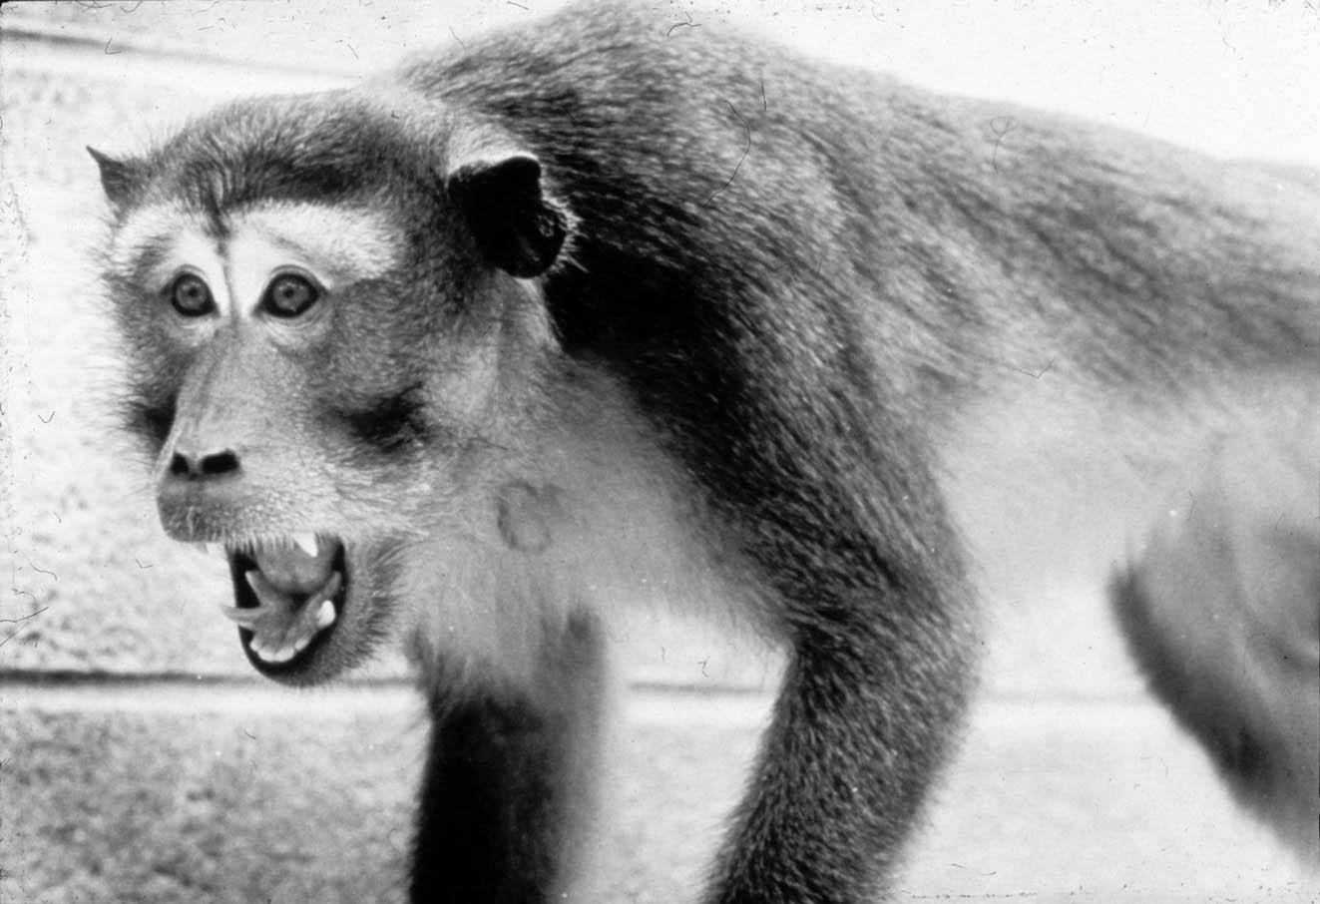
STRESS!!!
"Subordinate"
”LIDER”
Everyone has their own sensitivity to stress
Kaplan et al. Circulation 1987;76:1364-1372
Kaplan & Manuck. Ann N Y Acad Sci 1999; 896: 145-61

Slide 81
Risk factors contributing to the occurrence MI
Risk factor | Possibility of correction
1. Heredity | -
2. Age | -
3. Arterial hypertension | +
4. Dyslipidemia | +
5. Smoking | +
6. Unhealthy diet | +
7. Overweight | +
8. Low physical activity | +
9. Stress | ±

Slide 82
ANGINA PECTORIS (Summary)
Etiology | Atherosclerosis of the coronary arteries
Clinical presentation | Pressing (squeezing, burning) pain behind the sternum (along the chest, in the area of the heart, arising during physical activity, radiating to the left shoulder (arm, left half of the neck...), treated with nitroglycerin (stable angina).
Classification | 1. Angina pectoris (I-IV functional classes). 2. Unstable angina (new, progressive, post-infarction, Prinzmetal)
Diagnostics | Clinic → ECG, CM → Bicycle ergometry → Coronary angiography
Medication treatment | 1. Statins 2. Antiplatelet agents 3. β-blockers 4. ACE inhibitors
Surgical treatment | 1. PTCA (percutaneous transluminal coronary angioplasty) + STENTING. 2. CABG (coronary artery bypass grafting)

Slide 83
QUESTIONS :
Which groups of medications are mandatory for the treatment of a patient with angina pectoris II-IV functional classes?
Surgical methods used to treat angina pectoris

