Slide 1
Prof. V.F. Voino-Yasenetsky KrasSMU, MOH, Russian Federation Department of Faculty Therapy
Acute coronary syndrome
video lecture for the 4st year students,
majoring in the specialty 31.05.01 General Medicine
Doctor of Medical Science,
Professor
Anna Chernova
Krasnoyarsk
2024
Notes:
ПРИ СОЗДАНИИ ПРЕЗЕНТАЦИИ РЕКОМЕНДУЕМ ИСПОЛЬЗОВАТЬ СВЕТЛЫЙ ФОН И КОНТРАСТНЫЙ ЕМУ ПО ЦВЕТУ ТЕКСТ
ДЛЯ СОЗДАНИЯ ТИТУЛЬНОГО СЛАЙДА ИСПОЛЬЗОВАТЬ МАКЕТ «ЗАГОЛОВОК И ОБЪЕКТ»
ШРИФТ ПРЕЗЕНТАЦИИ НА УСМОТРЕНИЕ АВТОРА (на слайде представлен шрифт «Calibri (Заголовки)» и «Calibri (Основной текст)»)
1 – рекомендуемый размер шрифта 20, официальное сокращенное наименование образовательной организации
2 – рекомендуемый размер шрифта 18, название кафедры с заглавной буквы
3 – рекомендуемый размер шрифта 28, заглавные буквы, интервал междустрочный одинарный
4 – рекомендуемый размер шрифта 18, интервал междустрочный одинарный, начало текста с маленькой буквы
5 – с новой строки, перенос после запятой
6 – рекомендуемый размер шрифта 18, интервал междустрочный одинарный, ученое звание (сокращенный вариант) и должность с заглавной буквы, имя, отчество, фамилия с заглавной буквы
7 – рекомендуемый размер шрифта 16, интервал междустрочный одинарный

Slide 2
Plan of lecture
Definition and Epidemiology of Acute Coronary Syndrome (ACS)
Diagnostic criteria for ACS
Pathophysiology of ACS
Clinical types of ACS
Definitions of terms related to invasive strategy and reperfusion therapy
The A.C.S. assessment for the initial evaluation of patients with suspected acute coronary syndrome.
Modes of presentation and pathways to invasive management and myocardial revascularization in patients presenting with STEMI

Slide 3
Purpose and tasks of the lecture:
Purpose of the lecture: to familiarize with the concept, pathophysiological mechanisms, clinical picture, basic diagnostic approaches and therapeutic tactics in Acute Coronary Syndrome
Lecture tasks: 1. Familiarize with the classification of Acute Coronary Syndrome
2. Determine diagnostic tactics for different types of Acute Coronary Syndrome
3. Know dose regimen of antiplatelet and anticoagulant drugs in Acute Coronary Syndrome patients
4. Determine of modes of presentation and pathways to invasive management and myocardial revascularization in patients presenting with STEMI

Slide 4
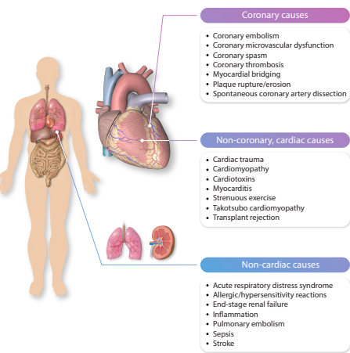

Slide 5
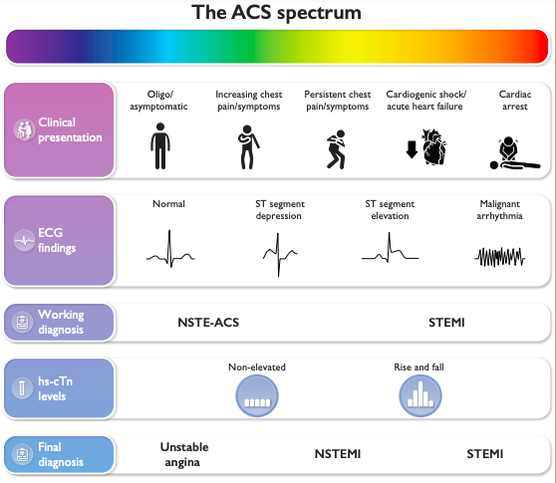

Slide 6
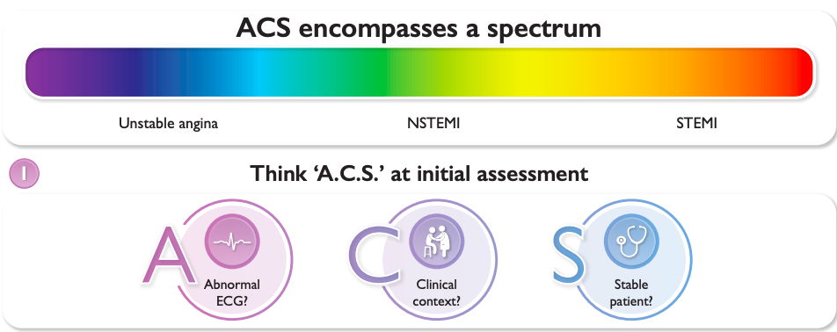

Slide 7
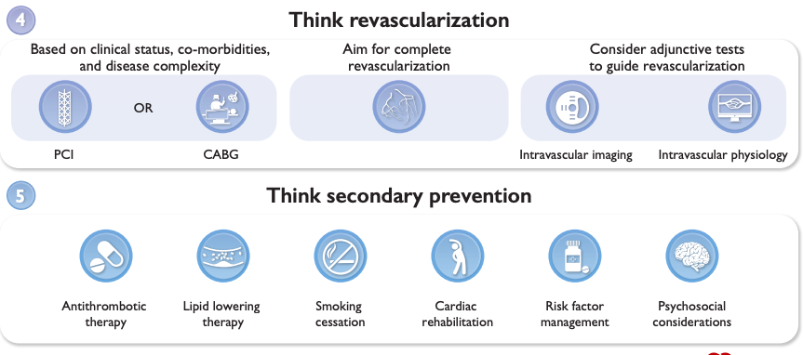

Slide 8
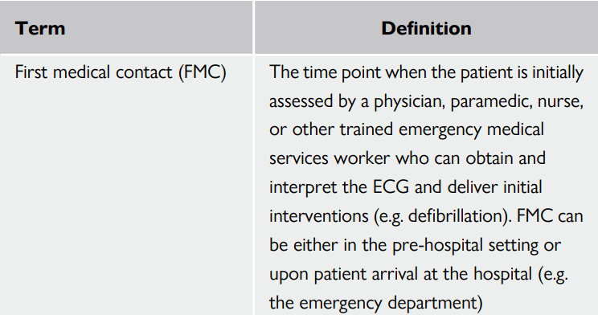
Definitions of terms related to invasive strategy and reperfusion therapy commonly used in this document
ACS, acute coronary syndrome; CABG, coronary artery bypass grafting; ECG, electrocardiogram; IRA, infarct-related artery; PCI, percutaneous coronary intervention; STE-ACS, ST-segment-elevation acute coronary syndrome. a CABG may also be indicated instead of PCI in certain circumstances.

Slide 9
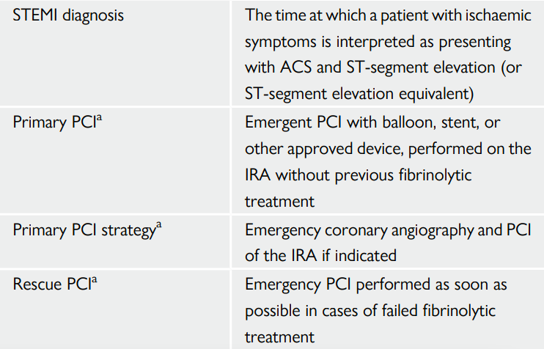
Definitions of terms related to invasive strategy and reperfusion therapy commonly used in this document

Slide 10
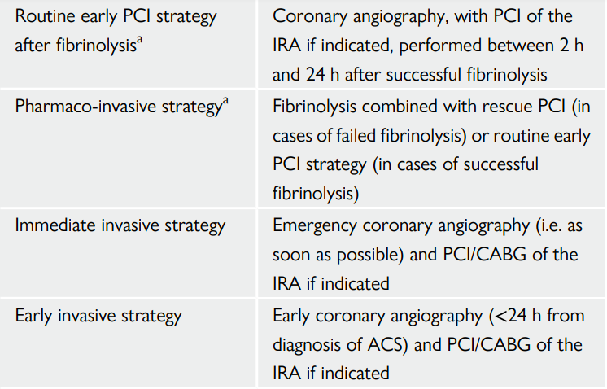
Definitions of terms related to invasive strategy and reperfusion therapy commonly used in this document

Slide 11
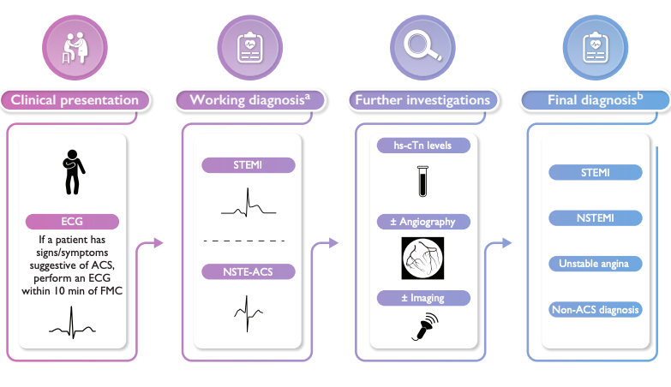
Classification of patients presenting with suspected acute coronary syndrome: from a working to a final diagnosis

Slide 12
Clinical presentation
Acute chest discomfort—which may be described as pain, pressure, tightness, heaviness, or burning—is the leading presenting symptom prompting consideration of the clinical diagnosis of ACS and the initiation of testing aligned with specific diagnostic algorithms
Chest pain descriptors should be classified as cardiac, possibly cardiac, and likely non-cardiac.
The use of the descriptor ‘atypical’ should be avoided. Chest pain-equivalent symptoms include dyspnoea, epigastric pain, and pain in the left or right arm or neck/jaw.

Slide 13
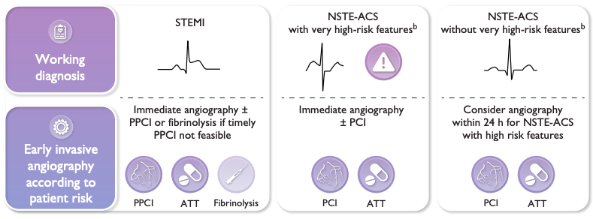
Misdiagnosis or delayed diagnosis is sometimes due to an incomplete history or difficulty in eliciting symptoms from the patient. In order to understand the complexity of ACS-related symptomatology, careful history taking and comprehensive interaction with the patient are crucial and may help to facilitate an early and accurate diagnosis.

Slide 14
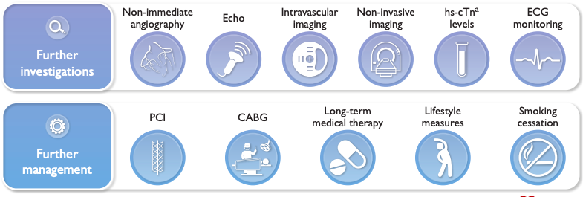
An overview of the initial triage, management and investigation of patients who present with signs and symptoms potentially consistent with acute coronary syndrome.

Slide 15
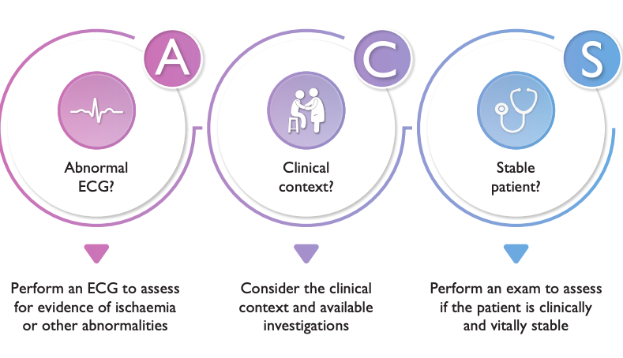
The A.C.S. assessment for the initial evaluation of patients with suspected acute coronary syndrome.
‘C’ stands for ‘Clinical Context?’: it is important to consider the clinical context of the patient’s presentation and the results of any investigations that are available. This should also include a targeted history with the aim of determining the patient’s symptoms and elucidating any other relevant background information. ‘
‘S’ stands for ‘Stable Patient?’: the patient should be quickly assessed to determine if they are clinically stable—this should include assessment of the clinical vital signs, including heart rate, blood pressure, and oxygen saturations, if possible, as well as checking for potential signs of CS.
‘A’ stands for ‘Abnormal ECG?’: an ECG should be performed within 10 min of FMC and assessed for evidence of abnormalities or ischemia.

Slide 16
Electrocardiogram
Patients with acute chest pain (or chest pain-equivalent signs/symptoms) and persistent ST-segment elevation (or ST-segment elevation equivalents) on ECG (working diagnosis: ST-segment elevation MI: STEMI).
Patients with acute chest pain (or chest pain-equivalent signs/symptoms) but without persistent ST-segment elevation (or ST-segment elevation equivalents) on ECG (working diagnosis: non-ST-elevation [NSTE]-ACS).

Slide 17
Acute coronary syndrome with persistent ST-segment elevation (suspected ST-elevation myocardial infarction)
The priority for these patients is the implementation of reperfusion therapy as soon as possible (see Section 5). In the appropriate clinical context, ST-segment elevation (measured at the J-point) is considered suggestive of ongoing coronary artery acute occlusion in the following cases:
New ST elevation at the J-point in at least two contiguous leads:

Slide 18
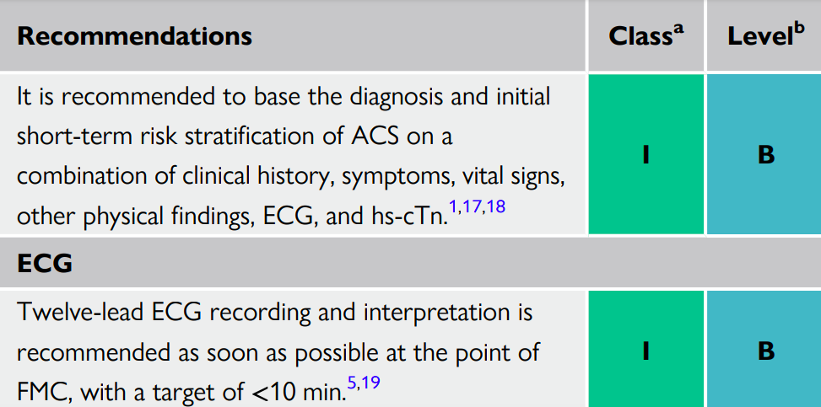
Recommendations for clinical and diagnostic tools for patients with suspected acute coronary syndrome

Slide 19
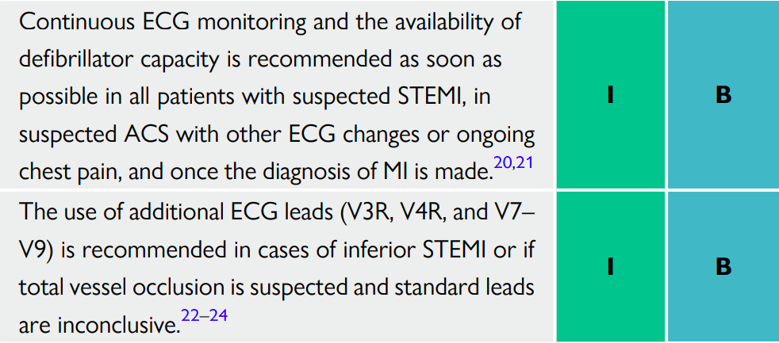
Recommendations for clinical and diagnostic tools for patients with suspected acute coronary syndrome

Slide 20
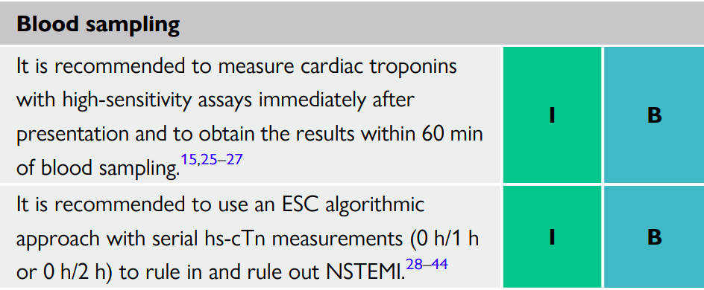
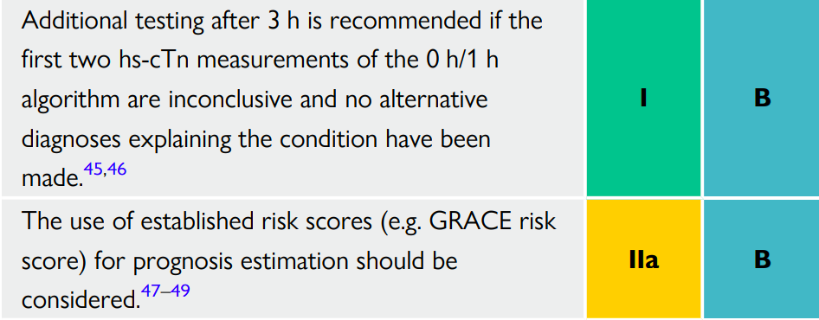

Slide 21
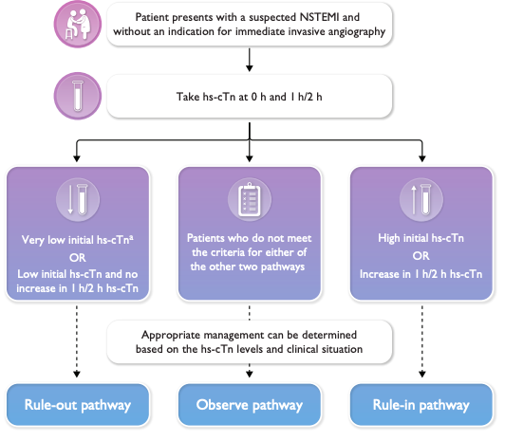
The 0 h/1 h or 0 h/2 h rule-out and rule-in algorithms using high-sensitivity cardiac troponin assays in patients presenting to the emergency department with suspected NSTEMI and without an indication for immediate invasive angiography.

Slide 22
Echocardiography
In emergency rooms and chest pain units, transthoracic echocardiography (TTE) performed or interpreted by trained healthcare professionals should be routinely available. In cases of suspected ACS with diagnostic uncertainty, TTE can be useful to identify signs suggestive of ongoing ischemia or prior MI.
However, this should not result in relevant delays in transfer to the cardiac catheterization laboratory if there is suspicion of an acute coronary artery occlusion. TTE can also be useful to suggest alternative etiologies associated with chest pain (i.e. acute aortic disease, RV signs in pulmonary embolism [PE]).
All patients presenting with CS or hemodynamic instability should undergo emergency TTE to try to identify the underlying cause—in particular, to assess LV and RV function and look for evidence of mechanical complications.

Slide 23
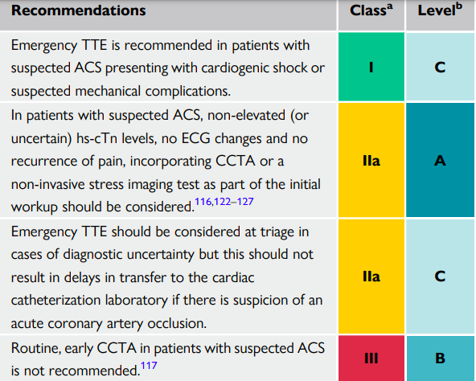
Recommendations for non-invasive imaging in the initial assessment of patients with suspected acute coronary syndrome

Slide 24
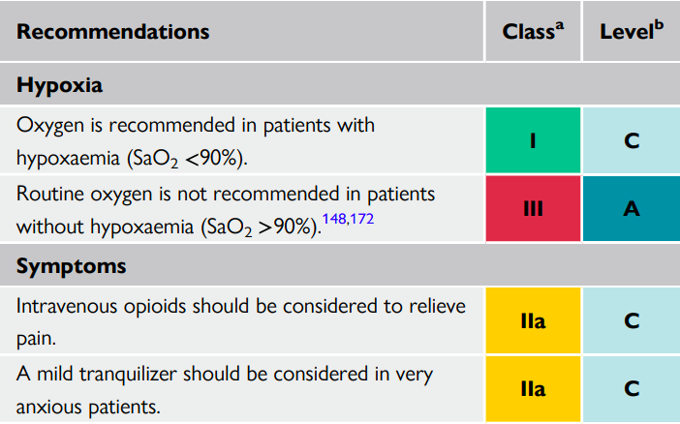
Recommendations for the initial management of patients with acute coronary syndrome

Slide 25
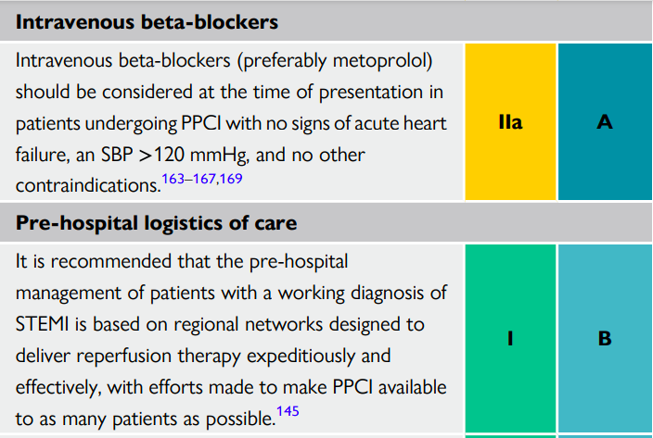
Recommendations for the initial management of patients with acute coronary syndrome

Slide 26
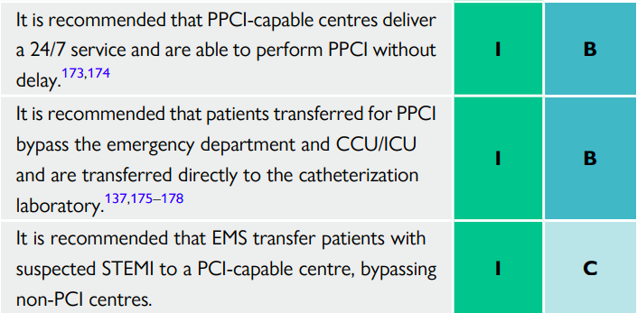
Recommendations for the initial management of patients with acute coronary syndrome

Slide 27
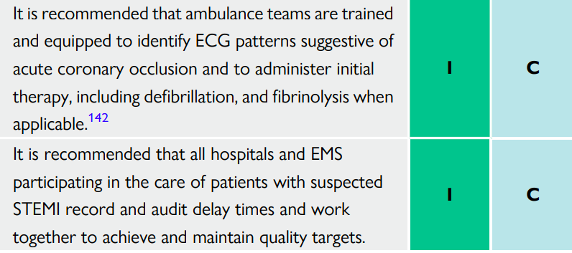
Recommendations for the initial management of patients with acute coronary syndrome
CCU, cardiac care unit; ECG, electrocardiogram; EMS, emergency medical services; ICU, intensive care unit; i.v., intravenous; PPCI, primary percutaneous coronary intervention; SaO2, saturation of oxygen; SBP, systolic blood pressure; STEMI, ST-elevation myocardial infarction.

Slide 28
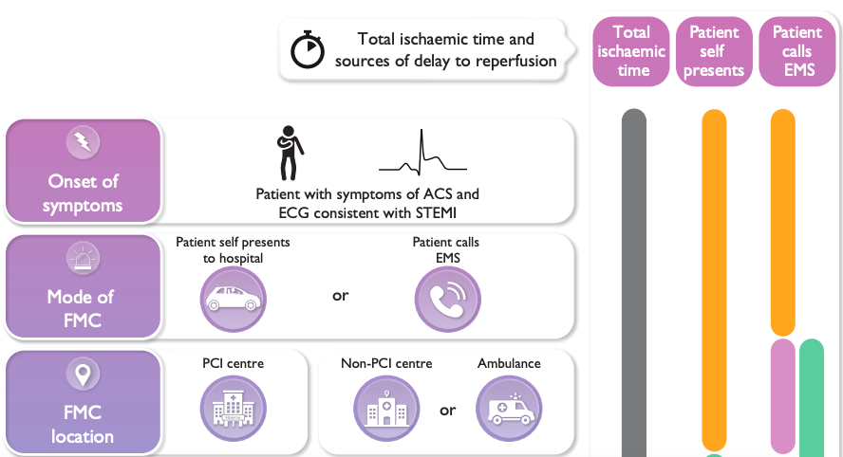
Modes of presentation and pathways to invasive management and myocardial revascularization in patients presenting with STEMI

Slide 29
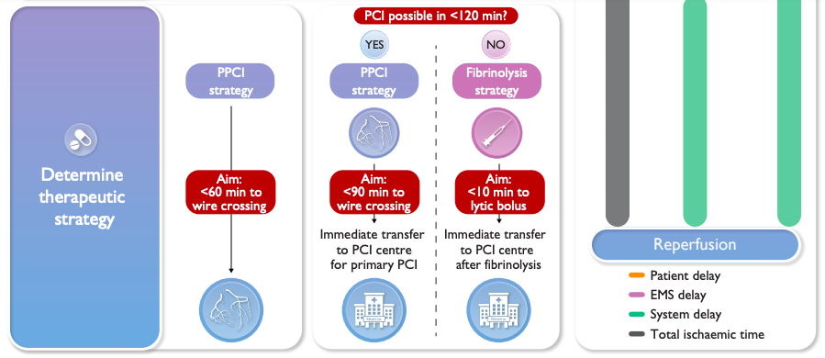
Modes of presentation and pathways to invasive management and myocardial revascularization in patients presenting with STEMI
ECG, electrocardiogram; EMS, emergency medical services; FMC, first medical contact; PCI, percutaneous coronary intervention; PPCI, primary percutaneous coronary intervention; STEMI, ST-segment elevation myocardial infarction.

Slide 30
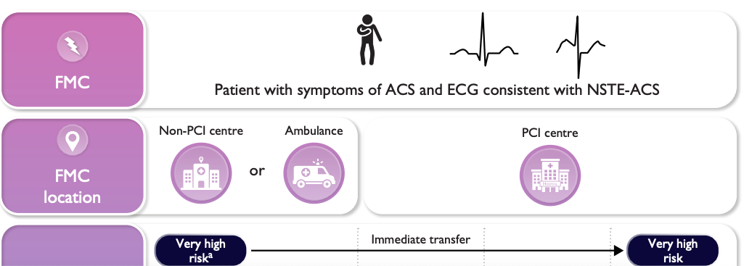
Modes of presentation and pathways to invasive management and myocardial revascularization in patients presenting with STEMI
In patients with a working diagnosis of STEMI, a PPCI strategy (i.e. immediate angiography and PCI as needed) is the preferred reperfusion strategy, provided it can be performed in a timely manner (i.e. within 120 min of the ECG-based diagnosis

Slide 31
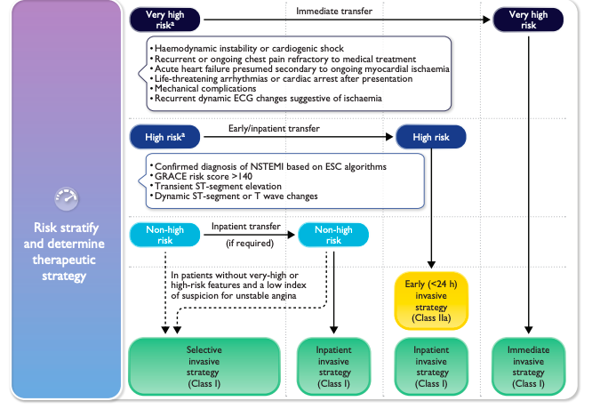
Modes of presentation and pathways to invasive management and myocardial revascularization in patients presenting with STEMI

Slide 32
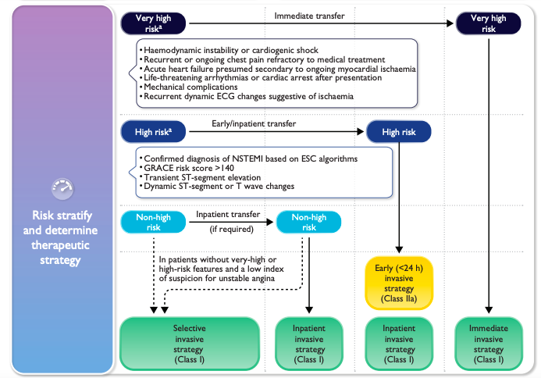
Selection of invasive strategy and reperfusion therapy in patients presenting with NSTE-ACS

Slide 33
Recommendations for reperfusion therapy and timing of invasive strategy

Slide 34
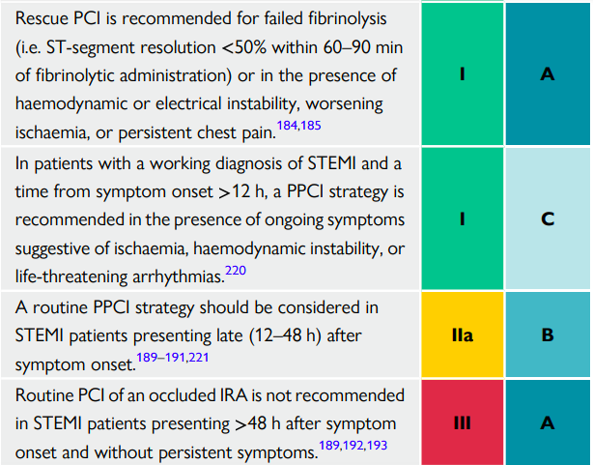
Recommendations for reperfusion therapy and timing of invasive strategy

Slide 35
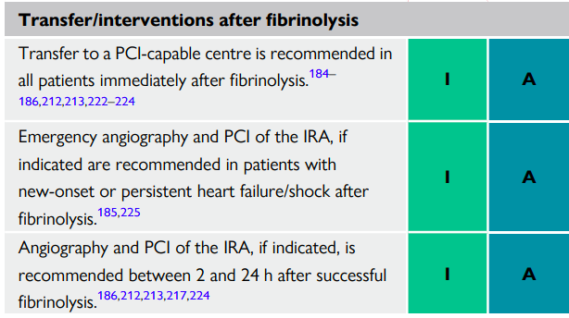
Recommendations for reperfusion therapy and timing of invasive strategy

Slide 37
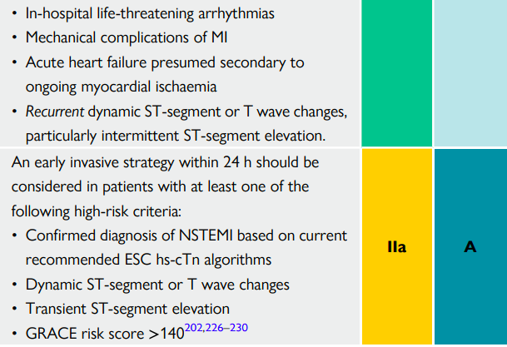

Slide 38
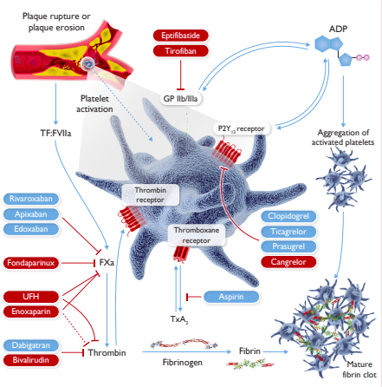
Antithrombotic treatments in acute coronary syndrome: pharmacological targets

Slide 39
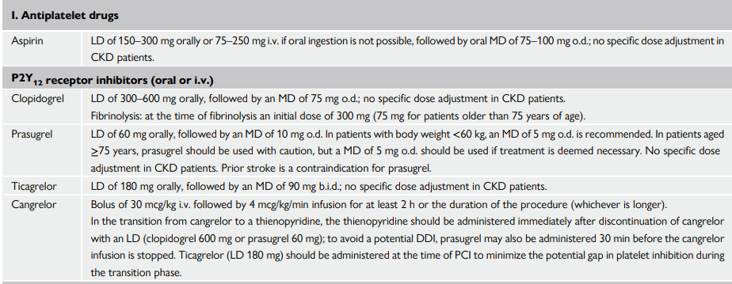
Dose regimen of antiplatelet and anticoagulant drugs in acute coronary syndrome patients (1)
ACS, acute coronary syndrome; ACT, activated clotting time; aPPT, activated partial thromboplastin time; b.i.d., bis in die (twice a day); CKD, chronic kidney disease; CrCl, creatinine clearance; DDI, drug–drug interactions; ICH, intracranial hemorrhage; i.v. intravenous; LD, loading dose; MD, maintenance dose; o.d., once a day; PPCI, primary percutaneous coronary intervention; s.c. subcutaneous; UFH, unfractionated heparin.

Slide 40
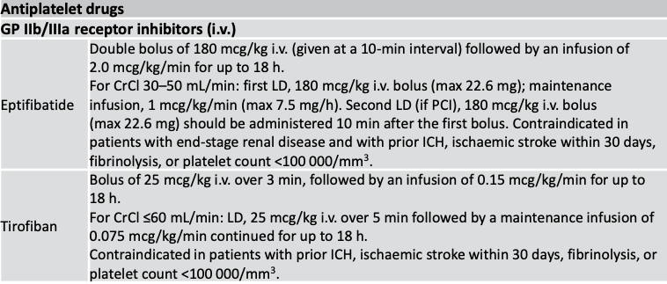
Dose regimen of antiplatelet and anticoagulant drugs in acute coronary syndrome patients (3)

Slide 41
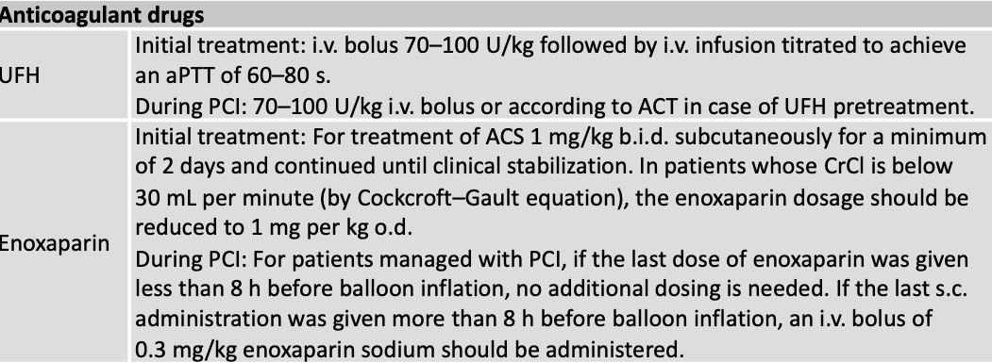
Dose regimen of antiplatelet and anticoagulant drugs in acute coronary syndrome patients (4)

Slide 42
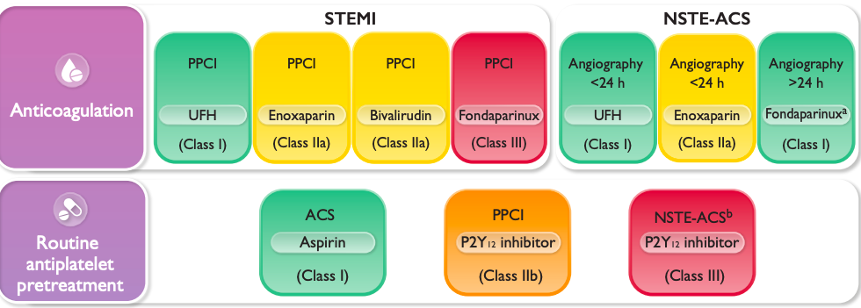
Recommended default antithrombotic therapy regimens in acute coronary syndrome patients without an indication for oral anticoagulation

Slide 43
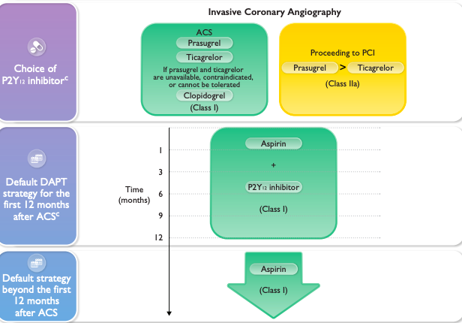
Recommended default antithrombotic therapy regimens in acute coronary syndrome patients without an indication for oral anticoagulation

Slide 44
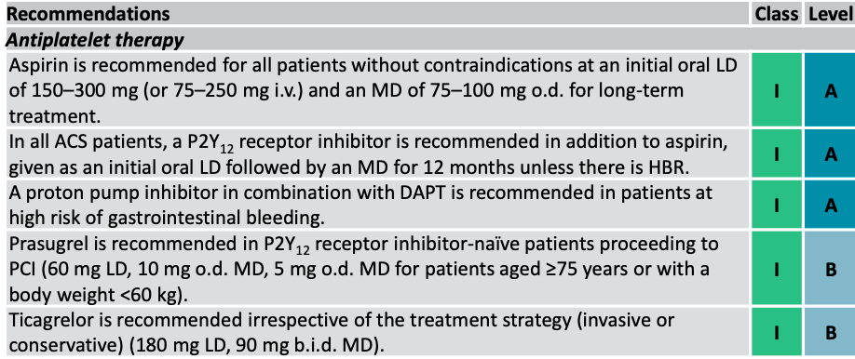
Recommendations for antiplatelet and anticoagulant therapy in acute coronary syndrome (1)

Slide 45
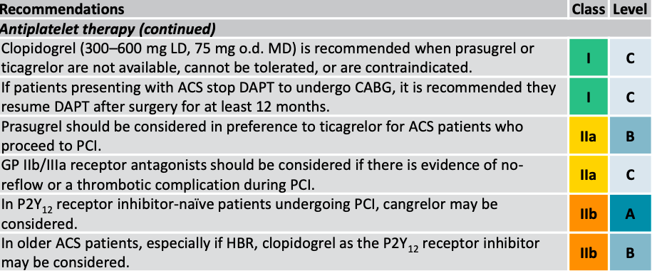
Recommendations for antiplatelet and anticoagulant therapy in acute coronary syndrome (2)

Slide 46
Recommendations for antiplatelet and anticoagulant therapy in acute coronary syndrome (3)

Slide 47
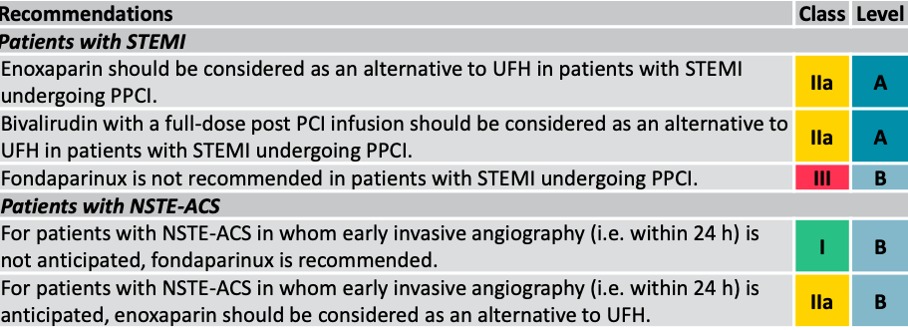
Recommendations for antiplatelet and anticoagulant therapy in acute coronary syndrome (4)

Slide 48
Recommendations for antiplatelet and anticoagulant therapy in acute coronary syndrome (5)

Slide 49
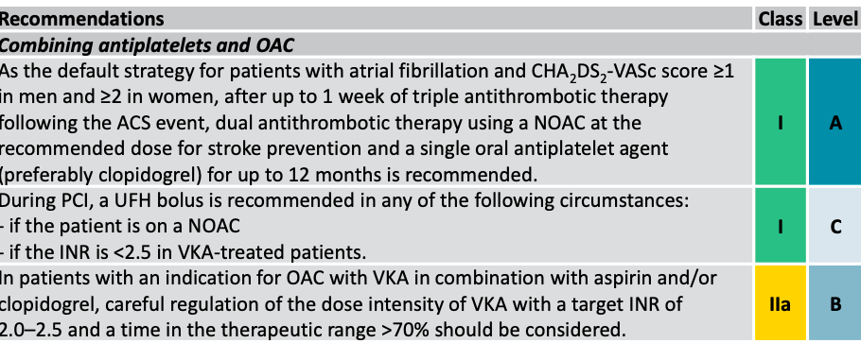
Recommendations for antiplatelet and anticoagulant therapy in acute coronary syndrome (6)

Slide 50
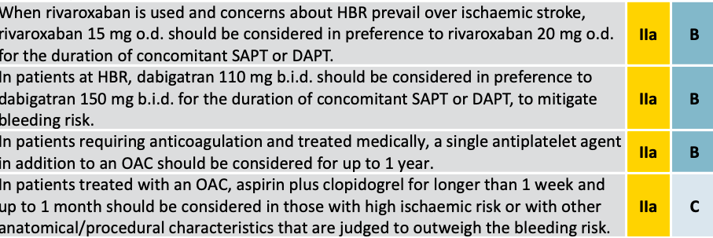
Recommendations for antiplatelet and anticoagulant therapy in acute coronary syndrome (7)

Slide 51
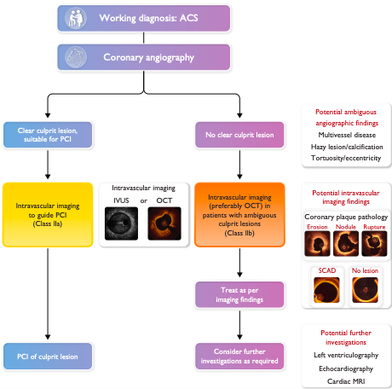
A practical algorithm to guide intravascular imaging in acute coronary syndrome patients
ACS, acute coronary syndrome; IVUS, intravascular ultrasound; MRI, magnetic resonance imaging; OCT, optical coherence tomography; PCI, percutaneous coronary intervention; SCAD, spontaneous coronary artery dissection

Slide 52
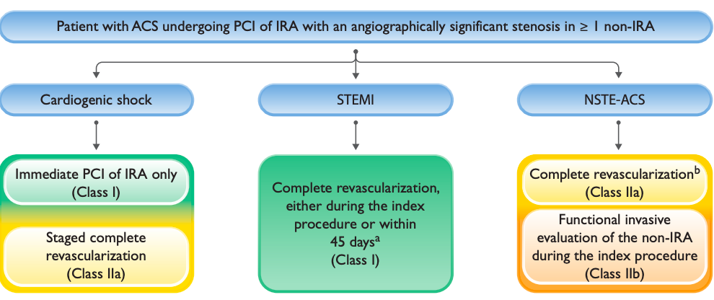
Algorithm for the management of acute coronary syndrome patients with multivessel coronary artery disease
CABG, coronary artery bypass grafting; IRA, infarct-related artery; MVD, multivessel disease; NSTE-ACS, non-ST-elevation acute coronary syndrome; PCI, percutaneous coronary intervention; STEMI, ST-elevation myocardial infarction; TIMI, Thrombolysis In Myocardial Infarction.a In patients presenting with STEMI and MVD without CS, complete revascularization either during the index PCI procedure or within 45 days, with PCI of non-IRA based on angiographic severity, is recommended. b In patients presenting with NSTE-ACS and MVD, complete revascularization, preferably during the index procedure should be considered. Functional invasive evaluation of non-IRA severity during the index procedure may be considered.

Slide 53
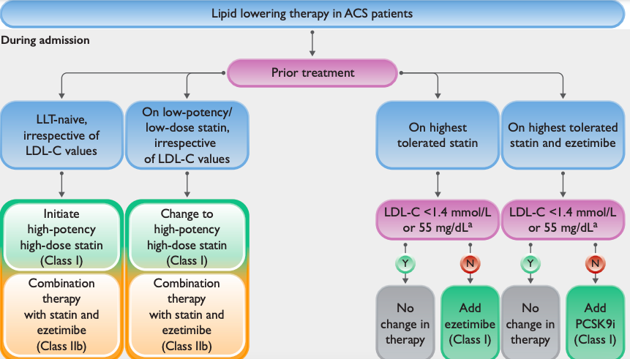
Lipid-lowering therapy in ACS patients

Slide 54
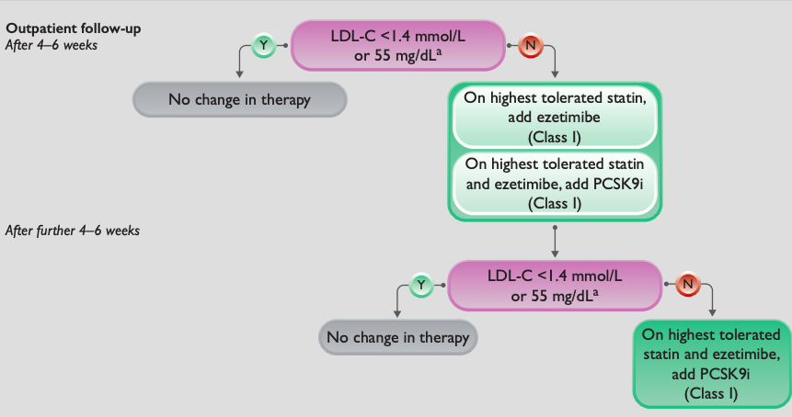
Lipid-lowering therapy in ACS patients
ACS, acute coronary syndrome; LDL-C, low-density lipoprotein cholesterol; LLT, lipid-lowering therapy; PCSK9i, proprotein convertase subtilisin/kexin type 9 inhibitor. a Consider LDL-C

Slide 55
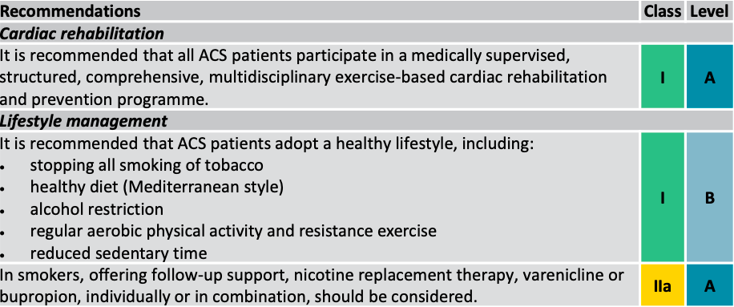
Recommendations for long-term management

Slide 56
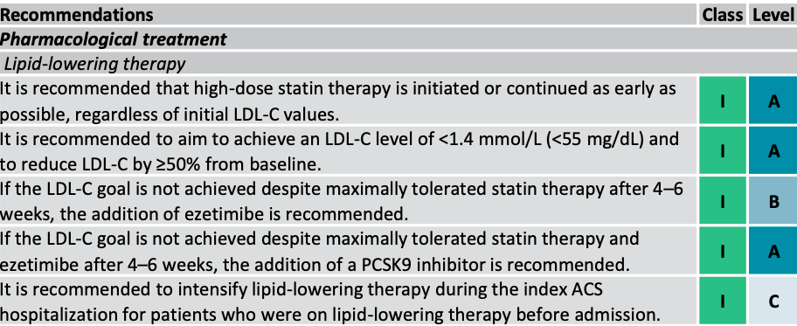
Recommendations for long-term management (1)

Slide 57
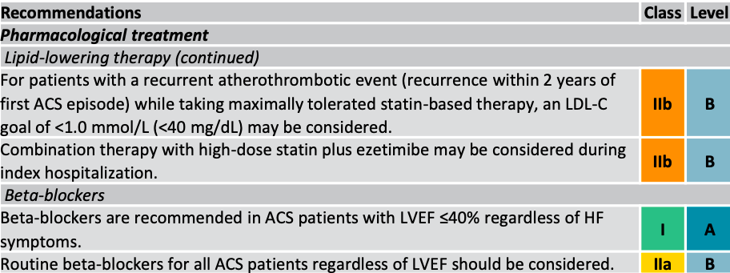
Recommendations for long-term management (2)

Slide 58
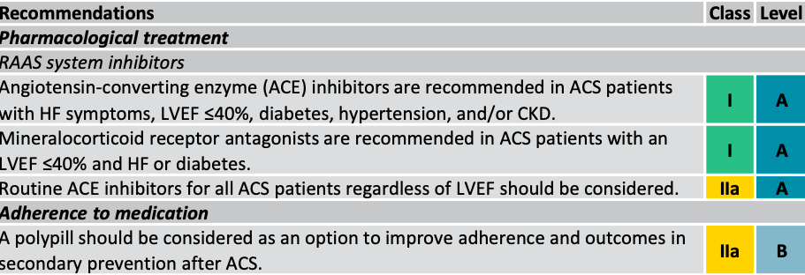
Recommendations for long-term management (3)

Slide 59
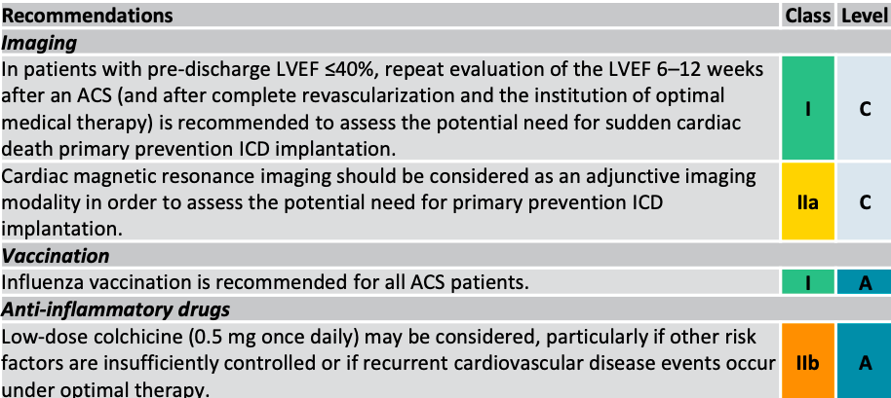
Recommendations for long-term management (4)

Slide 60
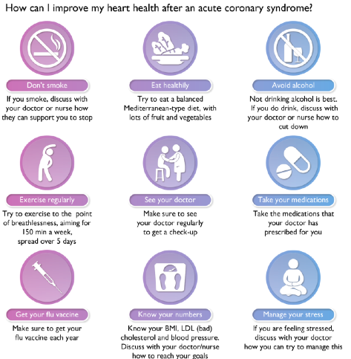

Slide 61
Recommended reading
1. Internal medicine : textbook : in 2 vols. / edited by V.S. Moiseeva, A.I. Martynova, N.A. Mukhina. – 3rd ed., rev. and suppl. - M. : GEOTAR-Media, 2013. - V. 1. - 960 p. : il. Gl. 2.
2. Internal medicine : textbook. - 6 ed., rev.and suppl. / Makolkin V.I., Ovchaenko S.I., Sulimov V.A. - M. : GEOTAR-Media, 2015. - 768 p.: il. Gl. 2. Electronic library reference guide “Student's Consultant”
3. Cardiology [Electronic source] : national guidance / edited by E.V. Shliakhto – 2nd ed., rev. and suppl. - M. : GEOTAR-Media, 2015. - http://www.rosmedlib.ru/book/ISBN9785970428450.html Ch.17. Electronic medical library "Doctor's Consultant“
4. Clinical guidelines for cardiology / edited by F.I. Belialov. – 8th ed., rev. and suppl. - M. : GEOTAR-Media, 2017. - 288 p. : il. - Library of the specialist physician. Cardiology).
5. Acute coronary syndrome, renal dysfunction and multifocal atherosclerosis: common pathogenetic mechanisms and current aspects of the problem / O.L. Barbarash, M.V. Zykov, V.V. Kashtalap [et al].- Kemerovo : Kuzbassvuzizdat, 2016. - 227 p.
6. Ruksin V.V. Emergency outpatient cardiology : a brief manual. / V.V. Ruksin. – 2nd ed.. - M. : GEOTAR-Media, 2016. - 256 p. : il.

Slide 62
Thank you for your attention!

