Slide 1
Raspberries and their medicinal properties
Выполнил: Студент 101гр,Фарм.

Slide 2
HEALTH
Improves brain function. Lowers your blood sugar. Protects the heart.

Slide 3
HEALTH
Helps to Lose Weight.
It fights with arthritis. Protects the skin from aging.

Slide 4
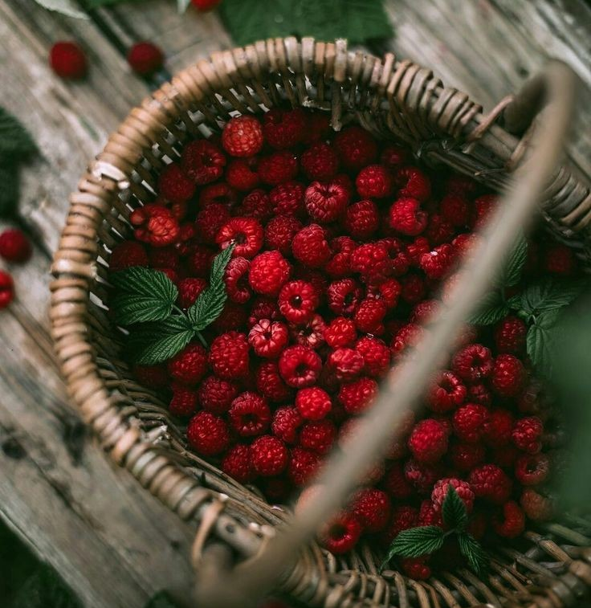
CONCLUSION
Malina contains many useful substances and vitamins. Berries, leaves and raspberry flowers are used for medicinal purposes. In folk medicine, fruits and leaves are used for colds, influenza, as a antipyretic.

