Slide 1
Prof. V.F. Voino-Yasenetsky Krasnoyarsk State Medical University
Topic: Digestion of proteins. Amino acid metabolism at the carboxyl group.
Lecture No. 9 on the discipline "biochemistry" for 2nd year students
Lecturer: Panina Yu.A.
Authors: Panina Yu.A., Malinovskaya N.A.
Krasnoyarsk, 2022

Slide 2
Lecture plan
Relevance of the topic.
Structure, function and physicochemical properties of amino acids, peptides and proteins.
Digestion of proteins in the gastrointestinal tract.
Regulation of the secretion of digestive juices.
Absorption of protein digestion products.
Disorders of protein digestion and absorption.
Sources of amino acids and ways of using them.
Amino acid exchange at the carboxyl group. Decarboxylation of amino acids.
Conclusion

Slide 3
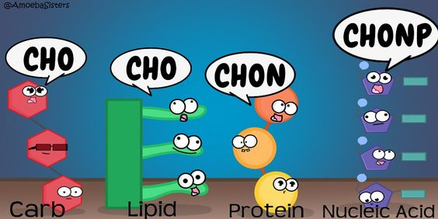

Slide 4
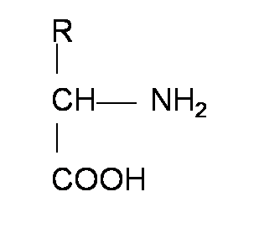
Amino acid structure
R-group
Amino-group
Carboxyl group

Slide 5
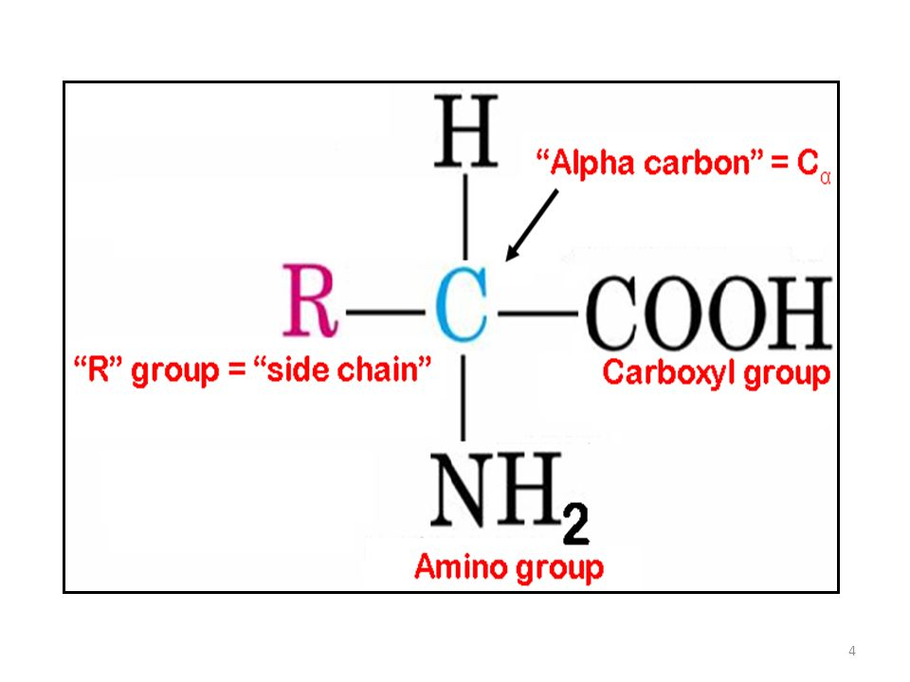
DEFINITION. GENERAL FORMULA
AMINO ACIDS (aminocarboxylic acids) are organic heterofunctional compounds, the molecule of which simultaneously contains carboxyl and amine groups.
Amino acids can be regarded as derivatives of carboxylic acids in which one or more hydrogen atoms are replaced by amino groups.

Slide 6
Functions and biomedical significance of amino acids
PLASTIC (structural, construction)
The composition of proteins includes 20 amino acids (protein), the composition of peptides
Structural elements of other natural compounds (coenzymes, bile acids, biologically active substances)
Part of phospholipids (serine)
REGULATORY
Signal carriers: some of the amino acids are neurotransmitters (glycine, glutamate) or precursors of neurotransmitters, mediators, or hormones (tyrosine, tryptophan)
ligands, metabolism regulators
METABOLITES
the most important (and some are vital) nutritional components
participation in metabolism (for example, serve as a donor of nitrogen, methyl groups, etc.)
Used for the synthesis of purine, pyrimidine nitrogenous bases (asp, glu, gly)

Slide 7
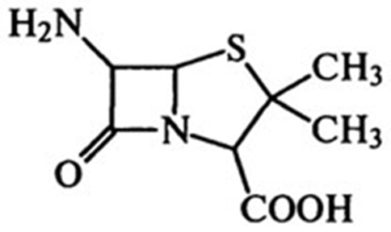
Functions and biomedical significance of amino acids
SPECIFIC FUNCTIONS
inherent only to some amino acids
tryptophan is used to form vitamin PP (HAD⁺ AND NADP)
MEDICAL VALUE
Antibiotics - derivatives of AA (cycloserine, b-lactams, penicillins)
Glycine is an inhibitory neurotransmitter
Cysteine - cataract prevention
Methionine, histidine - prevention and treatment of liver diseases
Preparations for parenteral nutrition (aminosol, aminosteril)
ENERGY
During fasting, they can perform energy functions (free AA and AA from reserve proteins)
penicillin

Slide 8
Classification of amino acids by radical
Protein amino acids
Hydrophobic radical (8 amino acids)
Ala, etc.
Hydrophilic radical (12 amino acids)
Hydrophilic polar uncharged
(7 AA) Glycine, gln, ser, cis, etc.
Hydrophilic polar negatively charged (2 AA) Glu and asp
Hydrophilic polar positively charged (3 AA) His, arg and lys

Slide 9
By the ability of synthesis in the body
Essential | Conditionally nonessential | Partially nonessential | Nonessential
Tryptophan Phenylalanine Lysine Threonine Methionine Leucine Isoleucine Valine | Tyrosine Cysteine | Histidine Arginine | Glycine Alanin Serine Glutamate Glutamine Aspartate Asparagine Proline
their presence in food proteins is obligatory | synthesized in small amounts in the body | essential amino acids are needed for their synthesis in the body | the need for them can be met by synthesis from other substances

Slide 11
Proteinogenic amino acids
glycine
alanine
valine
leucine
isoleucine
serine
threonine
aspartate
asparagine
glutamate
glutamine
lysine

Slide 12
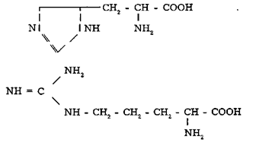
Proteinogenic amino acids
arginine
oxylysine
histidine
cysteine
proline
methionine
phenylalanine
tyrosine
tryptophan
hydroxyproline
proteinogenic imino acids
cystine

Slide 14
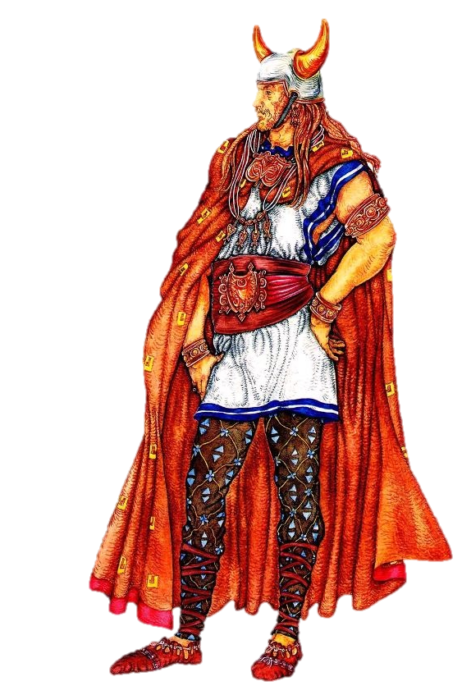
Biochemical memos
BASIC Amino Acids:
G - glycine
A - arginine
L - lysine
L
http://www.jaypeedigital.com/Chapter/IndexXML?Chapid=71709&sno=1&ChapNo=84012&isbn=9789351523925&N=-1&B=-1

Slide 15
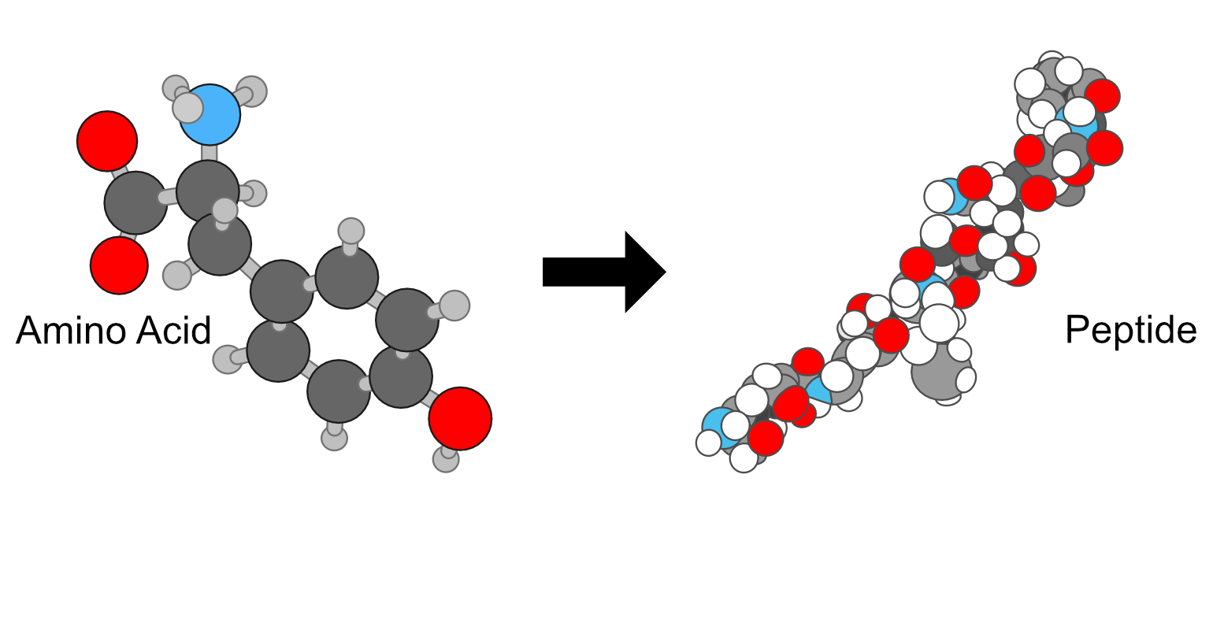
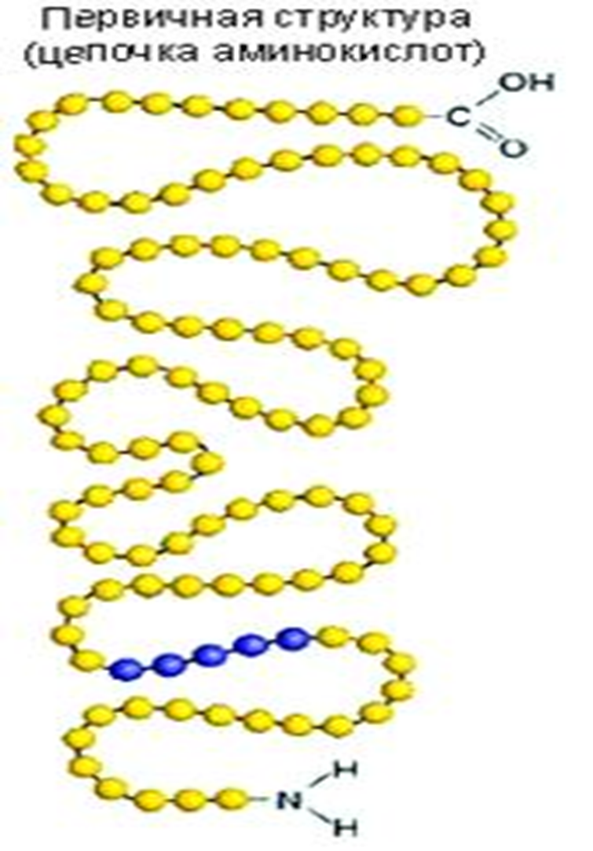
Peptides

Slide 16
CLASSIFICATION OF PEPTIDES
1. Oligopeptides - a chain containing from 2 to 10 (20) amino acid residues linked by a peptide bond
2. Polypeptides - a chain containing from 10 (20) to 50 (100) amino acid residues linked by a peptide bond
3. Proteins - a polypeptide containing more than 50 (100) amino acid residues (M> 5-10 thousand)

Slide 17
Functions of peptides
PROTECTIVE
Thymus hormones (thymosin - active participation in the formation of the immune system until reaching 15 years of age; thymopoietin - hormone-immunomodulator; thymulin - maturation, etc.)
Tuftsin (tetrapeptide tre-lys-pro-arg) - phagocytosis stimulator
Defensin- cationic peptides of the immune system, active against bacteria, fungi and many enveloped and non-enveloped viruses
REGULATORY
Hormones (in particular neurohormones) - oxytocin, vasopressin, liberins, statins, tropins
Ligands, regulators and biologically active substances, connectors, neurotransmitters, neuromodulators, endogenous opiates: endorphins and enkephalins, neuropeptide K, substance P, neurokinins A and B, vasoactive peptides (synthesized from food proteins, affect the digestion of food in the gastrointestinal tract and regulate vascular tone) etc.
SPECIFIC FUNCTIONS
Transition metal chelating agents (carnosine and anserine)
Cytosolic and cellular pH buffers (in animal and human muscles - carnosine)
Antioxidants / Protective Peptides (Glutathione, Carnosine)
Transport (ionophores - poisons, toxins, antibiotics)

Slide 18
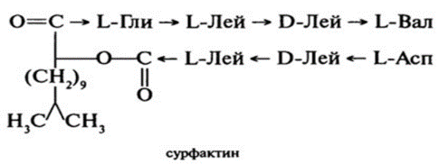
Biomedical significance of peptides
TOXINS AND POISONS
Poisons of animals (apitoxin of bees, venoms of snakes, scorpions, frogs, molluscs, jellyfish, tetrodotoxin of puffer fish, etc.), plants, fungi (poison of the pale toadstool, glycoproteins of plants, etc.)
Poisons and toxins of microorganisms (enterotoxins of Staphylococcus aureus, salmonella)
OTHER
Flavor peptides (aspartame - sugar substitute)
Preparations for parenteral nutrition (casein hydrolyzate, fibrinosol, cerebrolysin - mixtures of AA and peptides)
ANTIBIOTICS AND ANTIBACTERIAL DRUGS
Cyclosporin A
Gramicidin C, S
Surfactin
Epidermin

Slide 19
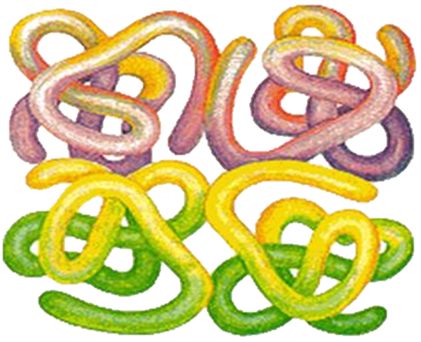
Proteins

Slide 20
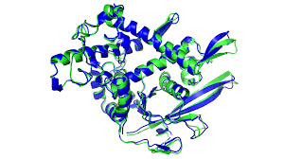
DEFINITION
Protein molecules are linear polymers consisting of α-amino acids (over 50).
When a protein is formed, peptide bonds are formed as a result of the interaction of the α-amino group (-NH2) of one amino acid with the α-carboxyl group (-COOH) of another amino acid.

Slide 23
Protein functions
PLASTIC (structural, construction)
Participation in the construction of cell membranes (integral, surface and immersed membrane proteins), all tissues and organs
Motor (supporting and contractile) function - proteins of muscles, connective tissue (actin and myosin, collagen, keratin, elastin, etc.), cytoskeleton, cilia, flagella, etc.
REGULATORY (hormonal, signaling and receptor functions)
Hormones (insulin, parathyroid hormone, etc.)
Receptors (proteins of the CD differentiation cluster), ligands (ligand proteins), participants in signaling pathways and cascades (protein kinases), etc.
ENZYMATIVE (catalysis of all reactions in a living cell)
Gastrointestinal enzymes (proteases, lipases, glycosidases, nucleases)
Intracellular enzymes (lysosomes, mitochondria, EPR, proteasomes, etc.)
Extracellular enzymes (matrix proteinases)
Blood plasma enzymes (plasma and organ specific)

Slide 24
Protein functions
SPECIFIC FUNCTIONS
Transport (plasma proteins - hemoglobin, albumin, transferrin, LP; transporter proteins of membranes and ion channels)
Oncotic and colloid-osmotic pressure of blood plasma (albumins), buffer systems
Cogenetic (together with NC participate in the storage and transmission of hereditary information)
Proteins with antifreeze properties - keep the blood from freezing (in Antarctic fish)
NUTRITIONAL (reserve, storage) and ENERGY
Proteins - sources of amino acids (reserve proteins, ovalbumin, milk caseins, wheat gliadin)
During fasting, they can also perform an energy function (when 1 g of proteins are burned, 16.8 kJ of energy is formed)
PROTECTIVE (immune)
Antibodies
Mechanical protection of mucous membranes and skin (collagen, proteoglycans)
Coagulation / fibrinolytic system proteins, complement
Group and Rh-affiliation of blood
Histocompatibility antigens (HLA antigens)

Slide 25
Biomedical significance of peptides and proteins
ANTIBIOTICS, TOXINS, POISONS
Snake venoms (viper phospholipase enzyme, asp neurotoxins, etc.)
Plant toxins (protein toxin ricin castor oil plant)
Microorganism toxins (diphtheria, cholera toxin, botulinum toxin)
Antibiotics (high molecular weight glycopeptide vancomycin)
OTHER MEDICAL SIGNIFICANCE
Enzymodiagnostics, enzyme therapy
Antihypertensive drugs (angiotensin converting enzyme inhibitors - captopril, enalapril, lisinopril)
Preparations for parenteral nutrition and replacement of protein losses (albumin)
Immunomodulators (thymogen) and hormone analogs (oxytocin, ocreotide, desmopressin, human insulin, glucagon, etc.)
Enzyme inhibitors (cholinesterase inhibitors, monoamine oxidase inhibitors, protease inhibitors, etc.)

Slide 28
CLASSES OF CONJUGATED PROTEINS
Glycoproteins
contain carbohydrate residues
covalent bonds (O- or N-glycosidic)
Lipoproteins
contain lipids
non-covalent bonds (hydrophobic and electrostatic interactions)
Nucleoproteins
contain nucleic acids (DNA or RNA)
non-covalent bonds (hydrogen; hydrophobic and electrostatic interactions)

Slide 29
CLASSES OF CONJUGATED PROTEINS
Phosphoproteins
contain phosphoric acid residues
covalent bond (ester)
Metalloproteids
contain metal ions (Mg, Ca, Mn, Fe, Co, Cu, V, Zn and Mo) - metal enzymes (tightly bound) and transport proteins (loosely bound)
coordination, covalent; non-covalent bonds
Chromoproteins
contain colored groups of various chemical nature
coordination, covalent; non-covalent bonds

Slide 30
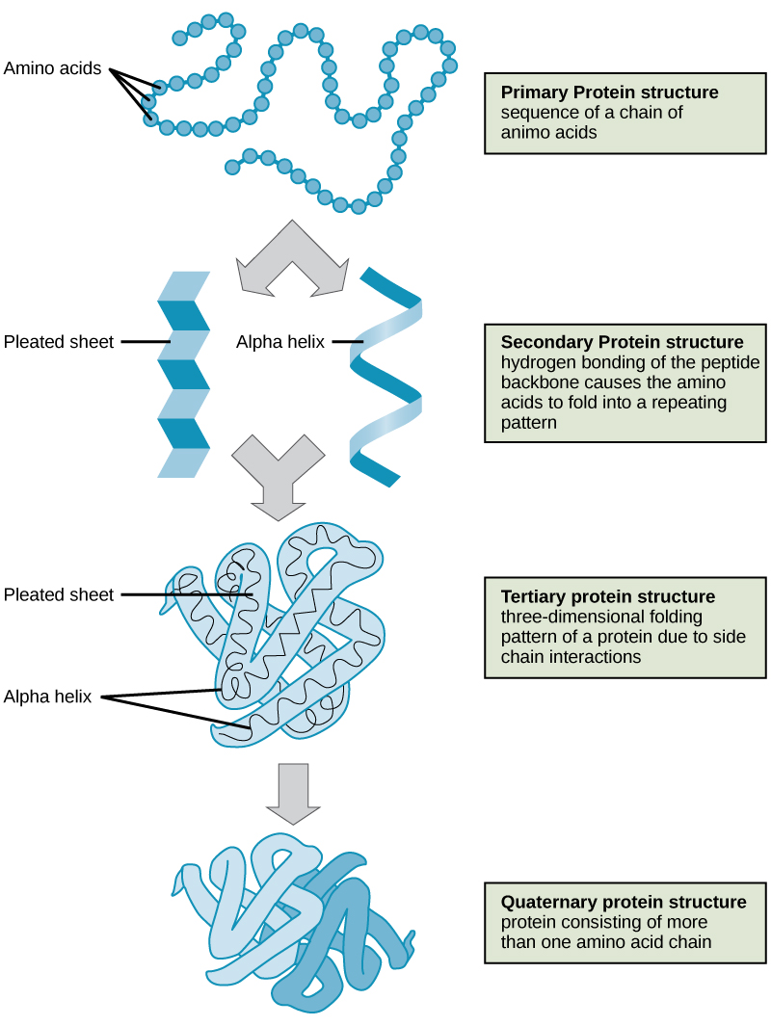

Slide 31
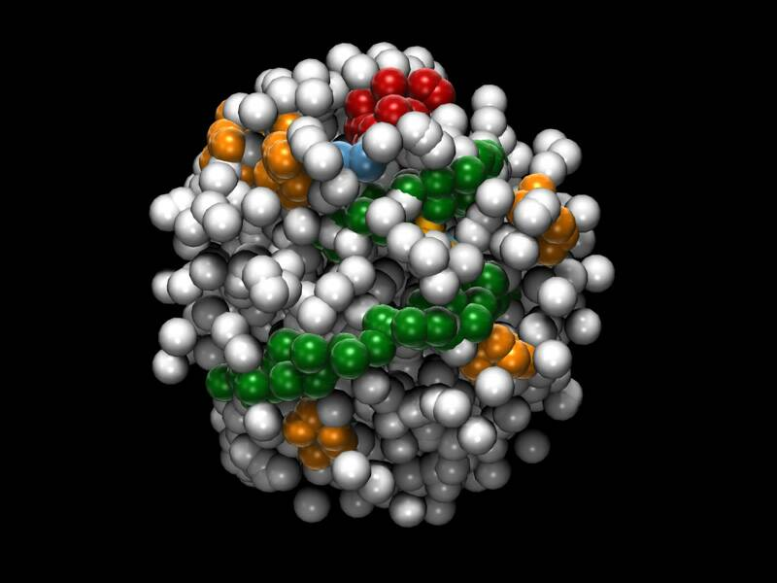
Solubility
Globular proteins
Fibrillar proteins
soluble in water and weak salt
solutions (can attract water dipoles and form
a hydration shell around the molecule, which prevents individual protein molecules from sticking together into larger aggregates)
insoluble in water
Protein molecules with the same charge repel and are in
suspended state, and with different charges - are attracted, proteins besieged

Slide 32
Protein in the diet
For adults with average physical activity - 100-120 g of proteins per day.
With heavy muscular work - 130 - 150 g per day.
Children under 12 years old - 50 - 70 g per day.

Slide 34
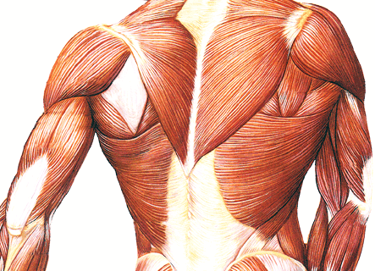
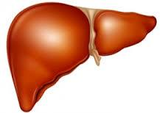
Reserve proteins
"Reserve proteins" are tissue proteins that are easily mobilized if necessary, which, after hydrolysis, serve as suppliers of amino acids.
proteins of muscles, lymphoid organs, epithelial tissues and liver

Slide 35
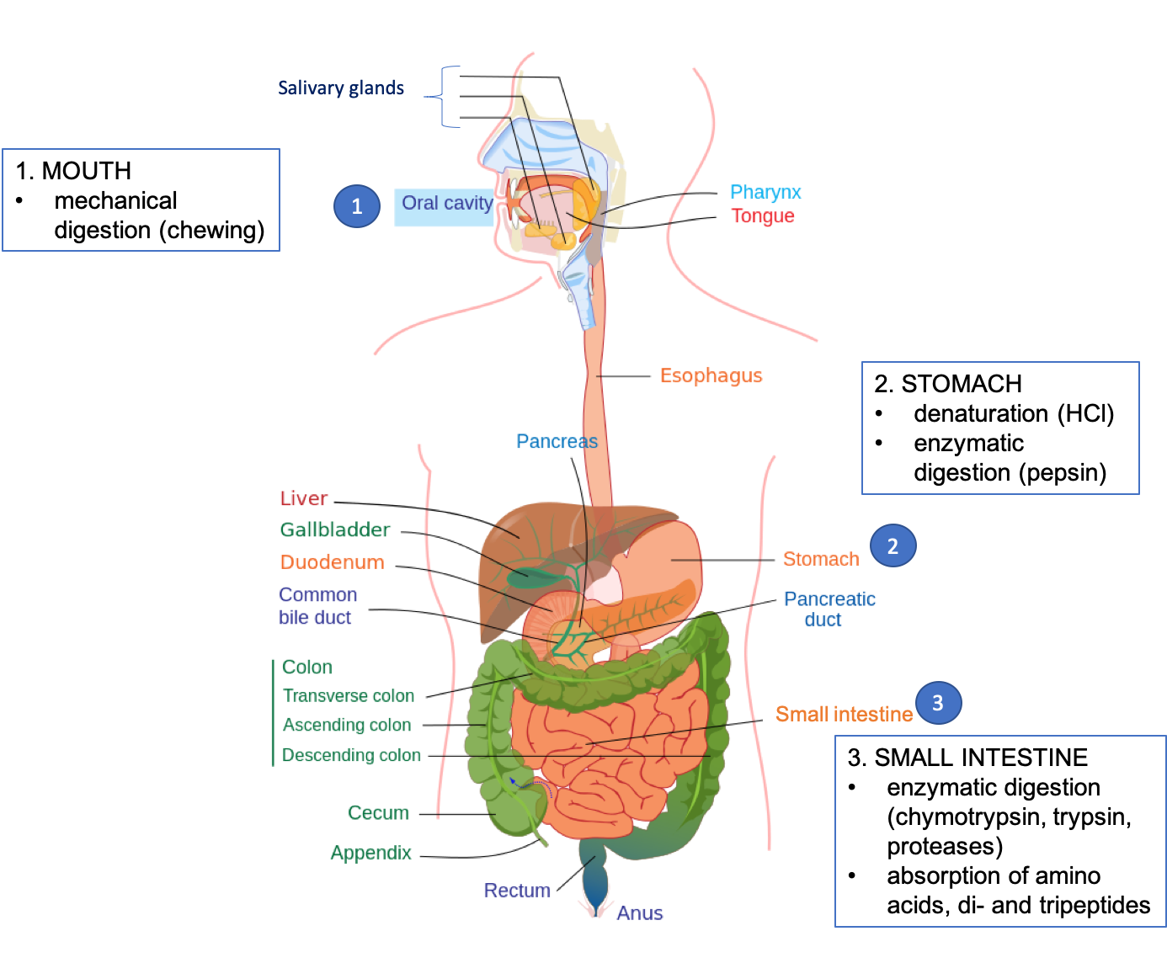
https://openoregon.pressbooks.pub/nutritionscience/chapter/6d-protein-digestion-absorption/

Slide 36
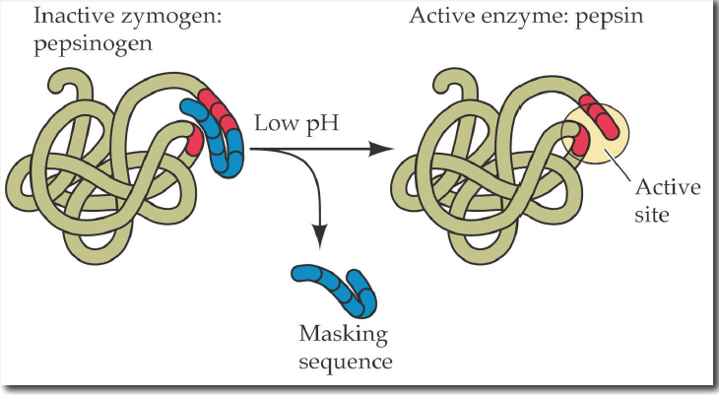
Digestion of proteins
- The digestion of proteins is carried out by peptidases. Peptidases are formed in an inactive form and are activated by limited proteolysis at the sites where they act.

Slide 37
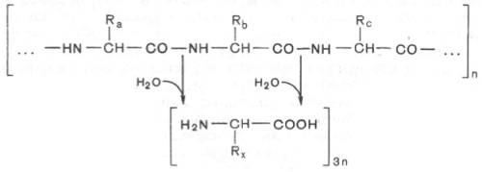
Digestion of proteins
- Peptidases are enzymes of the hydrolase class that cleave peptide bonds.
+ НОН
+ НОН

Slide 38
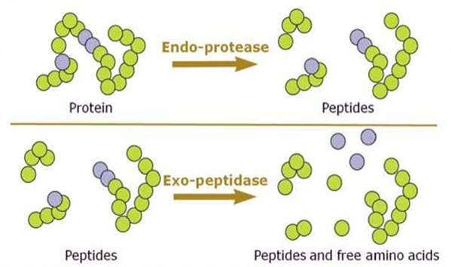
Digestion of proteins
- Distinguish between endo- and exopeptidases.
-Endopeptidases break down internal peptide bonds, these include pepsin and gastricsin, trypsin, chymotrypsin, pancreatic collagenase and elastase, intestinal enteropeptidase.
-Exopeptidases cleave external peptide bonds, these include pancreatic carboxypeptidase, aminopeptidase and intestinal oligopeptidase.

Slide 39
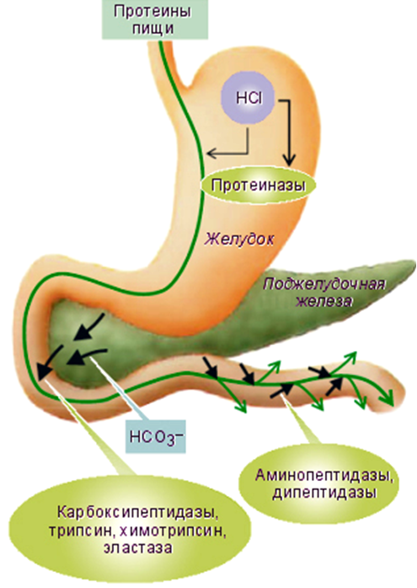
Digestion of proteins
Pepsin, gastricsin, rennin (chymosin)
aminopeptidase,
oligopeptidases (di- and tripeptidases)
trypsin
chymotrypsin carboxypetidase collagenase elastase

Slide 40
Characterization of stomach peptidases
Pepsin:
1) is an endopeptidase;
2) is formed by the chief cells of the stomach in the form of pepsinogen;
3) the conversion of pepsinogen to pepsin occurs by cleavage of 42 amino acid residues at the beginning under the action of hydrogen protons, then under the action of active pepsin molecules;
4) cleaves the bonds formed by the carboxyl groups of aromatic amino acids (phenylalanine, tyrosine and tryptophan);
5) acts in a strongly acidic environment at a pH of 1.5 - 2.5.
Gastricsin:
1) is an endopeptidase;
2) is formed in the stomach;
3) cleaves the bonds formed by the carboxyl groups of dicarboxylic amino acids (glutamate and aspartate);
4) acts at pH 3.5.
less and more slowly - cleaves bonds formed by amino groups and carboxy groups of leucine, glutamate, etc.
http://biokhimija.ru/images/obmen_AA-belkov/S05-02-specifichnost-pepsina.jpg

Slide 41
Characterization of stomach peptidases
Rennin (chymosin, rennet):
1) is an endopeptidase;
2) is formed in the stomach in the form of prorennin, is activated by hydrogen cations;
3) breaks down the milk protein caseinogen, which is hydrolyzed under the action of the enzyme and turns into insoluble casein protein;
4) acts at pH 3.0-4.0.
Parapepsin:
1) is an endopeptidase;
2) produced by the lining cells of the gastric mucosa, activated by H + ions (HCl);
3) breaks down the protein hemoglobin, hydrolysis products - polypeptides;
4) optimum pH 2.4 - 2.8.
Gelatinase:
1) is an endopeptidase;
2) breaks down proteins of connective tissue, liquefies gelatin;
3) acts at a pH of 2.4 - 2.8.

Slide 42
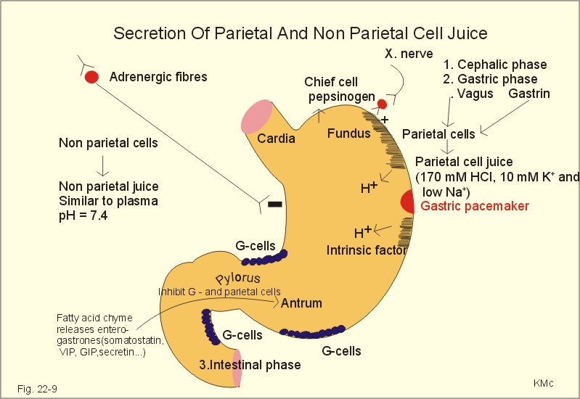
https://www.zuniv.net/physiology/book/chapter22.html

Slide 43
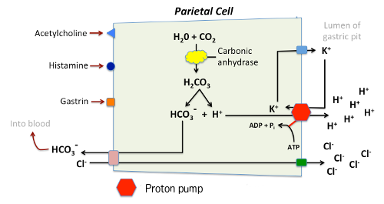
Secretion of hydrochloric acid in the stomach
http://www.vivo.colostate.edu/hbooks/pathphys/digestion/stomach/parietal.html

Slide 44
Role of HCl
is necessary for the conversion of pepsinogen to pepsin;
creates an optimum pH for pepsin to work;
promotes denaturation and swelling of food proteins, participates in milk curdling;
has a bactericidal effect, that is, it prevents the development of microflora;
stimulates the motor activity of the stomach;
participates in the implementation of the mechanism of the transfer of food from the stomach to the duodenum, irritating the chemoreceptors of its mucous membrane;
participates in the regulation of the secretion of the gastric and pancreas, stimulating the formation of gastrointestinal hormones;
stimulates the secretion of the enterokinase enzyme in the duodenum.

Slide 45
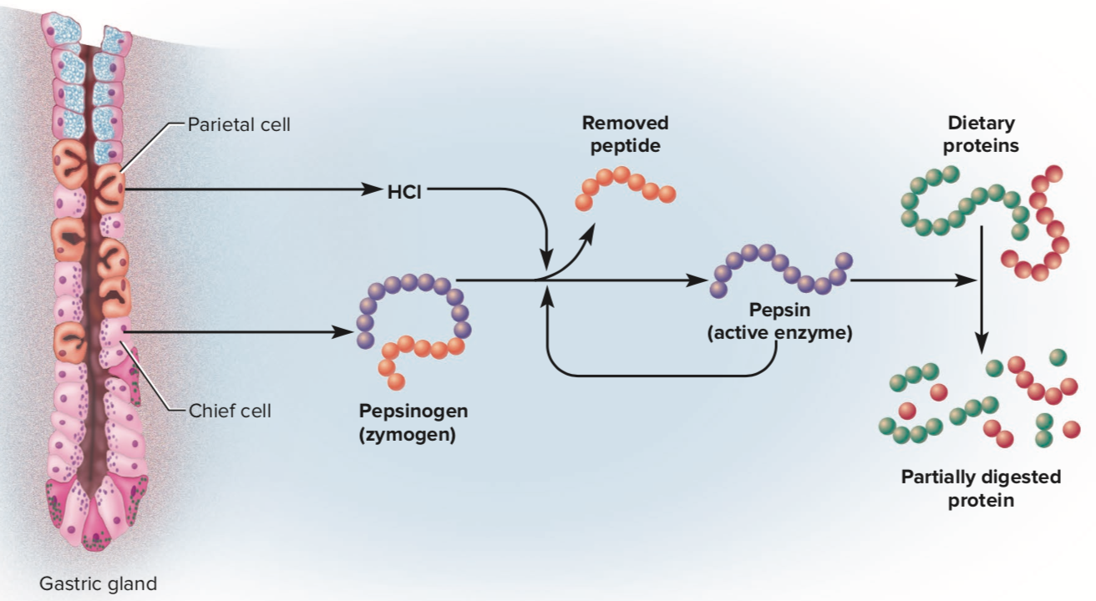
Activation of stomach peptidases
https://www.quora.com/What-is-the-relationship-between-pepsin-and-pepsinogen

Slide 46
Characterization of pancreatic peptidases
Trypsin:
1) is an endopeptidase;
2) is formed in the pancreas in the form of trypsinogen;
3) is activated by intestinal enteropeptidase by cleavage of 6 amino acids;
4) cleaves the bonds formed by the carboxyl groups of arginine or lysine;
5) activates other pancreatic peptidases.
Chymotrypsin:
1) is an endopeptidase;
2) is formed in the pancreas in the form of chymotrypsinogen;
3) activated by trypsin;
4) cleaves the bonds formed by the carboxyl groups of aromatic amino acids.

Slide 47
Characterization of pancreatic peptidases
Elastase:
1) is an endopeptidase;
2) is formed in the pancreas;
3) cleaves the bonds formed by proline.
4) is capable of cleaving the protein elastin, which is not hydrolyzed by either trypsin or chymotrypsin.
Collagenase:
1) is a narrowly targeted endopeptidase;
2) is formed in the pancreas;
3) breaks down collagen protein.
Carboxypeptidase:
1) is an exopeptidase;
2) is formed in the pancreas in an inactive form;
3) activated by trypsin;
4) cleaves off amino acids from the C-terminus.

Slide 48
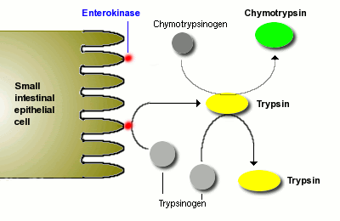
Activation of pancreatic peptidases
http://www.vivo.colostate.edu/hbooks/pathphys/digestion/pancreas/exocrine.html

Slide 50
Characterization of intestinal peptidases
Aminopeptidase:
1) is an exopeptidase;
2) is formed in the intestine;
3) cleaves amino acids from the N-terminus.
Dipeptidases and Tripeptidases:
1) are exopeptidases;
2) are formed in the intestine;
3) cleave dipeptides or tripeptides, respectively.

Slide 51
Regulation of the production of digestive juices
Stomach juices:
• Acetylcholine, released upon irritation of the vagus nerve, leads to the secretion of histamine, which stimulates the secretion of HCl via H2 receptors.
• Gastrine, a peptide hormone of the stomach, causes the secretion of gastric juice (stimulates the secretion of HCl, and pepsin).
Enterogastrone, a hormone of the duodenum, inhibits the secretion of HCl and pepsinogen in the stomach.
• GCS increase the secretion of gastric digestive juice, but reduce the secretion of mucus.

Slide 52
Regulation of the production of digestive juices
Pancreatic juices:
• Secretin, a peptide hormone of the duodenum, stimulates the secretion of pancreatic juice, which contains a lot of water and hydrocarbons, but depleted in enzymes.
• Acetylcholine stimulates the secretion of enzyme-rich pancreatic juice.
Cholecystokinin (outdated name - pancreozymin), a peptide hormone of the duodenum, enhances the secretion of pancreatic juice enriched with enzymes.
• GCS increase the secretion of all digestive juices (both stomach and pancreas), but reduces the secretion of mucus.

Slide 53
Regulation of the production of digestive juices (APUD-system)
amine
precursor
uptake
decarboxylation

Slide 54
Protecting cells from the action of peptidases
The mucous membrane of the stomach and intestines is covered with a layer of mucus, which prevents the contact of peptidases with mucosal proteins.
2) In the pancreas, peptidases are formed in an inactive form and are activated only in the intestinal lumen.
3) In the cells of the pancreas, there is a trypsin inhibitor protein, which forms a strong complex with the active form of trypsin (in the case of premature activation).
4) Each cell contains polysaccharides on the outer surface of the plasma membrane, which are not cleaved by proteases.
5) Lysosomes in cells are delimited by membranes, therefore, the digestion of intracellular proteins occurs inside them (if they are damaged, self-digestion and cell death)

Slide 55
Defense mechanisms against proteases
Protection type "cage" (grids)
spatial isolation of proteinases from those proteins that they can act on: intracellular proteinases are concentrated inside lysosomes and separated from proteins that they can hydrolyze
"Muzzle" protection
proteinases are produced as inactive precursors:
the active center of the enzyme is "covered" by a fragment of the polypeptide chain, after hydrolysis of a certain bond, this chain breaks off and the enzyme becomes active
Chain mail protection
Protection of a substrate protein by including any chemical structures in its molecule -
(protective groups covering peptide bonds)
Guard type protection
protein protection with endogenous proteinase inhibitors

Slide 56
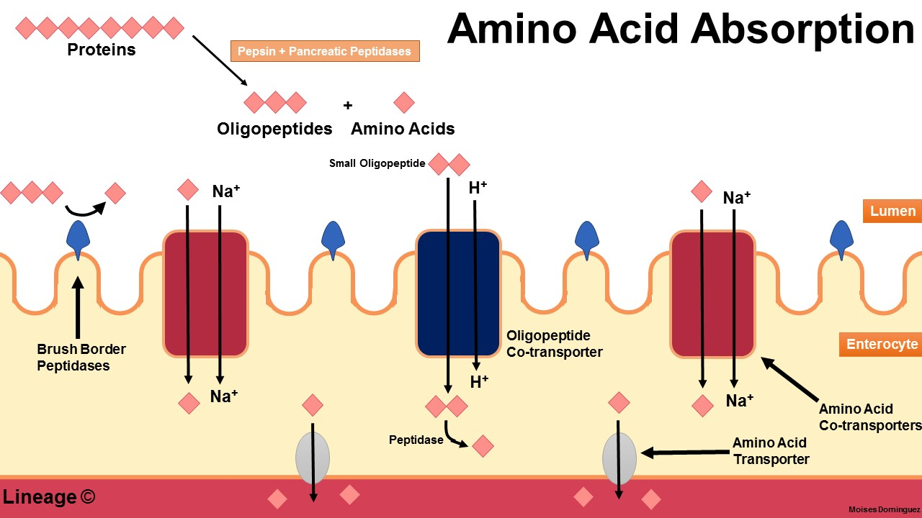
Absorption of amino acids

Slide 57
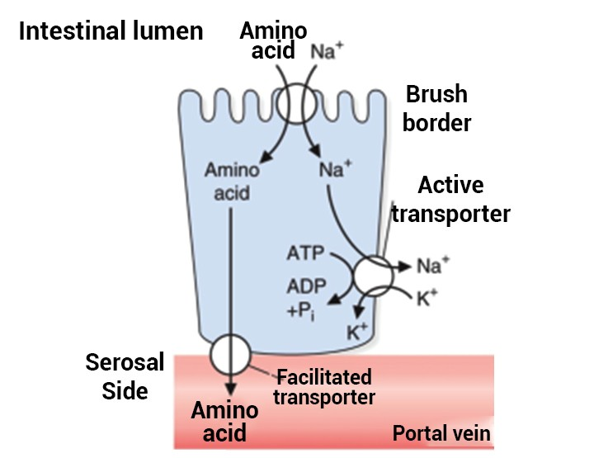
Transport of amino acids across cell membranes
There are at least five specific amino acid carrier systems:
neutral aliphatic;
cyclical;
main;
sour;
proline
For the transport of one amino acid molecule into the cell with the participation
The γ-glutamyl cycle consumes 3 ATP molecules.

Slide 58
Sources of amino acids
Digestion of food proteins in the gastrointestinal tract.
Cleavage of cellular proteins by lysosomal peptidases (cathepsins).
Synthesis from other amino acids.
Formation from nitrogen-free compounds (primarily from keto acids).

Slide 59
Ways to Use Amino Acids
Protein synthesis (this is the main way of using amino acids).
Synthesis of biologically important compounds (purines, pyrimidines, hormones, porphyrins and others).
Deamination of amino acids with the formation of keto acids, which can:
1) oxidize in the Krebs cycle,
2) used in the GNG for glucose synthesis,
3) turn into ketone bodies.

Slide 60
CHEMICAL PROPERTIES OF AMINO ACIDS
Three types of reactions
1. Reactions at the carboxyl group
3. Radical reactions
2. Reactions on the amino group
Significance: participation in the formation of the structures of protein molecules
Main reaction: peptide bond formation

Slide 61
General and particular ways of amino acid metabolism in the human body
decarboxylation
deamination
protein biosynthesis
transamination
racemization
(only for microorganisms)

Slide 62
Decarboxylation
Decarboxylase

Slide 63
α-decarboxylation of amino acids
Amino acid decarboxylation is the cleavage of a carboxyl group from an amino acid.
The process is catalyzed by decarboxylases, which include vitamin B6.
In most cases, amines are formed during the decarboxylation of amino acids (an exception is glutamate, the decarboxylation of which forms ɤ-aminobutyric acid).
R
CO₂
R
CH
COOH
CH₂
decarboxylase
NH₂
B₆
NH₂
Amino acid
Amine

Slide 64
α-decarboxylation of histidine
Histamine:
1. Formed in the mast cells of the connective tissue.
2. Forms a complex with proteins and is stored in mast cells.
3. It is secreted into the blood when tissue is damaged (blow, burn, exposure to endo- and exogenous substances), the development of immune and allergic reactions.
4. Performs the following functions:
- through H2-receptors stimulates the secretion of gastric juice, saliva;
- through H1 receptors increases capillary permeability, causes edema, lowers blood pressure (but increases intracranial pressure, causes headache);
- reduces the smooth muscles of the lungs, causes suffocation;
- participates in the formation of the inflammatory response;
- causes an allergic reaction;
- plays the role of a neurotransmitter;
- is a mediator of pain.

Slide 65
α-decarboxylation of serine
CO₂
CH₂OH
CH₂OH
Methyltransferase
CH₂OH
CH
NH₂
CH₂
decarboxylase
B₆
CH₂ N⁺ (CH₃)₃
COOH
NH₂
S-AM
S-AH
serine
Ethanolamine
Choline
Choline and ethanolamine are part of complex lipids.

Slide 66
α-decarboxylation of serine
O
CH₂OH
O
CH₂ O C CH₃
CH₃ C SCoA
CH₂ N⁺ (CH₃)₃
CH₂ N⁺ (CH₃)₃
Choline
AcetylCoA
Acetylcholine
Acetylcholine is one of the most important excitatory neurotransmitters of the autonomic nervous system.

Slide 67
α-decarboxylation of cysteine and cysteic acid
CO₂
CH₂SH
CH₂SH
Mercaptoethylamine:
- is part of the CoA;
- is a radioprotector.
CH
NH₂
CH₂
Decarboxylase
COOH
B₆
NH₂
Cysteine
Mercaptoethylamine
Taurine:
- formed by decarboxylation of cysteic acid;
-necessary for the synthesis of paired bile acids (taurocholic acid);
-is an antioxidant;
- is a neuroregulator.
CO₂
CH₂SO₃H
CH₂SO₃H
CH
NH₂
CH₂
Decarboxylase
COOH
B₆
NH₂
cysteic acid
taurine

Slide 68
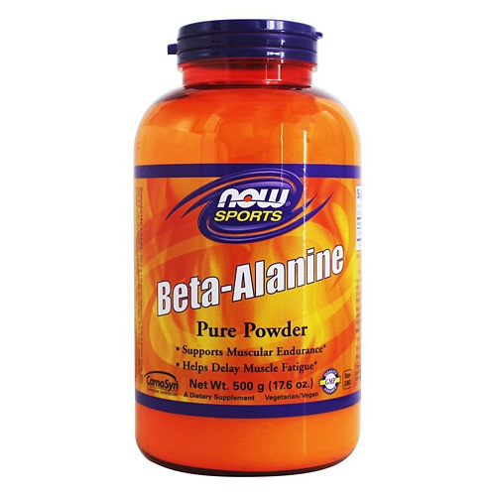
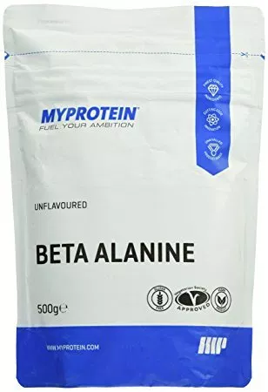
α-decarboxylation of aspartate
COOH
COOH
CO₂
CH₂
CH₂
CHNH₂
CH₂
Decarboxylase
COOH
B₆
NH₂
Aspartate
ß-alanine
part of biologically active substances (pantothenic acid, carnosine, anserine)

Slide 69
α-decarboxylation of glutamate
COOH
COOH
CO₂
CH₂
CH₂
CH₂
CH₂
Decarboxylase
CHNH₂
B₆
CH₂
COOH
NH₂
Glutamate
γ-aminobutyric acid
γ-aminobutyric acid (GABA):
1) serves as the main inhibitory modulator of the higher parts of the brain;
2) increases the permeability of postsynaptic membranes for K + ions, which causes inhibition of the nerve impulse;
3) increases the respiratory activity of the nervous tissue;
4) improves blood flow to the brain.

Slide 71
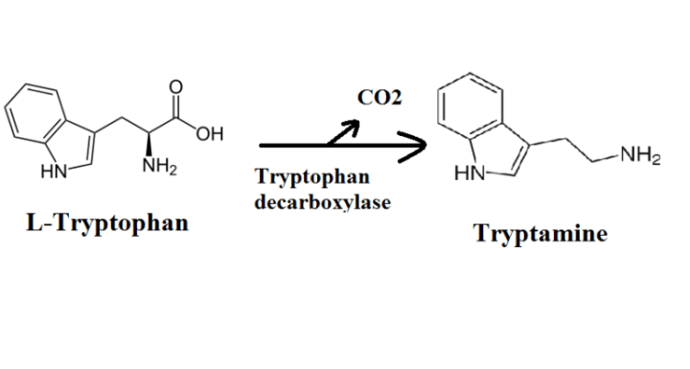
α-decarboxylation of tryptophan
Tryptamine, a biogenic amine, is an intermediate in the biosynthesis of most indole alkaloids and alkaloids of the quinine group.
It has, like serotonin, a vasoconstrictor effect.
Tryptamine is thought to play a neurotransmitter and neurotransmitter role in the mammalian brain.
Its derivative dimethyltryptamine (DMT) or N, N-dimethyltryptamine is an endogenous psychedelic (produced by the pineal gland during REM sleep), in the human nervous system it functions as an agonist of 5-HT2A serotonin receptors, an alkaloid of many plants, a potent psychoactive substance from the tryptamine class ( refers to narcotic substances).

Slide 72
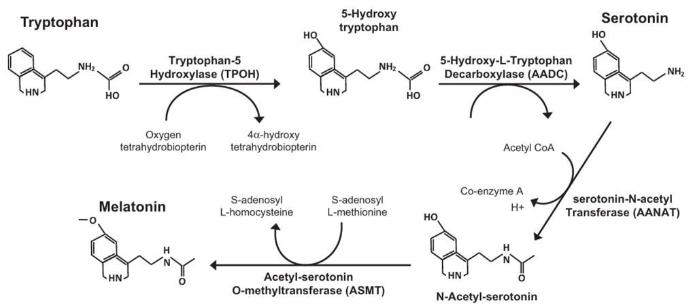
α-decarboxylation of tryptophan
Serotonin is a neurotransmitter of pathways.
Serotonin:
- stimulates the contraction of smooth muscles;
- has a vasoconstrictor effect;
- regulates blood pressure, body temperature, respiration;
- has an antidepressant effect;
- turns into melatonin, which regulates daily and seasonal changes in metabolism and is involved in the regulation of reproductive function.

Slide 73
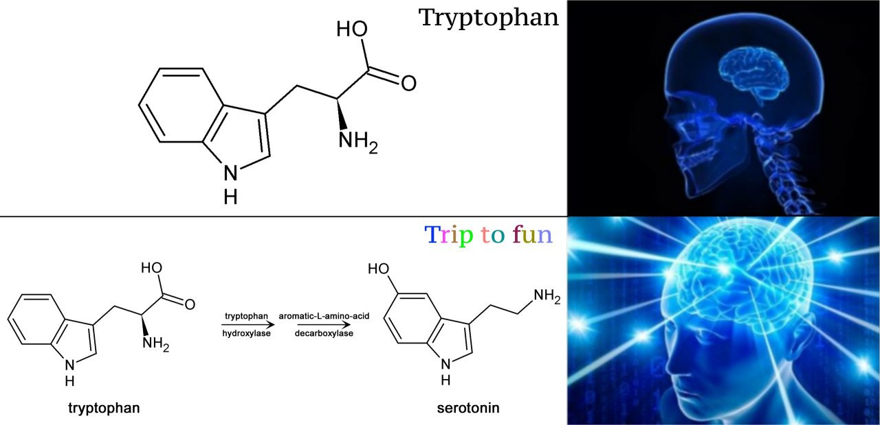

Slide 75
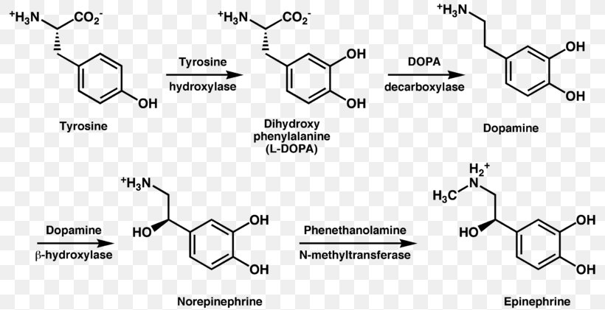
α-decarboxylation of dihydroxyphenylalanine
Dopamine is a hormone from the catecholamine group, a neurotransmitter of the pathways.
Dopamine:
- as a neurotransmitter: it is a hormone of pleasure, in the extrapyramidal system it plays the role of a stimulating neurotransmitter that helps to increase motor activity, reduce motor inhibition and stiffness, reduce muscle hypertonicity;
- as a hormone: it causes an increase in the resistance of peripheral vessels and increases cardiac output, also inhibits the synthesis of aldosterone in the adrenal cortex, lowers renin secretion by the kidneys, increases the secretion of prostaglandins by the kidney tissue, inhibits gastric and intestinal peristalsis, plays a role in adapting the body to stressful situations, injuries, blood loss, etc.

Slide 77
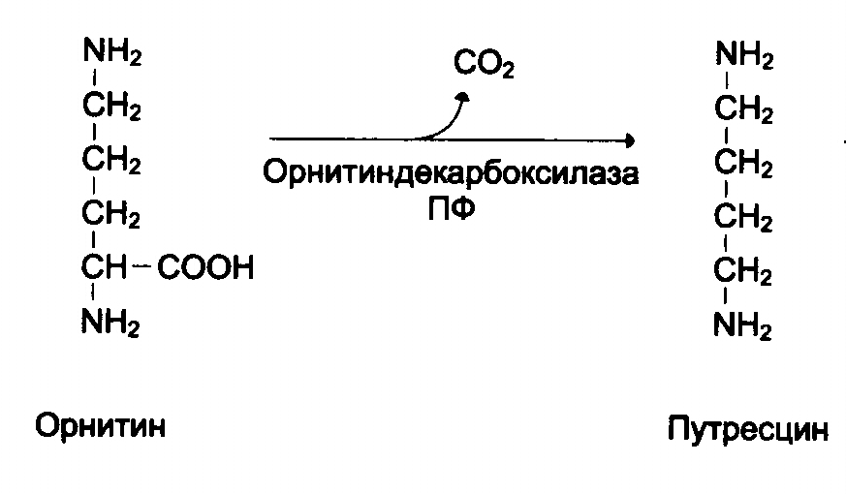
α-decarboxylation of ornithine and lysine
Ornithine decarboxylase
Лизиндекарбоксилаза
Lysine decarboxylase
Ornithine
Putrescine
Lysine
Cadaverine
When decarboxylation of ornithine is formed putrescine, lysine - cadaverine, which are polyamines.
Ornithine decarboxylase is induced by growth hormone, corticosteroids and testosterone. Both enzymes are inhibited by DFMO (difluoromethylornithine)

Slide 78
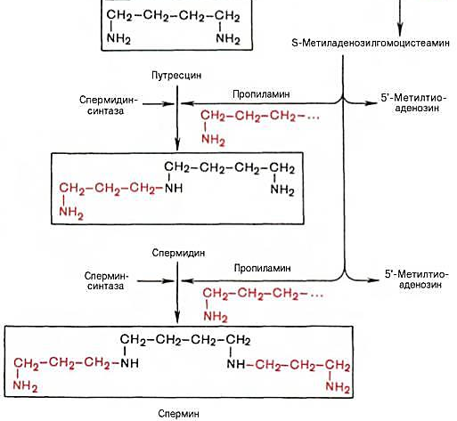
α-decarboxylation of ornithine and lysine
From putrescine spermine and spermidine are formed, which are found in the nuclei of cells of all human organs.
Functions of polyamines (putrescine, spermine and spermidine):
1) due to the large positive charge, they bind to DNA and RNA molecules;
2) stabilize the structure of membranes;
3) participate in DNA replication;
4) stimulate transcription and translation.

Slide 79
ω-decarboxylation of glutamate
COOH
CO₂
CH₂
CH₃
CH₂
CH₂
decarboxylase
CHNH₂
B₆
CHNH₂
COOH
COOH
Glutamate
α-aminobutyric acid
α-aminobutyric acid (butyrine, ethylglycine):
1) participates in the biosynthesis of ophthalmic acid

Slide 80
α- and ω- decarboxylation of aspartate
COOH
COOH
CO₂
CH₂
CH₂
CHNH₂
CH₂
decarboxylase
COOH
B₆
NH₂
Aspartate
ß-alanine
COOH
CO₂
CH₂
CH₃
CHNH₂
CHNH₂
decarboxylase
COOH
B₆
COOH
Aspartate
α-alanine

Slide 81
FORMATION OF PEPTIDES
When two α-amino acids interact, a dipeptide is formed. The intermolecular interaction of three α-amino acids leads to the formation of a tripeptide.
Fragments of amino acid molecules that form a peptide chain are called amino acid residues, and the CO – NH bond is called a peptide bond.
The reaction involves the carboxyl group of one amino acid and the amino group of another amino acid.

Slide 82
Peptide bond formation

Slide 84
Pathology of protein and nitrogen metabolism
Alimentary pathologies, pathologies of digestion and absorption
-Gastritis
-Duodenites
-Enterocolitis
-Achilia
-Stomach and duodenal ulcers
-NUCK and Crohn's disease
- Cancer of the esophagus, stomach and intestines
- Celiac disease
-Kwashiorkor
-Pancreatitis
- Cystic fibrosis
Pathology of protein and nitrogen metabolism
Metabolic pathologies
Pathologies of the metabolism of aromatic amino acids
Metabolic pathologies of non-aromatic amino acids
Pathologies of the metabolism of purines and pyrimidines
Bilirubin metabolism pathologies
Residual nitrogen pathologies

Slide 85
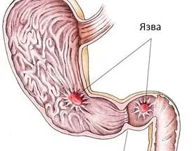
Hyperacid gastritis and the formation of stomach ulcers (less often - duodenal ulcer)
intact stomach wall
inflammation (gastritis)
erosion (erosive gastritis)
↑ HCl (hyperchlorhydria)
↑ pepsin
stomach and duodenal ulcer
Ulcer

Slide 86
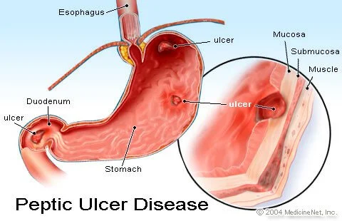
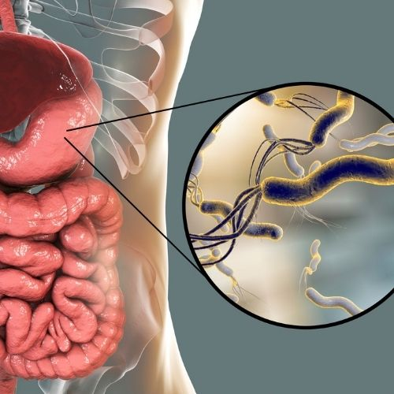

Slide 87
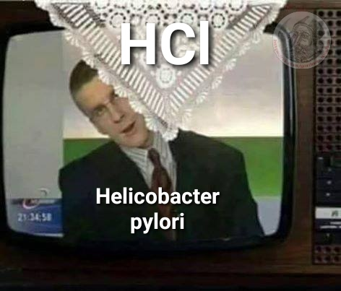

Slide 88
Hypoacidic gastritis and the formation of stomach cancer
inflammation (gastritis)
normal epithelium
atrophy
(atrophic
gastritis)
metaplasia
(the epithelium of the stomach becomes similar to the epithelium of the small or large intestine)
dysplasia (tissue disorder:
high proliferation and atypia of the epithelium)
↓ or 0 HCl (hypo (a) -chlorhydria)
N, ↓ or 0 pepsin
stomach cancer

Slide 89
Classification of gastritis by acidity of gastric juice
Hyper acidic
Normo-
acidic
Hypo-
acidic
An-
acidic
Achilia
no HCl (achlorhydria)
pepsin in N or ↓
↑ HCl (hyper-chloro-hydria)
pepsin more often ↑
N HCl (normo-chloro-hydria)
pepsin in N or ↑
↓ HCl (hypo-chloro-hydria)
pepsin in N or ↓
no HCl (achlorhydria)
pepsin in N or ↓
(in the case of ↑ pepsin and with Helicobacter pylori infection)
The risk of developing ulcers, much less often - oncology (ulcerated carcinoma or "Cancer-ulcer" - only 1% of cases)
The risk of developing cancer

Slide 90
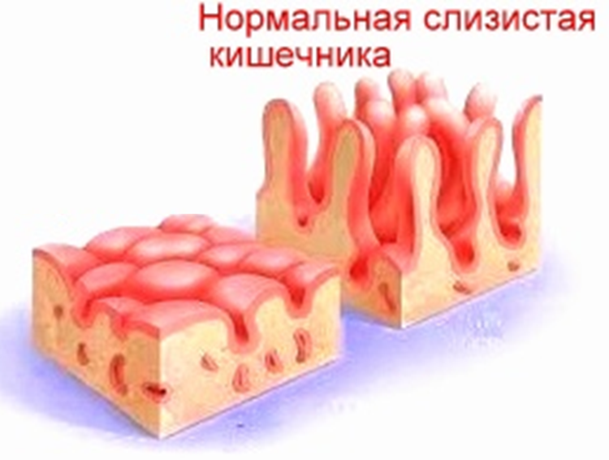
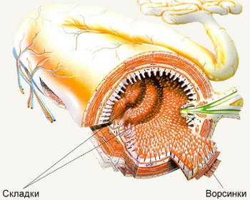
Important bowel disease syndromes
Malabsorption
Maldigestia
Pancreatitis
Celiac disease
Enteritis
Cystic fibrosis
digestive deficiency syndrome

Slide 91
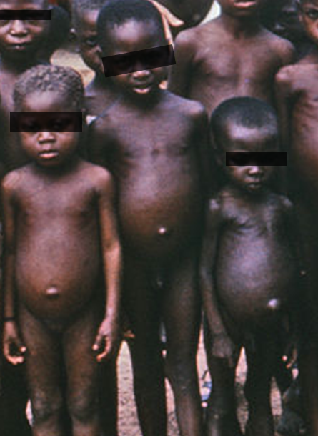
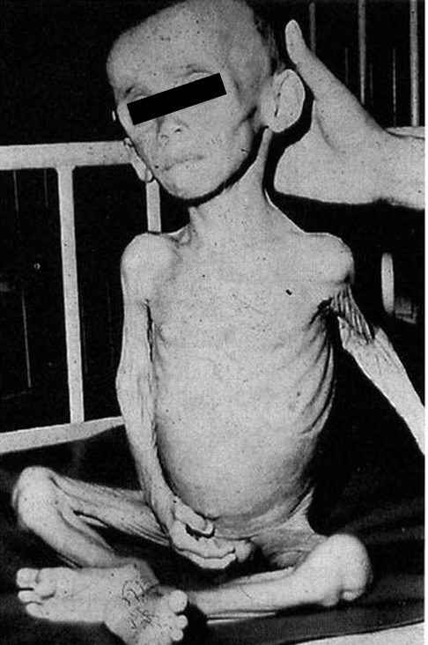
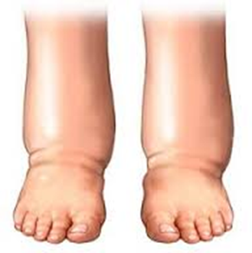
Alimentary protein deficiency
unbalanced
balanced
Kwashiorkor
alimentary marasmus
severe form of protein-energy malnutrition (balanced in protein) with a predominance of energy malnutrition (mainly observed in children under 1 year of age)
severe form of food dystrophy (protein starvation).
is mainly observed in children after 18 months.

Slide 92
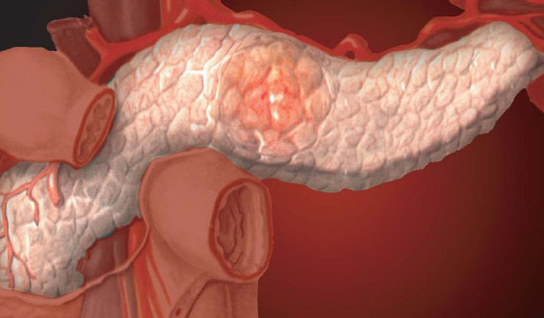
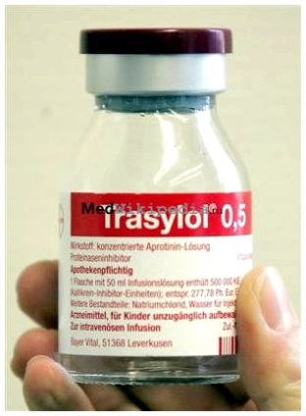
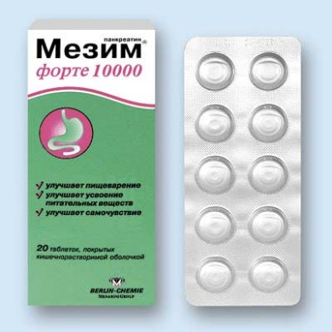
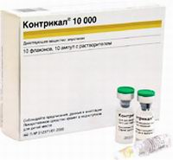
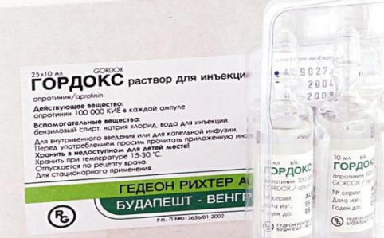
Pancreatitis
Pancreatitis is an acute or chronic inflammation of the pancreas.
Pancreatitis
Acute
Chronic
exacerbation
out of exacerbation
Activation of pancreatic enzymes in its tissue with release into the blood and pancreatic necrosis
Therapeutic tactics - a cocktail of protease inhibitors
Symptoms and treatment tactics as in acute pancreatitis
Normal enzyme activity with a gradual decrease in their production
Enzyme replacement therapy (mezim, pancreatin, creon, etc.)

Slide 93
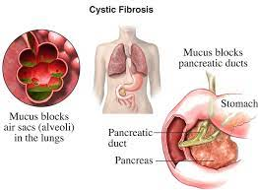
Cystic fibrosis
Thick viscous secretion in the bronchi and pancreatic duct

Slide 94
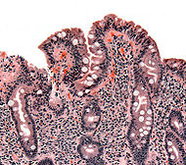
Celiac disease - impaired absorption of amino acids and other monomers
Bald intestines
Celiac disease (Guy-Herter-Heibner disease, gluten enteropathy, intestinal infantilism) is a hereditary disease caused by damage to the villi of the small intestine by certain foods containing certain proteins - gluten (gliadin) and related cereal proteins (avenin, hordein, etc.) - in foods such as wheat, rye, malt, barley and oats.
The presence of an enzyme defect is assumed - the absence or insufficiency of gliadininopeptidase or another enzyme involved in the breakdown of gluten. Has an autoimmune and allergic genesis (antibodies against gluten are formed, which I begin to destroy my own enterocytes).
Frequent foamy stools appear, plentiful, with a pungent odor, light or with a grayish tinge, greasy.

Slide 95
Conclusions:
1. Protein digestion enzymes are produced in an inactive form and are activated by limited proteolysis.
2. Decarboxylation of amino acids leads to the formation of biologically active amines.
3. Impaired digestion of exogenous proteins manifests itself in the form of diseases of the stomach, intestines and pancreas (gastritis, pancreatitis, etc.)

Slide 96
Thank you for attention!

Slide 97
Question:
What is the term for the absence of hydrochloric acid in the stomach?

