Slide 1
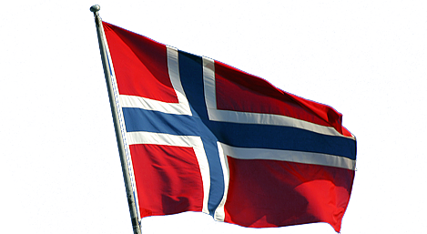
Medical education in Norway

Slide 2
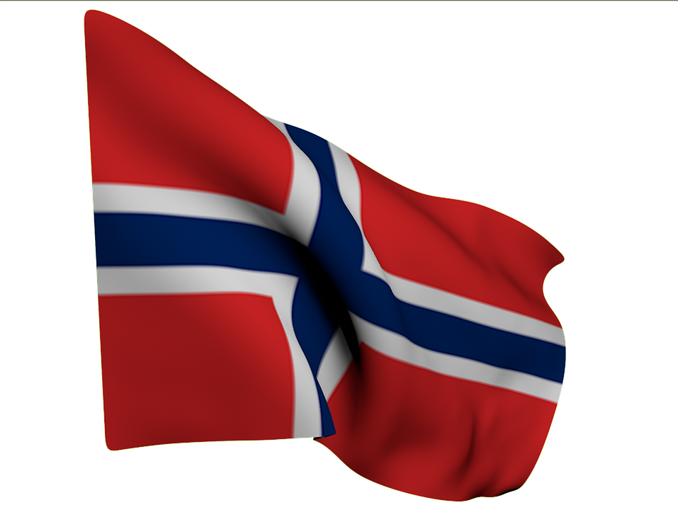
Introduction
In Norway there are four medical universities - in the cities of Oslo, Bergen, Trondheim and Troms. About 600 medical students start their education in Norway every year! In addition, many Norwegian students study abroad.

Slide 3
Conditions of admission
For admission to a medical university in Norway, it is necessary to have almost perfect grades in a school diploma. According to the Norwegian system of 6 points.
If the graduate school is not very good grades, there is an opportunity to improve them. To do this, you can take additional "training credits" and retake the exam on the chosen subject. To enter the university you need to pass examinations in mathematics, chemistry and physics.

Slide 4
Training in medical university
Training at the medical university lasts 6 years, and is divided into 2 stages: preclinical (2 years) and clinical (4 years).
The preclinical stage includes training in biology, anatomy, physiology, pathophysiology, biochemistry, microbiology, and so on.
The clinical stage is classes in groups of 7 students. Classes are held in the form of lectures, then the group works with the patient (anamnesis, physical examination, study of the medical history). Then follows the discussion with the teacher of diagnosis and treatment.

Slide 5
Training in medical university
On the 3rd course, all students are required to have 17 shifts in the waiting room of the university clinic, and on each of them take the patient and make out an idea about the patient.
Within 4 years of training at the clinical stage, students are required to have a watch with a doctor in the clinic for each specialty. For example, in the cycle of obstetrics and gynecology, students must be present at 3 births and 1 cesarean section.

Slide 6
Training in medical university
On the 4th course, students will have a three-week cycle in psychiatry, when they are in a psychiatric clinic for a whole working day and work under the guidance of a doctor. After this cycle, students return to the university and continue their education in the following clinical disciplines.
Also in the compulsory curriculum is participation in research activities, in connection with which the students of the 4th year are given 11 weeks to prepare their own project.

Slide 7
Training in medical university
On the 5th course, students undergo a six-week cycle of therapy and surgery, after which they begin a six-week cycle at the Department of General Practice, where they are present at the reception of a general practitioner and can even have several independent receptions under the guidance of their doctor.

Slide 8
Exams
Students take written exams, computer tests and an oral "clinical" exam, during which students must write a presentation about the patient and report it to the professor.
During the training, the students pass the OSCE (Objective Structured Clinical Examination) 4 times - after studying the theoretical disciplines, after the cycle of dermatology, at the stage of clinical training and at the release from the university.

Slide 9
Training in medical university
Tuition in the medical university is conditionally free. During the training, students receive payments. Payments represent the amount of the scholarship (40%) and benefits (60%). Upon completion of the training, graduates should return 60% of the received funds to the university within 20 years.

Slide 10
Training in medical university
After 4.5 years of study, students can obtain a temporary license and work as a doctor on a summer vacation. You can work in the clinic or office of a general practitioner. At this time, students receive a salary comparable to the salaries of doctors. This experience gives great advantages when entering the residency.

Slide 11
Training in medical university
After 6 years of study, students receive a diploma from the University and enter the internship. The training includes practice for 6 months at the therapy department, 6 months for surgery and 6 months in the general practitioner's office. The interns work independently, but they can contact their supervisor in case of questions.

Slide 12
Training in medical university
After the internship is over, doctors make a choice of a specialty. In Norway, there are 45 different medical specialties. Training in residency in the specialty will take from 4 to 9 years.
For example, the specialty "general practitioner" is mastered for 5 years - 4 years of work in the office of a general practitioner and 1 year of work in the clinic.

Slide 13
