Slide 1
Health system in Germany

Slide 2
Health system in Germany
Germany has one of the highest levels of health care expenditure in the world.
Health care in Germany is based on a well-structured system of health insurance, which consists of state compulsory insurance and private insurance funds.
All citizens of the country, as well as persons who permanently reside or temporarily work in Germany, must have medical insurance.

Slide 3
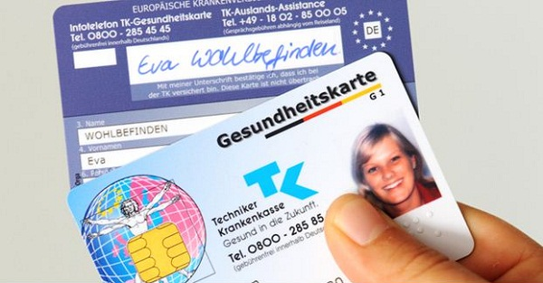
Insurance in Germany
In Germany, there are many insurance companies that provide the population with two main types of health insurance - mandatory and private.
About 90% of the total population is covered by the State Compulsory Social Health Insurance Program and 10% of the population are insured by private insurance companies.
According to the law, entrepreneurs and individuals with a monthly income of more than 4,300 euros are eligible to choose private health insurance in Germany.

Slide 4
Medical institutions in Germany
The conditions of the patient's stay in the clinic can be different and depend on the type of insurance. In the case of private insurance, the patient is placed in a separate room, which is designed for one or two people. Some hospitals have special departments for private patients.
If there is a state insurance, the patient can be placed in a multi-seat ward.
In case of emergency, assistance is provided immediately, regardless of the type of insurance.
German hospitals can be divided into three categories: public, private and charitable.

Slide 5
Acknowledgments to the doctor…
In Germany it is forbidden to give money and give expensive gifts. If you want, you can thank the health workers with flowers or a box of chocolates.

Slide 6
Supply of drugs in Germany
Germany is a country with a highly developed pharmacological industry.
All drugs are carefully monitored and sold only in pharmacies. Prescription medicines are given only if there is a prescription from a doctor.
The pharmacies employ qualified personnel. Network pharmacies in Germany are prohibited.
In Germany, you can buy any German medicines. Medicines produced in other countries can not be bought in German pharmacies, because strict and expensive monitoring does not allow pharmaceutical companies to obtain a license to sell their products in Germany. Pharmacists will always offer you a German equivalent.

Slide 7
Health system in Germany
In conclusion, I want to note that Germany's healthcare is at a high level and has every reason to take first place among the world health leaders.

