Slide 1
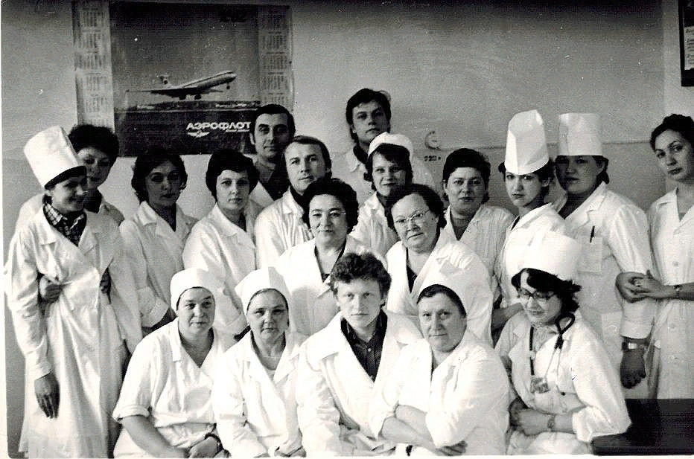
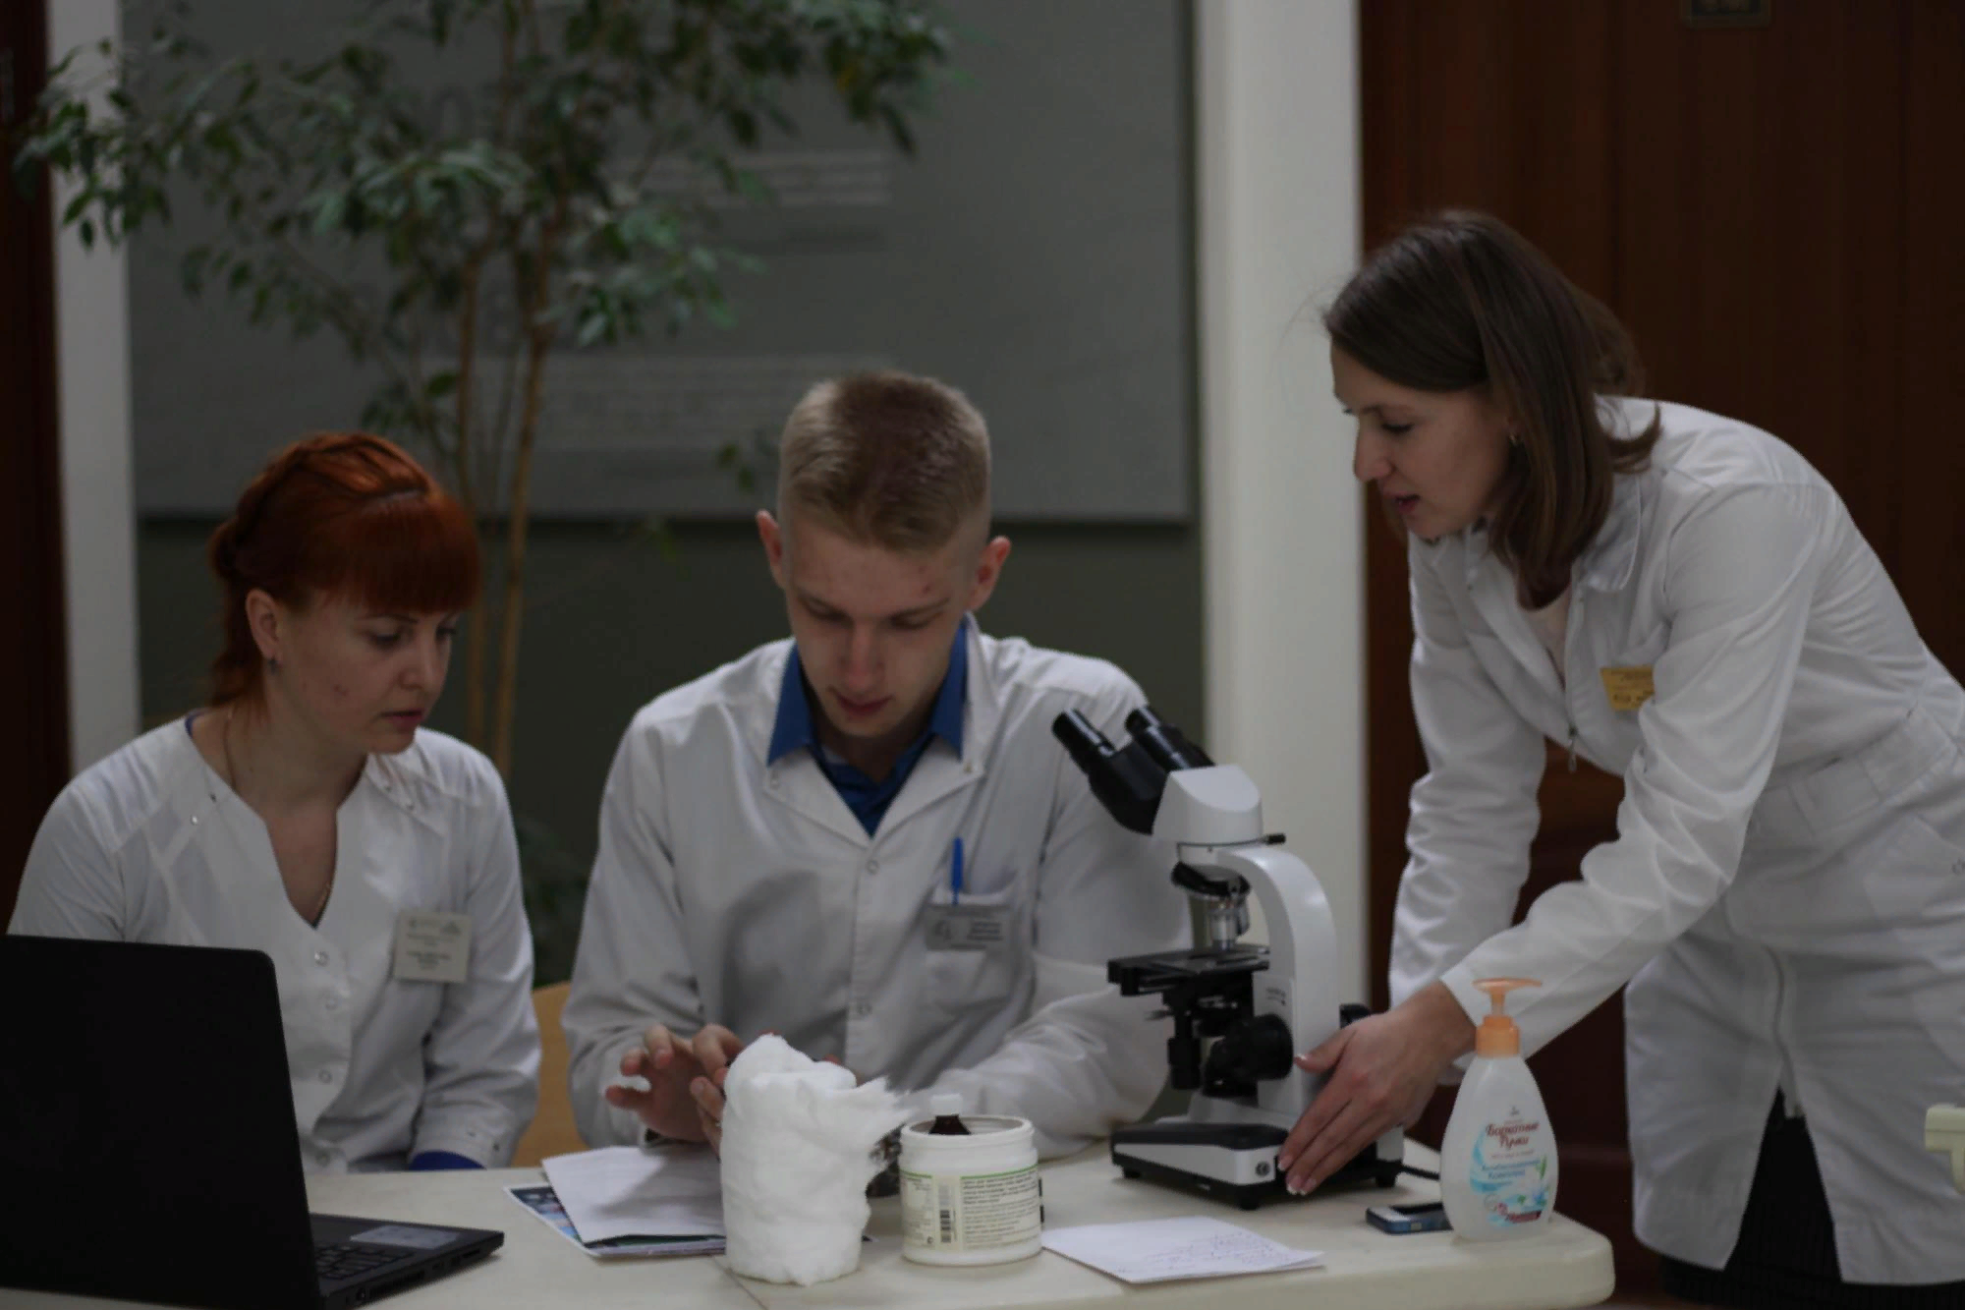
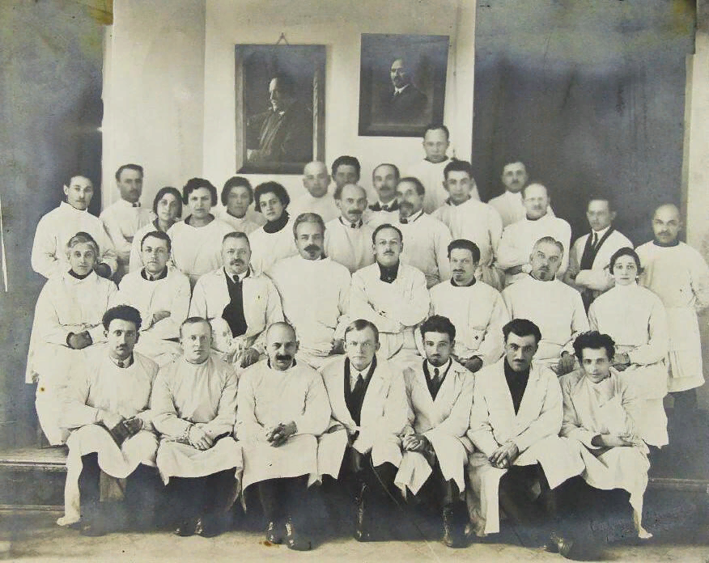
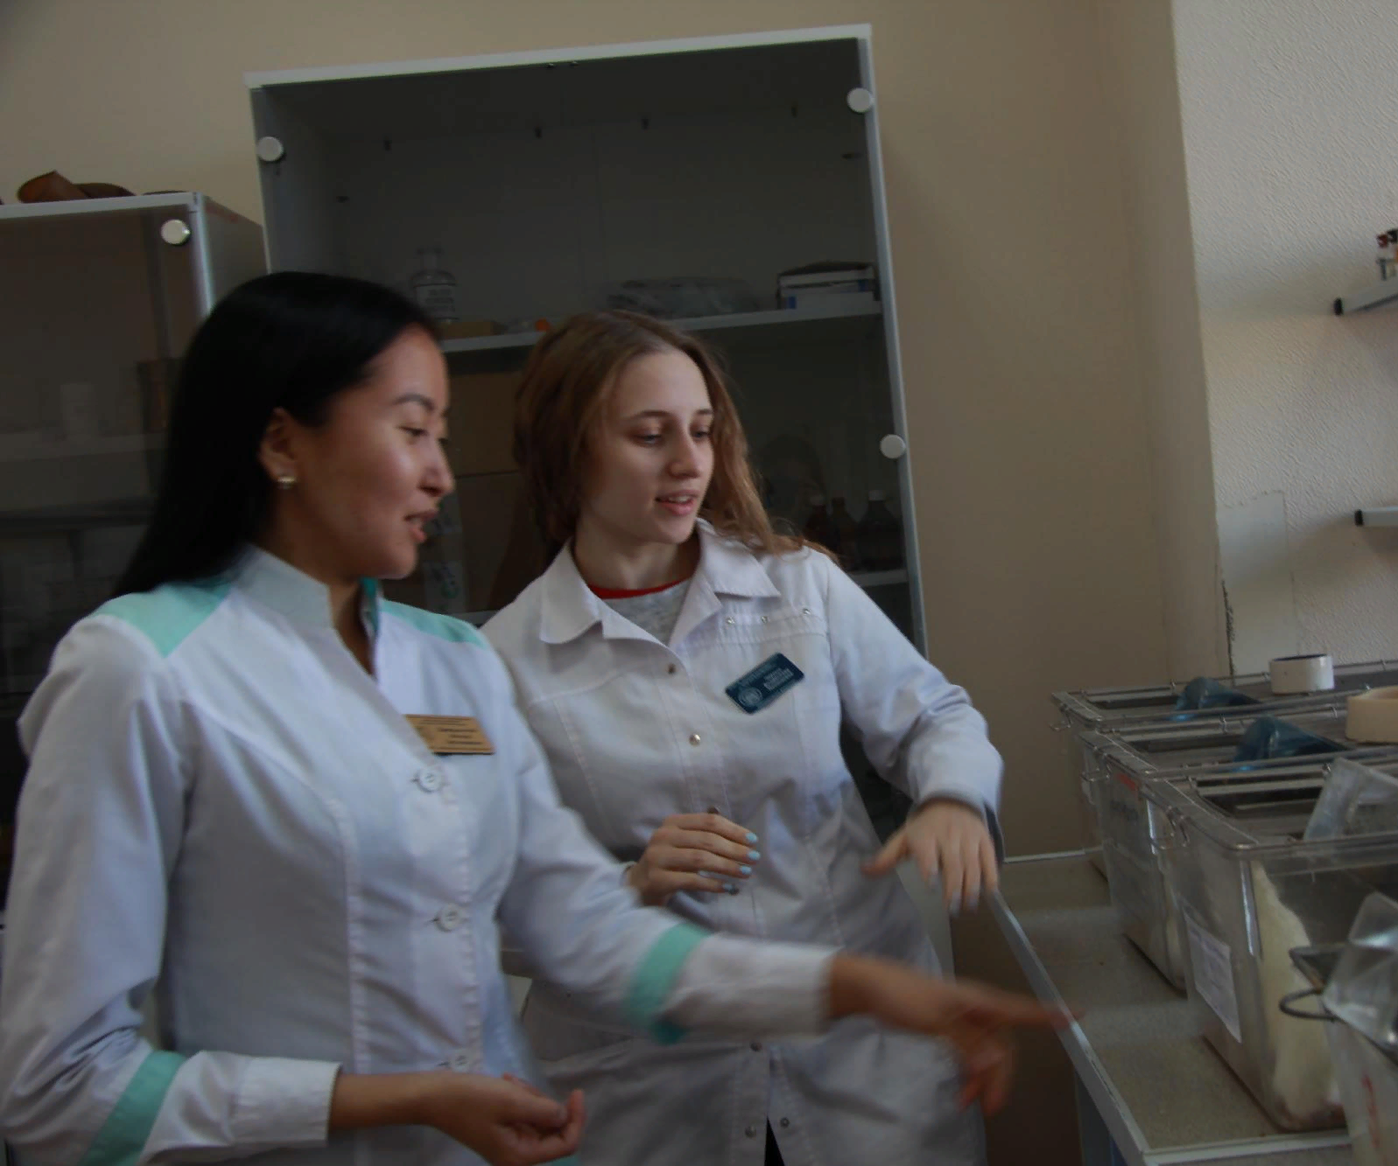
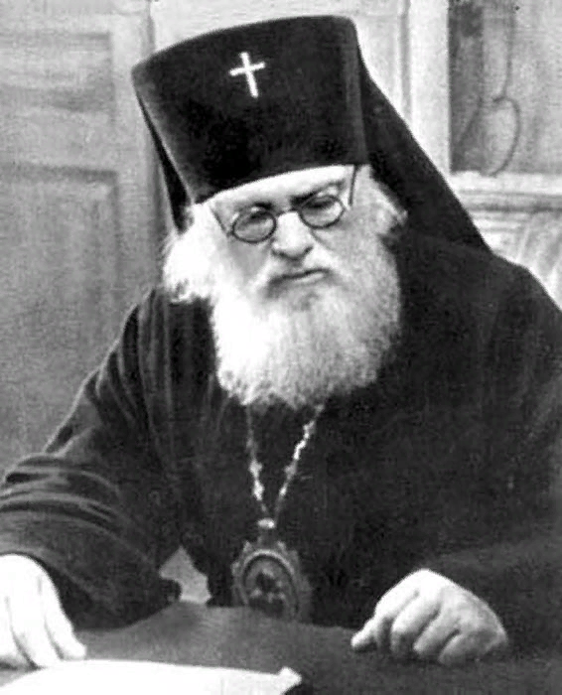
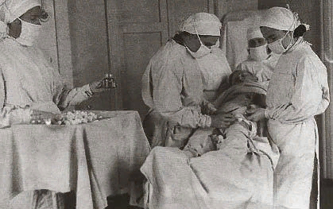
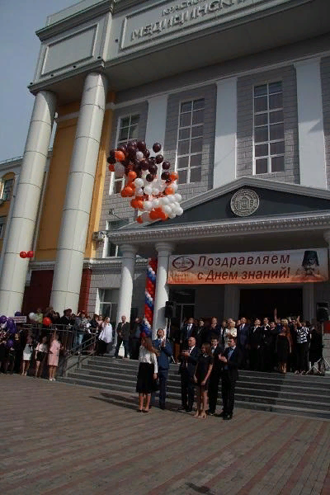
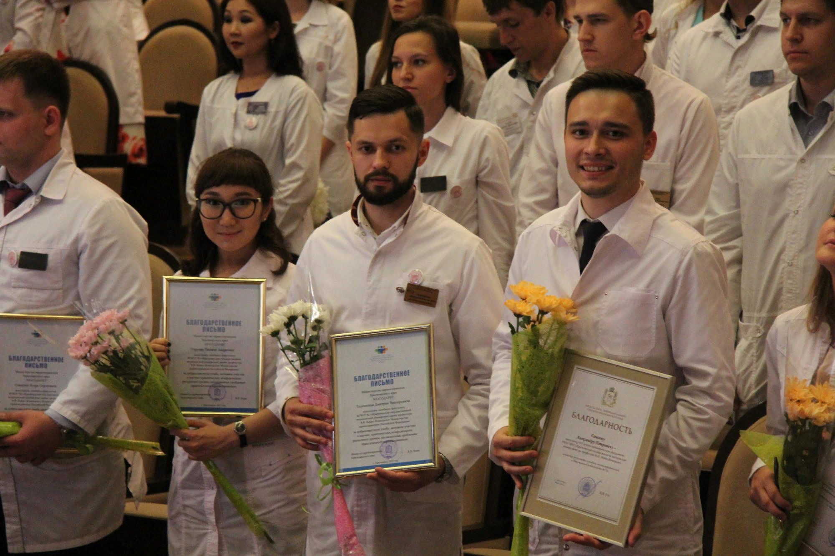
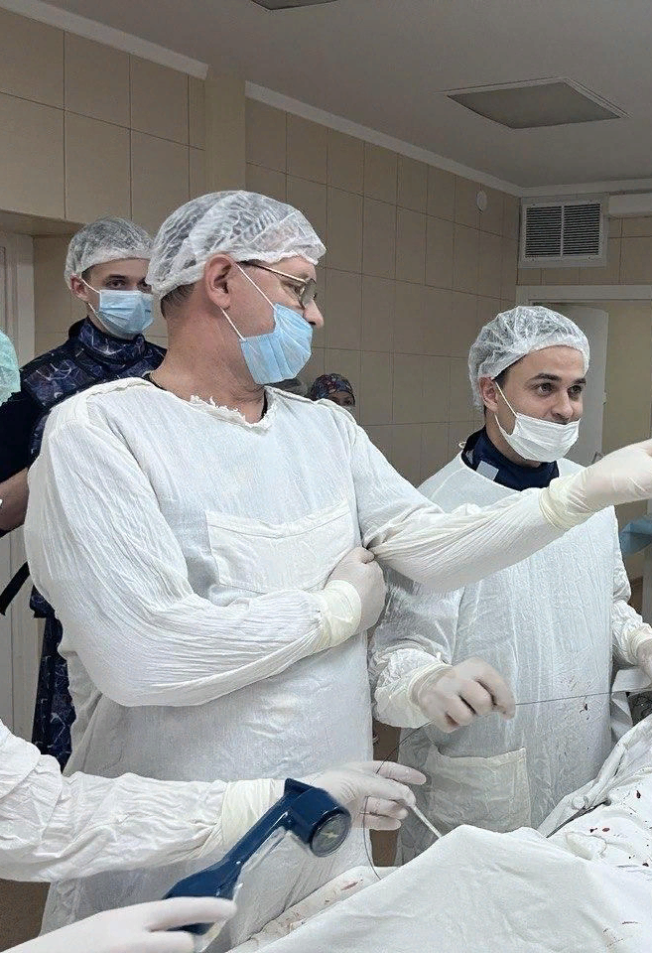
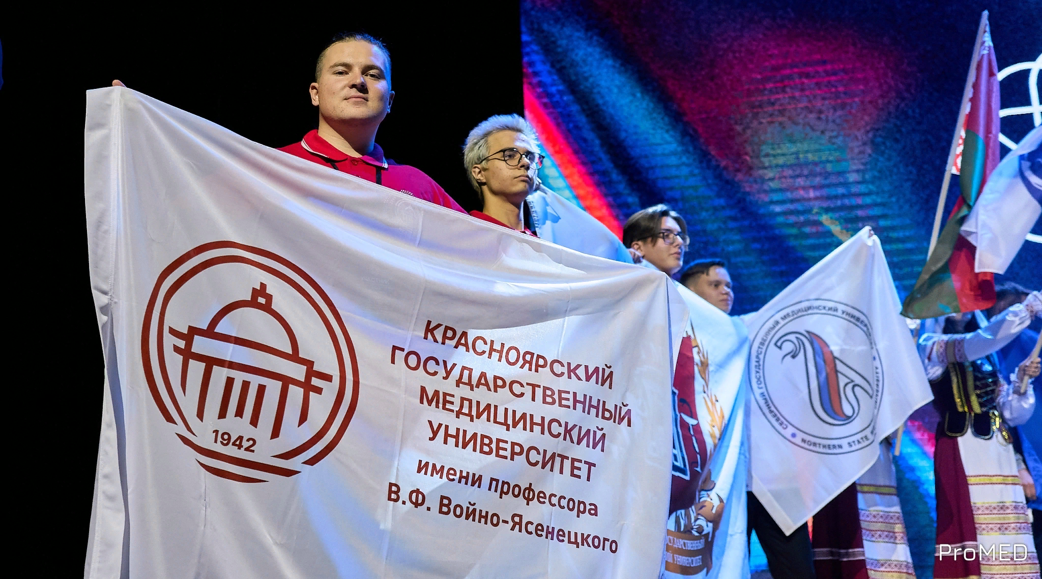
CHOOSE
RIGHT
CHOOSE
KrasSMU

Slide 2
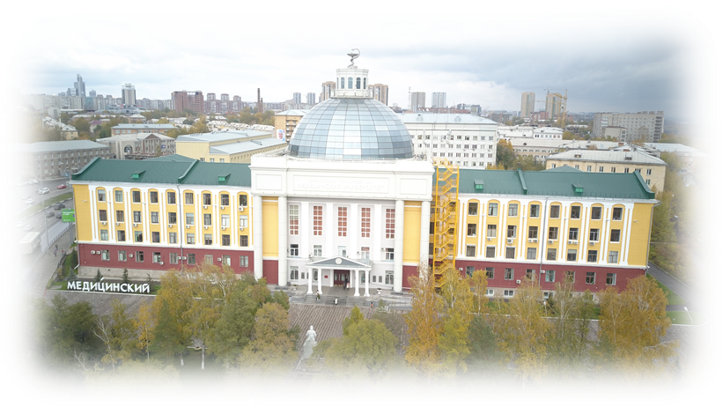
KRASNOYARSK STATE MEDICAL UNIVERSITY

Slide 3
WHY KrasSMU?
Excellence in teaching
Extensive medical facilities and state-of-the-art equipment
6 university’ clinics and more than 200 city and regional clinics available for practical training of the students
Multidisciplinary accreditation and simulation center
Tuition fee discount program
Dormitory accommodation
The university’s sports and fitness center, including a swimming pool, a skiing center, and a training and recreation facility

Slide 4
WHY KrasSMU?
Healthy Campus – Certified
Notes:
КрасГМУ является лауреатом множества престижных премий, что выделяет его в рейтинге из числа других вузов

Slide 5
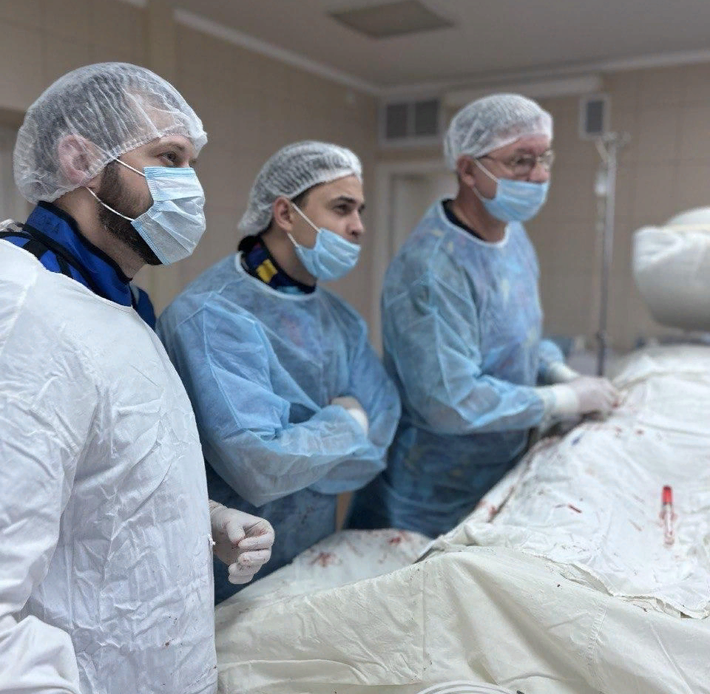
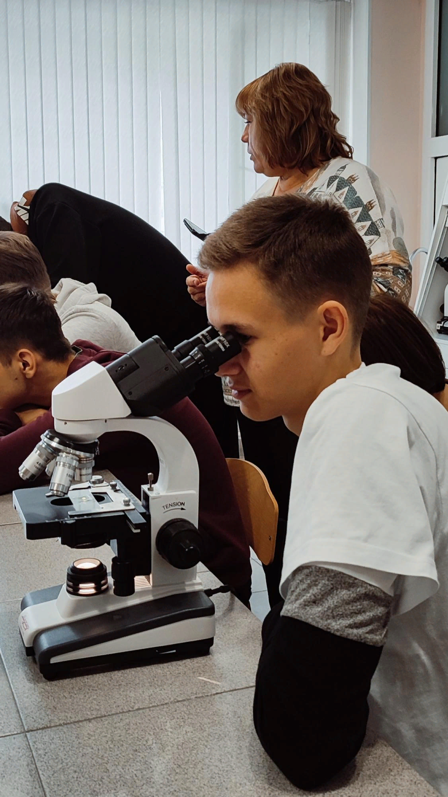
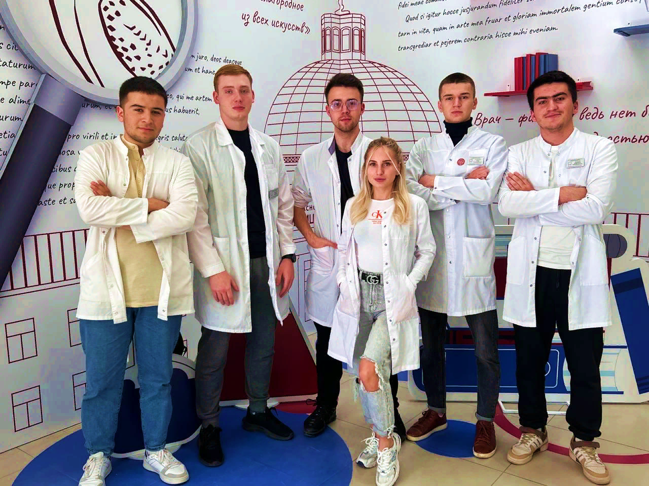
SPECIALIST DEGREE PROGRAMS
Specialty | Program duration
General Medicine RU ENG | 6 years
Pediatrics
Medical Cybernetics
Medical Biophysics
Preventive Medicine
Dentistry RU ENG | 5 years
Pharmacy
Clinical Psychology | 5,5 years

Slide 6
ENTRANCE EXAMINATIONS
For GENERAL MEDICINE and DENTISTRY in ENGLISH
Online exam in Chemistry and Biology in the English language
For programs in RUSSIAN
Online exam in: Biology/Chemistry/Mathematics/Social Studies/ Physics/IT/English Language/Russian Language (depending on the specialty you choose)

Slide 7
ADMISSION
Within the Russian Government quota
Apply at education-in-russia.com
On a fee-paying basis
Apply and submit documents at krasgmu.ru/foreigners
Contact us on international@krasgmu.ru or inted@krasgmu.ru and we will guide you through the process

Slide 8
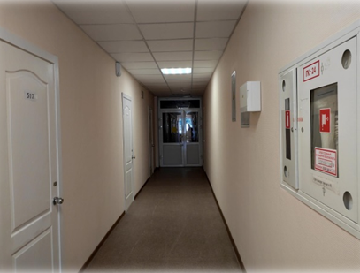
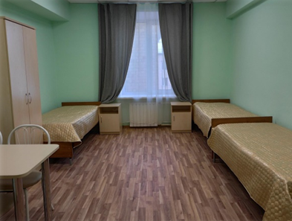
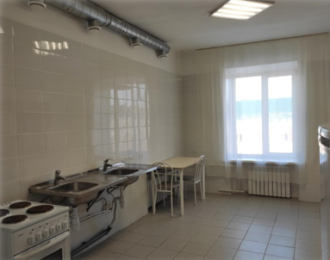
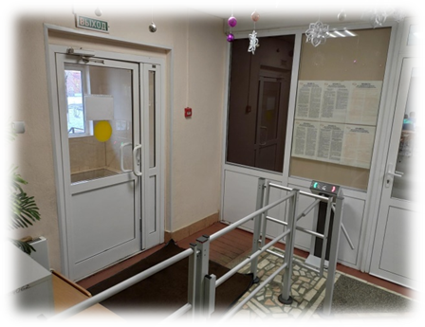
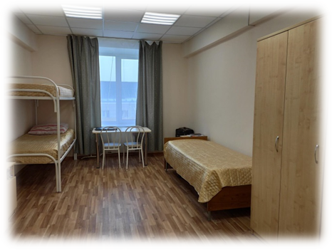
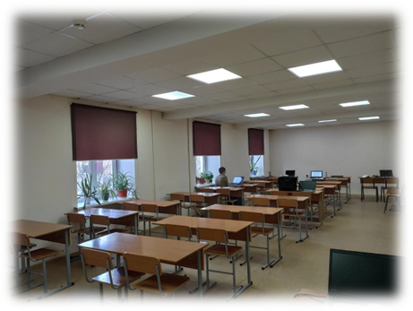
University Dormitories Accommodation in a dormitory is provided to all students who need it

Slide 9
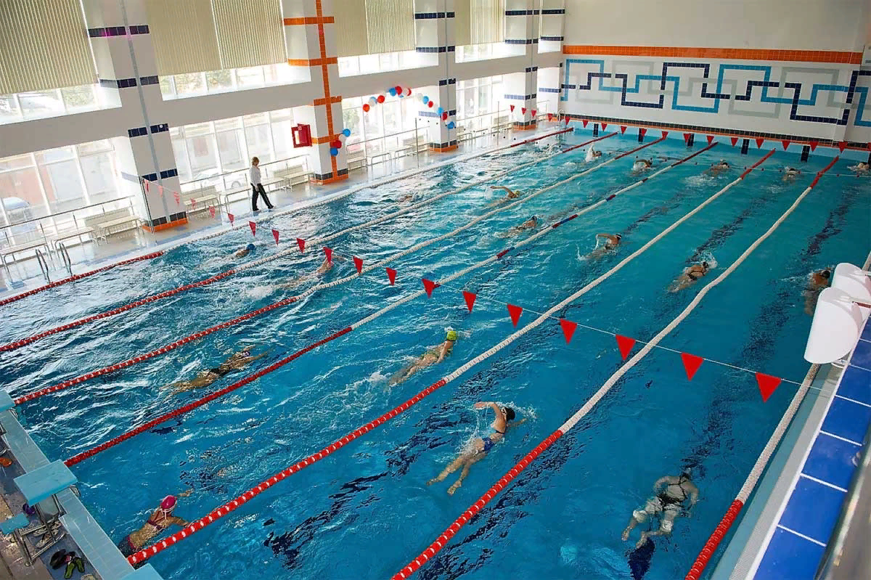
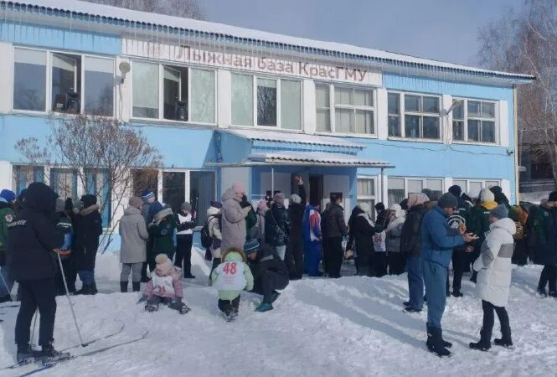
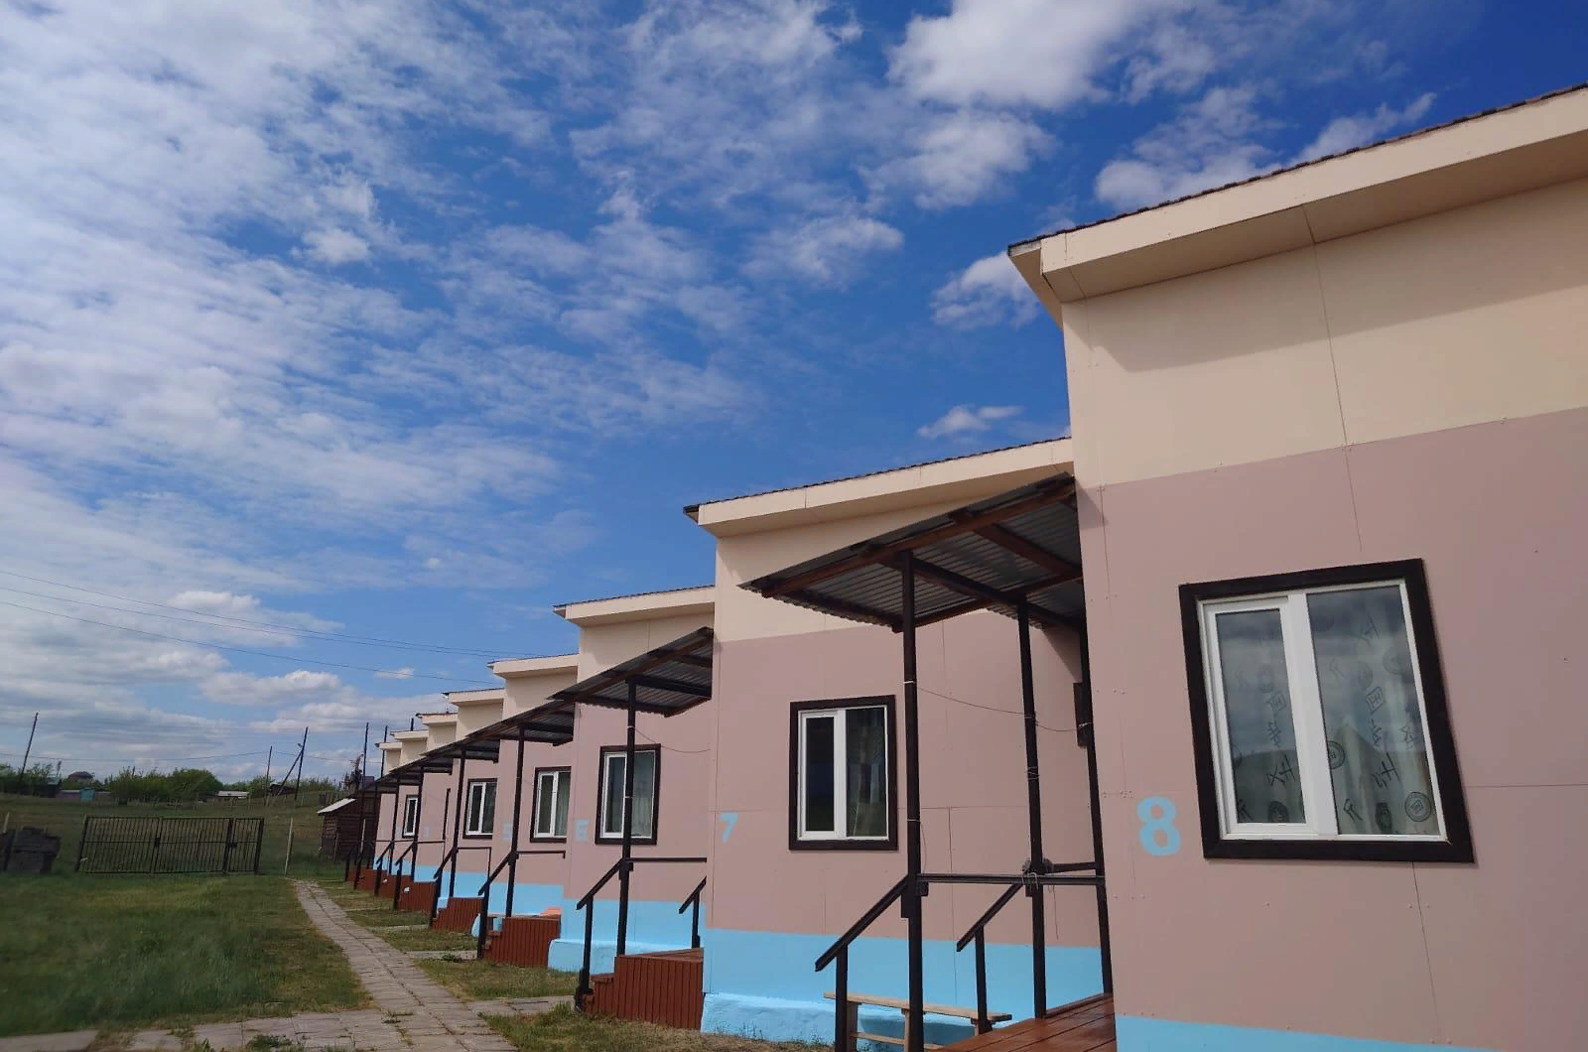
SPORTS AND RECREATION FACILITIES
Swimming pool
Skiing center
Shira Lake training and recreation facilities

Slide 10
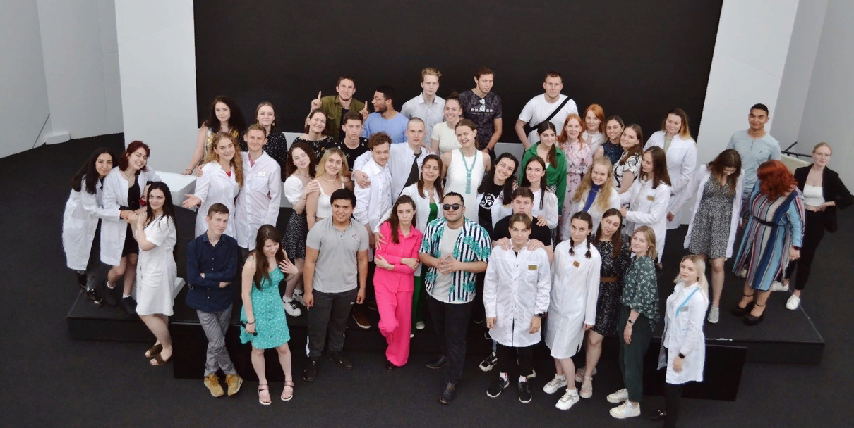
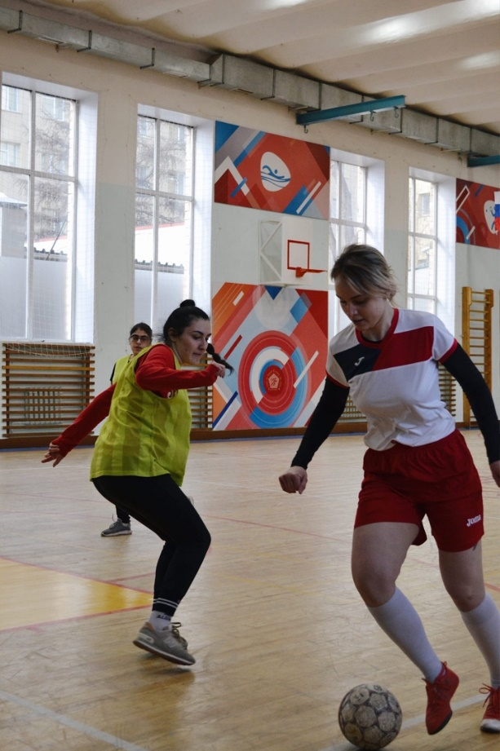
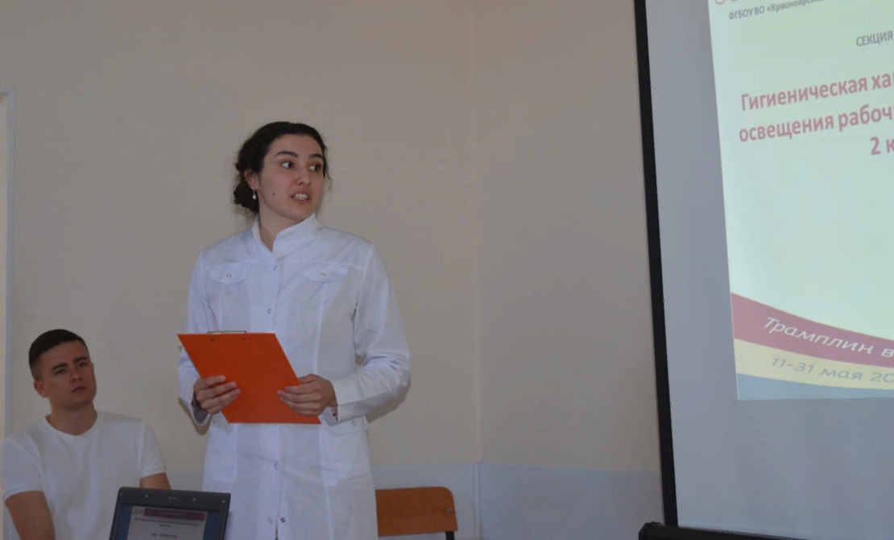
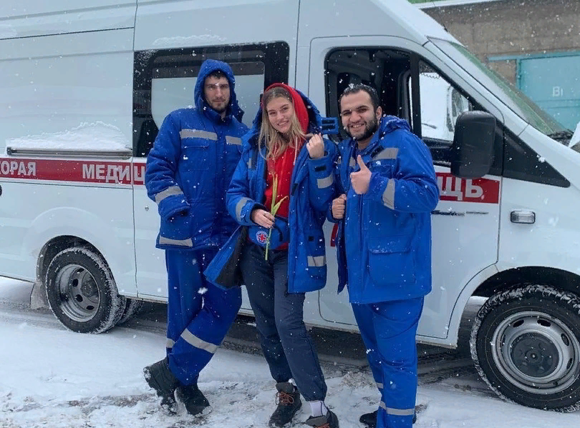
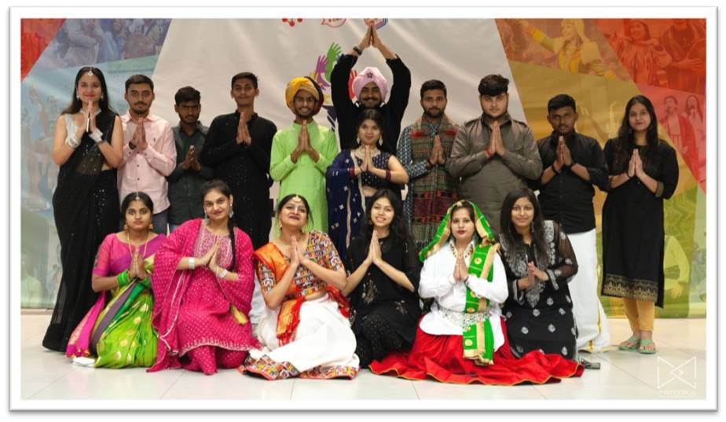
KrasSMU – the university of opportunities
Social Life
Science
Work
Creativity
Sports

Slide 11
Your future is in your hands
CHOOSE RIGHT!
CHOOSE KrasSMU!
KRASGMU.RU
Admission:
+7 391 228-08-58
pk@krasgmu.ru
international@krasgmu.ru inted@krasgmu.ru (for inquires in English)

