Slide 1
Gorlova Olga Pavlovna a biology lecturer
an associate Professor of the Department of biology and ecology of Krasnoyarsk State Medical University.
My contacts are
phone number - 8 923 270 19 04,
mail on the site of Krasnoyarsk State Medical University
e-mail - gorlova.o.p@yandex.ru

Slide 2
how we will work in the classroom
start the lesson with a greeting.
formulate the purpose of the lesson.
write a test on the topic of a lesson.
discuss the main issues and analyze what you did not understand in this topic.
formulate and write down conclusions, homework,
we ‘ll break up till the next class.

Slide 3
LEVELS OF ORGANIZATION OF THE LIVING

Slide 4
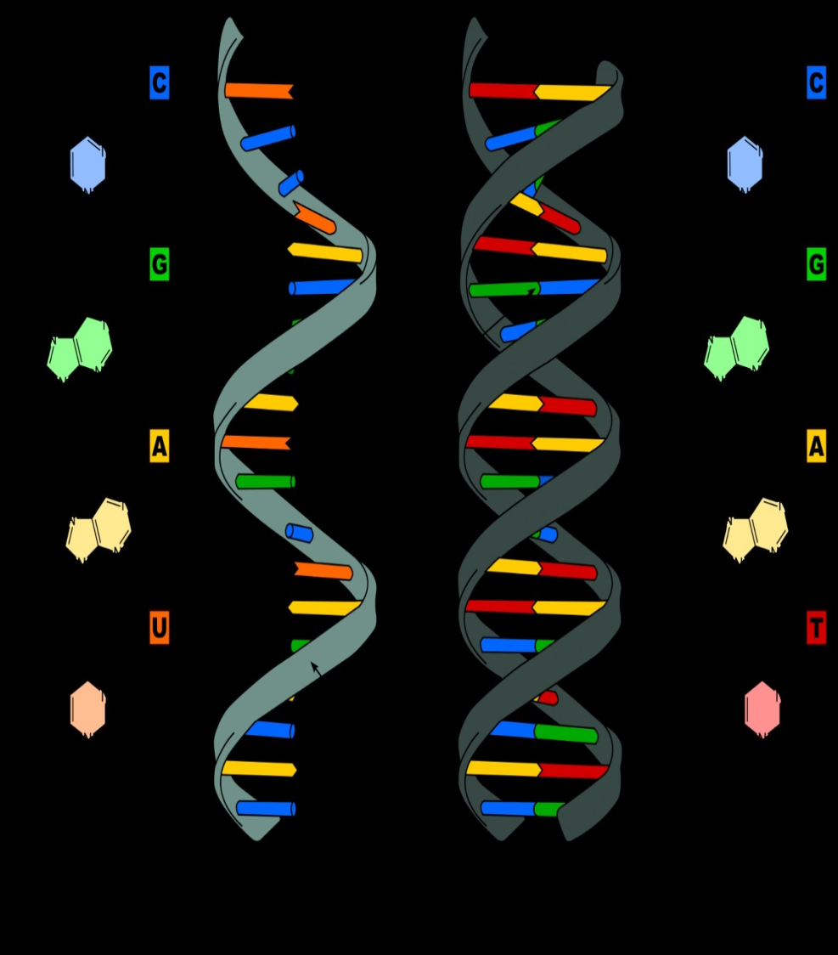
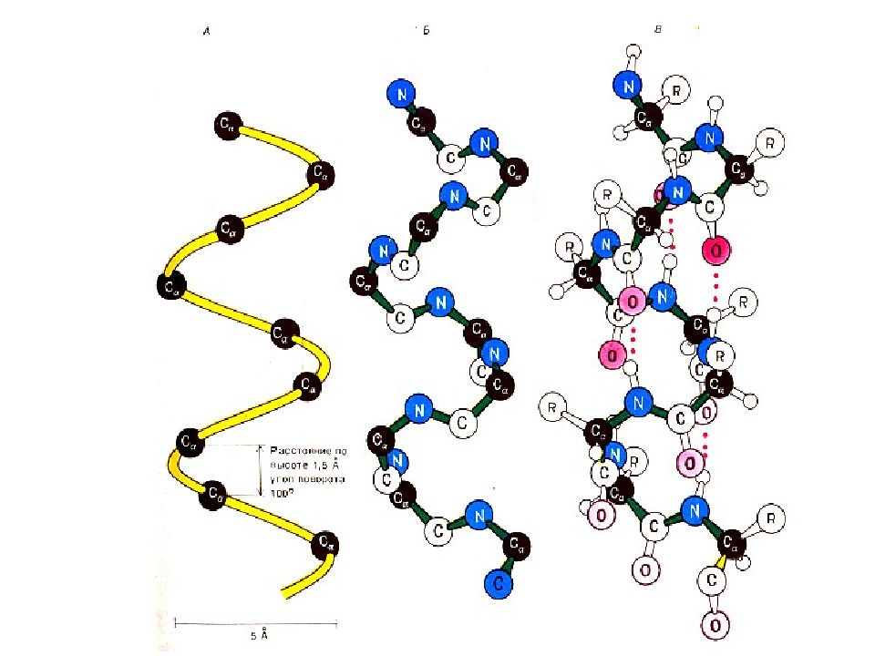
1. Molecular level
RNA
DNA
Poteins

Slide 5
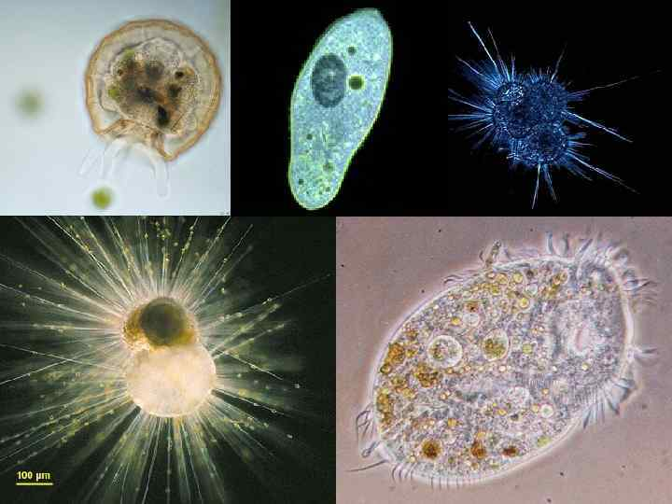
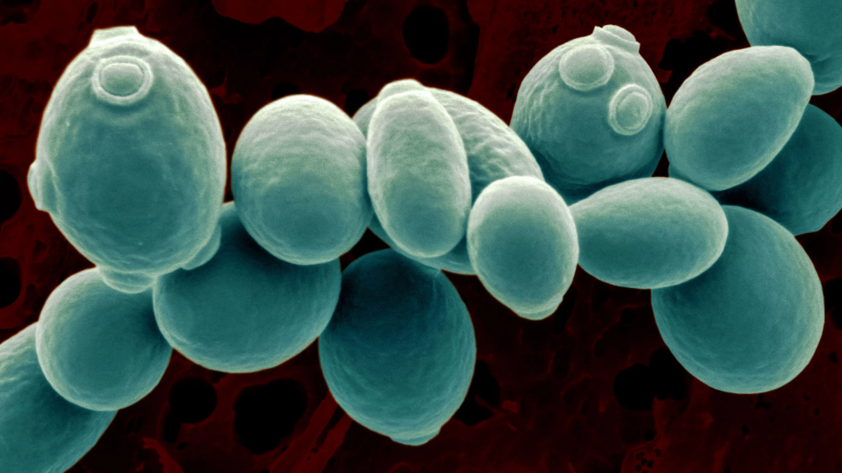
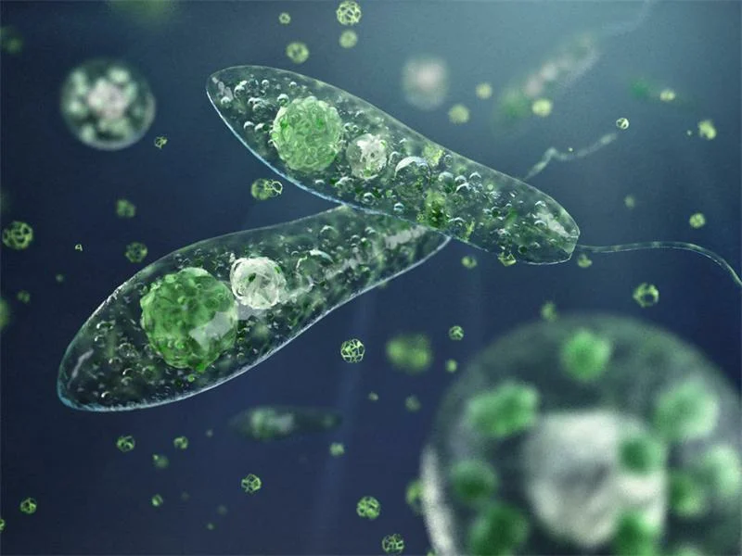
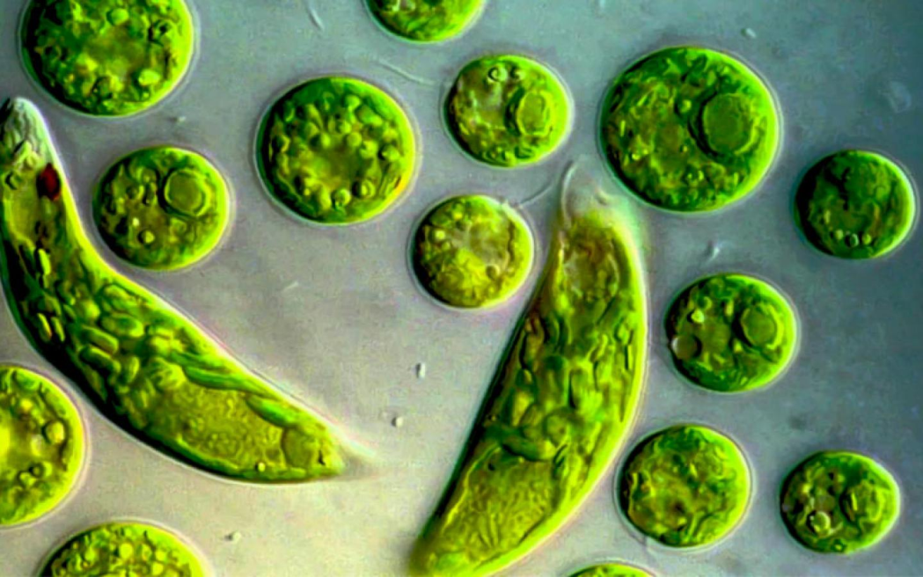
2. Cellular level

Slide 6
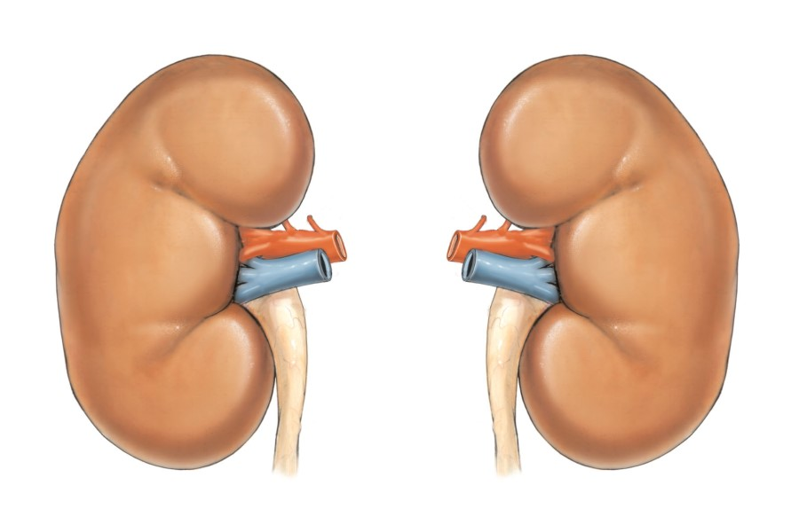
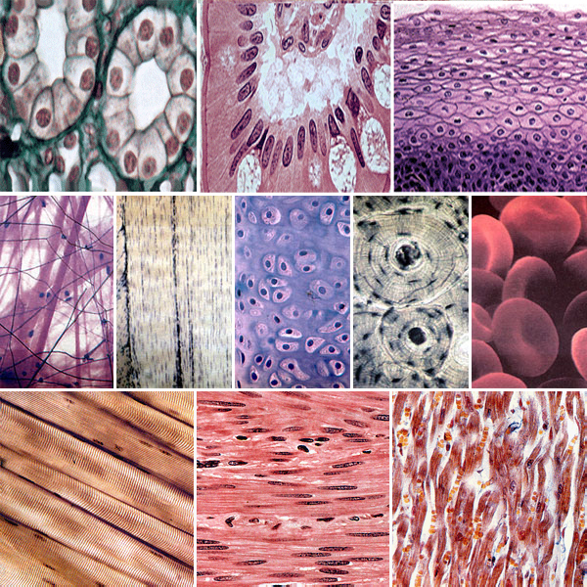
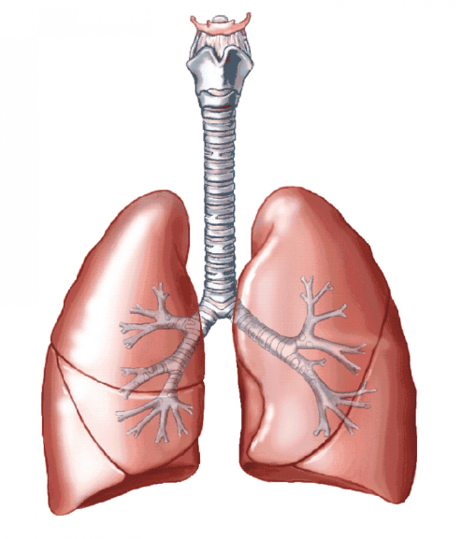
3. Tissue-organ level

Slide 7
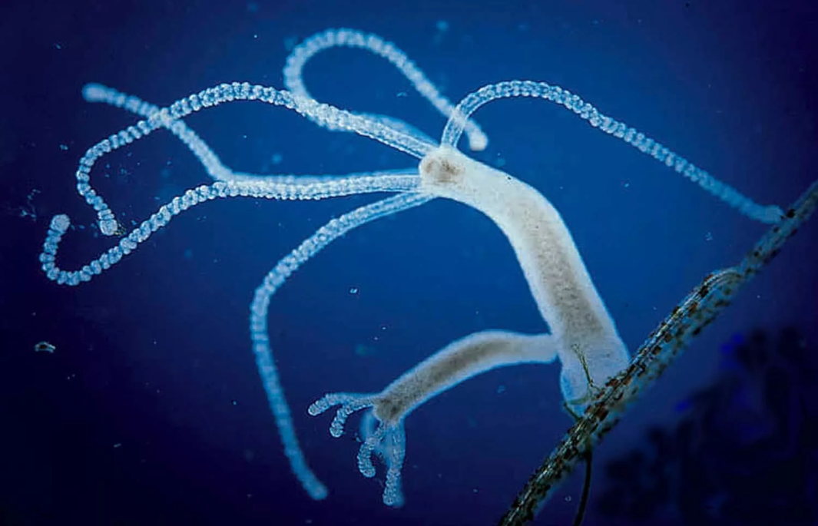
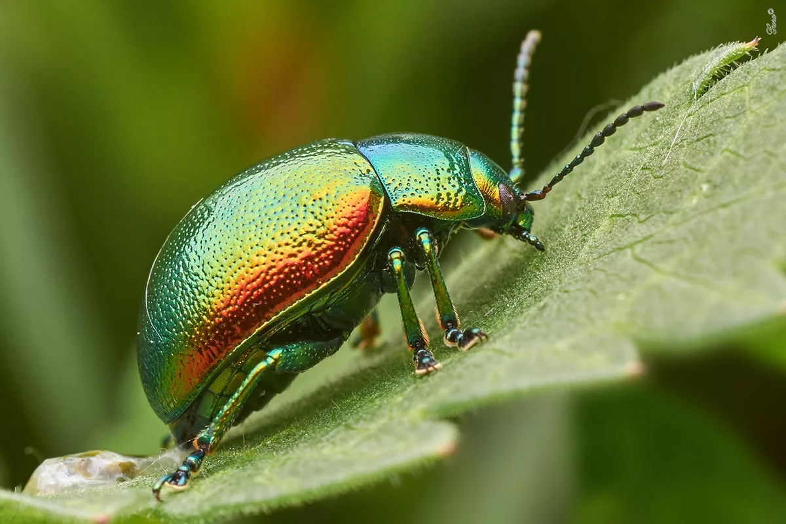
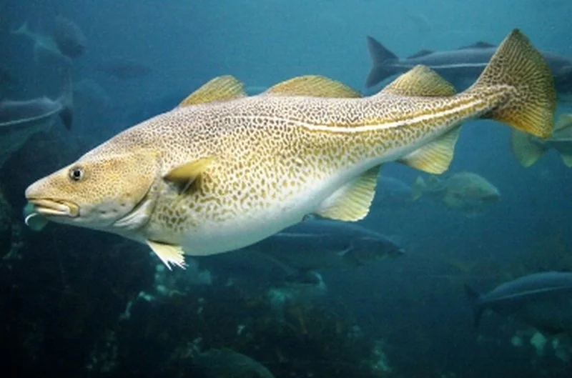
4. Organism level

Slide 8
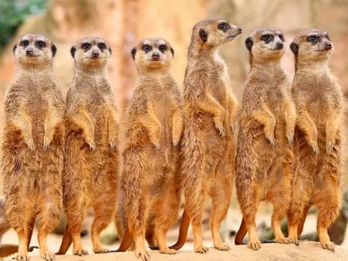
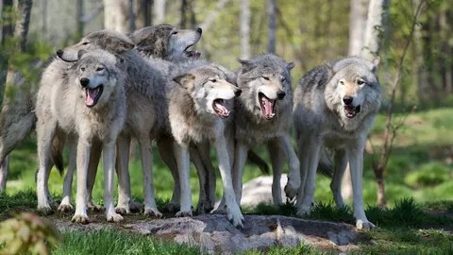
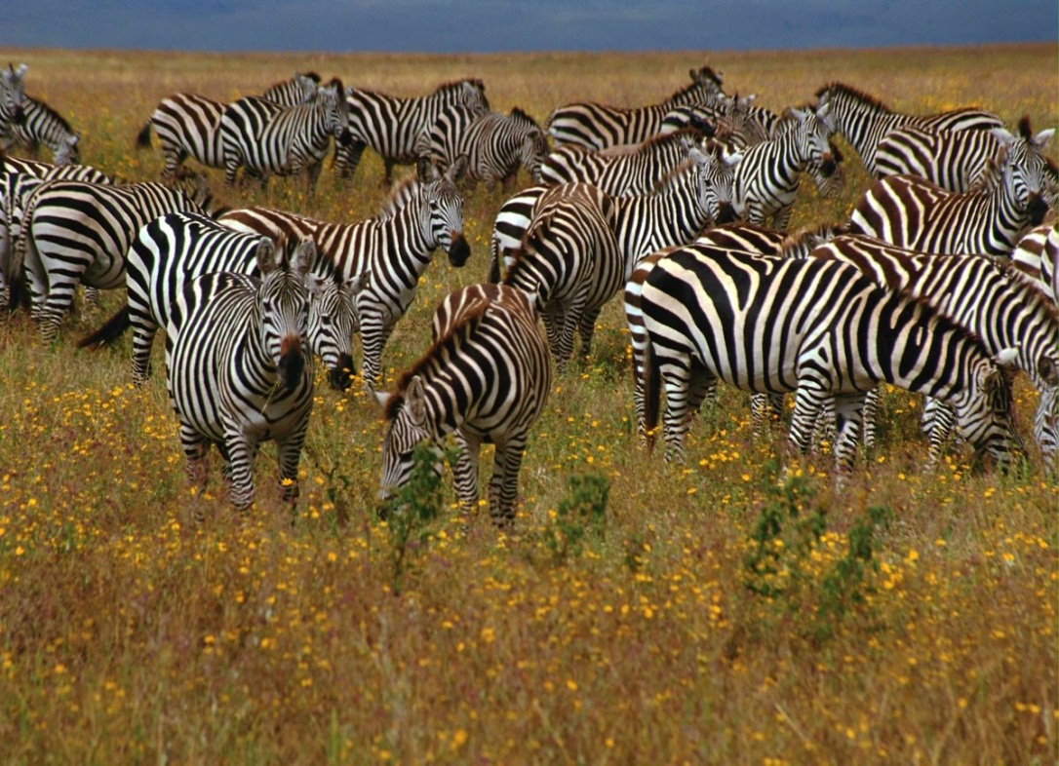
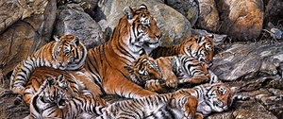
5. Species level

Slide 9
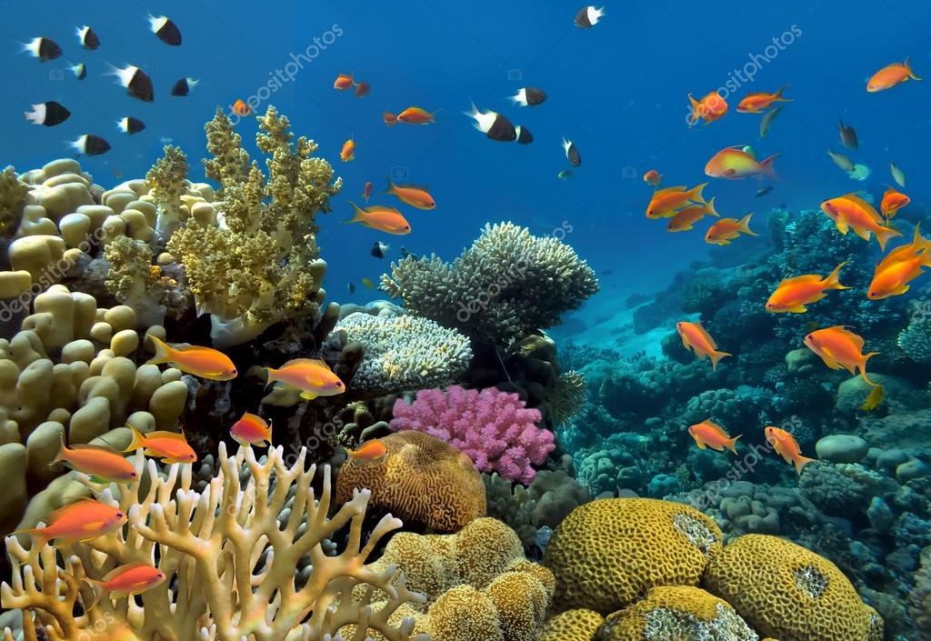
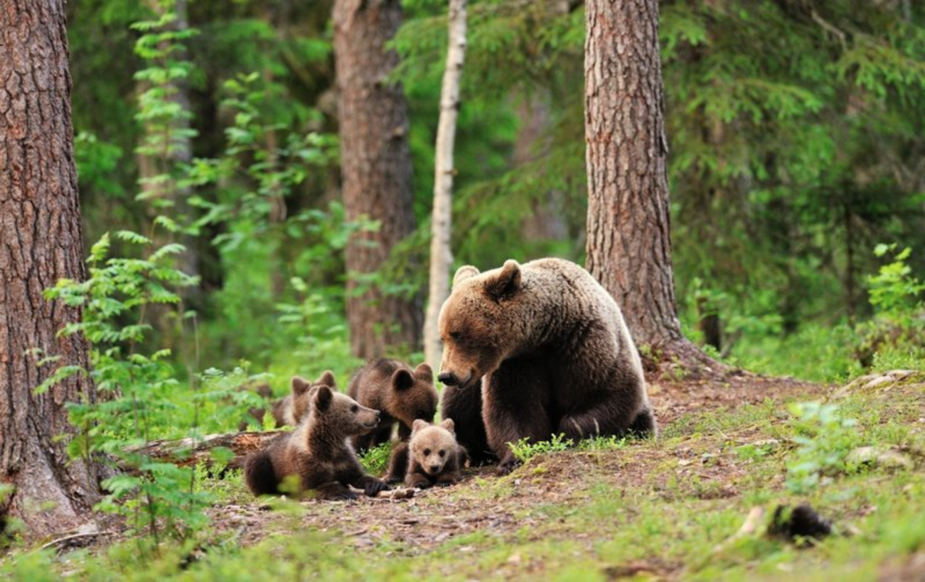
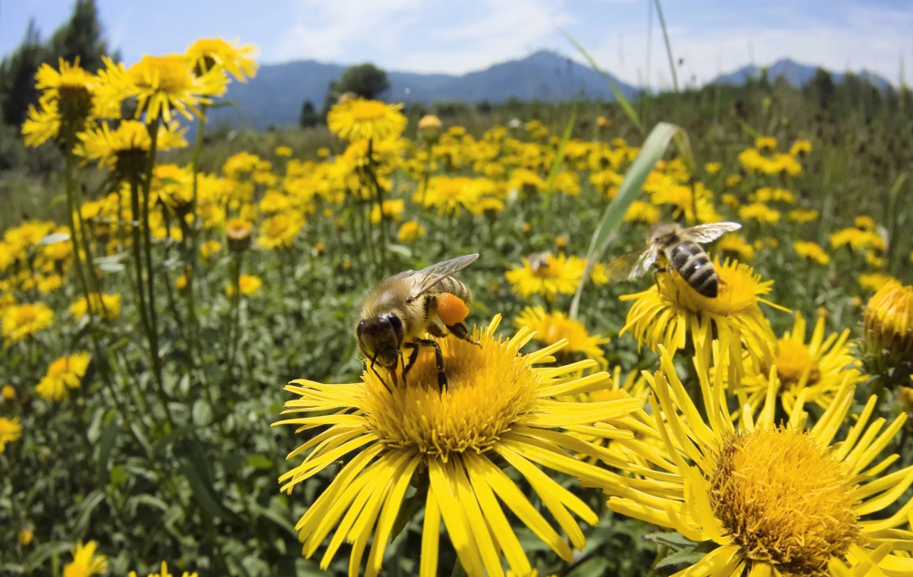
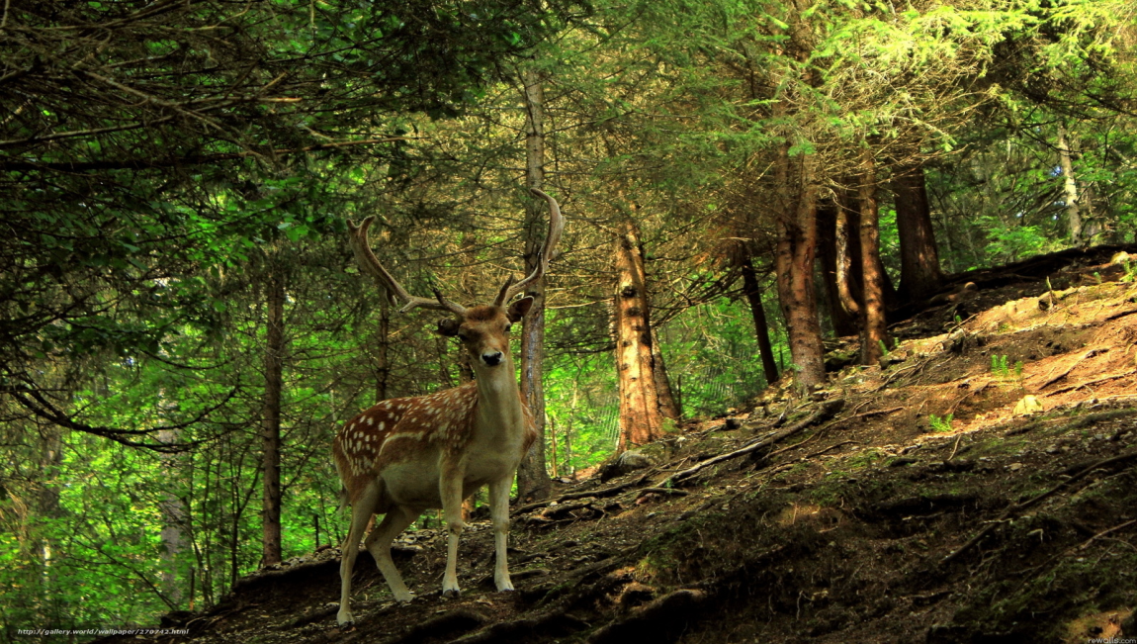
6. Biogeocenotic level

Slide 10
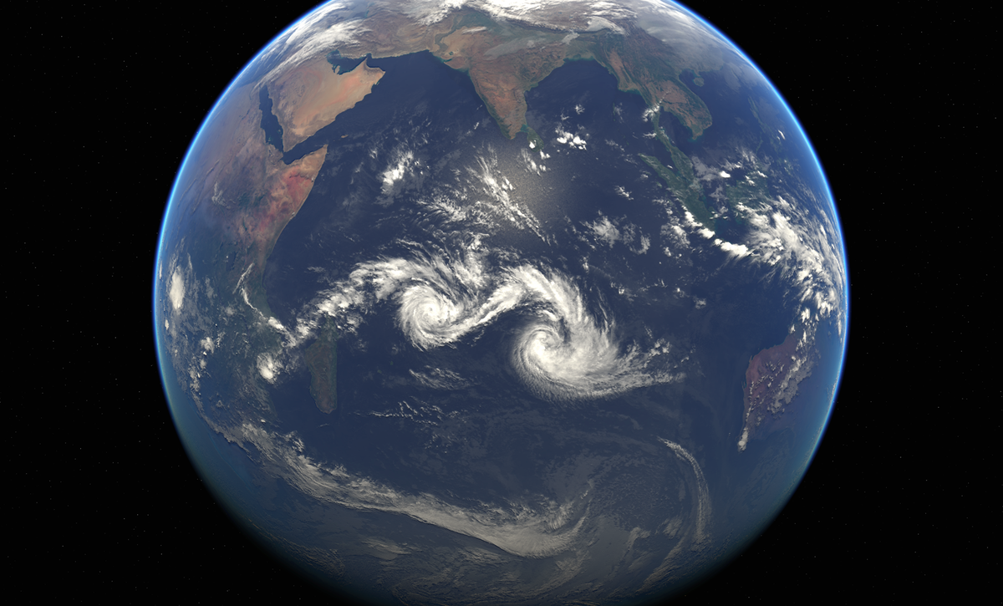
7. Biosphere level

Slide 11
MAGNIFYING DEVICES

Slide 12
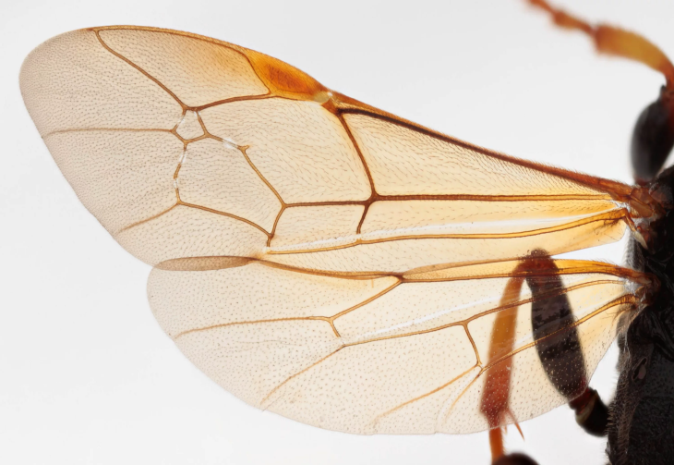
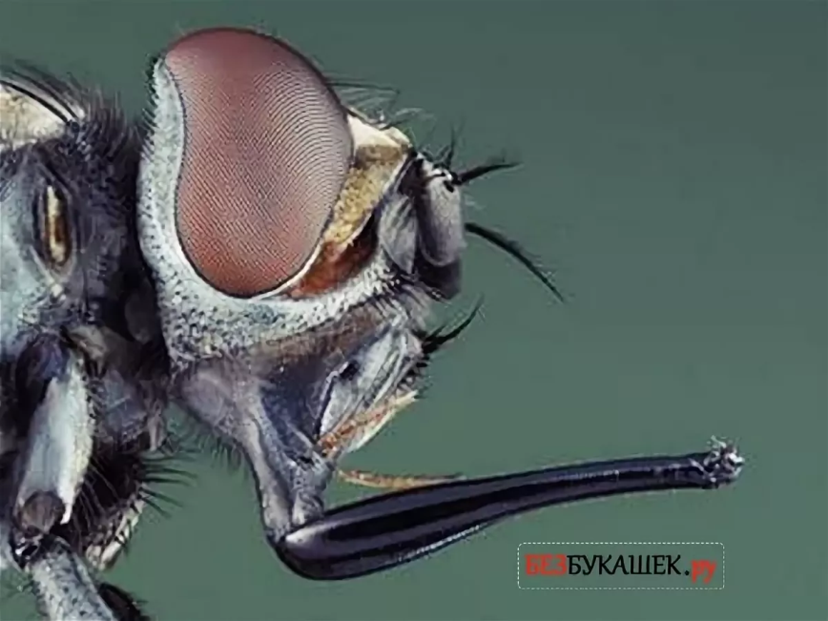
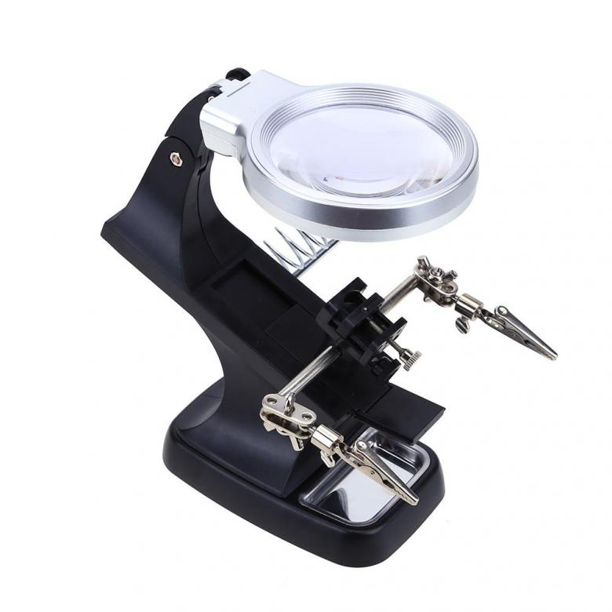
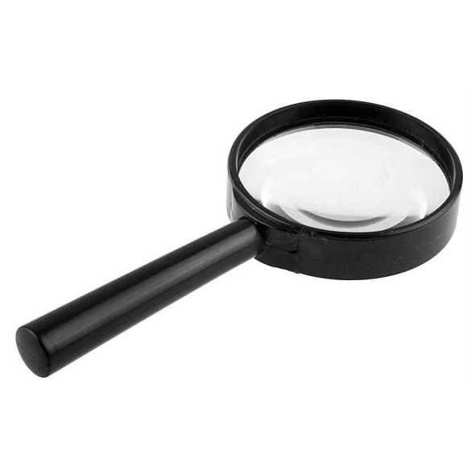
We study life at many levels
Various magnifying devices such as magnifiers, light microscopes, and electron microscopes are used to study various biological objects.

Slide 13
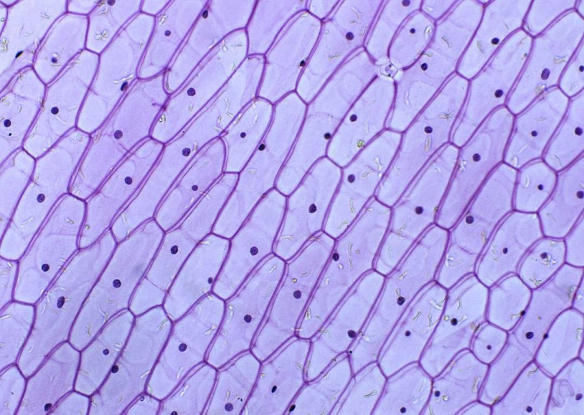
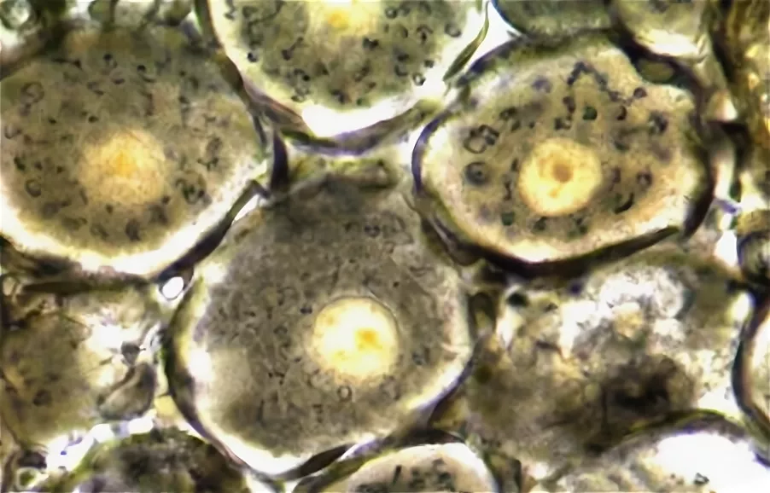
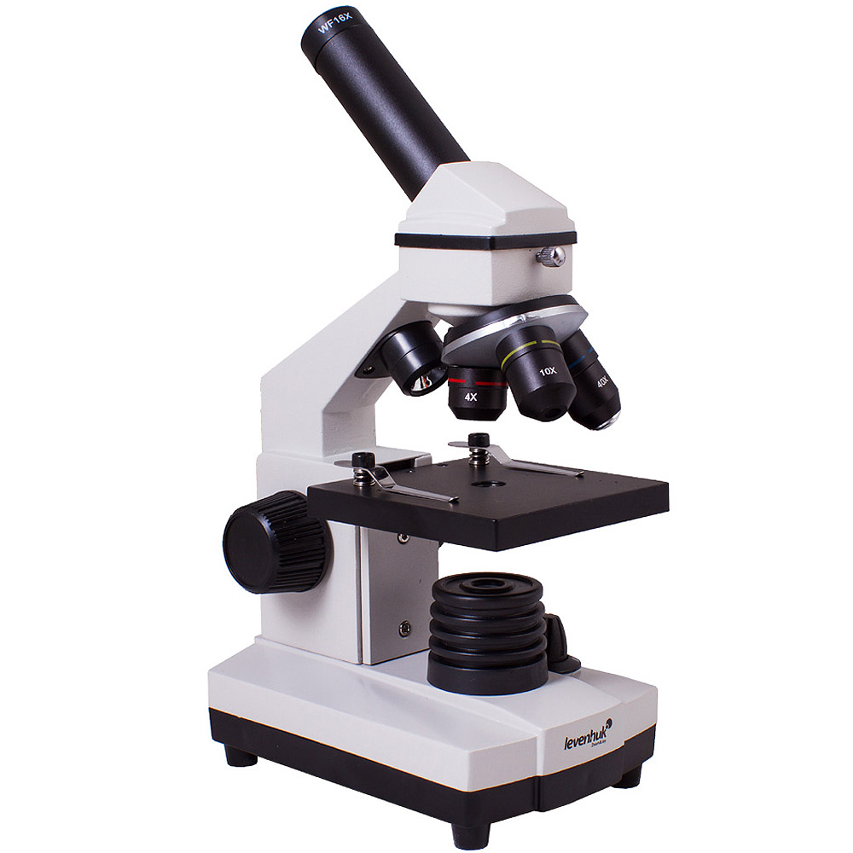
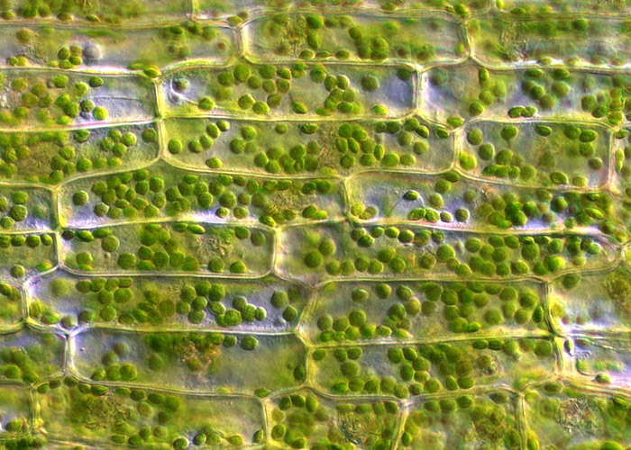
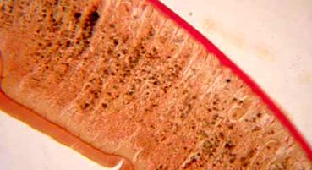

Slide 14
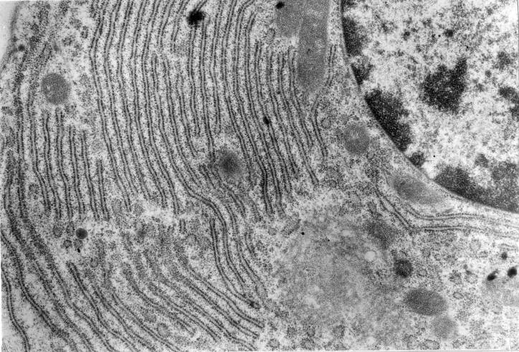
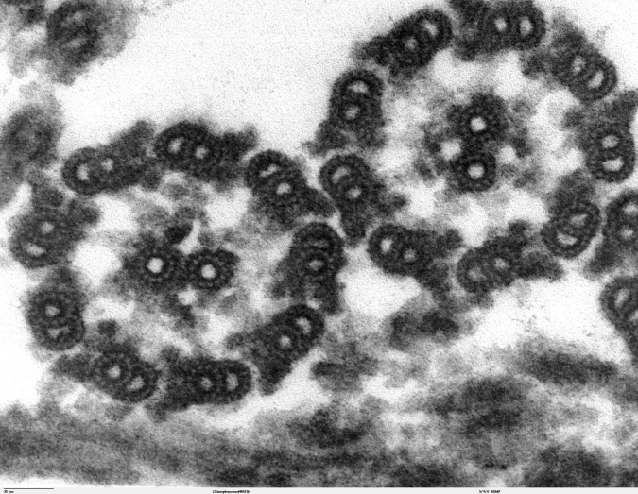
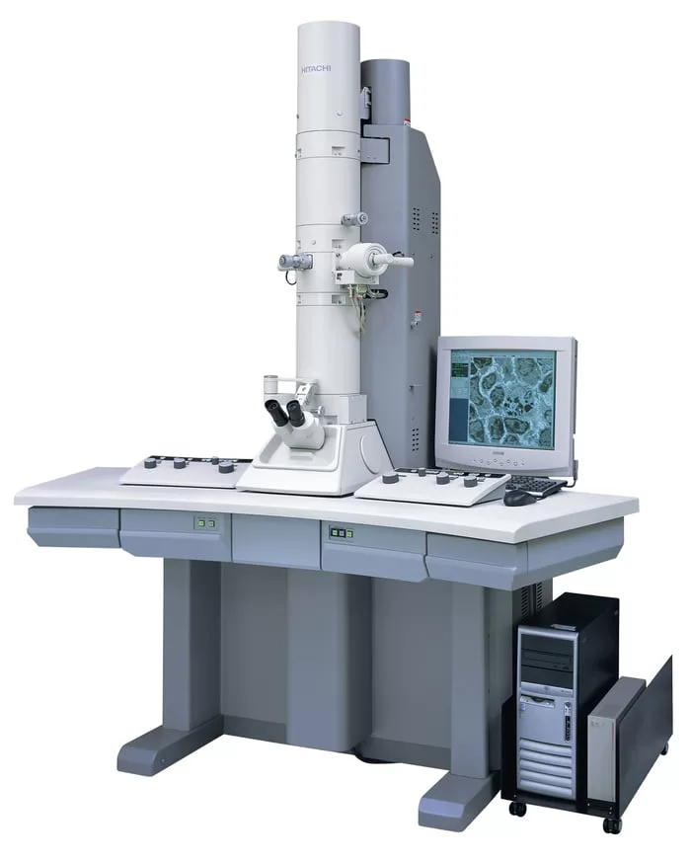
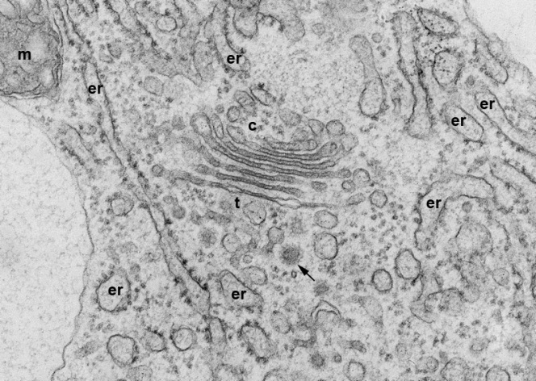
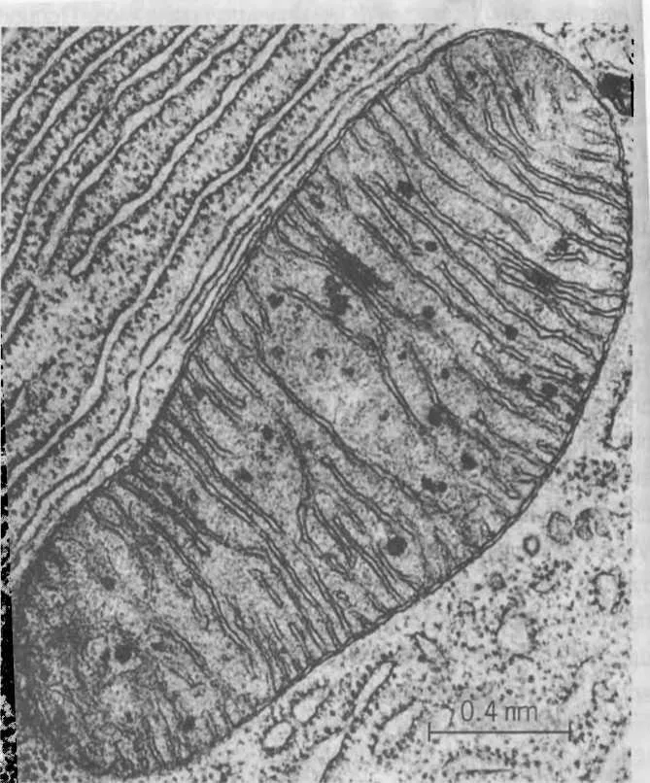
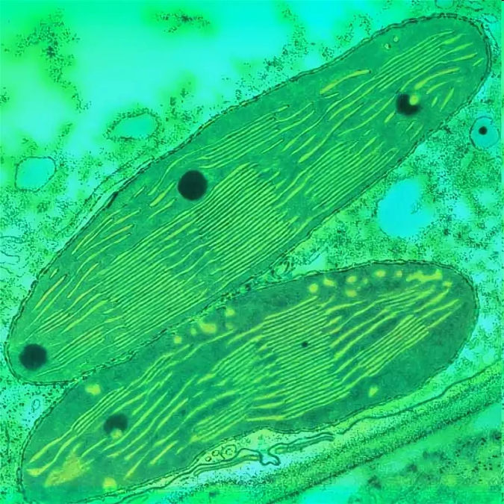

Slide 15
STRUCTURE OF THE LIGHT MICROSCOPE

Slide 16
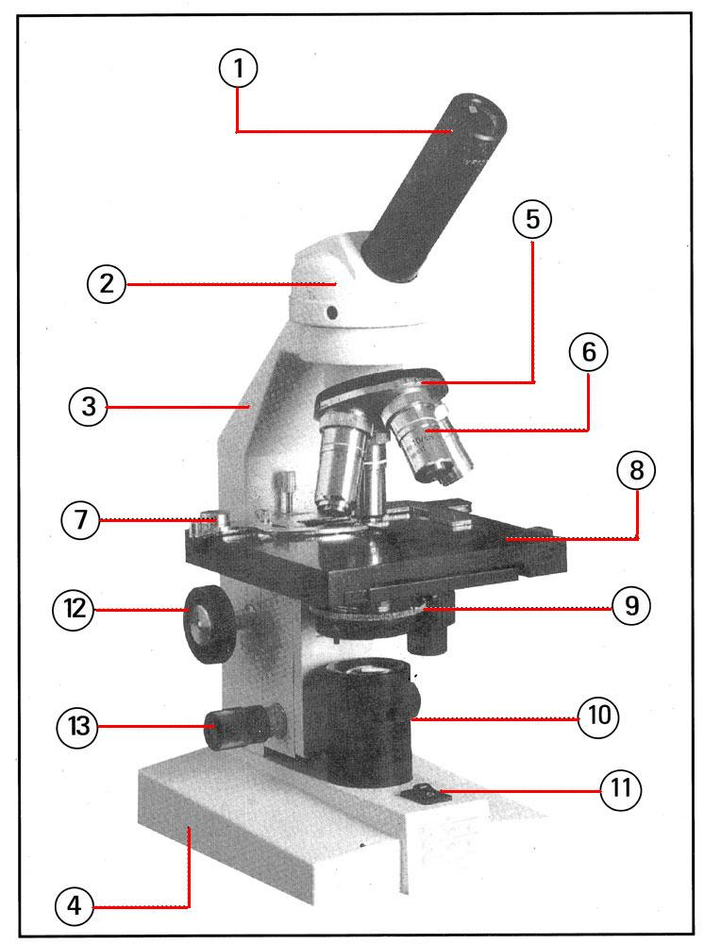
There are three parts of the Microscope
They are optical, lighting and mechanical parts

Slide 17
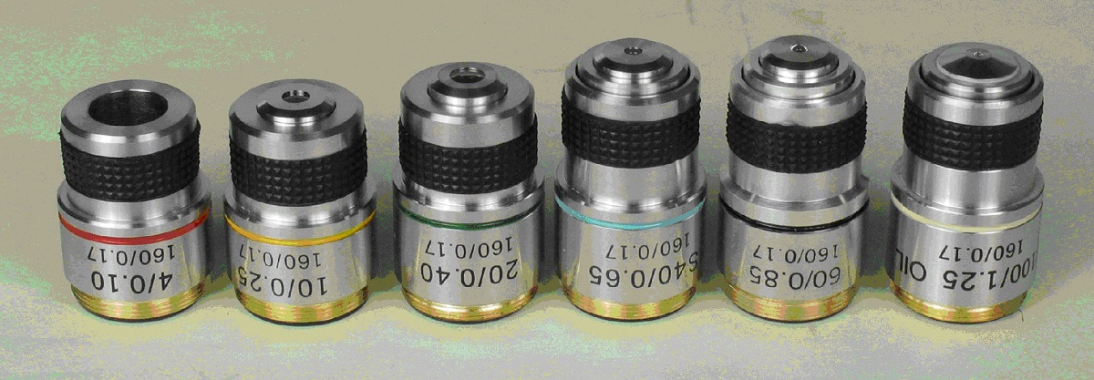
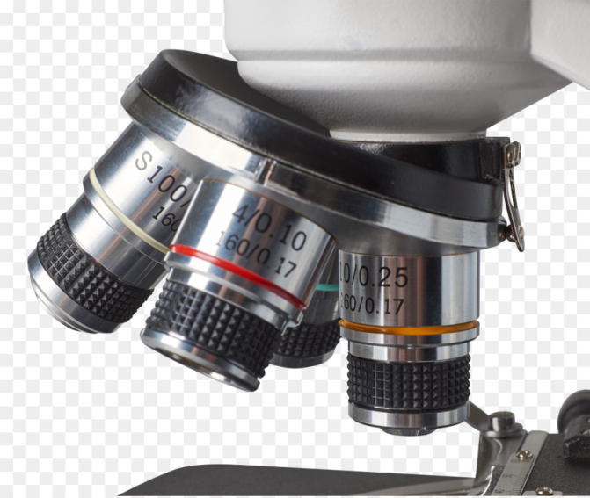
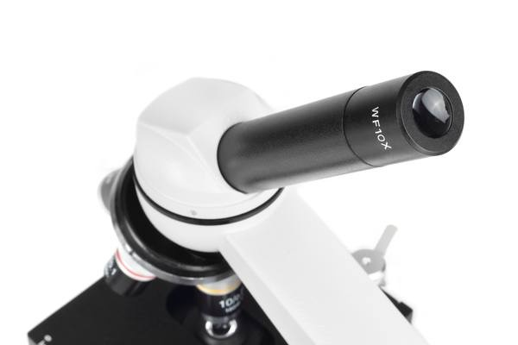
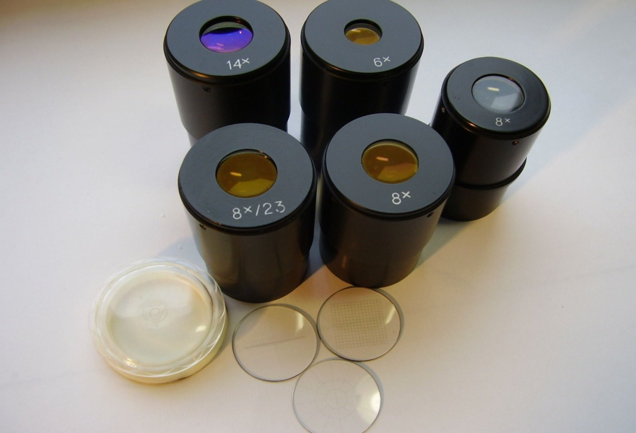
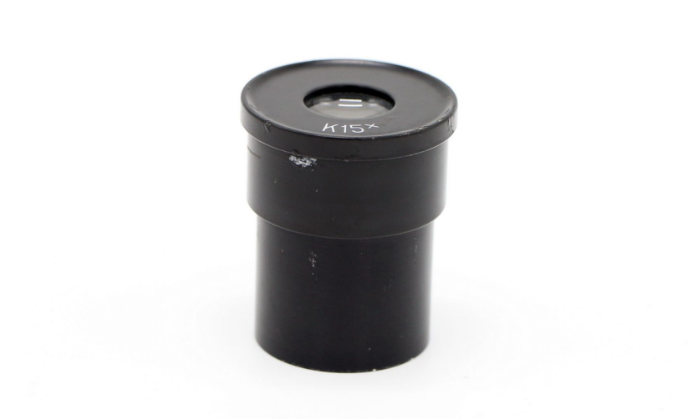
Optical part includes
1. microscope objectives
2. the eyepiece of the microscope

Slide 18
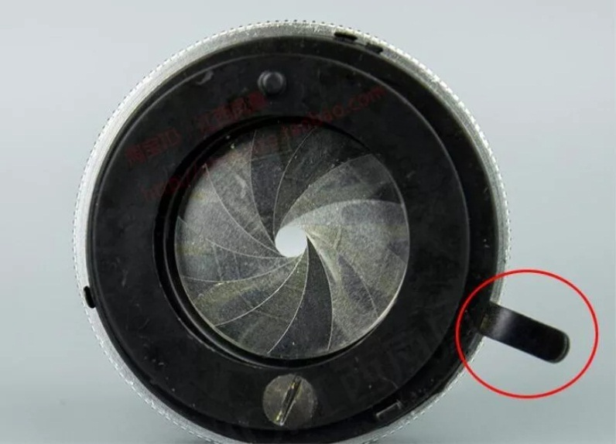
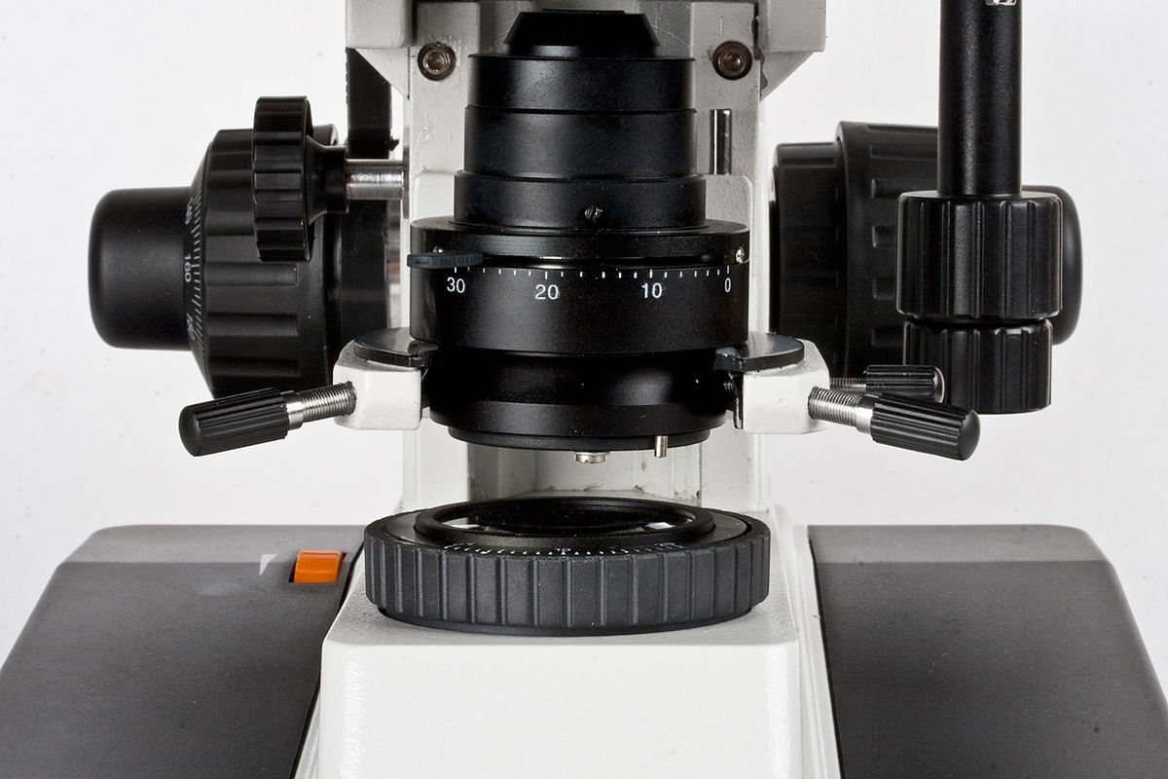
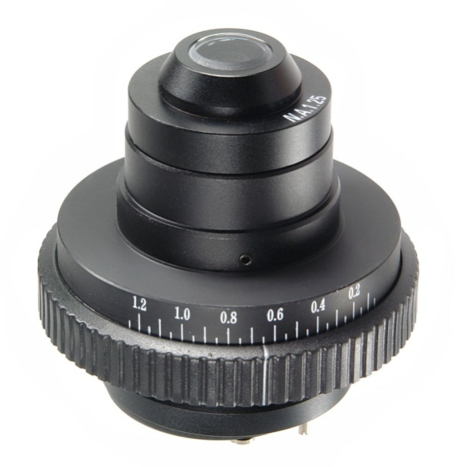
lighting system includes
1. the aperture of the microscope
2. the condenser of the microscope

Slide 19
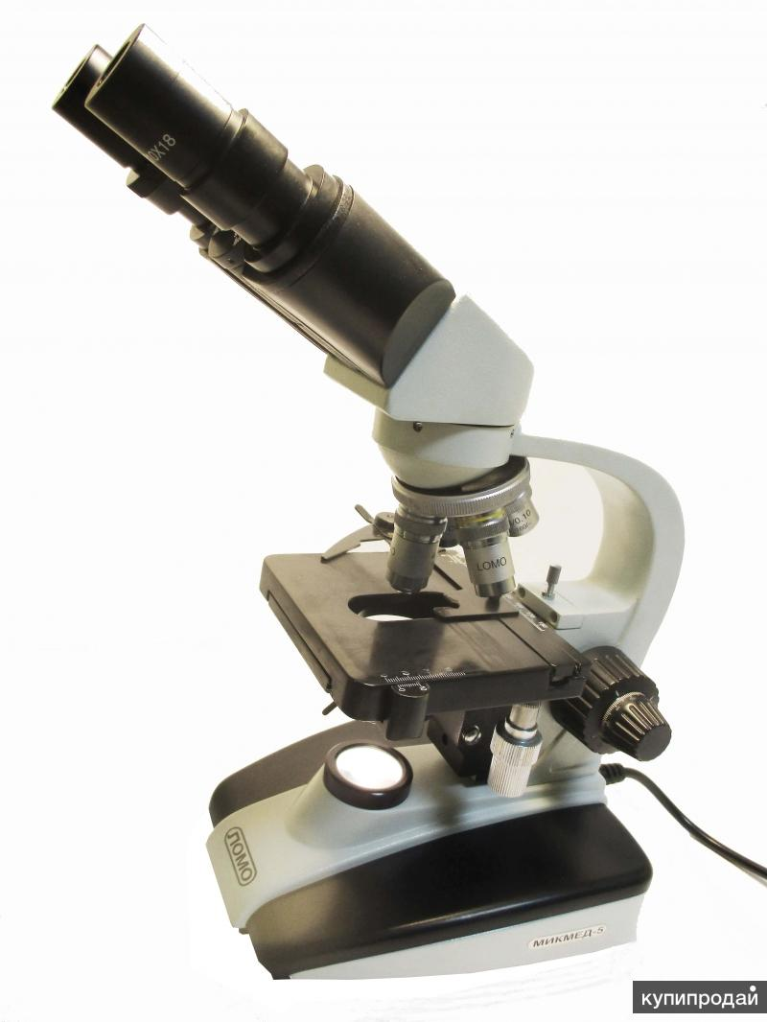
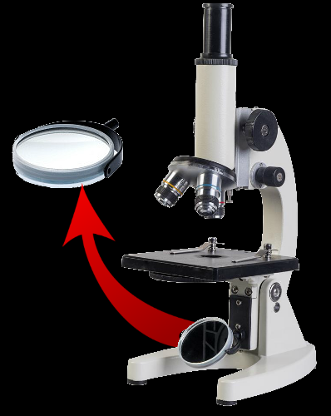
lighting part includes
3. the microscope lamp
or the mirror of the microscope

Slide 20
mechanical part includes:
1. the microscope stand
2. the tube of the microscope
3. the microscope slide table
4. the revolver of the microscope
5. clips of the slide table of the microscope
6. the macrometric microscope screw
7. the micrometer screw of the microscope
8. base of the microscope tripod foot

Slide 21
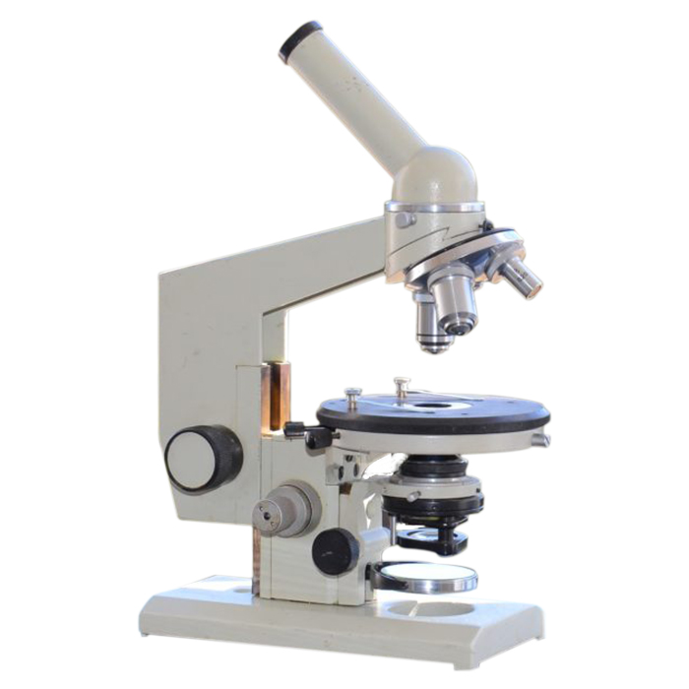
1
2
4
5
3
6
7
8

Slide 22
Rules for working with a microscope
Work with the microscope being seated;
Examine the microscope, wipe away the dust lenses, eyepiece, mirror or electric lamp with a soft cloth ;
Set the microscope in front of you, slightly to the left 2-3 cm from the edge of the table. Do not move it during operation;
Open the diaphragm completely, raise the condenser to the highest position;

Slide 23
5. Working with a microscope always start with a small increase;
6. Lower the lens to the working position, i.e. at a distance of 1 cm from the slide;
7. Set the illumination in the field of view of the microscope using an electric illuminator or mirror.
8. Put the micropreparation on the subject table so that the object being studied is under the lens.

Slide 24
9. Looking from the side, lower the lens using a macro screw until the distance between the lower edge of the lens and the micropreparation becomes 2-3 mm;
10. Look with one eye into the eyepiece and rotate the coarse focusing screw on yourself, smoothly raising the lens to a position where the image of the object will be clearly visible;
11. Moving the drug with your hand, find the right place, place it in the center of the field of view of the microscope;
12. If the image does not appear, then it is necessary to repeat all operations of points 6, 7, 8, 9, 10;

Slide 25
13. To study an object at high magnification, first put the selected area in the center of the field of view of the microscope at low magnification. Then change the lens to 40 x, turning the revolver so that it takes the working position. Using a micrometer screw to achieve a good image of the object.
14. At the end of work with a large increase, set a small increase, lift the lens, remove the drug from the work table, wipe with a clean cloth all parts of the microscope, cover it with a plastic bag and put it in the Cabinet.

Slide 26
Complete a task in a your workbook:
Answer questions:
What types of magnifying devices do you know?
What was the name of the developer of the first microscope?
What objects can be explored with a magnifying glass?
What biological objects are studied using an electron microscope?
List the parts of the optical system of the light microscope.

Slide 27
List the parts of the light microscope's lighting system.
Name the details of the mechanical system of the light microscope.
Draw and fill in a table in your notebook:
Systems of the microscope |  | Part of the microscope system | Functions of this part of the microscope
lighting system | 1 | Lamp, mirror
 | 2 | Diaphragm
 | … | …
optical system
mechanical system

Slide 28
PRO- AND EUKARYOTIC CELLS

Slide 29
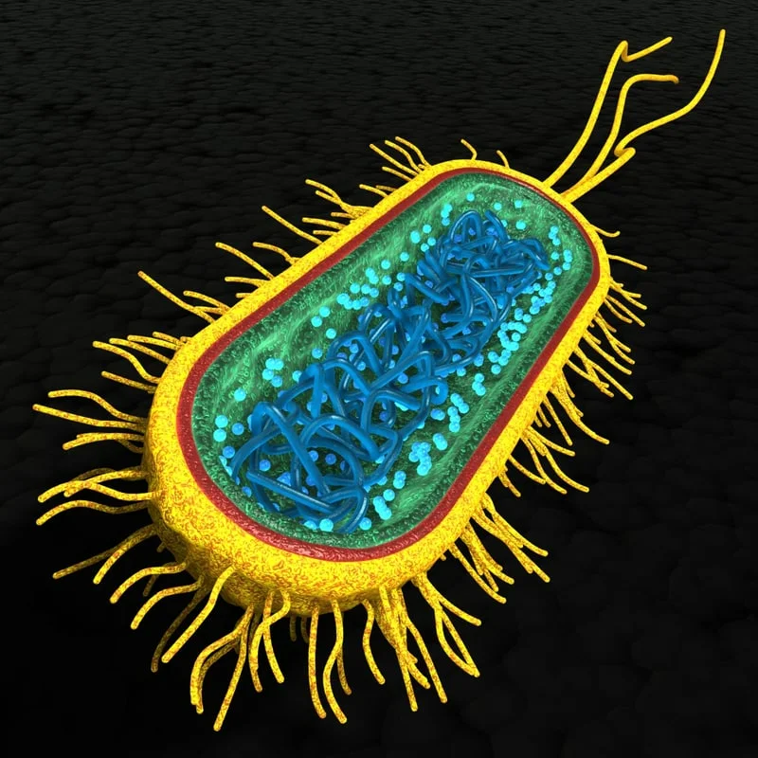
PROKARYOTIC CELLS
Bacteria are the oldest group of organisms
these were the first representatives of living nature
their bodies are primitive.

Slide 30
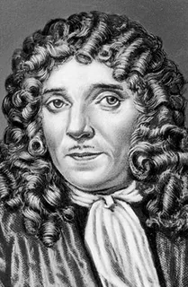
Antony van Leeuwenhoek (1632-1723)
he made the first microscope
and discovered the world of bacteria

Slide 31
General characteristics of prokaryotes
Bacteria are very hardy and adapted to various conditions of existence.
They live everywhere
Bacteria are numerous and diverse organisms.
They have different body shapes (coccus (circle or spherical), bacillus (rod-like), coccobacillus (between a sphere and a rod), spiral (corkscrew-like), filamentous (elongated)).
There are mobile and fixed forms among bacteria

Slide 32
External structure of bacteria
The cell of the bacterium is covered with a special shell.
This is the (1) cell wall (made of murein), which performs a protective and supporting function. It gives the bacteria a permanent, characteristic form.
Often, an additional protective layer of mucus — a capsule (2) is produced on top of the cell wall in bacteria.
there are long flagella(-s)(3) or short thin pillus (4) on the surface of some bacteria.
1
2
4
3

Slide 33
There are two main types of bacterial cell walls:
1 cytoplasmic membrane
2 peptidoglycan
3 periplasm
4 external membrane
5 nucleoid
6 mesosome
A - gram-positive
Б - gram-negative

Slide 34
Internal structure of bacteria
1 ribosomes
2 cytoplasm
3 flagellas
4 nucleoid (DNA and plasmids)
5 cytoplasmic membrane
6 mesosoms
6

Slide 35
Answer the question:
1. Establish a correspondence between the level of organization and an example of its structural unit:
1 molecular a leaf cell
2 cellular b wolf pack
3 tissue-organ c all inhabitants of the lake
4 organizational d facial muscles
5 population-specific e DNA
6 biogeocenotic f cow
2. Name the organoids that occur in both prokaryotic and eukaryotic cells.
3. What cellular structures only prokaryotes have?

