Slide 1
Healthcare in France

Slide 2
Healthcare in France
The health care system in France is currently one of the best in the world. The French people are provided with medical services at a decent level and the citizens of the country are satisfied with the work of doctors and the functioning of the health system as a whole.

Slide 3
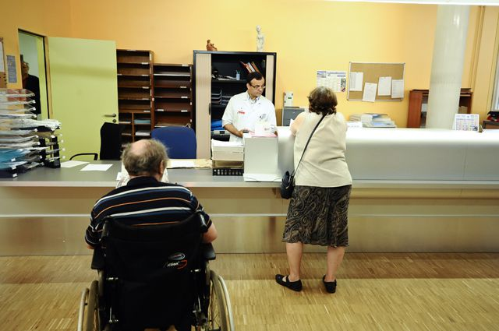
All medical institutions in France are divided into private and public. They differ only in the number of services provided. Frequent can be still commercial or non-commercial. They are referred for basic medical aid to the public clinics, but if the patient needs long-term additional care or supervision that the state can not provide, then the relatives transfer the patient to a private clinic.

Slide 4
Healthcare in France
Compulsory health insurance is available to all segments of the population. The main medical aid is provided by family doctors in clinics, and if there is a need to contact a narrow specialist, then the patient should have a referral from a family counselor. If there is not one, then the compulsory insurance fund will compensate for only a third of the funds expended.

Slide 5
Financing
On average about 75% of services are covered from the mandatory insurance fund of patients, and the remaining 25% can be covered if the citizen signs a voluntary health insurance contract. That is, this system works like this: when you go to a doctor, the patient pays for the service independently, and some time later receives compensation from the fund, if there is a contract with it. The fund receives money that is collected as taxes from working citizens, taxes for alcohol and tobacco products.

Slide 6
But nothing in this world is perfect, including the French health system. Its one of the drawbacks is that doctors mostly prescribe a large number of medicines, and the help of doctors is not always at the required level, despite their abilities and qualifications. But, although these errors are present, the system as a whole functions in a measured and coordinated manner, and on it some countries should be leveled.

Slide 7
Thank you for attention!

