Slide 1
Prof. V.F. Voino-Yasenetsky Krasnoyarsk State Medical University
Topic: Amino acid reactions by amino group and radical. Ammonia neutralization. Metabolism of creatine.
Lecture No. 10 on the discipline "biochemistry" for 2nd year students
Lecturer: Panina Yu.A.
Authors: Panina Yu.A., Malinovskaya N.A.
Krasnoyarsk, 2023

Slide 2
Lecture plan
Relevance
Amino group reactions of amino acids: types of deamination.Transamination.
Amino acid reactions by radical: the formation of bonds in protein structures.
The metabolism of some amino acids and their breakdown.
Sources of ammonia and causes of its toxicity.
Ammonia transport, ways of its neutralization.
Urea cycle. Ornithine cycle disorders.
Synthesis of creatine and its role in the body. Creatinine.
Pathology of the metabolism of individual amino acids.
Conclusion

Slide 3
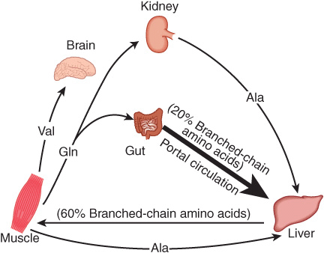
The metabolism of amino acids in tissues and organs during the absorptive period
During the absorption period, the intestines are the main source of free amino acids. Most of the amino acids supplied are hydrophobic branched chain amino acids. Exogenous polar amino acids from the portal vein are absorbed and used mainly by the liver. Branched-chain amino acids are absorbed from the bloodstream by brain or muscle cells.
https://basicmedicalkey.com/catabolism-of-proteins-of-amino-acid-nitrogen/

Slide 4
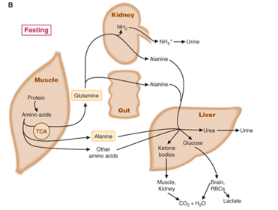
The metabolism of amino acids in tissues and organs during the postabsorptive period
In the post-absorptive period, free amino acids come mainly from muscles, in which protein catabolism is enhanced. Amino acids are used in gluconeogenesis in the liver. Blood levels of alanine, serine and glutamine are elevated.
https://o.quizlet.com/oANUNGA3r0uyqjtOT-E2xw.png

Slide 6
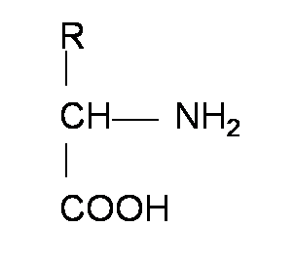
Amino acid structure
R-group
Amino-group
Carboxyl group

Slide 7
General and particular ways of amino acid metabolism in the human body
decarboxylation
deamination
protein biosynthesis
transamination
racemization
(only for microorganisms)

Slide 9
Oxidative deamination of glutamate
НОН
Glutamate dehydrogenase
Glutamate
α-iminoglutarate
α-ketoglutarate
Glutamate dehydrogenase (GDH):
- localized in mitochondria;
- consists of 6 subunits (Molecular weight 312 kDA);
- ATP, GTP, NADH inhibit GDH;
- ADP activates GDH;
- GCS induce GDH;
- has an energy significance.

Slide 10
Indirect deamination
For most amino acids, deamination is indirect:
1. Transamination with the formation of glutamate
aminotransferase (transaminase)
vitamin B6 (pyridoxal phosphate)
Amino acid 1
α-keto acid 1
(α-ketoglutarate)
α-keto acid 2
Amino acid 2
(glutamate)
2. Oxidative deamination of glutamate

Slide 11
Transamination of amino acids
1) transamination is catalyzed by aminotransferases differing in substrate specificity;
2) almost all amino acids, except for lysine, threonine and proline, enter into the transamination reaction;
3) due to the reversibility of this reaction, it can serve as both a source of keto acids and nonessential amino acids in case of their deficiency;
4) transamination is the initial stage of amino acid catabolism;
5) determination of the activity of aminotransferases in blood serum is used for the diagnosis of certain diseases (ASAT - for the diagnosis of myocardial infarction, ALT - hepatitis);
6) aminotransferases are activated by catecholamines, glucocorticoids, large doses of iodothyronines.
aminotransferase (transaminase)
vitamin B6 (pyridoxal phosphate)
Amino acid 1
α-keto acid 2
α-keto acid 1
Amino acid 2

Slide 12
The significance of the transamination reaction
Collector function - amino groups from many amino acids are collected in one form in the form of glutamate;
A source of nonessential amino acids;
During this reaction, amino acids are converted into keto acids, which can be oxidized in the Krebs cycle, used in GNG, or converted into ketone bodies.

Slide 13
Reductive amination in tissues
COOH
COOH
COOH
COOH
OH
C=O
C
HOH
C=NH
CHNH₂
NH₂
GDH
CH₂
NH₃
CH₂
CH₂
CH₂
NADP●H + Н⁺
NADP⁺
CH₂
CH₂
CH₂
CH₂
COOH
COOH
COOH
COOH
2-oxoglutarate
(α-ketoglutarate)
2-hydroxy-
2-aminoglutarate
(loose connection)
Iminoglutarate
Glutamate
a type of amination in which the carbonyl group is replaced by an amine via an intermediate imine

Slide 14
Reductive amination in tissues
α-ketoglutarate
glutamate
oxaloacetate
aspartate
pyruvate
alanine
The significance of reductive amination:
- the reverse process of oxidative deamination
- is a source of nonessential amino acids;
- serves as one of the ways of binding ammonia in the cell

Slide 15
Amino acid metabolism by radical
Formation of bonds in protein structures (as part of the protein - folding) and further protein modifications
In the secondary structure: hydrogen
In tertiary and quaternary structures: various connections
Various modifications: phosphorylation, glycosylation, etc.
The fate of the nitrogen-free amino acid residue (for free amino acids)
Glycogenic amino acids
Ketogenic amino acids
Mixed amino acids
The exchange of individual amino acids
Aromatic and heterocyclic
Sulfur Branched Amino Acids
Dicarboxylic and dibasic amino acids
Exchange of AAs containing hydroxyl and methyl groups

Slide 16
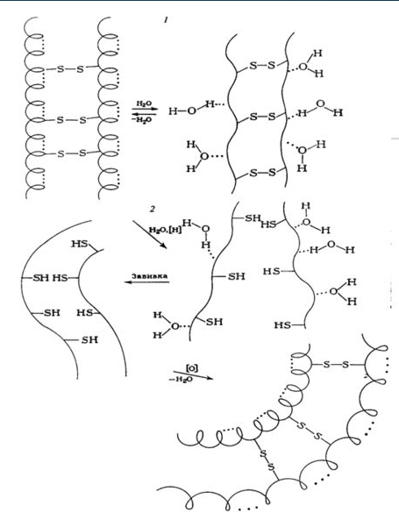
Further protein modifications also mainly proceed along the AA radicals

Slide 17
Further protein modifications also mainly proceed along the AA radicals
Methylation
addition of a methyl (CH3) group
Acylation
Example - acetylation
(addition of the remainder of acetic acid)
Phosphorylation
Attachment of the remainder of phosphoric acid (with hydrolysis of ATP)
Glycosylation
addition of glucose or oligosaccharide residue
(O-glycosidic bond)
Mono-ADP-ribosylation
addition of one ADP-ribose residue
Poly-ADP-ribosylation
addition of several residues of ADP-ribose
Adenylation
Addition of AMP
Ubiquitination
ubiquitin addition
"Black mark" for the destruction of protein in the proteasome

Slide 18
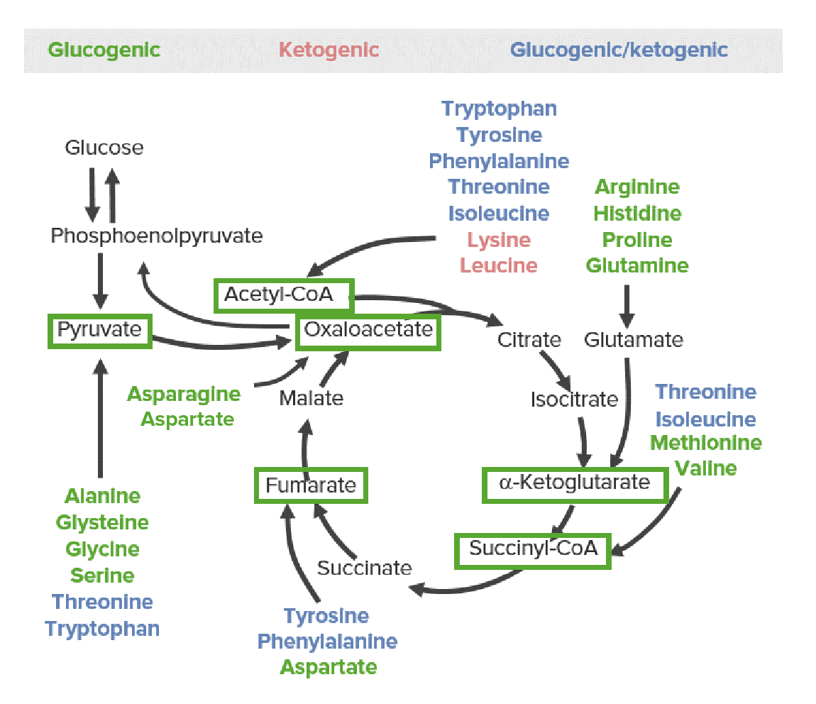
The fate of the nitrogen-free amino acid residue

Slide 20
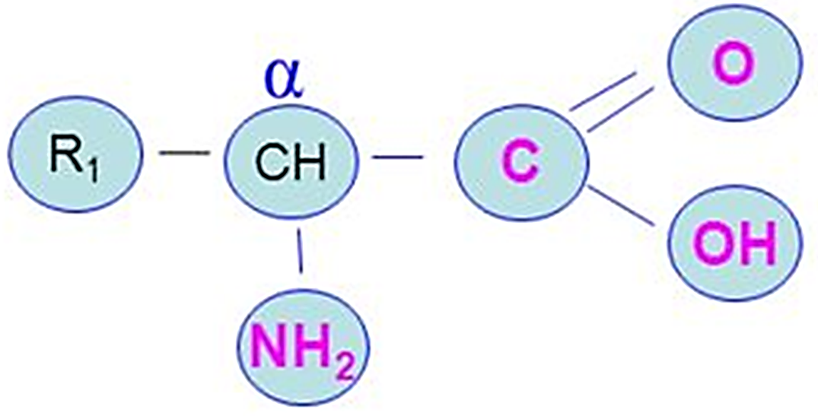
The metabolism of some amino acids

Slide 21
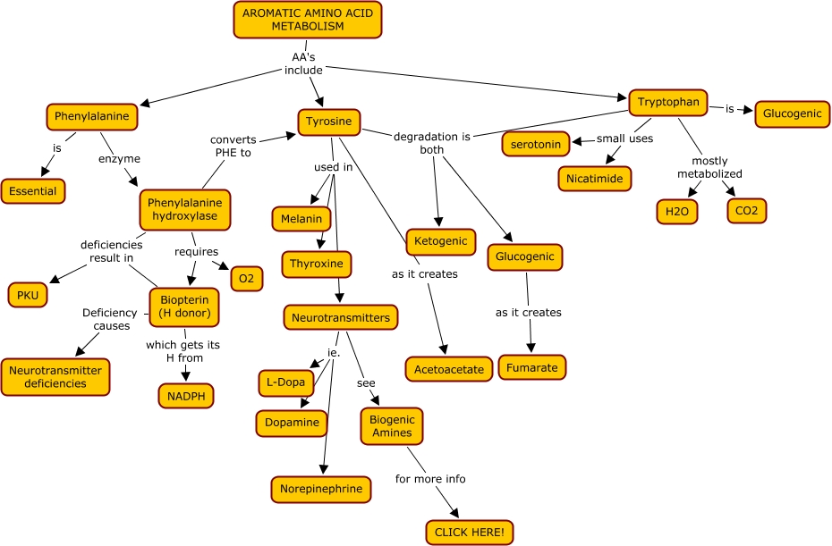

Slide 22
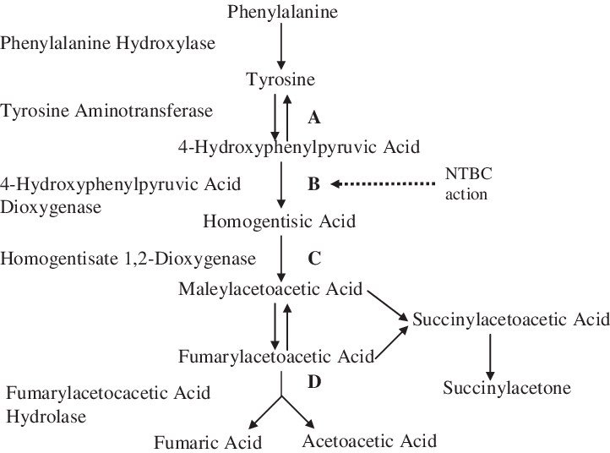
Metabolism of aromatic amino acids (phenylalanine and tyrosine)

Slide 23
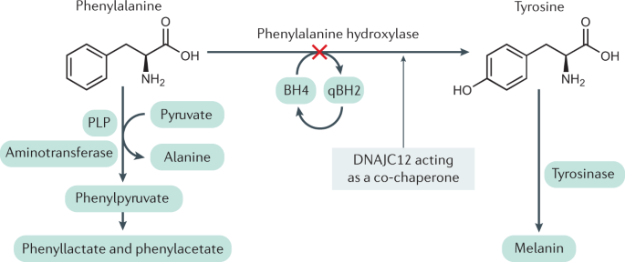
Phenylketonuria (PKU)

Slide 24
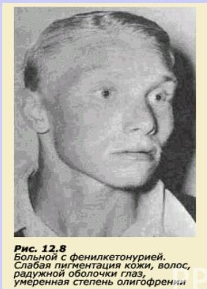
Aromatic amino acid metabolism pathologies
Phenylketonuria or pyruvic oligophrenia (dementia).
Cause: there is no gene responsible for the synthesis of phenylalanine hydroxylase.
Consequences:
1) phenylalanine, phenylpyruvate and phenyl lactate accumulate, which have a toxic effect, especially on the brain;
2) lack of tyrosine, from which iodothyronines, catecholamines and melanin are formed.
Treatment: A diet low in phenylalanine but rich in tyrosine.

Slide 25
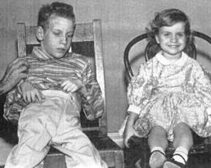
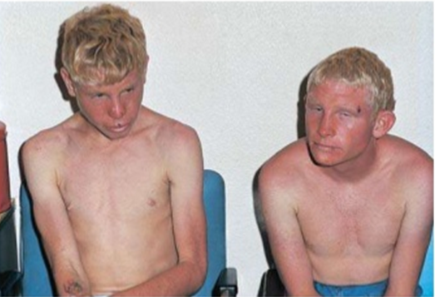
Phenylketonuria
Impaired mental and physical development
Increasing dementia
Abundant neurological symptoms
Psychoses
Convulsive syndrome

Slide 26
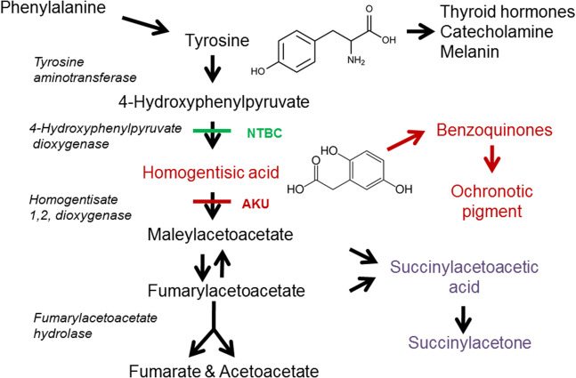
Alkaptonuria

Slide 27
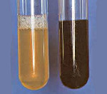
Alkaptonuria (ochronosis)

Slide 28
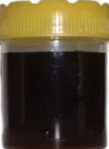
Aromatic amino acid metabolism pathologies
Alkaptonuria (ochronosis):
Causes: occurs in the absence of homogentisinate oxidase.
Consequences:
1) the oxidation of homogentisic acid in tissues is disturbed; its content in body fluids and urine increases;
2) in the presence of oxygen, homogentisic acid polymerizes with the formation of an alkapton (black pigment), therefore, the urine of such patients darkens in the air;
3) alkapone can be deposited in the skin, tendons, cartilage of the nose, ears and joints. With significant deposits of pigment in the joints, their mobility is impaired.
Newborns may have transient alkaptonuria. It differs from the true one in that it disappears after loading with ascorbic acid.

Slide 30
Albinism
X

Slide 31
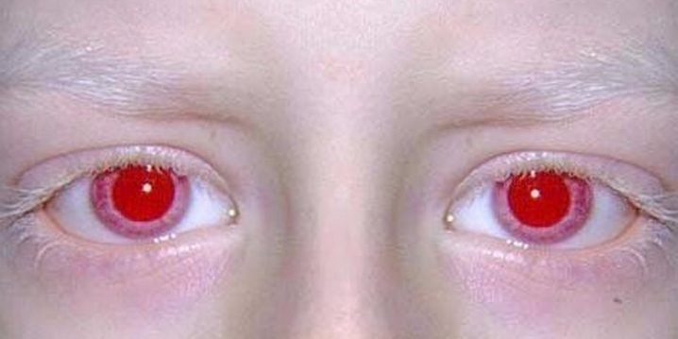
Aromatic amino acid metabolism pathologies
Albinism
Cause: arises in the absence of tyrosinase, which is involved in the conversion of DOPA into DOPA-quinone and then into melanin.
Consequences: people have a weak pigmentation of the skin, hair, reddish color of the iris of the eyes.

Slide 33
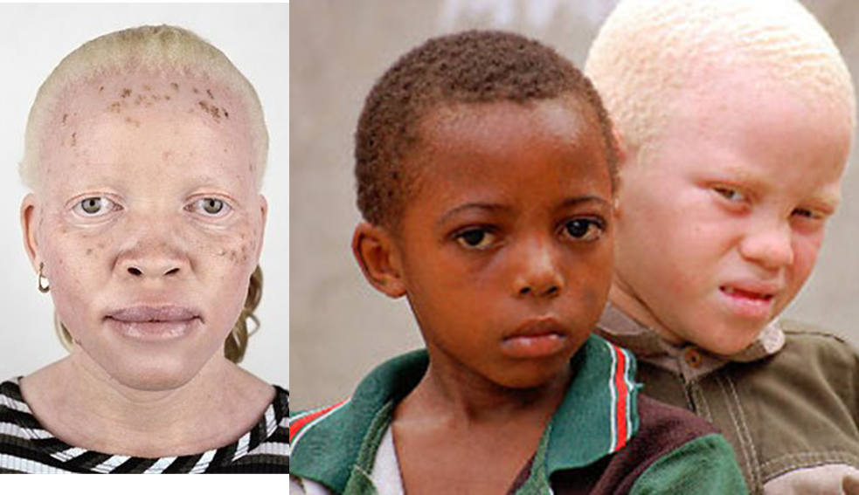

Slide 35
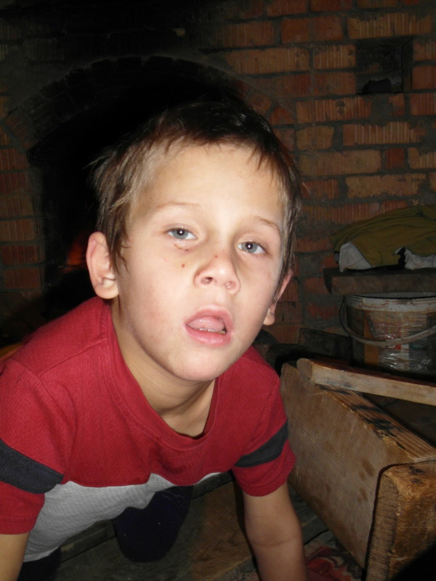
Amino acid metabolism pathologies
Maple Syrup Disease (leucinosis, branched-chain ketonuria, maple syrup-smelling urine disease) is a congenital defect in amino acid metabolism, leading to the appearance in the urine of large amounts of valine, leucine, isoleucine and alloisoleucines, and due to their ketonoisoleucines which makes it smell like maple syrup.
The primary biochemical defect is the absence or a sharp decrease in the activity of the enzyme system, which provides oxidative decarboxylation of three amino acids - leucine, isoleucine and valine. The most pathogenic is the accumulation of leucine.

Slide 36
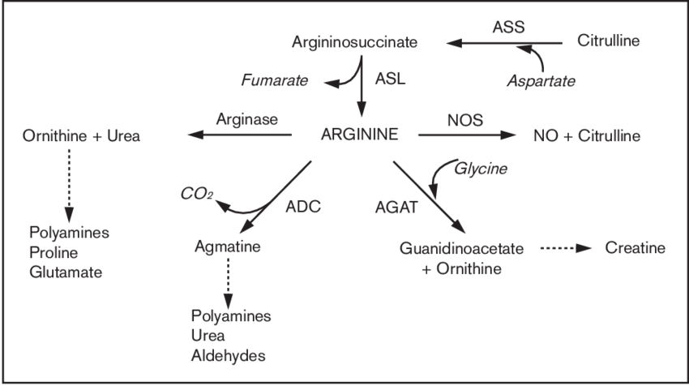
Metabolism of dibasic AA (arginine)
Arginine is a source of nitric oxide (NO), urea and ornithine.

Slide 37
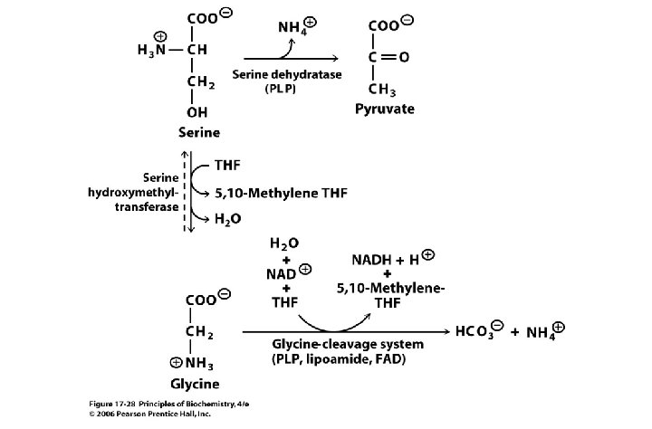
Hydroxy acid (serine) metabolism

Slide 39
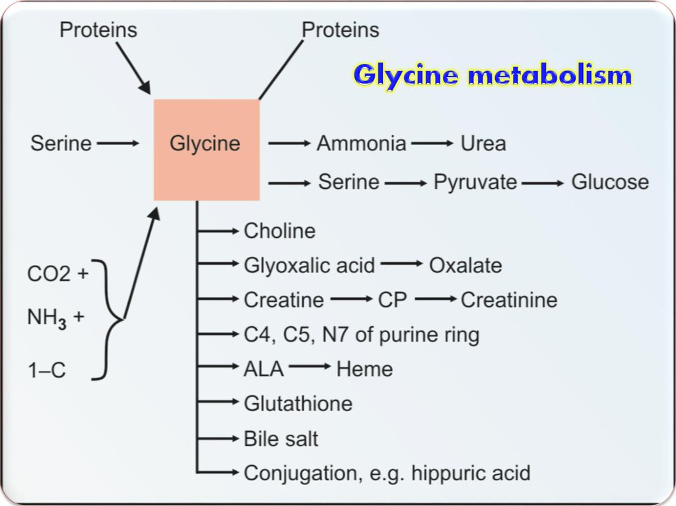
Metabolism of AA with methyl groups (glycine)

Slide 40
Glycine functions
1. Needed for synthesis of
purine and pyrimidine nitrogenous bases
porphyrins
serine
creatine
glutathione
2. Part of paired bile acids
3. Participates in the neutralization of benzoic acid with the formation of hippuric acid

Slide 41
Metabolism of AA with methyl groups (alanine)

Slide 43
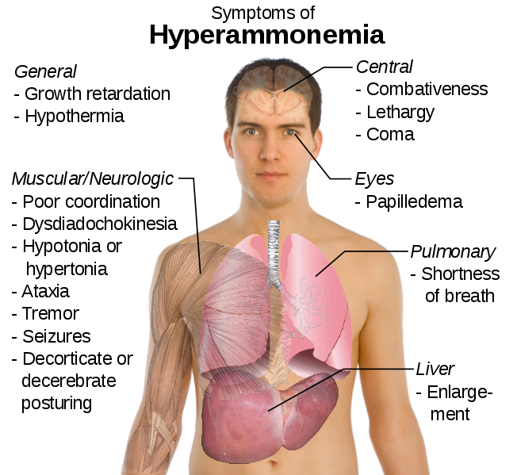
Ammonia is a toxic compound
https://s3-us-west-2.amazonaws.com/courses-images/wp-content/uploads/sites/2569/2017/10/26143451/100002010000028C00000257CC290D50.png

Slide 44
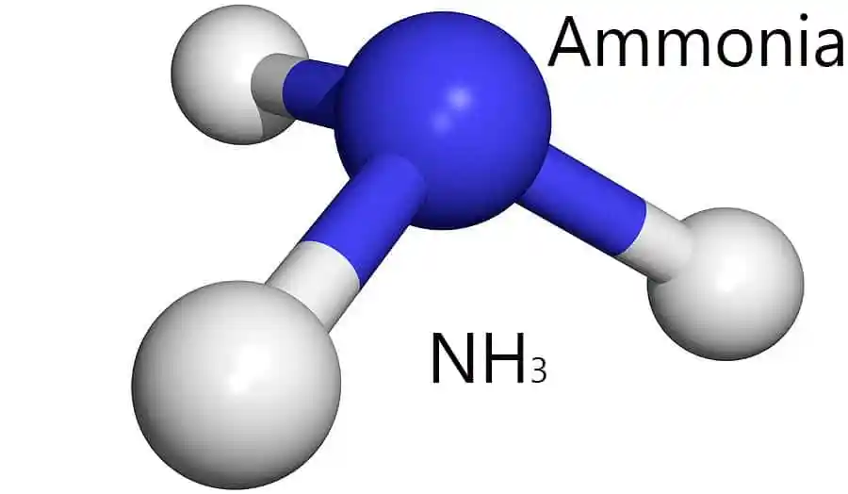
Sources of ammonia
Ammonia is formed:
1) as a result of deamination reactions of amino acids, biogenic amines (histamine, serotonin, catecholamines, etc.), purine and pyrimidine nitrogenous bases, amino acid amides in body tissues.
2) in the intestine as a result of the activity of microflora (decay of proteins); absorbed into the blood of the portal vein.
The ammonia content in the blood is normally 25-40 μmol/ l.

Slide 45
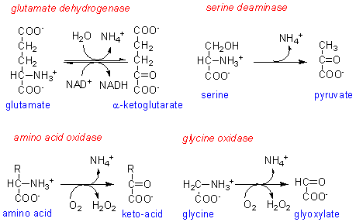
The most important source of ammonia is the deamination of amino acids

Slide 46
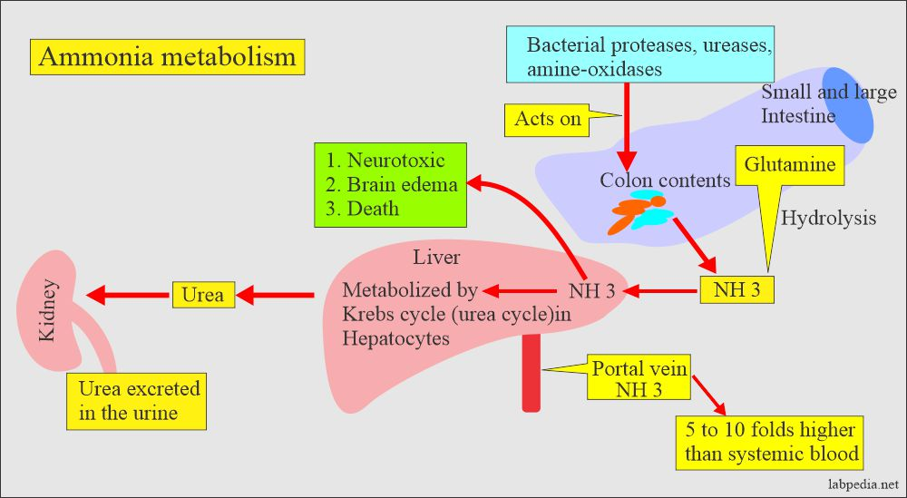
Sources of ammonia in the body

Slide 47
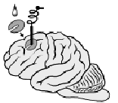
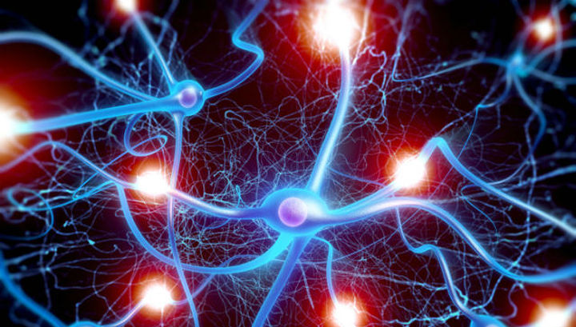
The toxicity of ammonia is mainly related to its effect on the central nervous system.
Ammonia passes through membranes and enters brain cells,
Causing the following violations

Slide 48
Causes of ammonia toxicity
1) It binds to 2-oxoglutarate, which causes inhibition of amino acid metabolism (transamination) and a hypoenergetic state (inhibition of the Krebs cycle due to the outflow of α-KG from it).
2) Ammonia enhances the synthesis of glutamine from glutamate in the nervous tissue. A decrease in glutamate concentration disrupts the exchange of neurotransmitters, in particular, the synthesis of γ-aminobutyric acid, the main inhibitory modulator. This disrupts the conduction of nerve impulses and causes seizures. Also, due to glutamine (an osmoactive substance), osmotic pressure increases, and cerebral edema develops.
3) Ammonia in the blood and cytosol forms an ammonium ion (NH4 +), the accumulation of which disrupts the transmembrane transfer of ions, in particular Na + and K + (competes with ion pumps for Na + and K +), which also affects the conduction of a nerve impulse.
4) The accumulation of ammonia can shift the pH to the alkaline side, causing metabolic alkalosis (this increases the affinity of hemoglobin for oxygen (Bohr effect), hemoglobin does not release oxygen in the capillaries, resulting in cell hypoxia)

Slide 49
Ammonia transport
The transport forms of ammonia from tissues to the liver are:
glutamine and alanine (their share among all blood amino acids is up to 50%),
to a lesser extent asparagine and glutamate,
some amount of ammonia is in the blood in free form.
Most of the glutamine comes from muscles and nervous tissue, alanine carries ammonia from the muscles and the intestinal wall.

Slide 50
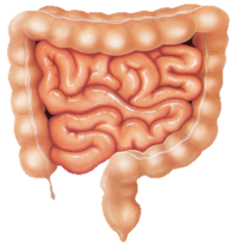
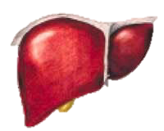
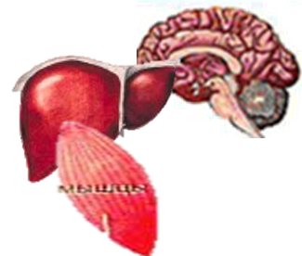
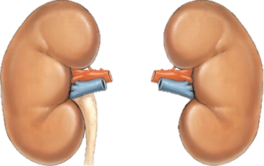
Sources and methods of neutralization of ammonia in different tissues
deamination
Biogenic amines, amides, imines
Nucleotides, nucleosides, nitrogenous bases
Protein decay
Amino acids
Ammonia
Alanine formation
Glutamine (asparagine) synthesis - amidation
Synthesis of urea
(~ 25 g \ day)
Formation of ammonium salts
(~ 0.5g / day)
Muscles, intestines
Glutamate formation - reductive amination
Muscle, brain and other tissues
Liver
Kidneys
Brain, liver (in all tissues except muscle)

Slide 51
Ammonia neutralization
1. Reductive amination (it has little, since glutamate is the preferred substrate for glutamate DH and the reaction equilibrium is shifted towards α-ketoglutarate)
The significance of reductive amination:
- is a source of nonessential amino acids;
- serves as one of the ways of binding ammonia in the cell (fast temporary way - "emergency").

Slide 52
Reductive amination in tissues
COOH
COOH
COOH
COOH
OH
C=O
C
HOH
C=NH
CHNH₂
NH₂
GDH
CH₂
NH₃
CH₂
CH₂
CH₂
NADP●H + Н⁺
NADP⁺
CH₂
CH₂
CH₂
CH₂
COOH
COOH
COOH
COOH
2-oxoglutarate
(α-ketoglutarate)
2-hydroxy-
2-aminoglutarate
(loose connection)
Iminoglutarate
Glutamate
a type of amination in which the carbonyl group is replaced by an amine via an intermediate imine

Slide 53
Ammonia neutralization
2. Formation of amides (glutamine and asparagine).
3. Formation of alanine in muscles
COOH
NH₃
CO NH₂
CH₂
CH₂
in young children, this is the main way of neutralizing ammonia
CH₂
CH₂
CHNH₂
АTP
АDP+Pi
CHNH₂
It is the main method for removing ammonia from the nervous and muscle tissues, kidneys, retina; runs in mitochondria
COOH
glutamine synthetase
COOH
Glutamate
glutamine

Slide 54
Glutamine is the main nitrogen donor in the body
Proteins
Purines
Pyrimidines
Asparagine
Aminosugars
Glucose
Glutamine
non-toxic, freely passes through the cell membrane by facilitated diffusion
easily gets not only into hepatocytes, but also into other cells where there is a need for amino groups
the form in which ammonia is transported, temporary ammonia storage
used for the synthesis of protein, amino sugars, purine and pyrimidine nucleotides, folic acid, amino acids (glu, three, his, asparagine),
ammonia donor

Slide 55
Asparagine synthesis
a secondary method of removing ammonia, energetically unprofitable (2 high-energy bonds are spent)
There are 2 isoforms of this enzyme - glutamine-dependent and ammonia-dependent, which are used by different donors of amide groups. The first functions in animal cells, the second predominates in bacterial cells, but is also present in animals

Slide 56
Proteins
Purines
Pyrimidines
Urea
The immune system
Critical for the growth and reproduction of leukemic cells (lymphocytic leukemia)
Asparagine and Aspartate
Therapy of some types of lymphocytic leukemia:
the cytostatic effect of the microbial enzyme L-asparaginase (disrupts the conversion of aspartic acid to asparagine and vice versa)
Asparagine - donor and transport form for ammonia

Slide 57
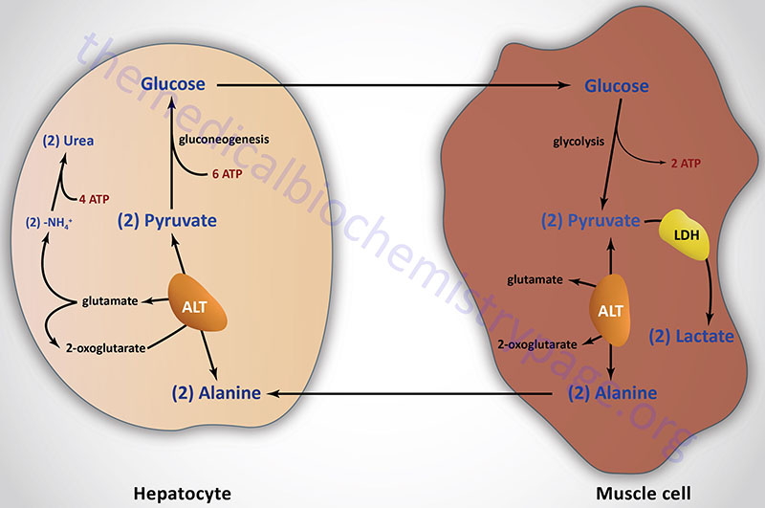
Alanine as a nitrogen carrier
In the form of alanine, amine nitrogen is transported to the liver for the synthesis of urea and the carbon skeleton for the synthesis of glucose (transfers amine nitrogen from the muscles and the intestinal wall)
The glucose-alanine cycle (shunt) indirectly ensures the "outflow" of nitrogen from the muscles and the "supply" of glucose to the working muscles (an energy source)

Slide 58
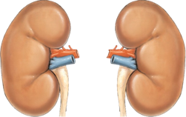
Removal of ammonia in the form of ammonium salts with urine and sweat (up to 0.5-1 g per day)
Ammonium cation is excreted into urine in exchange for K +, Na + ions, and ammonium ions, forming ammonium salts, are removed from the body

Slide 59
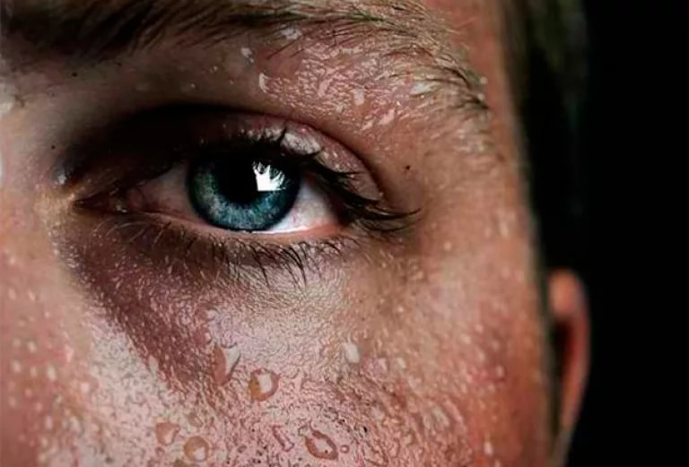
Removal of ammonia in the form of ammonium salts with urine and sweat (up to 0.5-1 g per day)
Anions
(Cl⁻,SO₄²⁻)
Ammonium chloride
2
Сульфат аммония

Slide 60
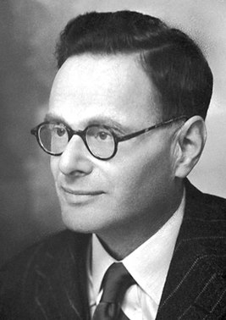
Krebs ornithine urea cycle
ornithine cycle (urea cycle, Krebs-Henseleit cycle)
Hans Adolph Krebs
Kurt Henseleit
https://slideplayer.com/slide/13559442/

Slide 61
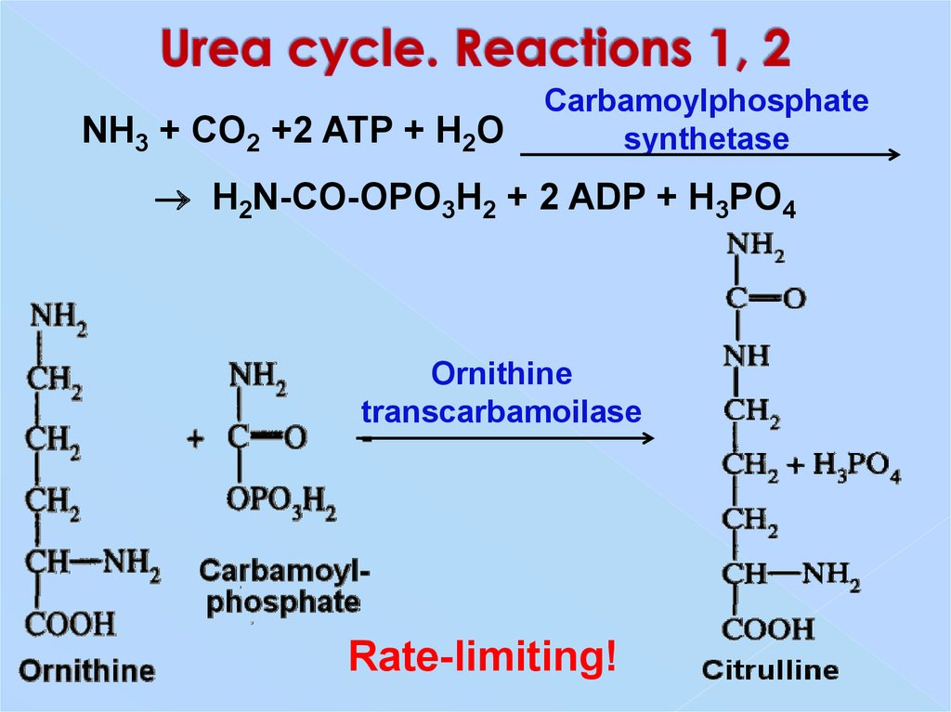

Slide 65
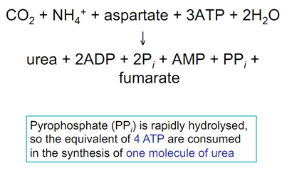
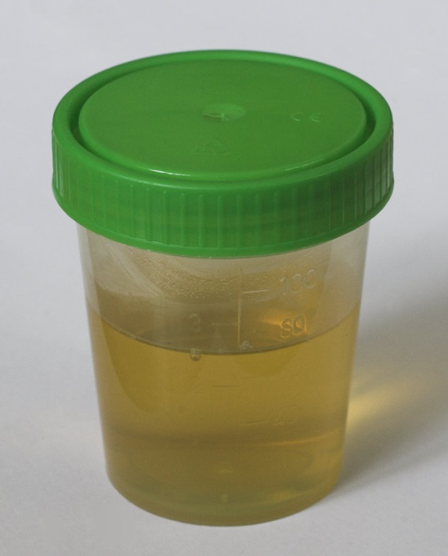
Ornithine cycle reactions
The overall equation for the synthesis of urea:
Urea, being a non-toxic, neutral compound with small size and high solubility in physiological fluids, is able to easily penetrate biological membranes, is easily transported by blood and excreted in urine
https://upload.wikimedia.org/wikipedia/commons/5/52/Urinbecher.jpg

Slide 67
Urea synthesis (ornithine cycle, Krebs-Henseleit cycle)
1. Synthesis of urea occurs in hepatocytes of the liver, is a cyclical process.
2. For the synthesis of one urea molecule, 3 ATP molecules, 1 ammonia molecule, 1 aspartate molecule, 1 CO2 molecule, 1 ornithine molecule are required.
3. The ornithine cycle is closely related to the Krebs cycle:
a) the Krebs cycle supplies the synthesis of urea with CO2 and ATP.
b) fumarate, formed in the ornithine cycle, goes into the Krebs cycle, turning into oxaloacetate. Oxaloacetate is transformed by transamination into aspartate, which can again be used in the synthesis of urea.
4. Urea synthesis is enhanced by catecholamines and glucocorticosteroids.
5. Determination of the activity of arginase and ornithine-carbamoyl phosphate transferase in blood serum is used to diagnose liver pathologies.

Slide 68
Ornithine is regenerated at each turn of the urea cycle.
In urea, one amino group enters the cycle in mitochondria during oxidative deamination of glutamate, the second amino group is supplied by aspartate from the cytosol.
In the ornithine cycle, 4 high-energy bonds of 3 ATP molecules are consumed for each revolution of the cycle.
In infants and children, urea synthesis is reduced for two reasons: immaturity of the liver and active synthesis of proteins and nucleic acids during the growth of the body

Slide 69
The process provides itself with energy
when aspartate is regenerated from fumarate, 1 molecule NADH + H + is formed, which gives 3 ATP
during oxidative deamination of glutamate, 3ATP is also formed
NAD+ NADH+H+
Ala pyruvate
Glu α-KG
Fumarate
Malate
Oxaloacetate
Aspartate

Slide 70
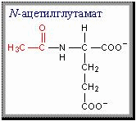
6 amino acids are involved in the synthesis of urea:
ornithine,
citrulline,
arginine,
aspartic acid
argininosuccinate,
N-acetylglutamate -
activator of the first reaction.

Slide 71
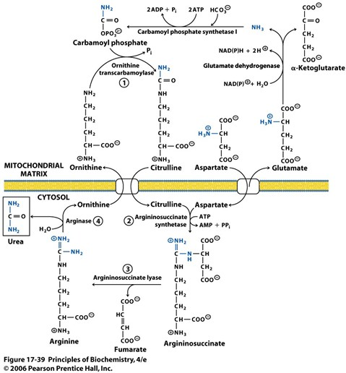
The Urea Cycle

Slide 72
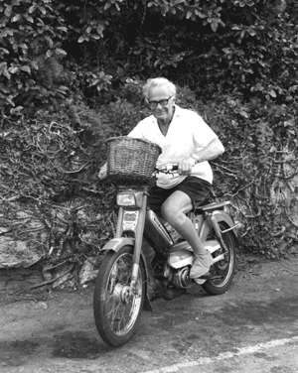
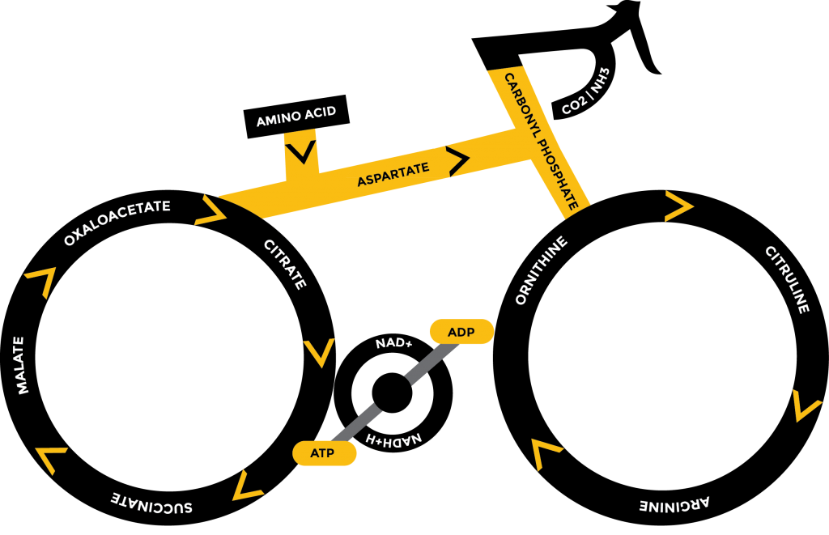
The Krebs BiCycle
https://i.pinimg.com/originals/5c/dd/bd/5cddbd2c481dd8b7004c38f1ccf856ef.jpg
https://media.nature.com/m685/nature-assets/nrm/journal/v1/n3/images/nrm1200_225a_f1.gif
http://www.deconstructingthetour.group.shef.ac.uk/wordpress/wp-content/uploads/krebscycle1-1024x783.png

Slide 73
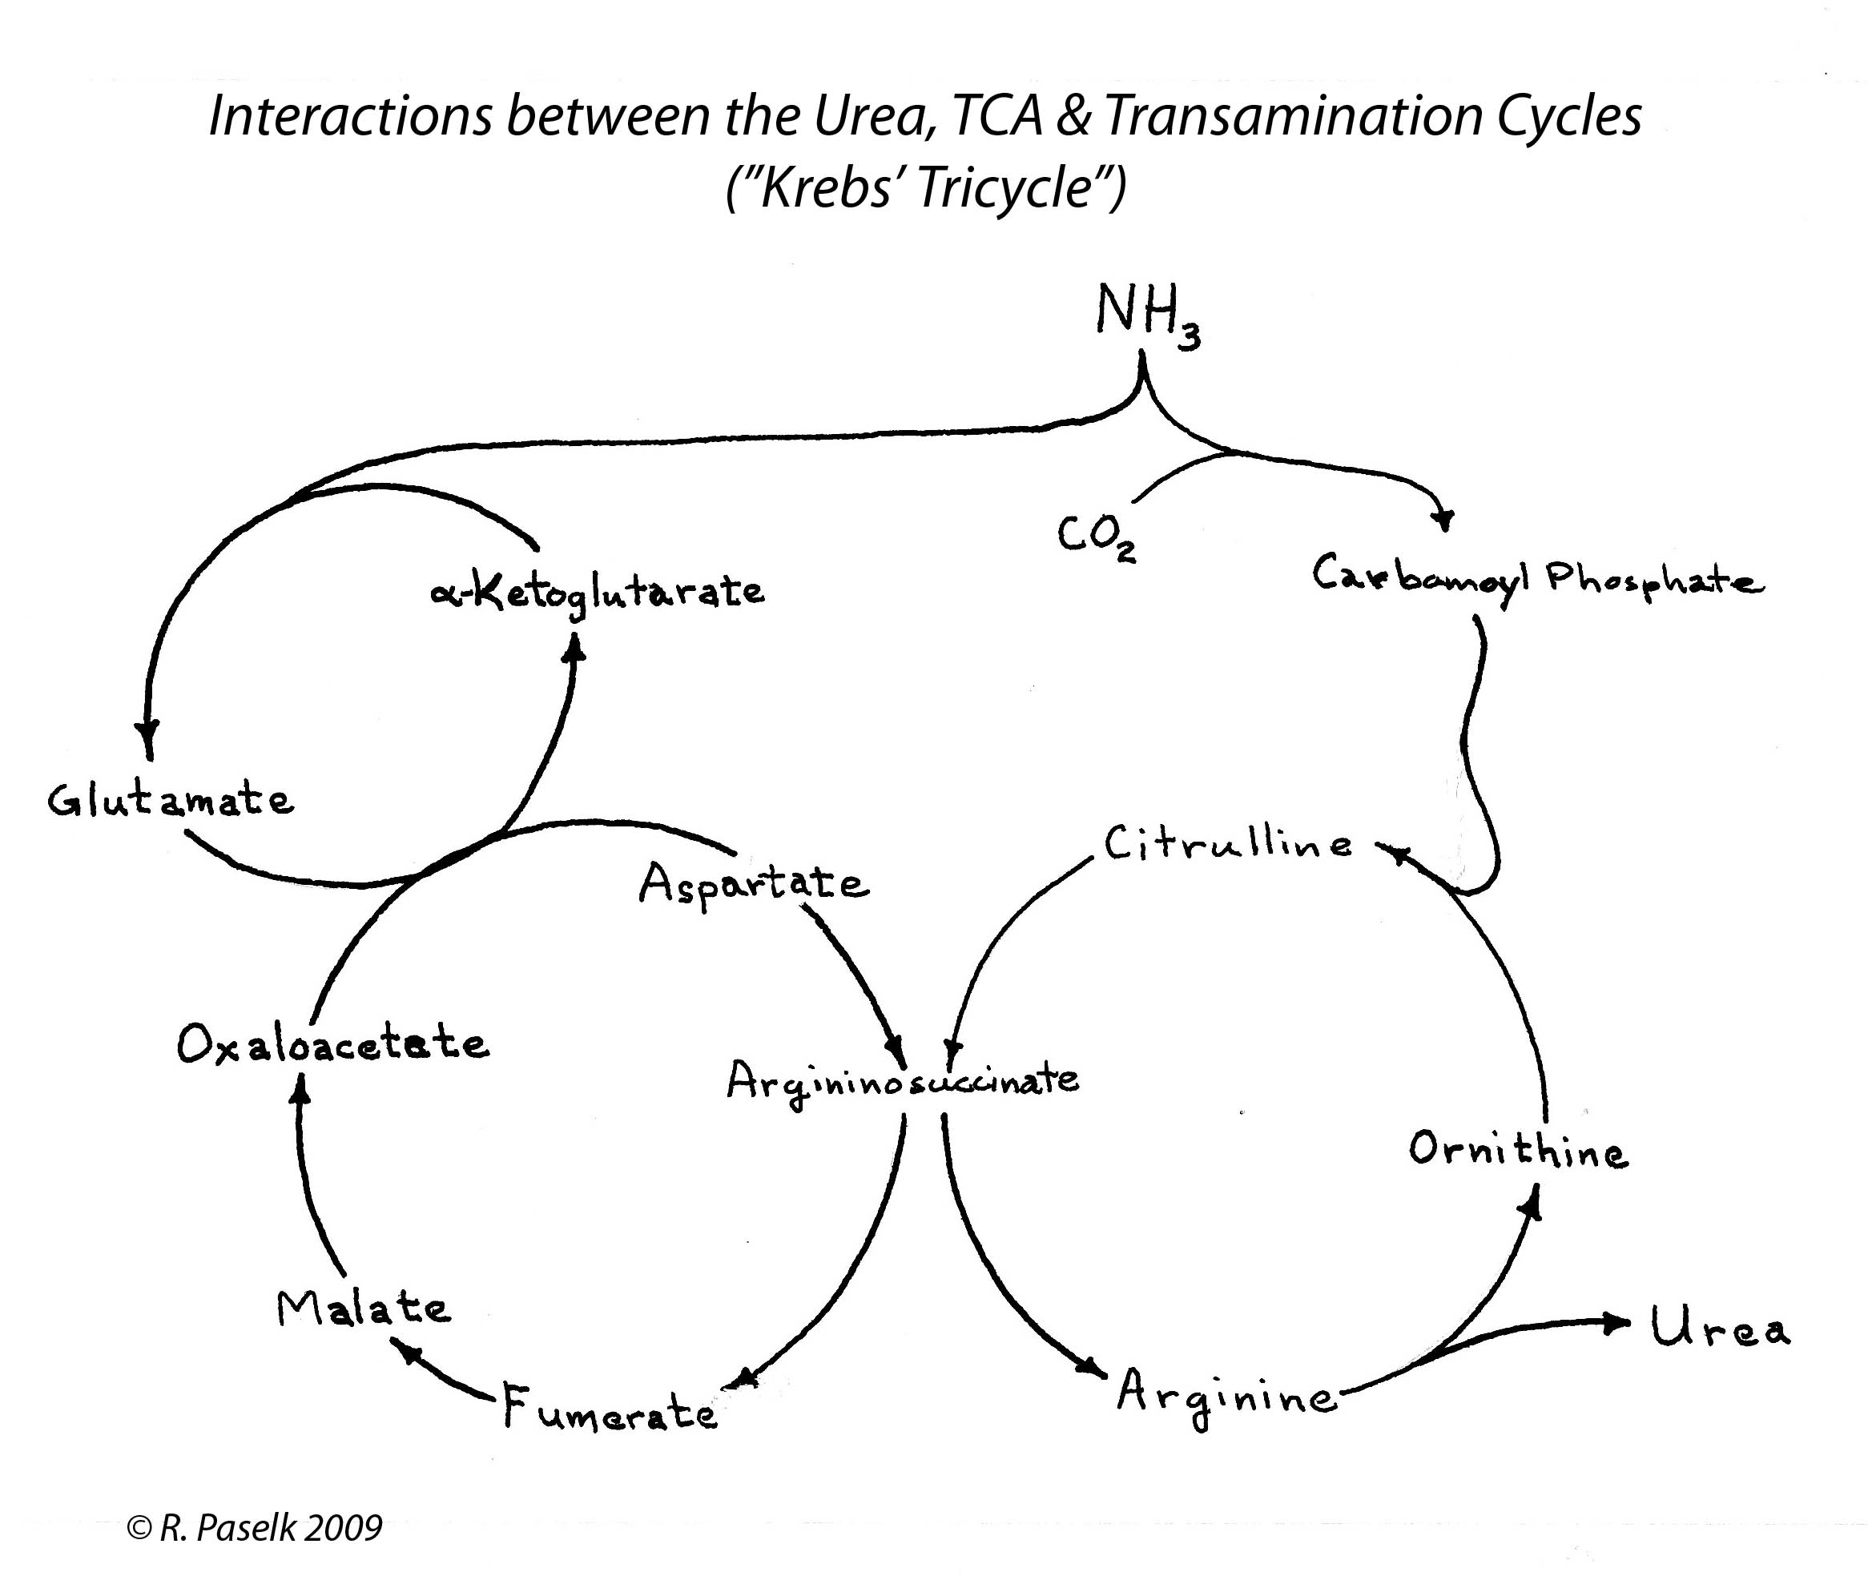

Slide 74
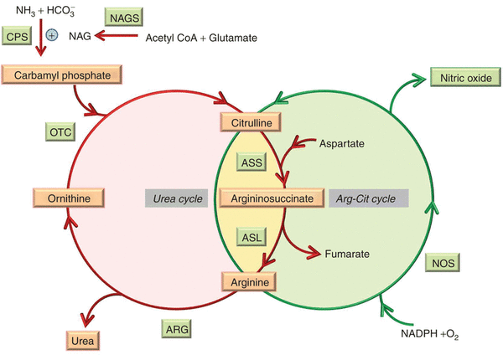
The urea cycle and NO synthesis
http://www.nature.com/gim/journal/v15/n4/images_article/gim2012166f3.gif

Slide 75
Ornithine cycle functions
conversion of amino acid nitrogen into urea, which prevents ammonia build-up,
synthesis of arginine and non-standard (non-proteinogenic) AA
participates in the regulation of blood pH
medicine - the use of enzymes (arginase and ornithinecarbamoyl (phosphate) transferase) and urea itself to diagnose liver damage

Slide 76
Pathologies of ammonia neutralization

Slide 77
Hyperammonemia - high levels of ammonia in the blood.
vomit,
drowsiness,
irritability,
lack of coordination,
convulsions
loss of consciousness,
swelling of the brain.

Slide 78
Hyperammonemia
Primary
Secondary
In the absence
of the enzyme
for the synthesis
of urea
With liver diseases
(portal hypertension,
mechanical damage)
and viral infections
With increased
putrefaction of
proteins in
the intestine

Slide 79
Correction of hyperammonemia
Diet (protein restriction)
Glutamate (binds ammonia)
Phenyl acetate (forms a water-soluble complex with glutamine, which is excreted in the urine)
Benzoates (form hippuric acid with glycine, which is excreted in the urine)
The using of large doses of arginine with argininosuccinaturia stimulates the regeneration of ornithine and the excretion of nitrogen in the composition of citrulline and argininosuccinate
In type II hyperammonemia, the administration of large doses of citrulline stimulates the synthesis of urea from aspartate, which leads to the excretion of nitrogen from the body

Slide 80
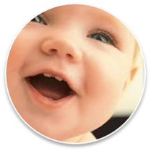
Ornithine cycle disorders:
Hyperammonemia (types 1 and 2)
Argininosuccinate aciduria
Citrullinemia
(Hyper) argininemia

Slide 81
Synthesis of creatine
Synthesis of creatine and creatinine
In the kidneys:
NH₂
NH₂
NH₂
NH₂
C=NH
CH₂
Glycinamidine transferase
(CH₂)₃
C=NH
NH
COOH
CHNH₂
NH
+
+
(CH₂)₃
COOH
CH₂
COOH
CHNH₂
COOH
Arginine
Glycine
Ornithine
Glycocyamine
(guanidine acetate)

Slide 82
Synthesis of creatine
Synthesis of creatine and creatinine
In the liver:
NH₂
NH₂
Methyltransferase
C=NH
C=NH
NH
N - CH₃
СН₃
CH₂
CH₂
S-AM
S-АH
COOH
S-adenosyl
methionine
S-adenosyl
homocysteine
COOH
Glycocyamine
Creatine

Slide 83
Synthesis of creatine phosphate
Synthesis of creatine and creatinine
In the muscles
(and the brain):
NH₂
NH ~ PO₃H₂
C=NH
C=NH
In a resting muscle
N - CH₃
N - CH₃
Creatine kinase
CH₂
+
АТP
CH₂
+
АDP
In a working muscle
COOH
COOH
АDP + Н₃РО₄
Creatine phosphate
Creatine

Slide 84
Creatine phosphate - a reserve of "explosive" energy
Creatine phosphate provides an urgent resynthesis of ATP in the first seconds of work (5-10 seconds), when no other energy sources have yet been activated and the blood supply to the muscle is not increased
In the form of creatine phosphate, creatine is a "depot" of high-energy bonds, it is used for rapid resynthesis of ATP during the work of cells. In the cells of the nervous tissue, creatine phosphate maintains cell viability in the absence of oxygen

Slide 85
Creatinuria
If the synthesis of creatine outpaces the possibility of its fixation in muscle tissue, then creatinuria develops - the appearance of creatine in the urine.
Physiological creatinuria (mild) is observed in the first years of a child's life and in old people (a consequence of muscle atrophy and incomplete use of creatine formed in the liver)
Pathological creatinuria (strongly pronounced) is observed in diseases of the muscular system (with myopathy or progressive muscular dystrophy)

Slide 86
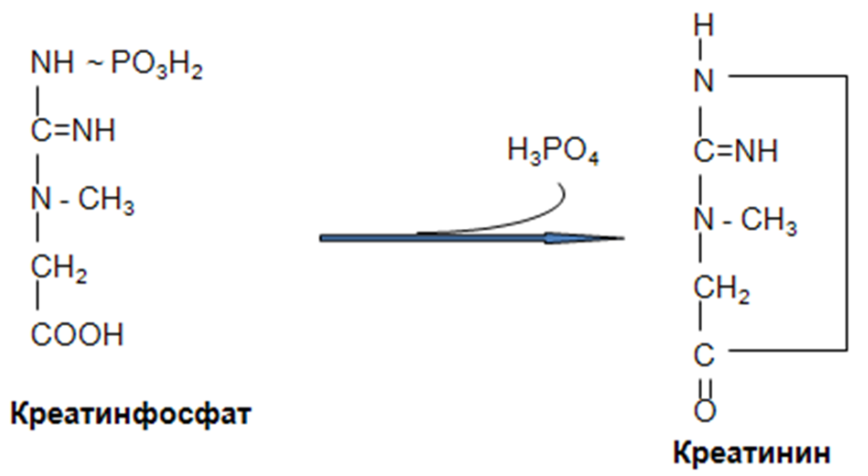
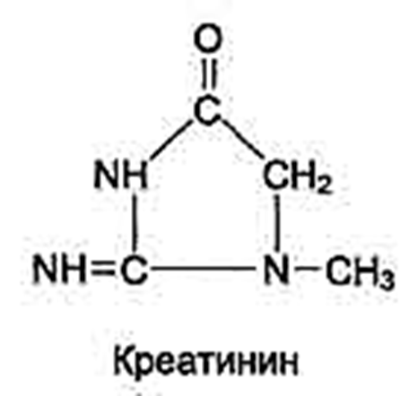
Synthesis of creatinine
Synthesis of creatine and creatinine
About 3% of creatine phosphate is constantly converted into creatinine in the reaction of non-enzymatic dephosphorylation
Non-enzymatically
Creatine phosphate
Creatinine
Creatinine

Slide 87
Significance of the synthesis of creatine, creatine phosphate and creatinine
1. Creatine is necessary for the formation of a high-energy compound in the muscles and the brain - creatine phosphate.
2. Determination of the content of creatine and creatinine in blood and urine is used to characterize:
a) the intensity of muscle work in sports medicine;
b) for the diagnosis of kidney disease;
3. Determination of the activity of creatine kinase and its isoenzymes in the blood is used to diagnose myocardial infarction, myopathies, muscular dystrophies and others.

Slide 88
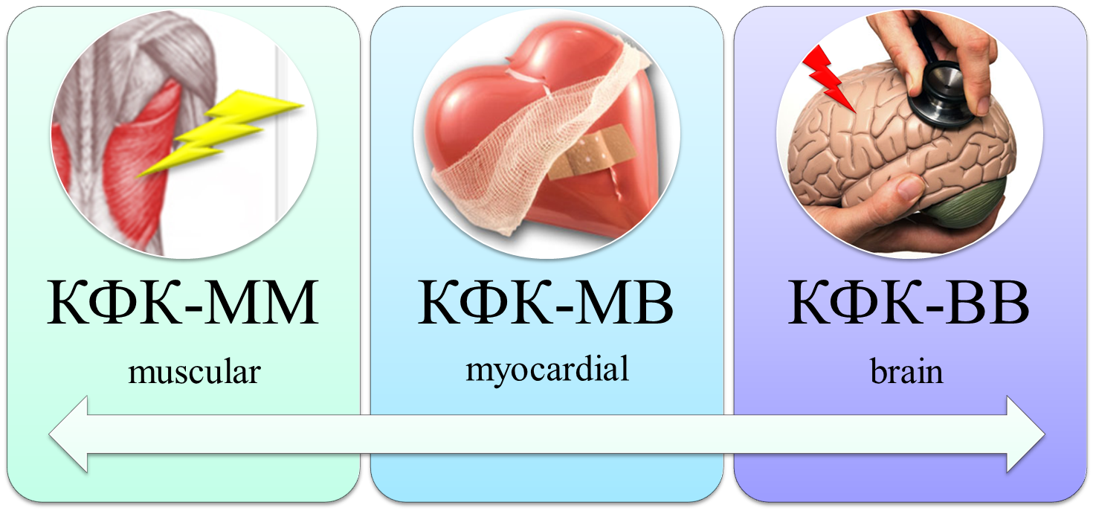
Creatine kinase (CK) and its isoenzymes
M
B
2 subunits:
3 isoforms:
M
M
M
B
B
B

Slide 89
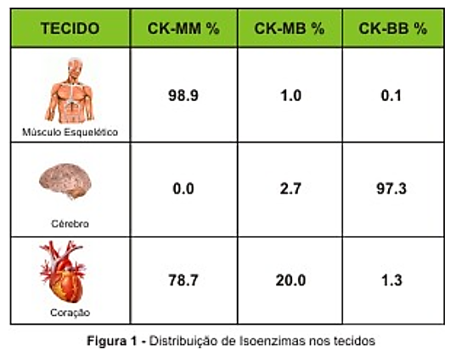
Creatine kinase (CK) and its isoenzymes

Slide 90
Conclusion:
1. Deamination and transamination of amino acids lead to the formation of alpha-keto acids and / or nonessential amino acids.
2. Reactions of amino acids in terms of radicals are associated with the conversion of a nitrogen-free residue into carbohydrates and / or ketone bodies, the exchange of individual amino acids, and in the composition of the protein, its structures are stabilized.

Slide 91
Conclusion:
3. Ammonia is very toxic to organs and tissues, especially to brain cells.
4. The main way of its neutralization in adults is the synthesis of urea, to a lesser extent - the formation of ammonium salts, in children - the formation of glutamate and aspartate amides.
5. Other methods of neutralizing ammonia, which are temporary, include reductive amination of glutamate and the formation of alanine

Slide 93
Question:
What is the end product of ammonia neutralization of healthy adults?

