Slide 1
Diagnosis and prevention of complications and errors during orthopedic treatment with various types of dentures and devices.
GBOU HPE Krasnoyarsk State Medical University named after Professor V.F. Voino-Yasenetsky
Department of Orthopedic Dentistry
Lecturer: Associate Professor, Ph.D.
Kostenko O.Yu.
Krasnoyarsk 2022

Slide 2
Purpose of the lecture
Consider the features of complications and errors when restoring occlusion and articulation of teeth with various types of dentures and devices in an orthopedic dentistry clinic

Slide 3
Lecture outline
Errors and complications at the stages of orthopedic treatment for dental crown defects;
Errors and complications at the stages of orthopedic treatment with partial absence of teeth;
Errors and complications at the stages of orthopedic treatment in the complete absence of teeth;
Rehabilitation and preventive stage of treatment.

Slide 4
Relevance
An in-depth study and clarification of errors, as well as complications that arise during the orthopedic treatment of patients using various designs of removable dentures is an urgent problem in clinical dentistry.
At the present stage of development of dentistry, the problem of preventing medical errors and treatment deficiencies, preventing complications associated with them is becoming increasingly important.

Slide 5
As before, one of the main reserves for improving the quality of dental care, in particular in dental prosthetics, remains the prevention of these errors, so an analysis of typical errors will allow us to identify their main causes and indicate ways to prevent them.

Slide 6
Errors and complications at the stages of orthopedic treatment
Prosthetics with veneers
When using prosthetics with veneers, special attention should be paid to the aesthetic results of prosthetics. Changes in the shape, position and size of teeth should be discussed in detail with the patient.
At this diagnostic stage, the patient must agree with the new shape and color of the tooth, its size and position in the dental arch. Therefore, evaluation of the temporary structure and its full approval by the patient should precede tooth preparation.

Slide 7
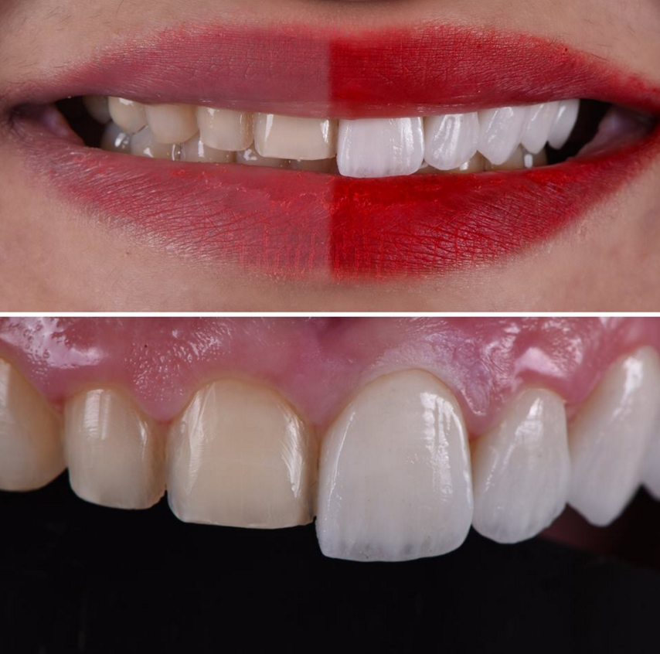

Slide 8
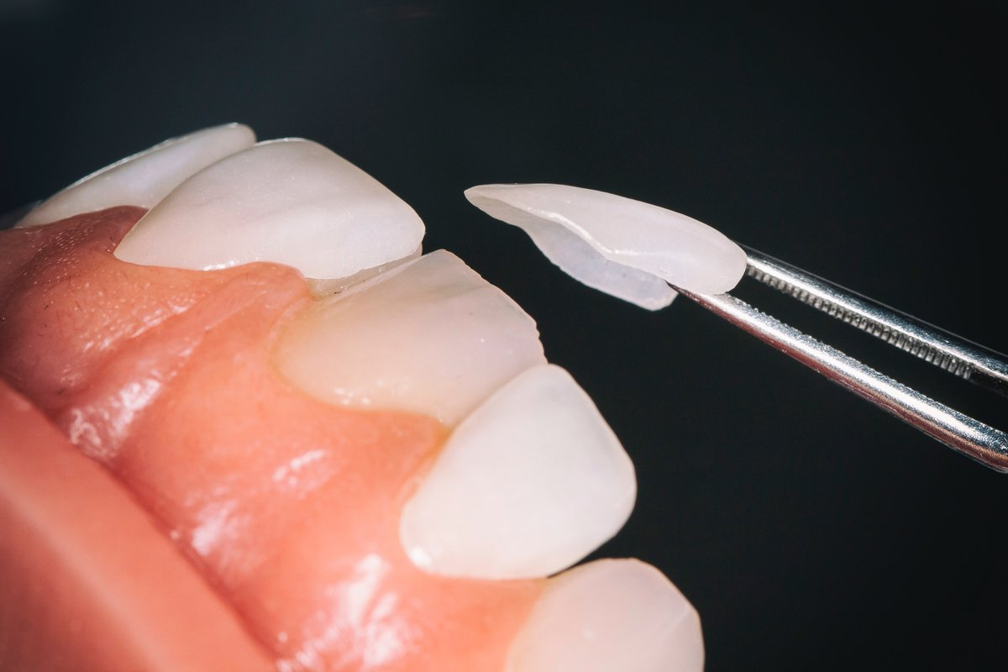
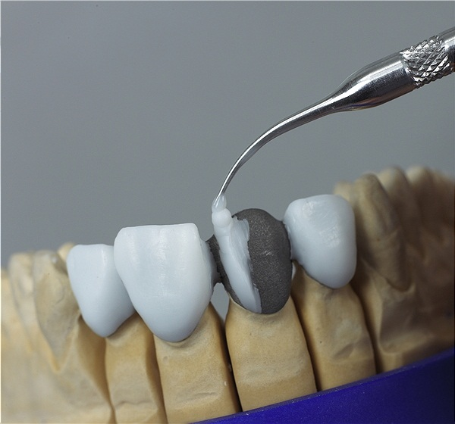
Prosthetics with veneers
Further possible errors are associated with preparation, covering with temporary veneers, fitting and fixation of prostheses.
Tactical and technical errors:
preparation without water cooling with a poorly centered instrument;
preparation of the cutting edge: the veneer-tooth boundary should not be in the area of ​​occlusal contact with antagonist teeth;
insufficient removal of hard tissue;
preparation of the vestibular surface in one plane;
deep subgingival preparation;
obtaining a fuzzy impression;

Slide 9
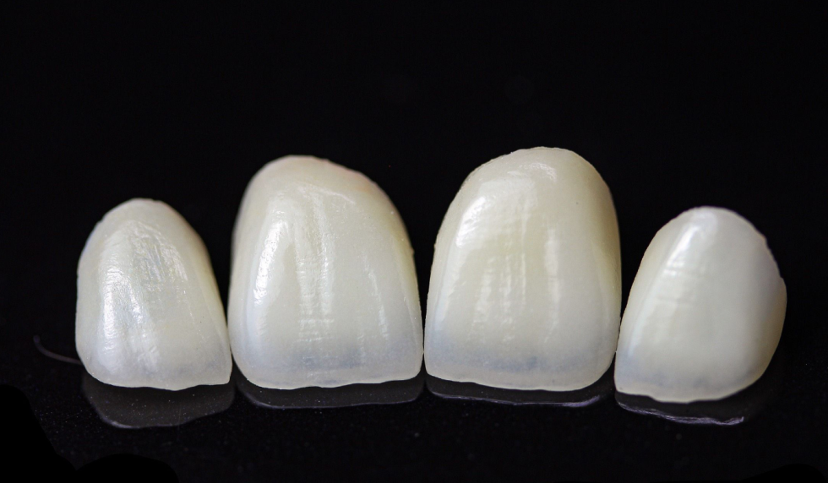
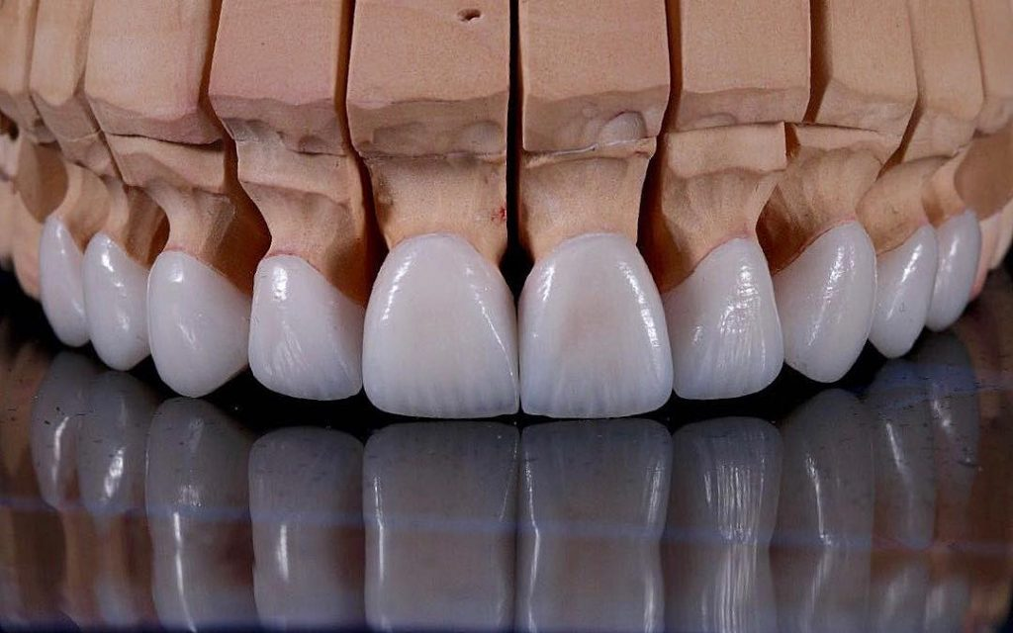
Prosthetics with veneers
Tactical and technical errors:
6) obtaining a fuzzy impression
7) the prepared surface was not coated with a desensitizer;
8) temporary veneers have not been made;
9) inability to evaluate the quality of the manufactured veneer;
10) errors in fitting the veneer;
11) fixation errors;
12) color discrepancy before and after fixation.

Slide 10
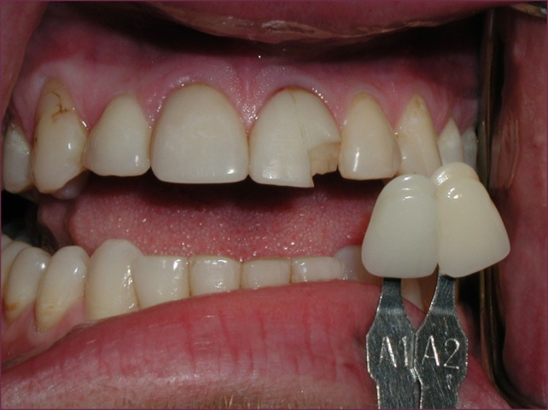
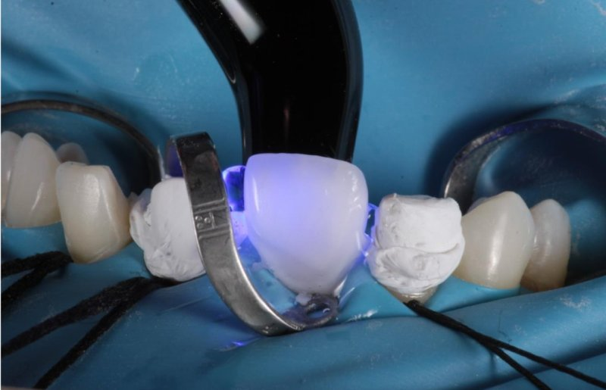
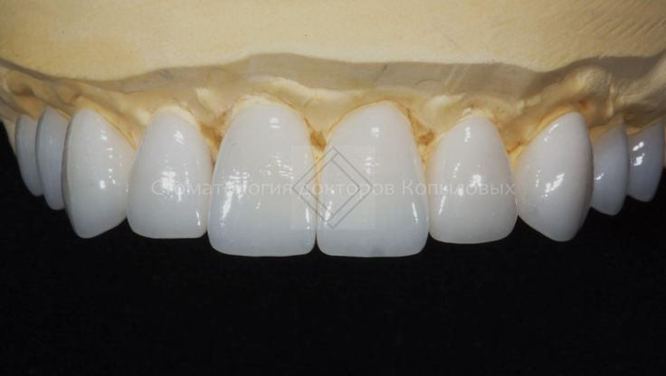
Prosthetics with veneers
Complications:
opening of the tooth cavity;
mechanical or thermal trauma to the pulp;
unsatisfactory aesthetic results (mismatch in color, shape, size);
fixation disorder;
chip;
gingivitis.

Slide 11
Prosthetics with veneers
Features of orthopedic treatment with veneers are mainly related to the structural material and fixation method used.
It is necessary to strive to complete the preparation at the level of the gum without immersion under it, so as not to complicate the marginal fit, subsequent hygienic care and the possibility of high-quality fixation of the dentures.
When fixing, it is mandatory to use “try-on” pastes to predict the color of the veneer after fixation.

Slide 12
Prosthetics with inlays
During orthopedic treatment with inlays, a complex of interdependent factors should be analyzed:
location of the hard tissue defect in relation to the dental pulp;
thickness and presence of dentin in the walls delimiting the defect;
topography of the defect and its relationship to occlusal loads, taking into account the nature of the action of chewing forces on the tooth tissue and the future prosthesis;
the position of the tooth in the dentition and its axial relationship in relation to antagonists and neighboring teeth.

Slide 13
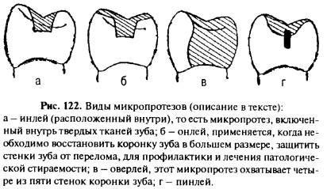

Slide 14
Prosthetics with inlays
Possible tactical and technical errors:
Preparation without water cooling, poorly centered instrument;
Incomplete removal of infected dentin;
Preparation of a tooth cavity without taking into account the creation of retention points;
Insufficient removal of hard tissue;
There is no overlap of the supporting tubercles when they are destroyed by more than 1/2;
Deep subgingival preparation;
Preparation with undercuts;
Obtaining a fuzzy impression;
The prepared cavity is not protected by temporary material;
Inability to evaluate the quality of the manufactured tab;
Errors in the fit of the tab;
Errors when fixing the tab.

Slide 15
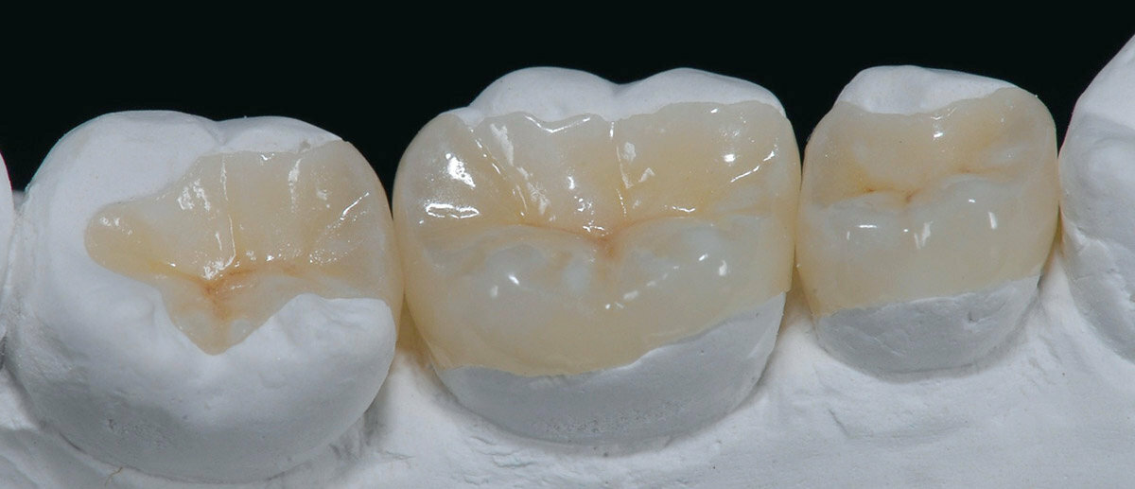
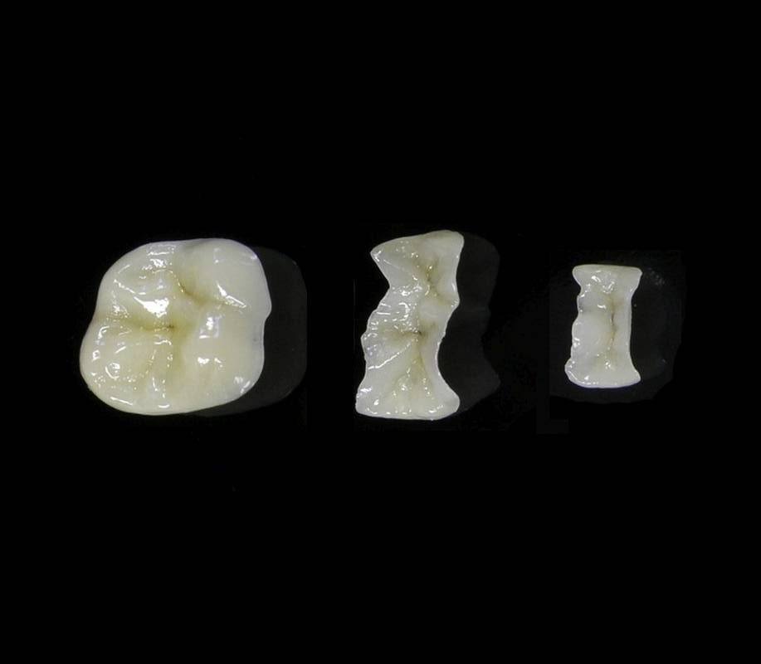
Prosthetics with inlays
Complications:
opening of the tooth cavity;
traumatic pulp burn;
fixation disorder;
secondary caries;
fracture of the tooth wall during the formation of a cavity, modeling or fixation of an inlay;
cracks and chips of the tab;
traumatic periodontitis.

Slide 16
Prosthetics with crowns
Regardless of the type of artificial crown, errors may occur at the stages of preparation, fitting and fixation, leading to the development of complications.
Errors also occur during the technical production of crowns in a dental laboratory, however, these errors should be regarded as medical errors, since ultimately the doctor is the controller of the technical quality of the prosthesis and bears full responsibility for the results of treatment.

Slide 17
Prosthetics with crowns
Tactical mistakes:
Preparation without water cooling, poorly centered instrument;
Excessive taper of the tooth crown stump;
Insufficient taper of the tooth crown stump;
Insufficient removal of hard tissue from the occlusal surface;
Preparation of the vestibular surface in one plane;
Deep subgingival preparation;
Obtaining a fuzzy impression;
No temporary crowns;
Inability to evaluate the quality of the manufactured crown;
Errors in crown fitting;
Errors in fixation.

Slide 18
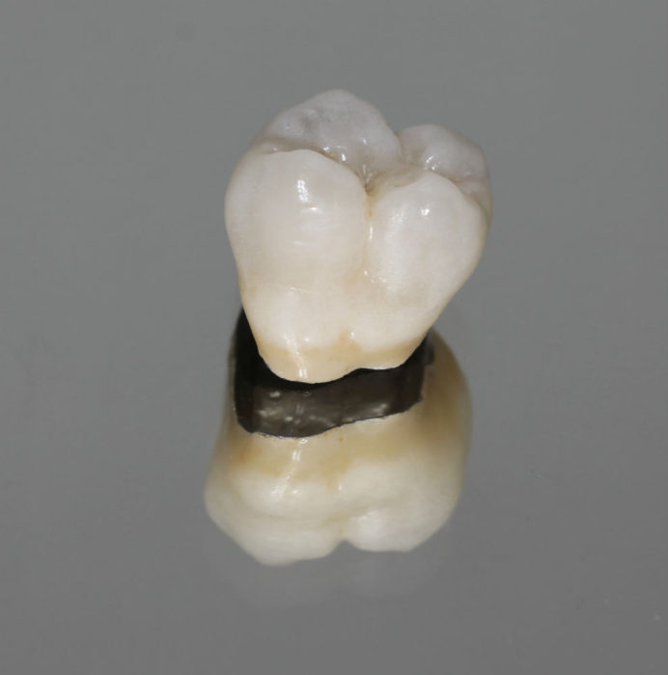
Prosthetics with crowns
Complications:
opening of the tooth cavity;
mechanical and thermal trauma of the pulp;
insufficient fixation;
cervical caries;
necrosis of hard tissues under the crown;
traumatic periodontitis;
gingivitis.

Slide 19
Prosthetics with crowns
It should be emphasized that if the doctor fixed a crown made poorly by a dental technician, this indicates his inability to assess the quality of the artificial crown.
The quality of crowns is affected by:
accuracy of the surgical technique of tooth preparation,
taking impressions and determining central occlusion,
ability to fit and fix prostheses.

Slide 20
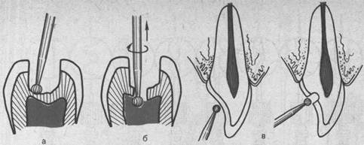
Prosthetics with crowns
Opening of the tooth cavity
It occurs as a result of significant grinding of hard tissues. Therefore, there is a need to prevent the general pain response of the body to dissection. The best means of such prevention is complex anesthesia: a combination of a highly effective anesthetic with premedication and psychological preparation of the patient for dental manipulations.

Slide 21
Prosthetics with crowns
Traumatic pulp burn
May be a consequence:
lack of water cooling,
continuity of preparation,
preparation with a poorly centered cutting instrument.
Traumatic pulpitis can develop in the long term after preparation, if temporary protective covering of the prepared teeth is not carried out; temporary crowns are made of fast-hardening acrylates. During the manufacturing period, temporary crowns are precariously fixed with medicinal pastes.

Slide 22
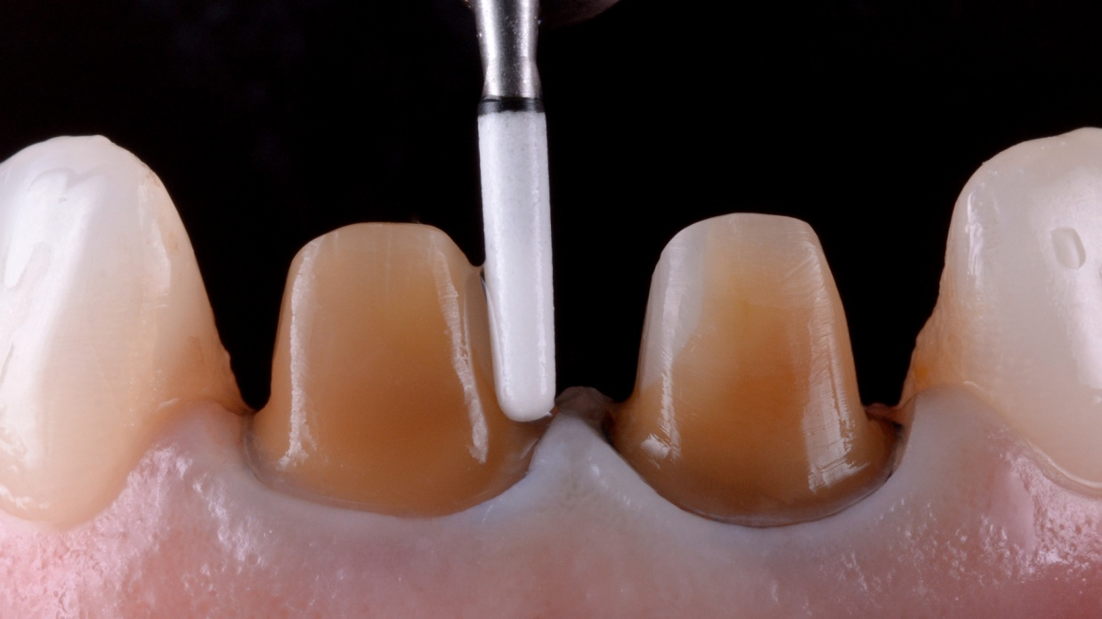
Prosthetics with crowns
Fixation failure
When preparing teeth, regardless of the condition of the pulp, the general requirement is the correct formation of the core of the prosthetic teeth. Errors can be observed when creating the shape and size of the stump of abutment teeth.

Slide 23
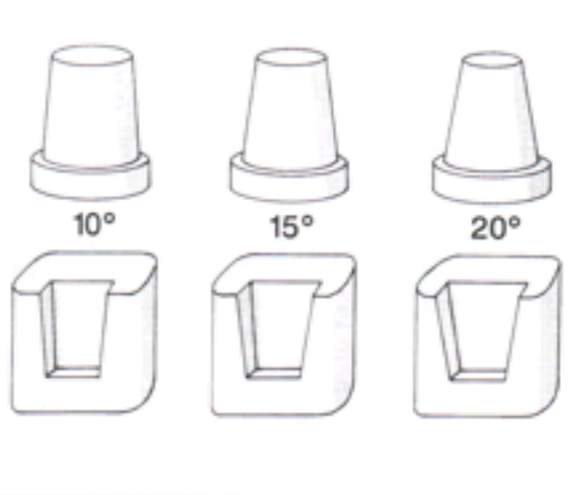
Prosthetics with crowns
In the manufacture of metal-ceramic prostheses, the taper of the stump of the abutment tooth after preparation is important.
If the taper is small, difficulties may arise when applying the prosthesis or more force will be required to apply the prosthesis, which leads to internal stress in the lining of the prosthesis and, as a result, to chipping of the ceramic coating.
A small taper of the prepared tooth stump can lead to insufficient fixation of the prosthesis due to the fact that the exit of excess cement from the cavity of the artificial crown is difficult.

Slide 24
Prosthetics with crowns
If the taper is excessive, the tooth stump becomes wedge-shaped, which significantly weakens the fixation of the prosthesis.
In addition, tooth preparation with the formation of excessive taper may entail a corresponding technical error - modeling the metal frame of the supporting crown of a cone shape and, as a result, chipping of the ceramic coating in the long term after fixation of the dentures, which is due to the lack of metal support for the ceramic coating with a vertical direction of forces chewing pressure.

Slide 25
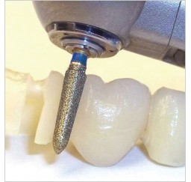
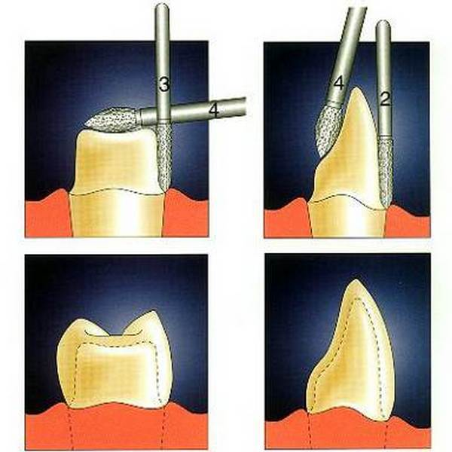
Prosthetics with crowns
If the stump of the tooth being prepared is excessively shortened, poor fixation of the prosthesis can often be a complication.
It is also possible for the ceramic coating to chip if, with a shortened stump, the required height is restored due to a thickened layer of coating rather than a metal frame.

Slide 26
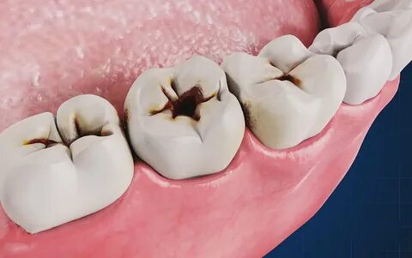
Prosthetics with crowns
Secondary caries
Secondary dental caries can also be caused by errors not related to preparation:
errors when fixing with a thick consistency of the fixing material and, as a result, exposure of the cervical area of the tooth;
poor-quality, wide crowns (caps) as a result of errors in taking impressions (pulls) and obtaining models (excessively thick layer of compensation varnish, applying varnish to the cervical area, engraving a model of the prepared tooth);
absence of a cervical wax detailing rim or its deformation when removing the wax blank from the model;
poor quality casting;
mechanical expansion of the crown when grinding the metal from inside the crown during the correction stages.

Slide 27
Prosthetics with crowns
All of the above errors are identified at the fitting stage. For fitting, the clinic should receive only flawlessly manufactured prosthetic frames, otherwise initial errors will lead to more significant complications, even irreversible ones. When fitting, it is necessary to carefully check whether the edges of the artificial crowns fit tightly to the preparation border and whether there is no pressure on the cervical part of the gum. The most common mistakes are pinching of the gingival papilla and trauma to the marginal periodontium by the expanded edge of the metal-ceramic crown.

Slide 28
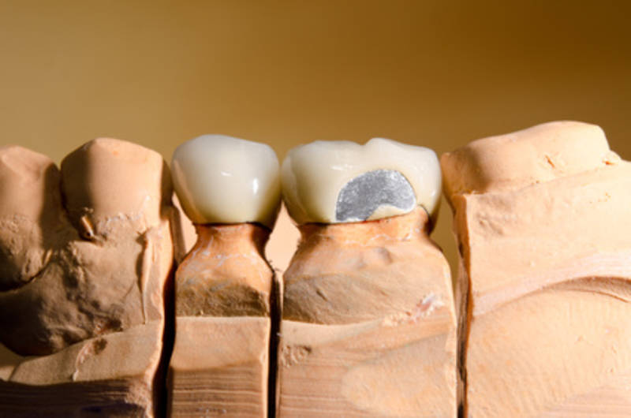
Prosthetics with crowns
Ceramic coating chips
Conventionally, for systematization, they are divided:
for chips of ceramic coating in the cervical area;
chips in the cutting edge area;
chipping of a large mass of coating.

Slide 29
Prosthetics with crowns
Chips of ceramic coating in the cervical area
Three errors can lead to this complication:
stress in the frame;
frame too thin;
overheating of the metal in the finished prosthesis.
Tension in the frame can arise due to improper preparation (small taper of the supporting teeth) and the presence of undercuts that were not eliminated in a timely manner at the stage of fitting the metal frame. Secondary stress may appear when the finished prosthesis is fixed with thick cement or when excessive force is applied at the time of application of the prosthesis. Overheating of the metal in the cervical area in almost finished prostheses is possible with strong pressure on the polishing rubber during the final finishing of the metal part. One of the reasons for overheating of the metal and, as a result, chipping of the ceramic coating is careless sandblasting to remove the oxide film from the inner surface of artificial crowns, especially when the air pressure in the jet apparatus is more than 40 MPa and the use of coarse sand.
A frame that is too thin in the cervical area can become deformed during the process of fixing the finished prosthesis or in the immediate future after fixation and lead to chipping of the facing layer.

Slide 30
Prosthetics with crowns
Chips of the ceramic coating in the cutting edge area
They can occur when the edge of the metal frame is short and the layer of transparent and enamel masses is excessively thick. With a shortened tooth stump, a metal frame is often made without restoring the required height of the cap in the metal. This occurs as a result of the dental technician using the “adapta” modeling method without subsequent refinement of the cutting edge with a layer of wax. The result is a metal-ceramic cap with an uneven coating thickness, namely a thickened layer of ceramic in the area of the cutting edge. As a result, a zone of lowest strength appears, along which, under extreme load, chipping occurs. It is necessary to strictly follow the rule of modeling a metal frame; in extreme cases, restore the height of the stump using metal, achieving a uniform layer of ceramic coating. Normally, both the thickness of the ceramic material and the thickness of the metal frame should be the same.

Slide 31
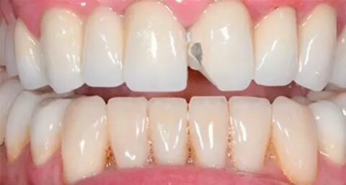

Slide 32
Prosthetics with crowns
Coating chipping
There are several reasons for this type of complication. The most common mistakes:
incorrect frame modeling;
uneven sandblasting of the metal surface of the frame or too smooth surface of the frame made of non-precious alloys;
frame contamination;
uneven or excessively thick primer layer;
non-compliance with temperature or time conditions during firing and cooling of the coating;
excessive number of firings;
incorrect occlusal contacts;
electrolytic gilding of the finished frame made of base alloys.
Coating chips are possible when modeling a metal frame without an equator or without tubercles, followed by restoration of the required anatomical shape by increasing the coating layer.

Slide 33
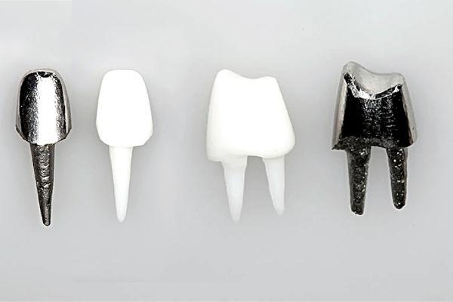
Pin designs
When deciding on the possibility of using pinned teeth and choosing their design, it is necessary first of all to proceed from the requirements for the root. It must be stable and of sufficient length.
With a short root, the “working lever” (coronal part) is longer than the “resistance lever” (tooth root), which leads to functional overload and loosening of the tooth root. In this regard, the root of the tooth must be longer than the crown part.

Slide 34
Pin designs
The root walls should not be destroyed by the carious process and should have sufficient thickness and strength. With hypo or demineralization of hard tissues, the microhardness of the root walls and the ability to withstand loads from a pin tooth decrease. Roots with thin walls less than 2 mm thick also cannot withstand the load transmitted through the pin. Often in such cases, a wall or root fracture occurs.

Slide 35
Pin designs
The main tactical mistakes that can cause irreversible consequences (tooth extraction) most often occur at the stage of root canal preparation.
Technical errors:
insufficient drying of the root canal;
using too thick or too thin a material to fill the tooth canal;
the presence of air pores in the root canal filling material;
insufficient degreasing of the pin;
insertion of a pin into the root canal less than 2/3 of its length;
twisting the active pin more than half a turn;
insufficient opening of the root canal;
lack of radiological control during canal preparation.

Slide 36
Pin designs
Complications:
fixation disorder;
development of root caries;
fracture of a tooth root or pin;
perforation of the root wall during preparation for a pin with the development of acute or chronic periodontitis.

Slide 37
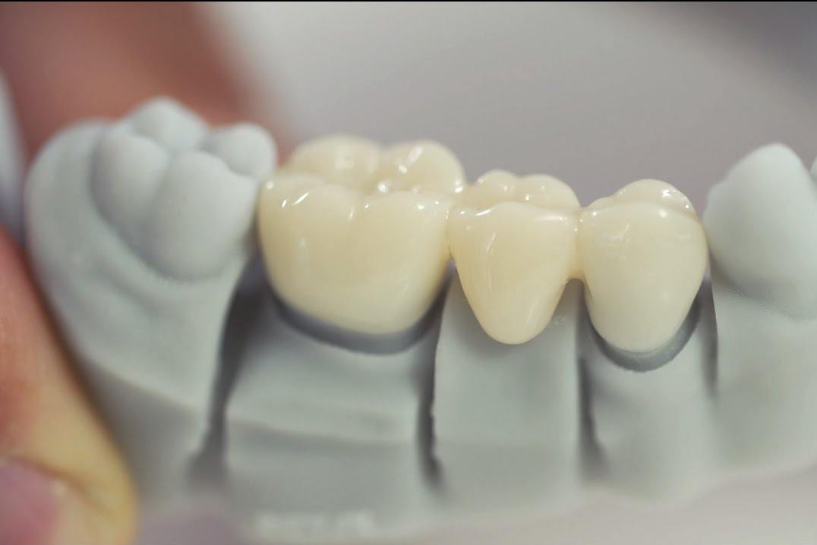
Bridges
During the manufacture of bridges, errors may occur at the stages of preparation, correction and fixation, leading to the development of complications. When treating with bridges, errors occur that are typical for treatment with single crowns, as well as those inherent only to this prosthetic technique.

Slide 38
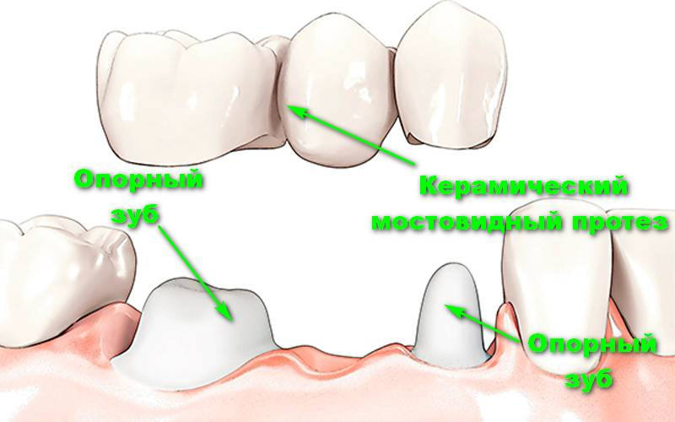

Slide 39
Bridges
Tactical and technical errors:
preparation without water cooling, with poorly centered instruments;
excessive taper of the stump of supporting teeth;
insufficient taper of the stump of supporting teeth;
insufficient removal of hard tissue from the occlusal surface;
preparation of the vestibular surface in one plane;
deep subgingival preparation;
lack of alignment of supporting teeth;

Slide 40
Bridges
Tactical and technical errors:
8) obtaining a fuzzy impression;
9) absence of temporary bridges;
10) production of temporary single crowns instead of bridges;
11) inability to assess the quality of the manufactured bridge;
12) errors in fitting the prosthesis;
13) occlusal contacts are poorly adjusted;
14) errors during fixation.

Slide 41
Bridges
Complications during treatment with bridges, in addition to complications when using single crowns, include:
development of traumatic gingivitis due to incorrect occlusal relationships recreated on the intermediate part of the prosthesis;
trauma to the mucous membrane in the area of the flushing channel, which was incorrectly created in terms of vertical size, shape of the intermediate part, the nature and degree of adherence to the mucous membrane, the size of the gap or contact with the plastic lining;
use of low-quality solders for soldering bridge parts.

Slide 42
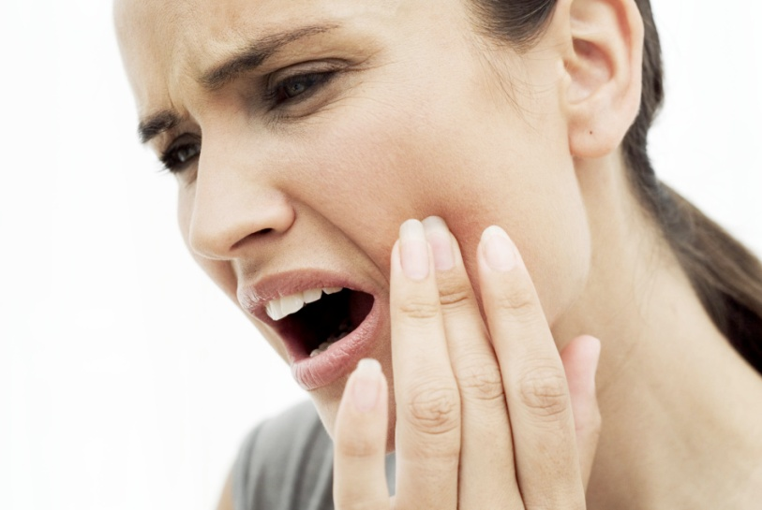
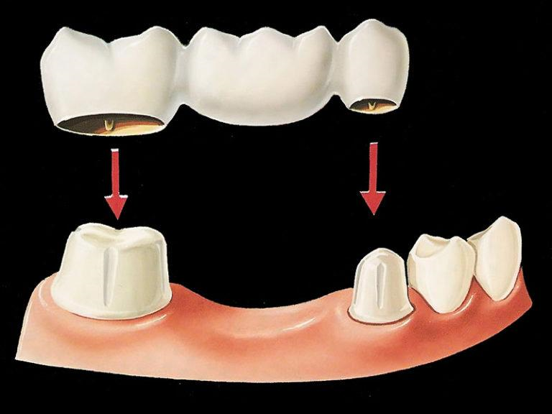
Bridges
Mucosal injury
A serious complication when using bridges in the area of the lateral teeth is biting the mucous membrane of the cheek. The latter, falling between the bridge and the antagonist teeth, is injured with each closure of the dentition.
The cause of biting the buccal mucosa is most often the incorrect modeling of the crowns and the intermediate part of the bridge, when their buccal tubercles meet end-to-end with the antagonists.
To prevent this complication, when modeling crowns and the intermediate part of the bridge in the area of the upper premolars and molars, a so-called horizontal overlap should be created. In other words, the buccal cusps of the upper lateral teeth should protrude slightly towards the vestibular side in relation to the antagonist teeth; then the cheek moves away from the lower teeth and the mucous membrane is not pinched between the bridge and these teeth.

Slide 43
Bridges
Coating chipped
There are several reasons for this type of complication. The most common mistakes:
incorrect modeling of the prosthesis frame (without taking into account the properties of the metal alloy);
long metal-ceramic prostheses;
the intermediate part of the frame is too thin (without taking into account the properties of the metal alloy);
cantilever type prostheses;
uneven sandblasting of the metal surface of the frame;
the surface of the base alloy frame is too smooth;
contamination of the frame;
errors when applying the primer coating layer;
errors during firing and cooling of the structure;
excessive number of burns;
verified occlusal contacts;
electrolytic gilding of frames made of base alloys.

Slide 44
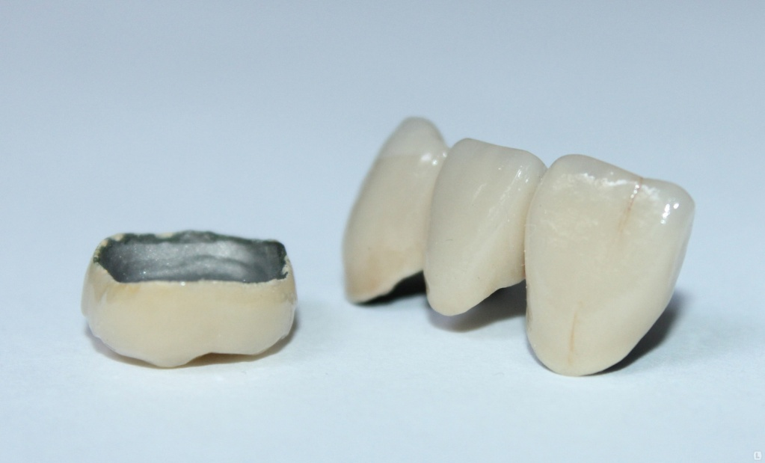
Bridges
Chipping of the coating
One of the methods of preventing possible chipping of the ceramic coating is the use of bridges in practice, consisting of 4-5 units. If, according to clinical indications, for example, for the purpose of splinting in periodontitis, it is still necessary to apply a long-length prosthesis, then composite bridges are used. The parts of such a prosthesis, fixed on different functionally oriented groups of teeth, are connected by locking fasteners. It is possible to use soldering with high-temperature solder, for example, gold "Super VP".

Slide 45
Bridges
Chipping of the coating
The fixation of prostheses can be started only if the prosthesis meets all clinical requirements and is technically performed flawlessly. The fixing material must be sufficiently fluid, which eliminates errors and complications such as:
insufficient fit of the prosthesis during fixation, which results in the exposure of the necks and the development of cervical caries, as well as a cosmetic defect and the occurrence of functional overload of the teeth due to the supra-occlusive position of the prosthesis;
excessive force during fixation is the occurrence of stresses in the prosthesis frame and, as a result, the possibility of chipping the coating, primarily in the cervical region of the supporting crowns.

Slide 46
Removable dentures
One of the complications characteristic of prosthetics with removable dentures, regardless of the design, is a violation of diction.
Complaints of patients with speech defects in the process of adaptation to removable dentures are inevitable and depend on the size and boundaries of the base of the removable plate prosthesis, the location and thickness of the arch of the supporting prosthesis, the size of the teeth, the placement of artificial teeth, the relief of the inner surface of the base of the upper jaw prosthesis. In each specific case, patients' claims to diction should be clarified in detail in order to take them into account when modeling the basis and setting artificial teeth.

Slide 47
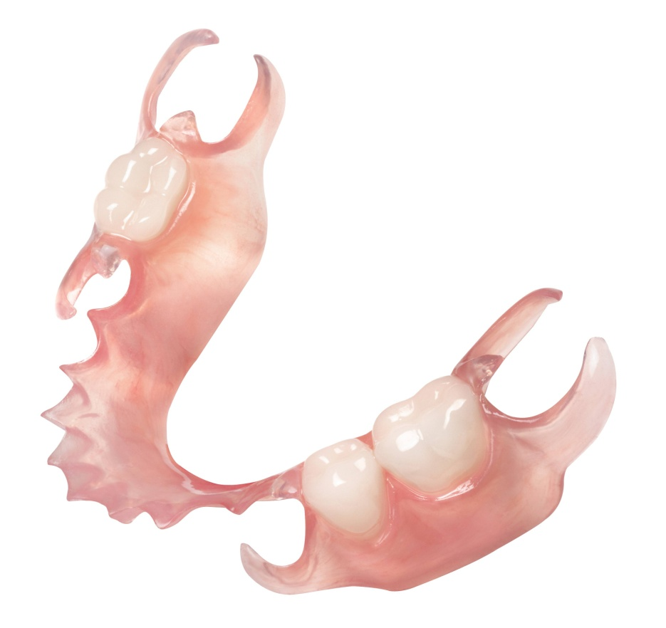
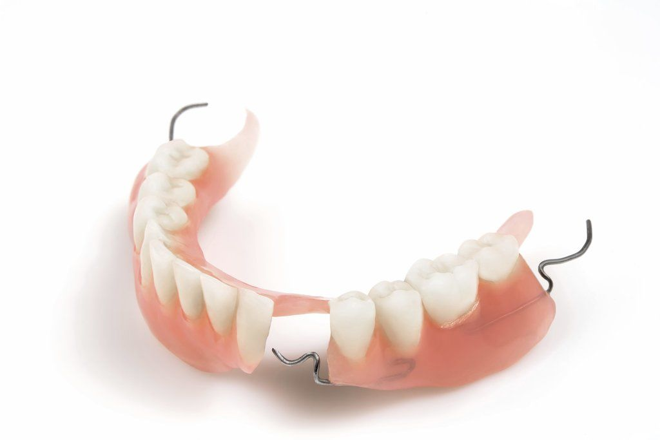
Removable plate prostheses
When treated with removable plate prostheses with retaining clamps, the chewing pressure is completely distributed to the mucous membrane, which can lead to the development of hyperemia, erosion of the mucous membrane under the prosthesis. The retaining clamps transfer the horizontal component of the chewing load to the teeth, which negatively affects the periodontal condition.

Slide 48
Removable plate prostheses
Tactical and technical errors:
errors in determining the central ratio of the jaws;
errors when removing the impression (the alveolar process, the alveolar part, the cords and frenules, the transitional fold must be understood);
inaccuracies in obtaining impressions due to the wrong choice of impression material - significant compression or deformation of the mucous membrane (injury of the mucous membrane, diffuse hyperemia of the alveolar process);
incorrect choice of the shape and size of artificial teeth;
occlusal contacts are insufficiently pronounced, teeth are incorrectly positioned in relation to the top of the alveolar ridge;
lack of isolation in the area of acute bone protrusions;
lack of insulation or excessive insulation of the palatal cushion;
an elongated, shortened or thinned edge of the prosthesis;
damage to the model;

Slide 49
Removable plate prostheses
Tactical and technical errors:
deformation of the model during plastic pressing;
errors in checking the design of the prosthesis;
inability to properly assess the quality of prostheses;
a conversation with the patient about the rules of using the prosthesis and the timing of check-ups was poorly conducted;
multiple corrections.

Slide 50
Removable plate prostheses
Given many of the above complications, in most cases, in the treatment of partial absence of teeth, preference should be given to dentures. The use of a removable plate prosthesis where the use of a clasp is indicated should be considered a medical error.

Slide 51
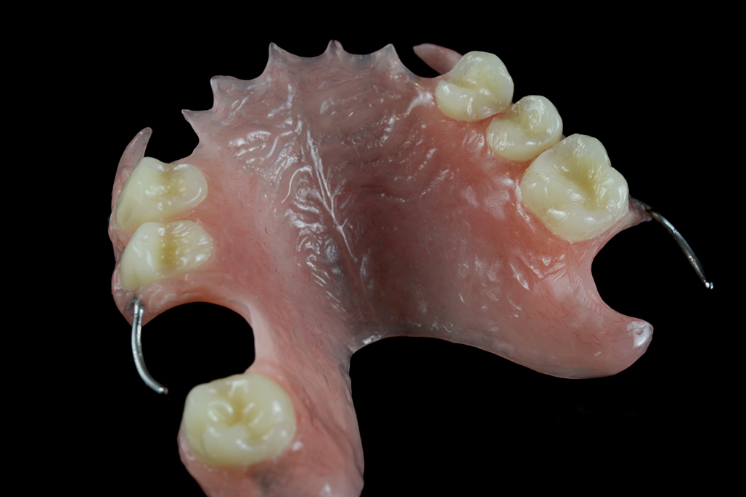
Removable plate prosthesis

Slide 52
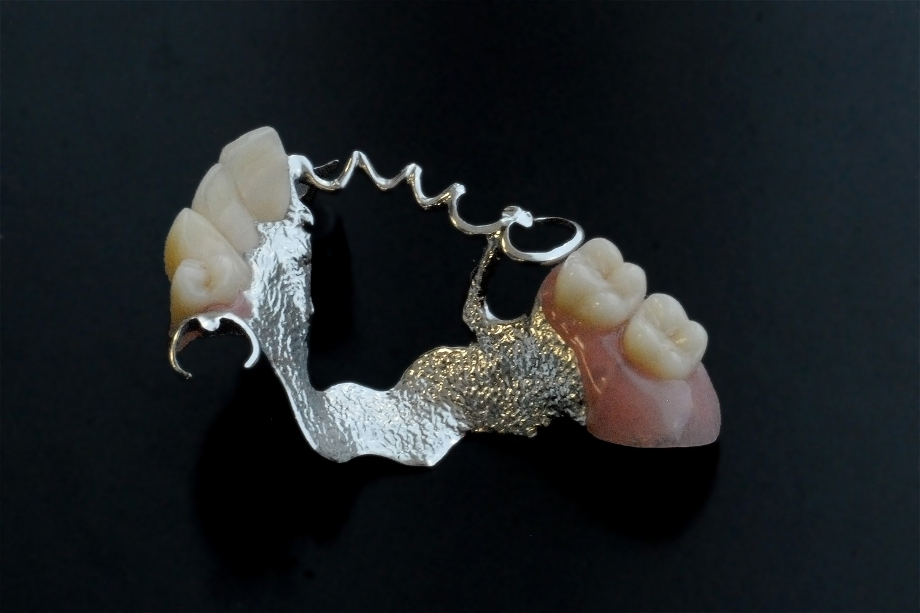
Clasp prosthesis

Slide 53
Removable plate prostheses
Errors when removing the impression
The examination data of the alveolar process, the alveolar part and the mucous membrane covering it (its mobility, pliability) should be the basis for the selection of the impression material.

Slide 54
Removable plate prostheses
Errors when removing the impression
In cases where the mucous membrane of the alveolar ridge, especially along its top, is stationary, but uniformly malleable, materials are used that exert pressure on the mucous membrane and cause its compression - thermoplastic materials. This achieves compression of the most malleable areas of the mucous membrane during the meal.

Slide 55
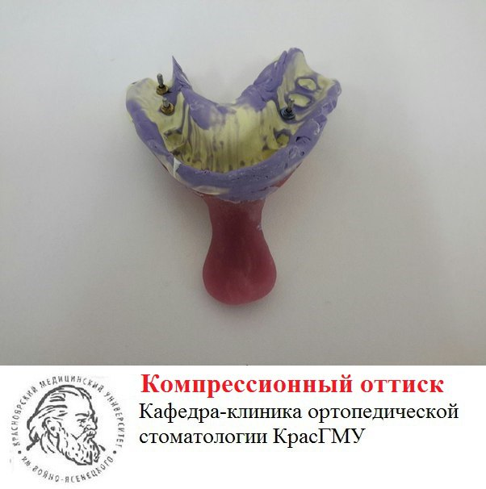

Slide 56
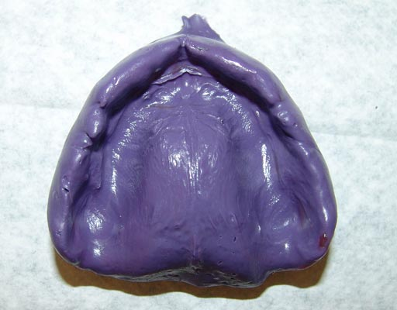
Removable plate prostheses
Errors when removing the impression
When detecting areas of the mucous membrane of the prosthetic bed that are easily movable in the horizontal plane (displaced by palpation), especially at the top of the alveolar ridge, only unloading impressions using liquid-flowing masses should be used. This tactic, when removing the impression, makes it possible to avoid deformation of soft tissues (flattening, displacement with the formation of folds).

Slide 57
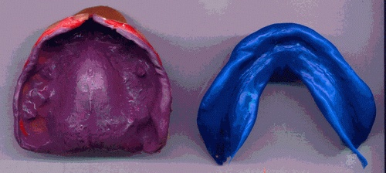
Removable plate prostheses
Errors when removing the impression
The purposeful choice of the impression material allows you to prevent one of the complications - injury of the mucous membrane.

Slide 58
Removable plate prostheses
Decubital ulcer
Decubital ulcers, erosions in the area of the prosthetic bed can also occur with improper fixation of the central occlusion or the central ratio of the jaws due to the concentration of chewing pressure on a small area, therefore, before correcting the prosthesis, it is necessary to accurately determine the cause of the complication.

Slide 59
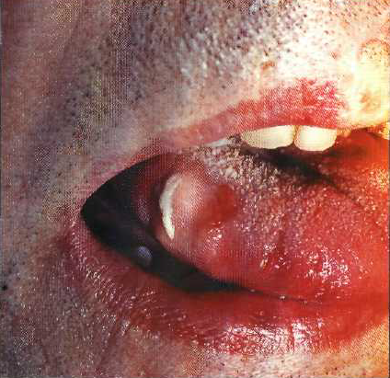
Decubital ulcer on the mucous membrane
the lateral surface of the tongue.

Slide 60
Removable plate prostheses
Decubital ulcer
Decubital ulcers, erosions in the area of the prosthetic bed can also occur with improper fixation of the central occlusion or the central ratio of the jaws due to the concentration of chewing pressure on a small area, therefore, before correcting the prosthesis, it is necessary to accurately determine the cause of the complication.
Depending on individual sensitivity, these injuries are accompanied by sharp pain, but in a small number of cases they occur It's painless. Painless chronic injury to the mucous membrane of the prosthetic bed often leads to the development of papillomas (traumatic papillomatosis).

Slide 61
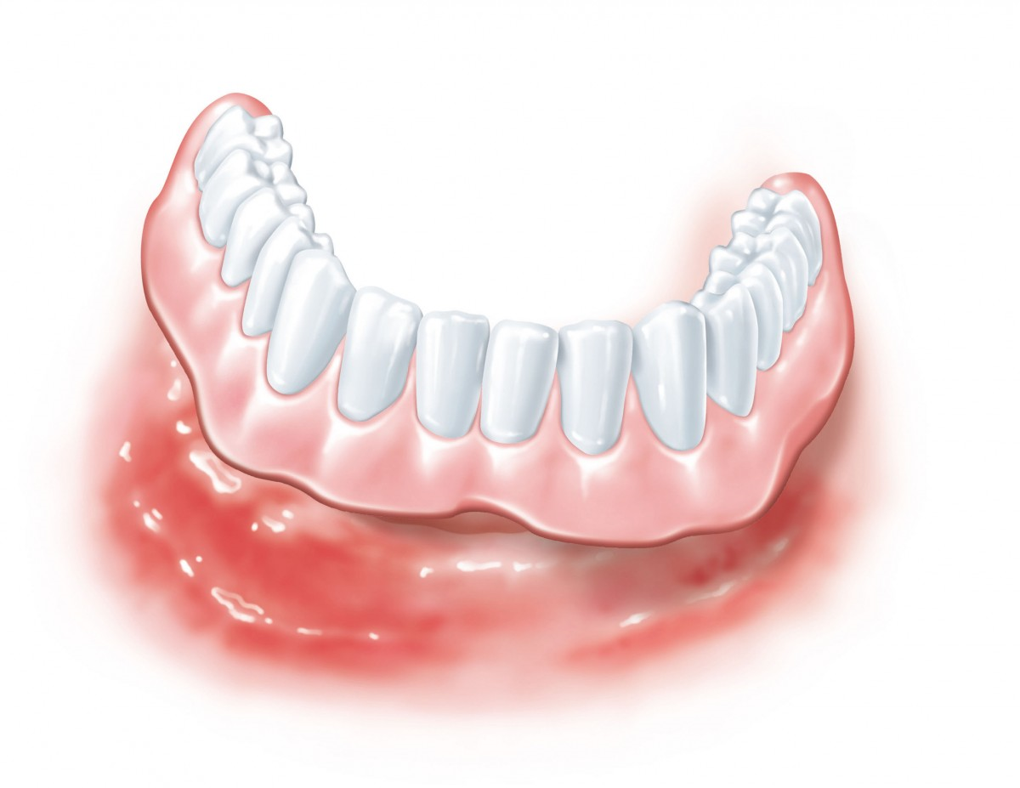
Removable plate prostheses
Toxic effects of plastic base
The toxic effect of the plastic base of a removable denture on the mucous membrane is possible due to poor-quality polymerization of plastic, and as a result, the excessive presence of a free monomer in it, which has a pronounced toxic and allergic effect.

Slide 62
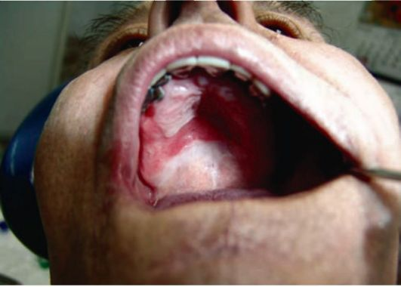
Removable plate prostheses
Toxic effects of plastic base
To reduce the monomer content, various depolymerization methods have been proposed - repeated heat treatment in gypsum form, ultraviolet, ultrasonic irradiation, vacuum use, etc.
Contact stomatitis corresponding to the boundaries of the arch prosthesis

Slide 63
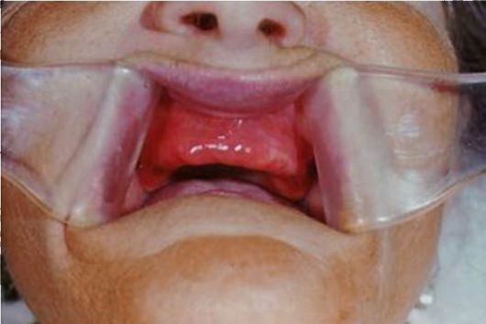
Removable plate prostheses
Toxic effects of plastic base
During the examination of the patient in this case, hyperemia of the mucous membrane of the prosthetic bed is also observed, but it is not localized, but diffuse, diffuse.
Manifestations of acrylic stomatitis

Slide 64
Removable plate prostheses
Toxic effects of plastic base
Burning under the prosthesis can be observed in patients with general somatic pathology that reduces the reserve forces of the oral mucosa, including the zone of the prosthetic bed: diabetes mellitus, alcoholism, AIDS, after radiation therapy, etc. In these cases, clasp prostheses should be made, and if it is impossible, due to the small number of preserved teeth, plate prostheses with support-retaining clamps and bases with a soft layer.

Slide 65
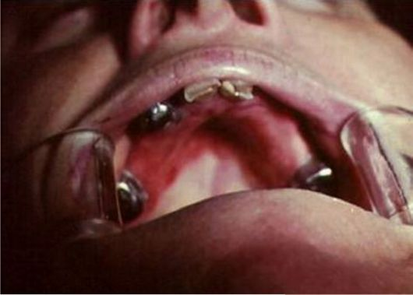
Manifestations of toxic stomatitis correspond to the boundaries of the lamellar prosthesis

Slide 66
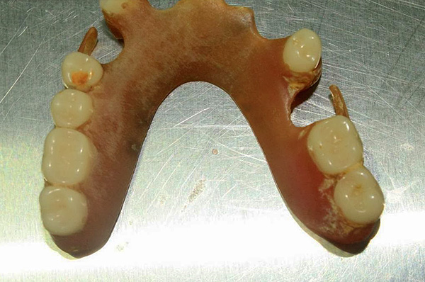
Removable plate prostheses
Unsatisfactory hygienic care of the prosthesis
Unsatisfactory hygienic care of prostheses and, as a result, the accumulation of microflora on the inner surface of the base of the prosthesis, the waste products of which have a toxic effect on the mucous membrane, can be a common cause of burning.

Slide 67
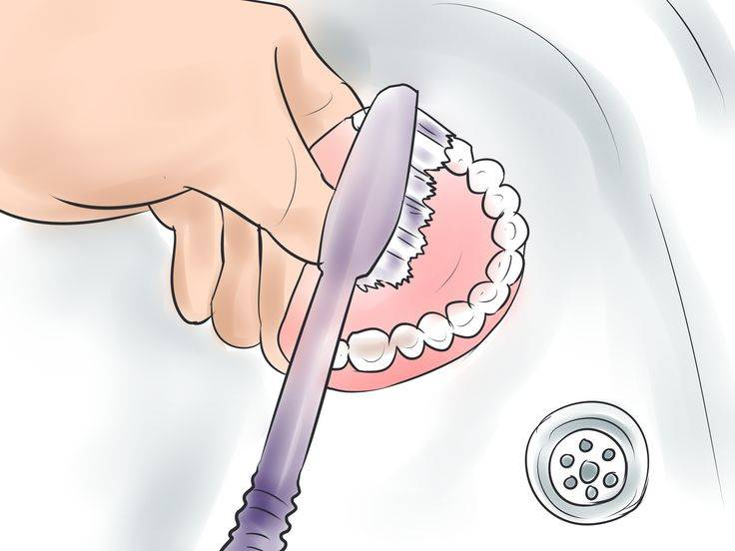
Removable plate prostheses
Unsatisfactory hygienic care of the prosthesis
To prevent such a complication, it is necessary to conduct a special conversation with each patient on the day of application and fixation of the prosthesis about the rules of use and care of removable dentures.

Slide 68
A prosthesis of any design, disrupting sensory functions, should not cause pain. Consequently, the painful reaction to the insertion of a prosthesis of any kind into the oral cavity indicates (if the patient has no psychopathic complications) certain qualitative disadvantages of the prosthesis.

Slide 69
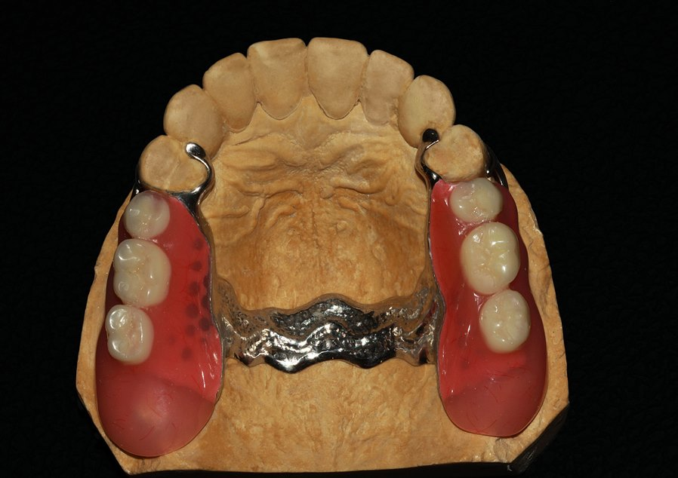
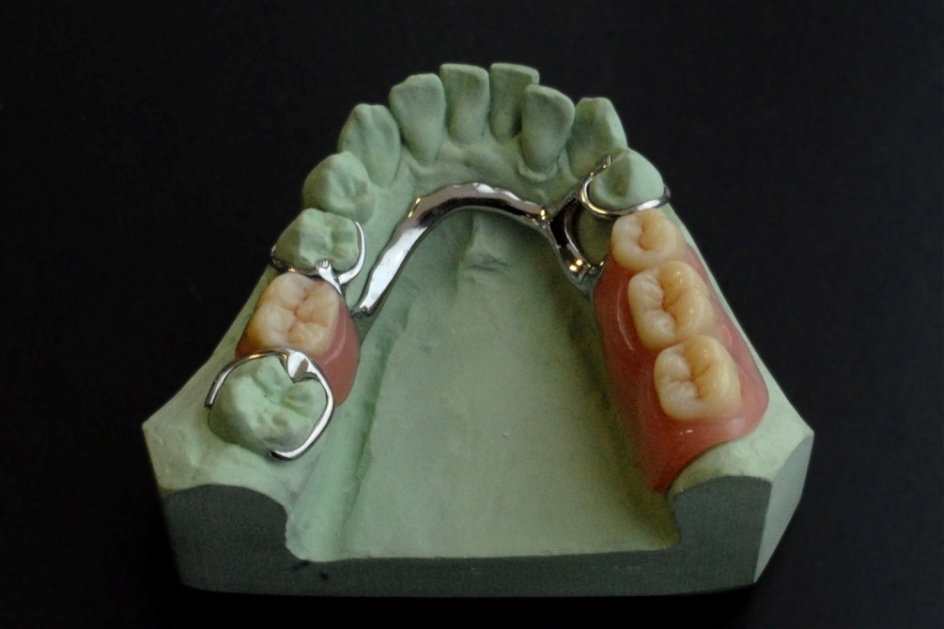
Clasp prostheses
A characteristic feature of the clasp (arched, supported) prostheses is the distribution of chewing pressure on the supporting teeth and mucous membrane. The following errors and complications are possible during their manufacture.

Slide 70
Clasp prostheses
Tactical and technical errors:
incorrect location of the equator line during parallelometry;
errors in determining the central ratio of the jaws (central occlusion);
errors in the removal of the impression;
errors in the casting of the frame of the clasp prosthesis;
an elongated, shortened or thinned edge of the prosthesis;
damage to the plaster model;
deformation of the model during plastic pressing;
errors in checking the design of the prosthesis;
inability to properly assess the quality of prostheses;
a conversation with the patient about the rules of using the prosthesis and the timing of check-ups was poorly conducted;
multiple corrections.

Slide 71
Clasp prostheses
Complications:
poor fixation and stabilization of prostheses;
violation of diction;
failure of the prosthesis and clamps;
the balance of the prosthesis due to errors in obtaining impressions and technical manufacture;
periodontal overload of the supporting teeth;
hyperemia of the mucous membrane and erosion on the prosthetic bed;
multiple corrections.

Slide 72
Clasp prostheses
Unsatisfactory fixation and stabilization of prostheses
Unsatisfactory fixation (stability) of a removable denture may be a consequence of the atypical shape of the supporting teeth, the incorrect location of the retaining part of the clamp relative to the line of sight.
The supporting teeth during clamp fixation must have a well-defined equator and a sufficient crown height, otherwise it is necessary to pre-manufacture artificial crowns on the supporting teeth. It is necessary to cover supporting teeth with atypical crowns in cases where they have the shape of a triangle or an inverse cone, are restored from the vestibular side with fillings or are affected by a wedge-shaped defect.

Slide 73
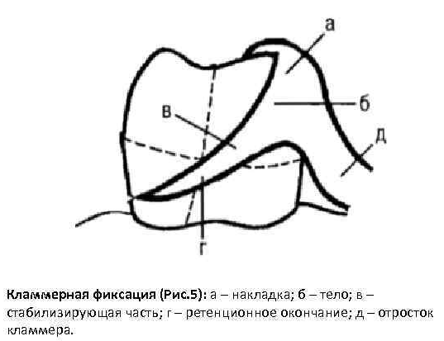
Clasp prostheses
Unsatisfactory fixation and stabilization of prostheses
Unsatisfactory fixation of the clasp prosthesis may be associated with an incorrect position of the retention part of the support-retaining clamp relative to the equator line, i.e. it is located above it between the equator and the chewing surface or goes under the line to a depth of less than 0.25 mm.

Slide 74
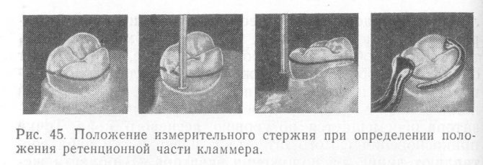
Clasp prostheses
Unsatisfactory fixation and stabilization of prostheses
To eliminate this complication, it is necessary to carefully determine the line of sight and apply it to the plaster model, as well as use calibers to determine the depth of retention.

Slide 75
Clasp prostheses
The breakdown of the prosthesis
One of the complications in the treatment of patients with partial absence of teeth with dentures is a breakdown:
fracture of the base,
from the number of artificial teeth,
fracture of the clamp.
A fracture of the base of a removable denture most often occurs as a result of its excessive thinning.

Slide 76
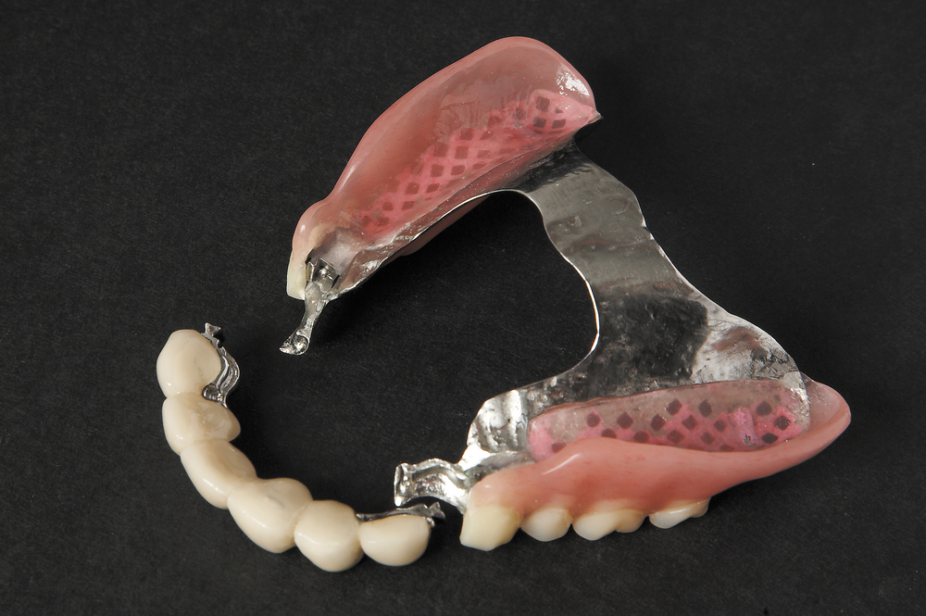

Slide 77
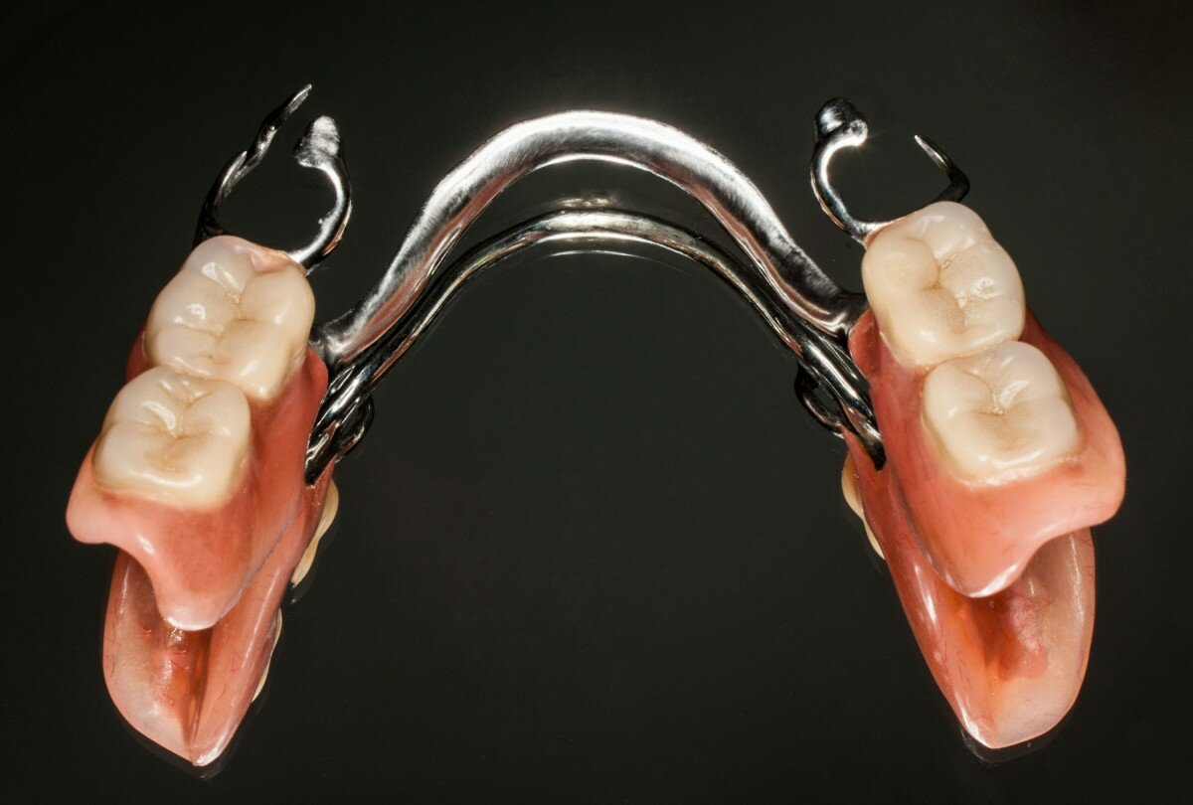
Clasp prostheses
Aesthetic defects
Aesthetic defects detected by patients are often associated with a mismatch in the color, size or shape of teeth, an unnatural color of artificial gums, as well as with the unaesthetic setting of artificial teeth or the location of clamps.

Slide 78
Diagnostic and tactical errors, complications in orthopedic treatment of patients with complete absence of teeth

Slide 79
Orthopedic treatment of patients with partial or complete loss of chewing teeth, complicated by a decrease in the height of the lower face, distal displacement of the lower jaw and functional changes in the chewing muscles and temporomandibular joint, as well as patients with complications when using bridges and removable prostheses, should be carried out in two stages, using:
corrective mouthguards or temporary medical prostheses;
permanent orthopedic devices and prostheses.

Slide 80
It is important to reasonably approach each stage of diagnosis and treatment in order to solve the main task – successful treatment.

Slide 81
From the point of view of the consequences, the most important first, fundamental clinical stage is the preparation of a detailed treatment plan based on a thorough comprehensive examination of the patient and diagnosis.
Diagnostic errors are possible at this stage:
incorrect determination of indications for the choice of treatment method;
the prosthesis design was chosen incorrectly;
the stage of treatment is incorrectly determined;
the analysis of diagnostic models has not been carried out; the height of the lower part of the face has not been determined;
Parallelometry has not been performed on diagnostic models;
unjustified tooth depulpation;
the condition of chronic pulpitis or periodontitis has not been diagnosed, indications for filling the tooth canal have not been determined;
a decrease in the height of the lower face has not been diagnosed;
pathology of the temporomandibular joint has not been diagnosed;
periodontal condition has not been diagnosed;
indications for tooth extraction have not been determined;
the color of the artificial crown and artificial teeth is incorrectly determined.

Slide 82
Examination of the temporomandibular joint
Determine the swelling, redness of the skin
At the same time, palpation and auscultation of the joint are performed
To determine the degree of freedom of movement of the articular heads, the amplitude of movement, the index fingers are placed on the joint area on both sides or the little fingers are inserted into the external auditory canal, and the thumbs are placed on the forehead, while the patient opens or closes his mouth, shifts the lower jaw to the sides
We can determine the symmetry, smoothness, painfulness of the movements of the articular heads, the absence or presence of noise, clicking, crepitation

Slide 83
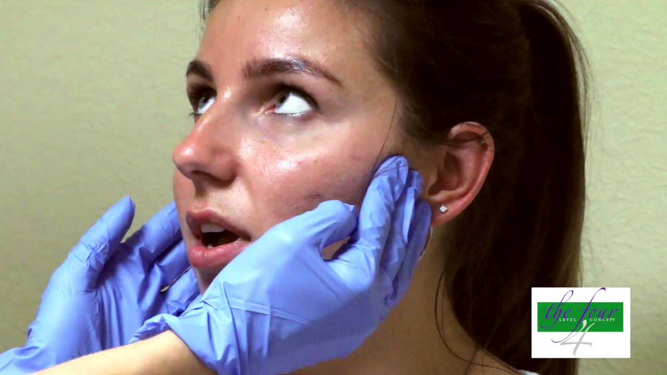

Slide 84
Examination and palpation of the chewing muscles
Examination of the superficially located muscles is carried out in the course of a conversation with the patient by movements of the lower jaw and facial movements
During the examination, the asymmetry of the masticatory muscles can be established
. Palpation of the muscles allows you to determine their tone and pain points (trigger points)

Slide 85
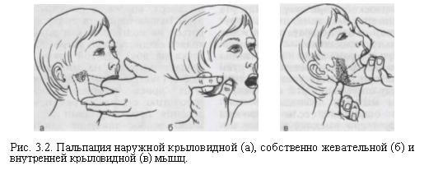

Slide 86
When palpating the chewing muscle itself
The patient is asked to clench his teeth and determine the leading edge of the muscle
The thumb is placed on this edge, and the rest on the back edge of the muscle and determine the width of the muscle
With the index finger of the other hand, the muscle is palpated from the outside or from the side of the oral cavity
They find painful areas, compare them with the same areas on the opposite side.

Slide 87
With external palpation of the lower parts of the medial pterygoid muscle
The finger is placed under the lower jaw and slides along the inner surface of the jaw from the angle upwards
The lower end of the muscle is revealed one centimeter above the angle of the lower jaw
Palpation of the middle part of the abdomen of the muscle is carried out through the oral cavity
The tip of the index finger slides along the molars to the edge of the branch of the lower jaw, lying behind and laterally to the last molar

Slide 88
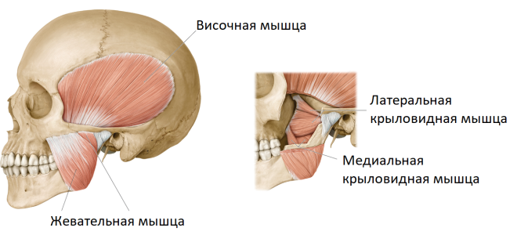
On palpation of the lateral pterygoid muscle
The outer pterygoid muscle is palpated extraorally anteriorly from the articular head, its lower part is intraorally, while the index finger is directed along the mucous membrane of the vestibular surface of the alveolar process distally and upward beyond the maxillary tubercle

Slide 89
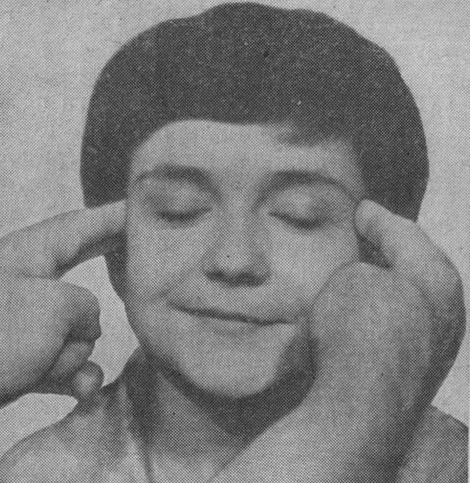
Palpation of the temporal muscle
The anterior part of the temporal muscle (raises the lower jaw) is palpated in the area of the temple and corner of the eye, the middle part (raises and moves the lower jaw back) is above the ear, the back part (moves the lower jaw back) is above the ear and behind the ear.
To palpate the tendon of the muscle, the index finger with the mouth half open is placed at the end of the upper vestibular transitional fold behind the upper molars.

Slide 90
The nature of the movements of the lower jaw
smoothness
discontinuity
soreness
deviation from the middle line

Slide 91
Special examination methods
Radiological methods of examination of teeth and parotid tissues:
dental radiography (sighting).
panoramic radiography.
sagittal tomography.
computed tomography (CT).
telerentgenography.
X-ray examination.
X-ray cinematography.
radiovisiography.

Slide 92
panoramic radiography

Slide 93
computed tomography

Slide 94
teleroentgenography

Slide 95
Complete removable prosthetics
Treatment of patients with complete absence of teeth with removable plate prostheses (without the use of implants) is carried out according to the scheme generally accepted in orthopedic dentistry.

Slide 96
Complete removable prosthetics
The following errors are possible at the diagnostic stage:
Not identified:
mental disorders (leading to unfounded claims and conflicts; epilepsy requires training in special rules for the use of prostheses);
endocrine pathology (for example: diabetes mellitus is accompanied by rapidly progressive atrophy of the alveolar bone and, as a result, deterioration of the fixation of the prosthesis);
allergic diseases (can lead to intolerance of the base material and require its individual selection);
errors in choosing the method of fixation of a removable denture of a complete dentition;
the presence of cords, exostoses was not revealed, complex clinical conditions were not diagnosed, as a result - the absence of a preparatory stage of prosthetics;
an analysis of the compliance and mobility of the mucous membrane of the prosthetic bed has not been carried out or incorrectly carried out;
there is no informed consent of the patient to the proposed treatment plan.

Slide 97
Complete removable prosthetics
At the stages of orthopedic treatment, tactical and technical errors may occur, as well as errors associated with a violation of the stages of treatment:
Tactical and technical errors:
errors in choosing the method of obtaining a functional impression;
removal of only an anatomical impression without subsequent manufacture of individual spoons;
errors in the selection of the impression material;
errors in the choice of the method of registration of the central jaw ratio;
engraving of the model;
incorrect determination of the level of the prosthetic plane;
errors in determining the boundaries of the prosthesis base;
lack of isolation in the area of acute bone protrusions;
lack of insulation or excessive insulation of the palatal cushion;
an elongated, shortened or thinned edge of the prosthesis;
damage to the plaster model;
deformation of the model during pressing of plastic dough;
errors in checking the design of the prosthesis;
inability to properly assess the quality of prostheses;
a conversation with the patient about the rules of using the prosthesis and the timing of control examinations was not clearly conducted.

Slide 98
Complete removable prosthetics
Complications of orthopedic treatment of patients with complete absence of teeth:
1. Of a general nature:
allergic reaction to materials;
exacerbation of the pathology of the cardiovascular system;
psychoemotional trauma.

Slide 99
Complete removable prosthetics
Complications of orthopedic treatment of patients with complete absence of teeth:
2. Local character:
violation of tactile, temperature, taste, etc. sensitivity;
violation of salivation (excessive salivation or dry mouth).

Slide 100
3. Complications resulting from errors at the clinical and technical stages:
dysfunction of the temporomandibular joint;
knocks from the contact of artificial teeth during the function;
violation of diction;
aesthetic disorders (the shape, color and size of artificial teeth are incorrectly chosen; the upper teeth are not visible during conversation or protrude strongly from under the lip);
violations of occlusive contacts;
lowering or overestimating the height of the lower face;
poor fixation and stabilization of prostheses;
balancing the prosthesis base;
decubital ulcers, erosions;
traumatic papillomatosis;
formation of a "dangling" alveolar ridge;
multiple corrections.

Slide 101
Complete removable prosthetics
When prosthetics of toothless jaws, it is important to remember that the manufacture of prostheses is impossible without the use of individual spoons.

Slide 102
Complete removable prosthetics
If the doctor does not know the technique of packing an individual spoon using Gerbst samples in strict sequence, then one should not expect to achieve a high effect not only of fixation, but also stabilization of prostheses.

Slide 105
Complete removable prosthetics
Errors at the stage of determining and fixing the central ratio of the jaws
This stage consists of determining and recreating on occlusal rollers the main anthropometric landmarks for the construction of artificial dentitions.

Slide 106
Complete removable prosthetics
In order to avoid mistakes, it is necessary to strictly adhere to the sequence of actions to create anthropometric landmarks, which are the starting points for a dental technician.
Assessment of the quality and correctness of the manufacture of wax bases with occlusive rollers.
Design of the relief of the vestibular surface and the level of the prosthetic plane of the occlusal roller on the upper base: creating a reference point for the level of the cutting edges of the front teeth, determining the direction of the long axis of the crowns of the teeth and the level of the prosthetic plane.

Slide 107
Complete removable prosthetics
Formation of a prosthetic plane throughout the occlusal roller on the upper base.
Determination of the size of the lower part of the face by randomly selected points at the position of the lower jaw in a state of physiological rest and in central occlusion.

Slide 108
Complete removable prosthetics
• Determination of the vertical size of the occlusal roller on the lower jaw and the creation of a prosthetic plane throughout its entire length, the design of its vestibular relief in the anterior part.
• Checking the correct dimensions of the height of the lower face with the position of the lower jaw in the central ratio.
• Fixation of the central jaw ratio.
Measurement of the height of the lower part of the face:
A – in a state of relative physiological rest;
B – in the central occlusion.

Slide 109
Complete removable prosthetics
• Checking and correction of the ratio of occlusal rollers in the anterior section in accordance with the ratio of the interalveolar lines (the ratio of the vertices of the alveolar ridges).
• Applying the remaining landmarks (the middle line of the face, the line of fangs, the smile line) to the occlusal rollers.
• Checking the correct fixation of the central jaw ratio. Due to the incorrect determination of the level of the location of the upper and lower artificial teeth, i.e. the level of the prosthetic plane, prostheses do not satisfy patients aesthetically. Guided by incorrectly defined landmarks, the dental technician sets longer upper teeth and shorter lower teeth, or vice versa.

Slide 110
Complete removable prosthetics
Incorrect identification and application of the middle line of the face to wax rollers leads to a violation not only of the symmetry of the arrangement of artificial teeth on the right and left sides, but also of occlusive contacts and, as a result, violation of aesthetic norms. This error is most often due to the fact that this landmark is determined not by the middle line of the face, but by the position of the frenulum of the upper lip. In some cases, the frenulum of the upper lip does not coincide with the middle of the face.

Slide 111
Complete removable prosthetics
Aesthetic defects detected by patients are often associated with a mismatch in the color, size or shape of teeth, an unnatural color of artificial gums, as well as with the unaesthetic setting of artificial teeth.

Slide 112
Complete removable prosthetics
Errors in fixing the central ratio of the jaws may occur due to poor fixation of wax bases with occlusive rollers in the oral cavity. In addition, when a foreign body is inserted into the oral cavity, the patient often cannot leave the lower jaw in the correct position.

Slide 113
Complete removable prosthetics
Improper fixation of the lower jaw is also facilitated by excessive pressure of the doctor's hand on the chin at the moment of closing the jaws due to the natural reflex reaction of countering the force of the muscular system.

Slide 114
Complete removable prosthetics
Errors that are made in determining and fixing the central ratio of the jaws can be identified and eliminated at the stage of checking the prosthesis designs. They can be divided into 4 main groups.

Slide 115
Complete removable prosthetics
1. Fixation of the lower jaw is not in the central, but in the anterior or lateral (right, left) ratio.
At the moment of fixation of the central jaw ratio, the patient pushes the lower jaw forward or shifts it to the side, i.e. one of the sagittal or lateral occlusions is fixed.
In the first case, the front teeth of the upper jaw significantly overlap the teeth of the lower jaw, and there is no occlusal contact between them. The lateral teeth are closed, but the fissure-tubercle contact is usually absent.

Slide 116
Complete removable prosthetics
In the second case, occlusal contact is noted on the side opposite to the displacement, and on the other side the teeth are separated, and the segments of the midline passing between the upper and lower central teeth do not coincide.
For control, the lower jaw should be moved in the direction of the intended displacement, which will lead to a coincidence of the closing pattern with the nature of the contacts in the articulator.

Slide 118
Complete removable prosthetics
Correction of inaccuracies in determining the central ratio of the jaws consists in removing artificial teeth from the lower wax base, manufacturing a new occlusal roller and re-determining the central ratio of the jaws.

Slide 119
Complete removable prosthetics
2. Fixation of the central ratio at the moment of displacement of one of the wax bases.
3. Fixation of the central ratio with simultaneous crushing of the wax base or occlusal roller.
In the second and third groups of errors, the absence of dense fissure-tubercle occlusal contact may be a consequence of deformation of the bases or their displacement during fixation of the central jaw ratio.
At the same time, various types of tooth closure are possible: closure of the lateral and separation of the front teeth, or, conversely, the appearance of a gap between the teeth on only one side and tubercle contact on the other, etc.

Slide 120
Complete removable prosthetics
4. Fixation of the central ratio when one of the wax bases is shifted in the horizontal plane.
In the fourth group of errors, when applied to a toothless jaw, the base may be shifted in the horizontal plane, and in some areas it may rise or fall. It is characterized by the absence of dense fissure-tubercle contact during movements of the lower jaw.

Slide 121
Complete removable prosthetics
In all cases involving the displacement of the base on the upper jaw, it is necessary to re-determine the central ratio of the jaws using new wax bases, sometimes rigid.

Slide 122
Complete removable prosthetics
The elimination of these errors is possible only at the stage of checking the wax composition of the prosthesis and the correctness of the placement of teeth. If errors are detected related to the displacement of the jaw or wax bases, it is necessary to remove the lower lateral teeth, and sometimes canines from the wax base, make wax rollers on these areas and re-determine the central ratio with subsequent re-plastering of the upper jaw model in the articulator.

Slide 123
Complete removable prosthetics
The central and lateral incisors are left to control the correctness of fixing the central ratio when re-determining it: if, after re-determination, the incisors are in the occlusion established when checking the wax composition (the center line does not match, open bite, etc.), then it can be assumed that the correct ratio is fixed. If, after repeated fixation, the incisors are in the same ratio as in the articulator, then the same mistake is repeated.

Slide 124
Complete removable prosthetics
The imposition of prostheses, artificial dentitions of which incorrectly restore occlusal contacts (first of all, contacts in the central occlusion), is a gross medical error.
Correction of occlusal contacts, which may result in a decrease in the height of the lower face and, as a result, complete grinding of the chewing tubercles, is also unacceptable.
Occlusion correction using self-hardening plastics should not be resorted to, since as a result, the prosthesis turns out to be of poor quality.

Slide 125
Complete removable prosthetics
Changing the volume of the edge of the prosthesis or normalizing its length in cases where the dental technician made a mistake must be carried out in a laboratory way.

Slide 126
Complete removable prosthetics
Prostheses that have a balance are also not subject to fixation!
Recommendations for eliminating the balance by rebasing using self-hardening plastics should be considered untenable. Partial or complete relocation of prostheses in the oral cavity using these plastics is harmful, since, in addition to burning the oral mucosa, the body may develop sensitization to acrylic group plastics or their individual ingredients (primarily monomer).

Slide 127
Complete removable prosthetics
Self-hardening plastics are strictly forbidden to be used in cases where the patient suffers from bronchial asthma. Complications combined in the general concept of "intolerance to plate prostheses" can be both an allergic reaction and a reaction to other influences.

Slide 128
Complete removable prosthetics
Initially, the factor of mechanical injury, violations of the heat exchange of the tissues of the prosthetic bed, chemical damage to the mucous membrane by a monomer or an allergic reaction to it are excluded.
For this purpose, a thin layer of silver is chemically applied to the inner and outer surfaces of the base of a high-quality prosthesis in all parameters.

Slide 129
Contact allergic stomatitis in the area of the arch of the denture

Slide 130
Complete removable prosthetics
With increased sensitivity of the mucous membrane, in addition to the destructive method of obtaining an impression, it is necessary to use a two-layer base of the prosthesis (with a soft elastic layer of the base).

Slide 132
Complete removable prosthetics
In all these cases, the main base material should be colorless, uncluttered acrylic plastic (for the prevention of allergic reactions).
For the same purpose, it is possible to apply electroplating of the prosthesis base from colorless plastic with gold or an all-cast base is made (preferably from titanium or cobalt-chromium alloy).

Slide 133
Removable plate prosthesis with a transparent base

Slide 134
Complete removable prosthetics
The method of gilding the base of a prosthesis made of colorless plastic is also effective in case of chemical irritation (damage) of the mucous membrane by a residual monomer emerging from the thickness of the base. However, before this, it is necessary to differentiate two types of complications - chemical damage and an allergic reaction.

Slide 135
Only an accurate diagnosis, a targeted technique for taking impressions, the choice of basic material and high-quality materials can relieve allergic phenomena.

Slide 136
Rehabilitation and preventive stage
Poor oral hygiene, lack of control of bone atrophy under the basis of the prosthesis can negate all the successes of orthopedic treatment.

Slide 137
Rehabilitation and preventive stage
In the treatment of patients with complete absence of teeth, it is necessary to carry out a number of measures.
Correction of the basis of the prosthesis in the presence of complaints from the patient and the identification of areas of acute inflammation during the first 1-3 hours of use.
Thorough training of patients in the rules of using prostheses, storing and caring for them.

Slide 138
Rehabilitation and preventive stage
Check-ups 1 time every six months:
to control the rules of use of the prosthesis;
to control the stability of the prosthesis (laboratory relocation if necessary);
to control occlusal contacts of artificial dentition and height of the lower face;
with significant abrasion of artificial teeth and a decrease in the height of the lower part of the face, the prosthesis is redesigned.

Slide 139
Thank you for your attention!

Slide 140
List of literature
Basic literature:
Ортопедическая стоматология : учебник ред. И. Ю. Лебеденко, Э. С. Каливраджиян М. : ГЭОТАР-Медиа, 2016.
Ортопедическая стоматология [Электронный ресурс] : учебник. - Режим доступа: http://www.studmedlib.ru/ru/book/ISBN9785970437223.html ред. И. Ю. Лебеденко, Э. С. КаливраджиянМ. : ГЭОТАР-Медиа, 2016.
Загорский В.А. // Протезирование при полной адентии. 2-е изд., дополненное. — М.: Издательский дом БИНОМ, 2017. — 440 с.: ил.

