Slide 1
Prof. V.F. Voino-Yasenetsky KrasSMU, MOH, Russian Federation Department of Faculty Therapy
Cardiomyopathies. Pericarditis. Myocarditis.
video lecture for the 4st year students,
majoring in the specialty 31.05.01 General Medicine
Doctor of Medical Science,
Professor
Anna Chernova
Krasnoyarsk
2024
Notes:
ПРИ СОЗДАНИИ ПРЕЗЕНТАЦИИ РЕКОМЕНДУЕМ ИСПОЛЬЗОВАТЬ СВЕТЛЫЙ ФОН И КОНТРАСТНЫЙ ЕМУ ПО ЦВЕТУ ТЕКСТ
ДЛЯ СОЗДАНИЯ ТИТУЛЬНОГО СЛАЙДА ИСПОЛЬЗОВАТЬ МАКЕТ «ЗАГОЛОВОК И ОБЪЕКТ»
ШРИФТ ПРЕЗЕНТАЦИИ НА УСМОТРЕНИЕ АВТОРА (на слайде представлен шрифт «Calibri (Заголовки)» и «Calibri (Основной текст)»)
1 – рекомендуемый размер шрифта 20, официальное сокращенное наименование образовательной организации
2 – рекомендуемый размер шрифта 18, название кафедры с заглавной буквы
3 – рекомендуемый размер шрифта 28, заглавные буквы, интервал междустрочный одинарный
4 – рекомендуемый размер шрифта 18, интервал междустрочный одинарный, начало текста с маленькой буквы
5 – с новой строки, перенос после запятой
6 – рекомендуемый размер шрифта 18, интервал междустрочный одинарный, ученое звание (сокращенный вариант) и должность с заглавной буквы, имя, отчество, фамилия с заглавной буквы
7 – рекомендуемый размер шрифта 16, интервал междустрочный одинарный

Slide 2
Plan of lecture
Phenotypic approach to cardiomyopathies. Pericarditis. Myocarditis.
Epidemiology of cardiomyopathies, pericarditis, myocarditis.
Integrated patient management
Systematic approach to diagnosis of cardiomyopathy
General principles in the management of patients with cardiomyopathy, pericarditis, myocarditis.
Primary and secondary prevention of sudden cardiac death

Slide 3
Purpose and tasks of the lecture:
Purpose of the lecture: to familiarize with the concept, pathophysiological mechanisms, clinical picture, basic diagnostic approaches and therapeutic tactics in cardiomyopathies, pericarditis, myocarditis.
Lecture tasks: 1. Familiarize with the classification of cardiomyopathies, pericarditis, myocarditis. 2. Determine diagnostic tactics for different types of cardiomyopathies, pericarditis, myocarditis.
3. Primary and secondary prevention of sudden cardiac death

Slide 4
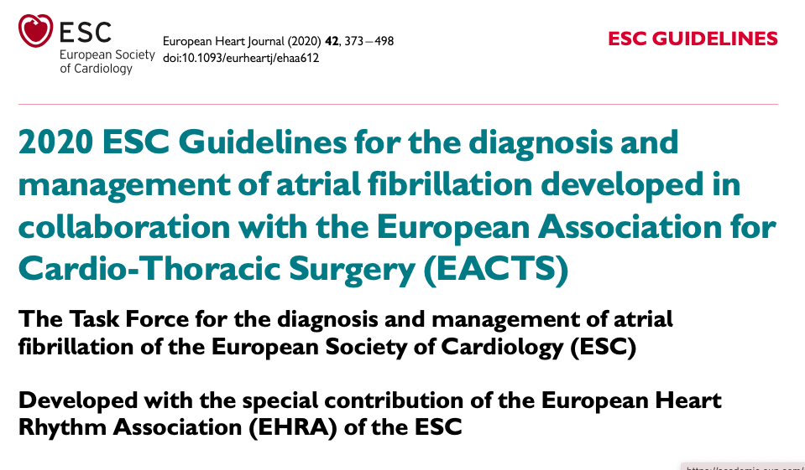
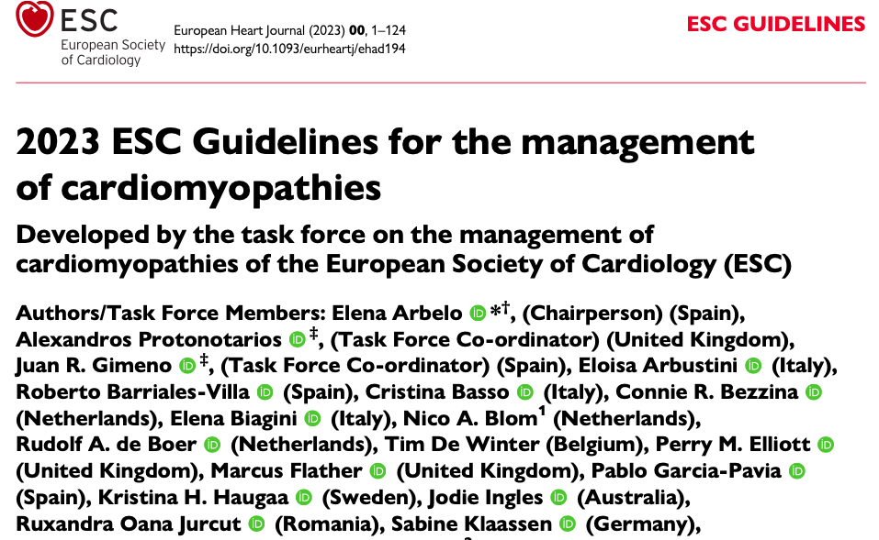
Guidelines

Slide 5
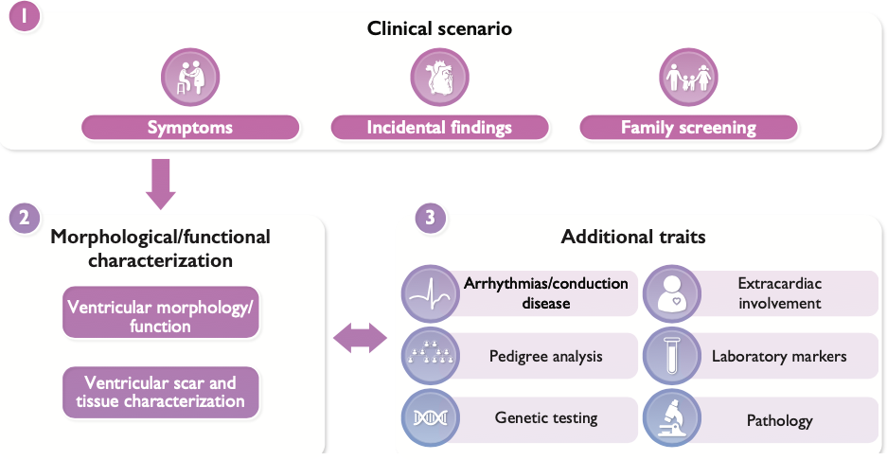
Key aspects in the evaluation and management of cardiomyopathies

Slide 6
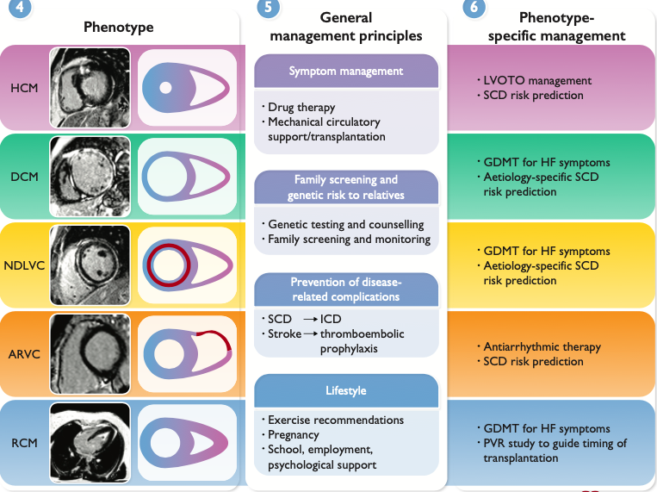
Key aspects in the evaluation and management of cardiomyopathies
The diagnosis, assessment, and management of patients with cardiomyopathy requires a coordinated, systematic, and individualized pathway that delivers optimized care by a multidisciplinary and expert team.
ARVC - arrhythmogenic right ventricular cardiomyopathy; CMR - cardiac magnetic resonance; DCM - dilated cardiomyopathy; GDMT - guideline-directed medical therapy; HCM - hypertrophic cardiomyopathy; HF - heart failure; ICD - implantable cardioverter defibrillator; LVOTO - left ventricular outflow tract obstruction; MCS - mechanical circulatory support; NDLVC - non-dilated left ventricular cardiomyopathy; PVR - pulmonary vascular resistance; RCM - restrictive cardiomyopathy; SCD - sudden cardiac death.Ige%:

Slide 7
Key aspects in the evaluation and management of cardiomyopathies
Central to this approach is not only the individual patient, but also the family as a whole; clinical findings in relatives are essential for under- standing what happens to the patient, and vice versa.
ARVC - arrhythmogenic right ventricular cardiomyopathy; CMR - cardiac magnetic resonance; DCM - dilated cardiomyopathy; GDMT - guideline-directed medical therapy; HCM - hypertrophic cardiomyopathy; HF - heart failure; ICD - implantable cardioverter defibrillator; LVOTO - left ventricular outflow tract obstruction; MCS - mechanical circulatory support; NDLVC - non-dilated left ventricular cardiomyopathy; PVR - pulmonary vascular resistance; RCM - restrictive cardiomyopathy; SCD - sudden cardiac death.Im%:

Slide 8
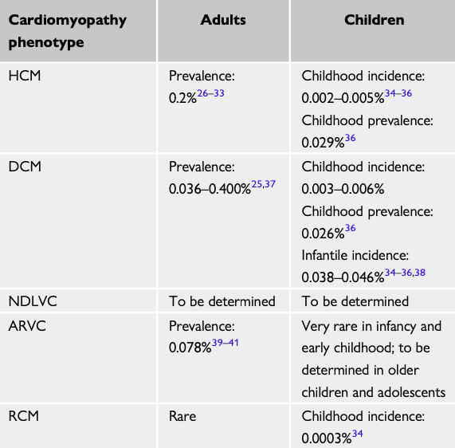
Key epidemiological metrics in adults and children for the different cardiomyopathy phenotypes
Cardiomyopathies have a variable expression throughout life. Geographical distribution of genetic variants influences estimated prevalence in different populations, ethnicities, regions, and countries. The complexity of diagnostic criteria for some conditions, such as ARVC, limits the evaluation of the true prevalence of the disease in the general population.
ARVC - arrhythmogenic right ventricular cardiomyopathy; DCM - dilated cardiomyopathy; HCM - hypertrophic cardiomyopathy; NDLVC - non-dilated left ventricular cardiomyopathy; RCM - restrictive cardiomyopathy.

Slide 9
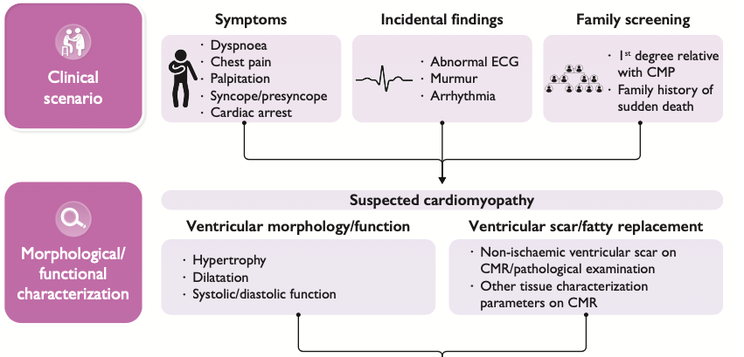
Clinical diagnostic workflow of cardiomyopathy (1)

Slide 10
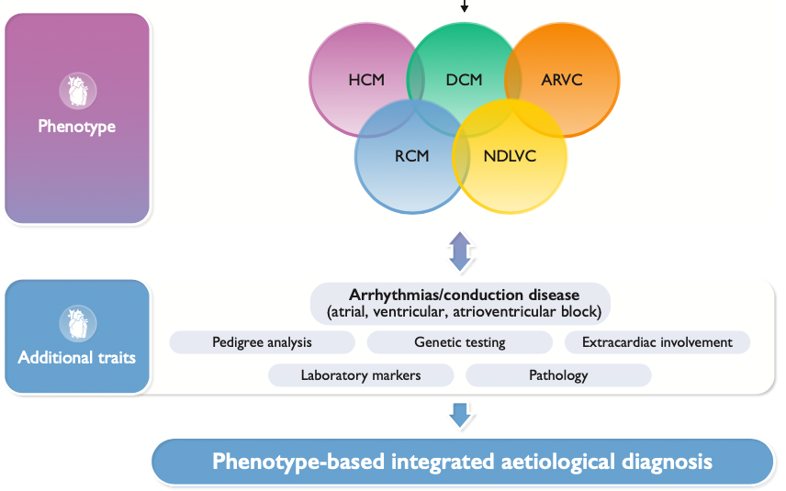
Clinical diagnostic workflow of cardiomyopathy (2)
ARVC - arrhythmogenic right ventricular cardiomyopathy; DCM - dilated cardiomyopathy; HCM - hypertrophic cardiomyopathy; NDLVC - non-dilated left ventricular cardiomyopathy; RCM - restrictive cardiomyopathy.

Slide 11
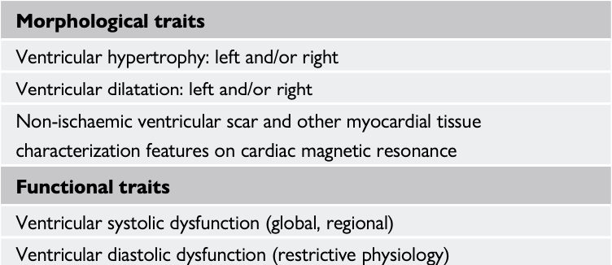
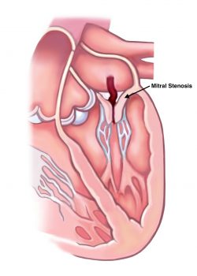
Definitions of cardiomyopathy
A cardiomyopathy is defined as a myocardial disorder in which the heart muscle is structurally and functionally abnormal, in the absence of coronary artery disease (CAD), hypertension, valvular disease, and congenital heart disease (CHD) sufficient to cause the observed myocardial abnormality
This definition applies to both children and adults and makes no a priori assumptions about etiology (which can be familial/genetic or acquired) or myocardial pathology.
Morphological and functional traits used to describe cardiomyopathy phenotypes

Slide 12
Cardiomyopathy phenotypes. Hypertrophic cardiomyopathy.
Hypertrophic cardiomyopathy (HCM) is defined as the presence of increased LV wall thickness (with or without RV hypertrophy) or mass that is not solely explained by abnormal loading conditions.
Examples of inheritance patterns that should raise the suspicion of specific genetic etiologies, grouped according to cardiomyopathy phenotype
The RASopathies constitute a group of multisystemic syndromes caused by variants in the RAS-mitogen-activated kinase (RAS-MAPK) cascade, including Noonan syndrome, Noonan syndrome with multiple lentigines; Costello syndrome, and cardiofaciocutaneous syndrome.

Slide 13
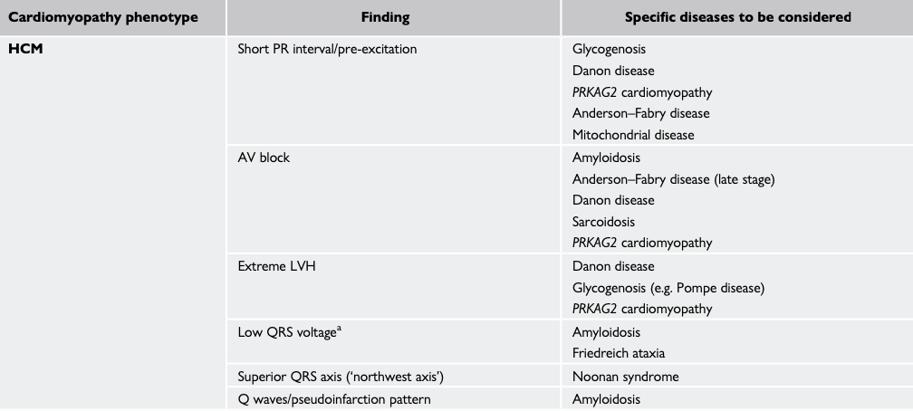
Examples of electrocardiographic features that should raise the suspicion of specific etiologies. Hypertrophic cardiomyopathy

Slide 14
Cardiomyopathy phenotypes. Dilated cardiomyopathy.
Dilated cardiomyopathy (DCM) is defined as the presence of LV dilatation and global or regional systolic dysfunction unexplained solely by abnormal loading conditions (e.g. hypertension, valve disease, CHD) or CAD.
Very rarely, LV dilatation can occur with normal ejection fraction (EF) in the absence of athletic remodeling or other environmental factors; this is not in itself a cardiomyopathy, but may represent an early manifestation of DCM. The preferred term for this is isolated left ventricular dilatation.
Examples of inheritance patterns that should raise the suspicion of specific genetic etiologies, grouped according to cardiomyopathy phenotype

Slide 15
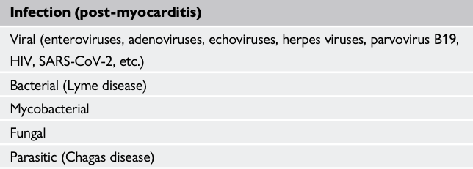
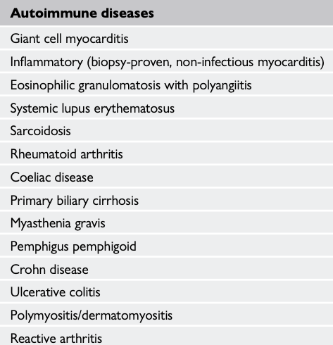
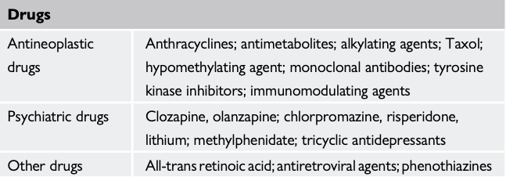
Non-genetic causes of dilated cardiomyopathy

Slide 16
Cardiomyopathy phenotypes. Restrictive cardiomyopathy
Restrictive cardiomyopathy (RCM) is defined as restrictive left and/or RV pathophysiology in the presence of normal or reduced diastolic volumes (of one or both ventricles), normal or reduced systolic volumes, and normal ventricular wall thickness.
Examples of inheritance patterns that should raise the suspicion of specific genetic etiologies, grouped according to cardiomyopathy phenotype

Slide 17
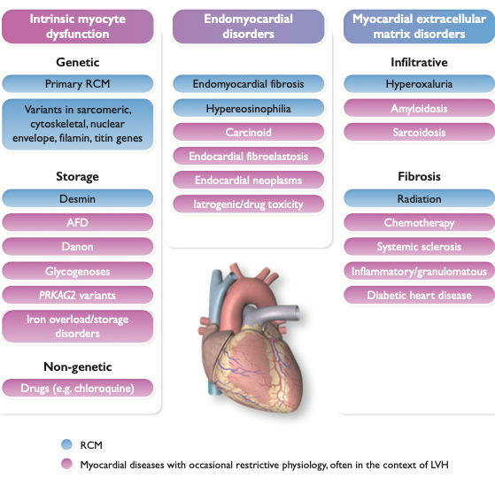
Spectrum of restrictive heart diseases
AFD - Anderson–Fabry disease; LVH - left ventricular hypertrophy; PRKAG2 - Protein kinase AMP-activated non-catalytic subunit gamma 2; RCM - restrictive cardiomyopathy.

Slide 18
Cardiomyopathy phenotypes. Non-dilated left ventricular cardiomyopathy
The definition of DCM had a number of important limitations, most notably the exclusion of genetic and acquired disorders that manifest as intermediate phenotypes that do not meet standard disease definitions in spite of the presence of myocardial disease on cardiac imaging or tissue analysis.
Examples of inheritance patterns that should raise the suspicion of specific genetic etiologies, grouped according to cardiomyopathy phenotype

Slide 19
Arrhythmogenic right ventricular cardiomyopathy
Arrhythmogenic right ventricular cardiomyopathy (ARVC) is defined as the presence of predominantly RV dilatation and/or dysfunction in the presence of histological involvement and/or electrocardiographic abnormalities in accordance with published criteria.
For decades, ARVC has been one of the principal cardiomyopathy subtypes. It has been defined in accordance with published consensus criteria that comprise RV dysfunction (global or regional), histological abnormalities in the form of fibro-fatty replacement of cardiomyocytes, electrocardiographic characteristics, ventricular arrhythmia of RV origin, and the presence of familial disease and/or pathogenic variants in desmosomal protein genes.
Examples of inheritance patterns that should raise the suspicion of specific genetic etiologies, grouped according to cardiomyopathy phenotype

Slide 20
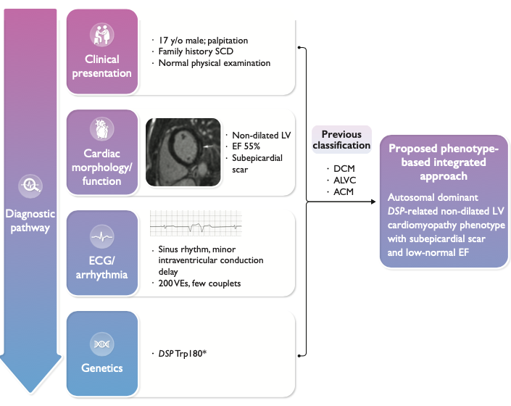
Worked example of the non-dilated left ventricular cardiomyopathy phenotype
Worked example of the NDLVC phenotype showing how a systematic multiparametric approach to clinical phenotyping, starting from the recognition of a clinical phenotype and integrating extended phenotypic information and targeted diagnostics, including genetic testing, can be used to arrive at highly specific phenotypic descriptions that can result in personalized treatment plans.
In this worked example, the diagnosis transforms from a simplistic categorization to a complex genetic disorder characterized by myocardial scar and a propensity to ventricular arrhythmia.
ACM - arrhythmogenic cardiomyopathy; ALVC - arrhythmogenic left ventricular cardiomyopathy; DCM - dilated cardiomyopathy; DSP - desmoplakin; ECG - electrocardiogram; EF - ejection fraction; LV - left ventricular; NDLVC - non-dilated left ventricular cardiomyopathy; SCD - sudden cardiac death; VE - ventricular extrasystole.

Slide 21
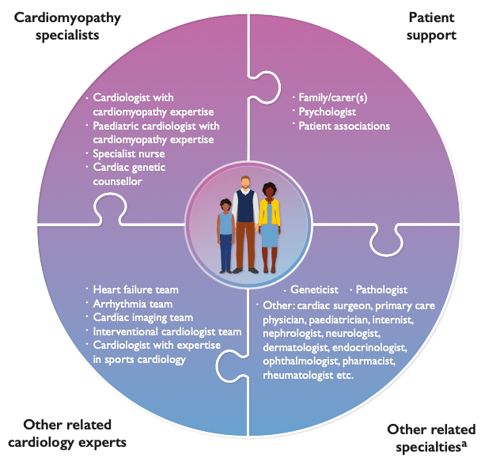
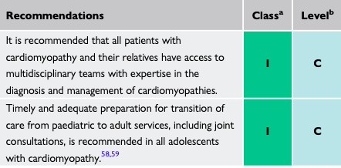
Multidisciplinary care of cardiomyopathies
Recommendations for the provision of service of multidisciplinary cardiomyopathy teams
The list presented is not exhaustive and represents examples of specialties that often interact in the care of cardiomyopathy patients

Slide 22
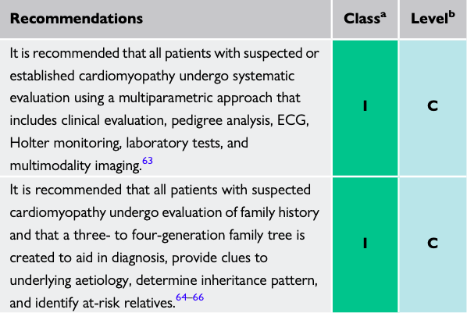
Recommendations for diagnostic work-up in cardiomyopathies

Slide 23
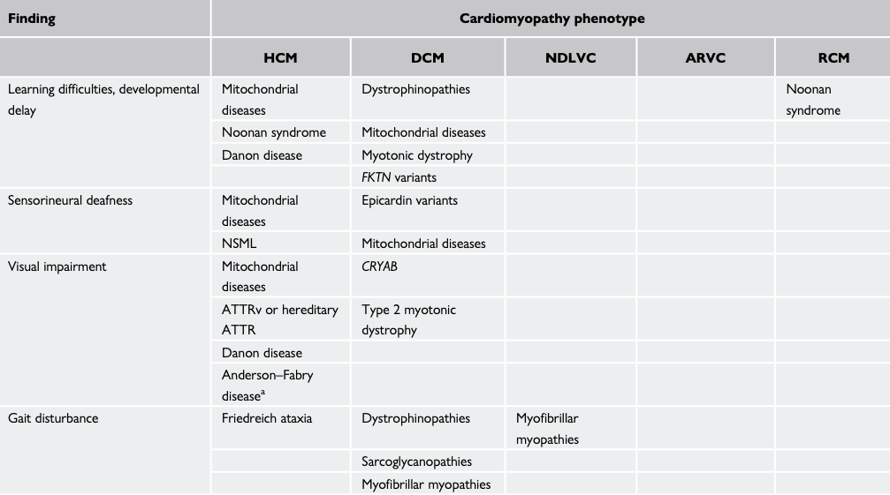
Examples of signs and symptoms that should raise the suspicion of specific aetiologies, grouped according to cardiomyopathy phenotype (1)
ARVC - arrhythmogenic right ventricular cardiomyopathy; DCM - dilated cardiomyopathy; HCM - hypertrophic cardiomyopathy; NDLVC - non-dilated left ventricular cardiomyopathy; RCM - restrictive cardiomyopathy.

Slide 24
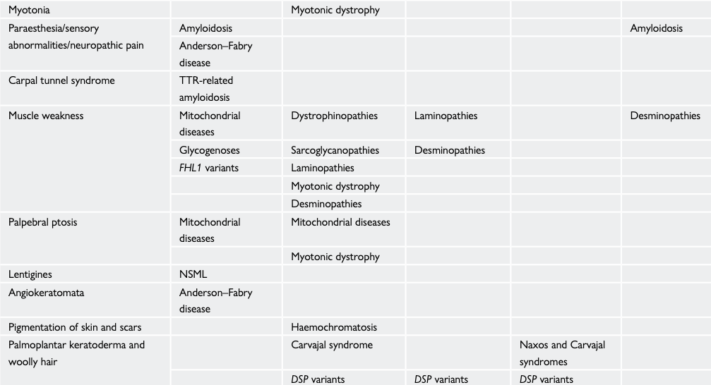
Examples of signs and symptoms that should raise the suspicion of specific aetiologies, grouped according to cardiomyopathy phenotype (2)
ARVC - arrhythmogenic right ventricular cardiomyopathy; DCM - dilated cardiomyopathy; HCM - hypertrophic cardiomyopathy; NDLVC - non-dilated left ventricular cardiomyopathy; RCM - restrictive cardiomyopathy.

Slide 25
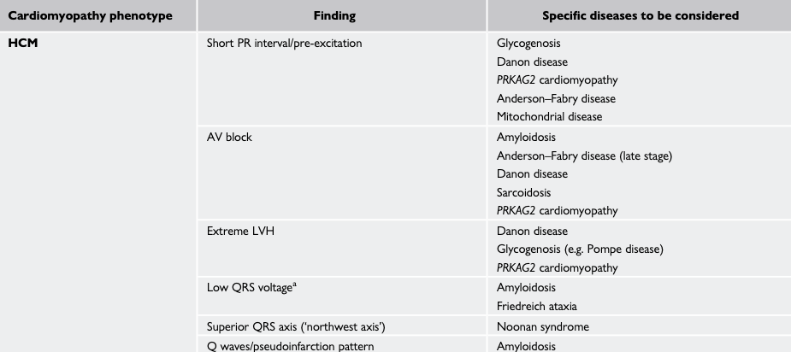
Examples of electrocardiographic features that should raise the suspicion of specific etiologies, grouped according to cardiomyopathy phenotype. Hypertrophic cardiomyopathy.
The resting 12-lead ECG is often the first test that suggests the possibility of cardiomyopathy. Although the ECG can be normal in a small proportion of individuals with cardiomyopathy, standard ECG abnormalities are common in all cardiomyopathy subtypes and can precede the development of an overt morphological or functional phenotype by many years; for example, in genotype-positive individuals identified during family screening.
AV - atrioventricular; HCM - hypertrophic cardiomyopathy; LVH - left ventricular hypertrophy

Slide 26
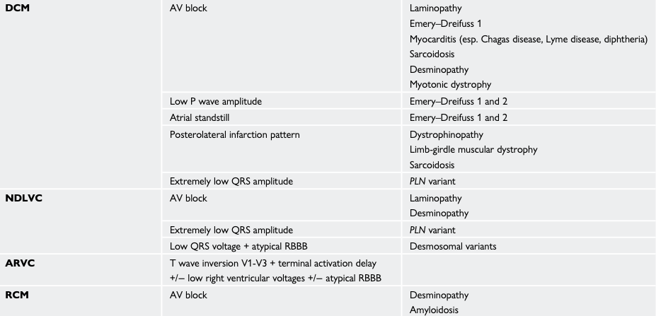
Examples of electrocardiographic features that should raise the suspicion of specific etiologies, grouped according to cardiomyopathy phenotype. DCM. NDLVC. ARVC. RCM.
When interpreted in conjunction with findings on echocardiography and CMR imaging, features that would normally indicate other conditions, such as myocardial ischemia or infarction, can with age at diagnosis, inheritance pattern, and associated clinical features suggest an underlying diagnosis or provide clues to the underlying diagnosis.
ARVC - arrhythmogenic right ventricular cardiomyopathy; AV - atrioventricular; DCM - dilated cardiomyopathy; HCM -hypertrophic cardiomyopathy; LVH - left ventricular hypertrophy; NDLVC - non-dilated left ventricular cardiomyopathy; PKP2 -plakophilin 2; PLN - phospholamban; PRKAG2 - protein kinase AMP-activated non-catalytic subunit gamma 2; QRS, Q, R, and S waves of an ECG; RBBB - right bundle branch block; RCM - restrictive cardiomyopathy.

Slide 27
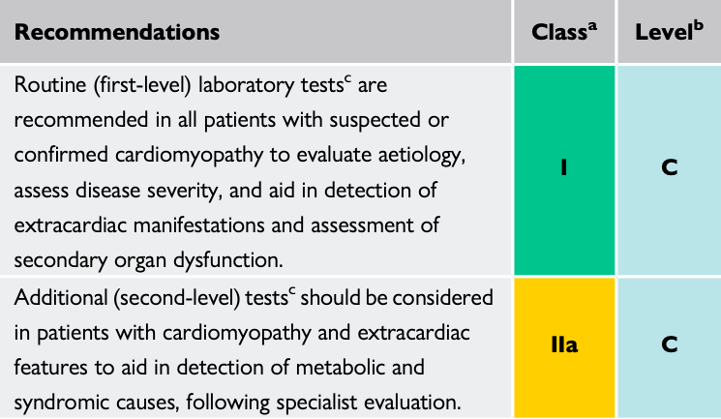
Recommendations for laboratory tests in the diagnosis of cardiomyopathies
Routine laboratory testing aids the detection of extracardiac conditions that cause or exacerbate ventricular dysfunction (e.g. thyroid disease, renal dysfunction, and diabetes mellitus) and secondary organ dysfunction in patients with severe heart failure. High levels of brain natriuretic peptide (BNP), N-terminal pro-brain natriuretic peptide (NT-proBNP), and high-sensitivity cardiac troponin T (hs-cTnT) are associated with cardiovascular events, heart failure, and death, and may have diagnostic, prognostic, and therapeutic monitoring value.

Slide 28
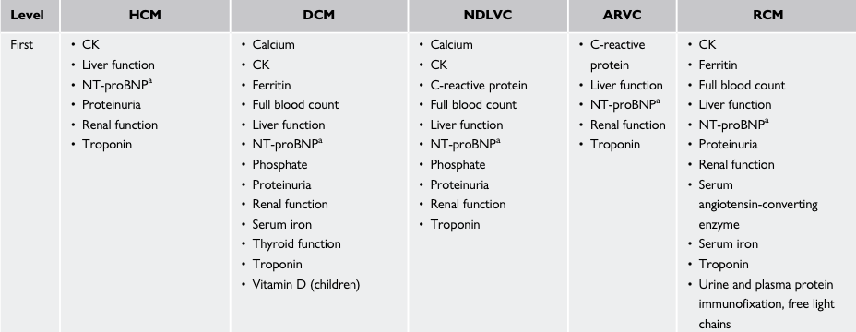
First-level (to be performed in each patient) and second-level (to be performed in selected patients following specialist evaluation to identify specific aetiologies) laboratory tests, grouped by cardiomyopathy phenotype (1)
ARVC - arrhythmogenic right ventricular cardiomyopathy; DCM - dilated cardiomyopathy; HCM - hypertrophic cardiomyopathy; NDLVC - non-dilated left ventricular cardiomyopathy; RCM - restrictive cardiomyopathy.

Slide 29
First-level (to be performed in each patient) and second-level (to be performed in selected patients following specialist evaluation to identify specific aetiologies) laboratory tests, grouped by cardiomyopathy phenotype (2)
ARVC - arrhythmogenic right ventricular cardiomyopathy; DCM - dilated cardiomyopathy; HCM - hypertrophic cardiomyopathy; NDLVC - non-dilated left ventricular cardiomyopathy; RCM - restrictive cardiomyopathy.

Slide 30
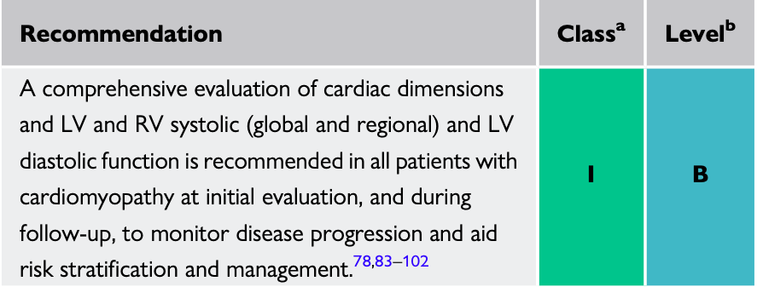
Echocardiography
The non-invasive nature and widespread availability of echocardiography make it the main imaging tool, from initial diagnosis to follow-up. Transthoracic echocardiography (TTE) provides relevant information on global and regional RV and LV anatomy and function as well as valve function and the presence of dynamic obstruction, pulmonary hypertension, or pericardial effusions.
Myocardial deformation imaging (speckle tracking or tissue Doppler) with global longitudinal strain is a more sensitive marker than EF to detect subtle ventricular dysfunction (e.g. in genotype-positive HCM, DCM, and ARVC family members), and may help discriminate between different etiologies of hypertrophy (e.g. amyloidosis, HCM, and athlete’s heart).

Slide 31
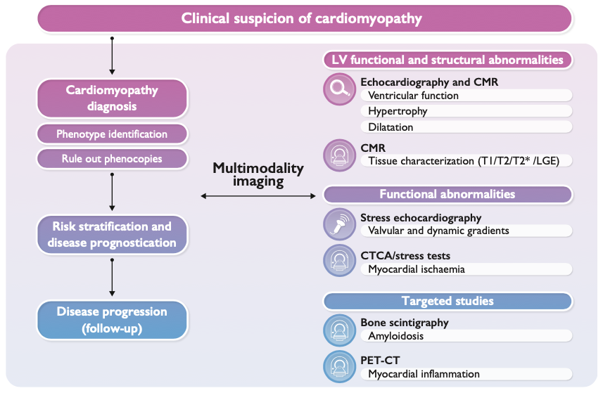
Multimodality imaging process in cardiomyopathies
Cardiac magnetic resonance imaging (MRI) combines the advantages of non-invasiveness and independence of acoustic window with the ability for tissue characterization.
CMR - cardiac magnetic resonance; CTCA - computed tomography coronary angiography; LGE - late gadolinium enhancement; LV - left ventricular; PET - positron emission tomography.

Slide 32
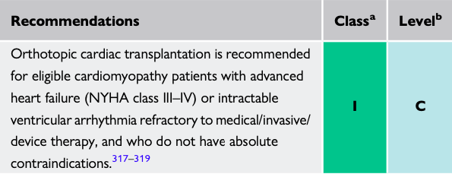
General principles in the management of patients with cardiomyopathy
Assessment of symptoms
Heart failure management
Some people with subtle structural abnormalities with cardiomyopathy remain asymptomatic and have a normal lifespan; however, others may develop symptoms, often many years after the appearance of ECG or imaging evidence of disease.
Recommendations are generally independent from the aetiology of heart failure and include current medical therapy, devices, and LV assist device (LVAD)/transplantation. As such, the treatment recommendations must be regarded as generic and not specific to the different forms of cardiomyopathy. Medical therapies for HFrEF based on randomized controlled trials (RCTs) from large cohorts, including angiotensin-converting enzyme inhibitors (ACE-I)/angiotensin receptor neprilysin inhibitors (ARNIs), beta-blockers, mineralocorticoid receptor antagonists (MRA), and sodium–glucose co-transporter 2 inhibitors (SGLT2i), would be mostly applicable to genetic DCM, NDLVC, and other phenotypes associated with LV dysfunction (e.g. end-stage HCM, RCM, and ARVC). Indications for a cardiac resynchronization therapy (CRT) device and heart transplant would also be generally applicable accordingly.
Recommendations for cardiac transplantation in patients with cardiomyopathy

Slide 33
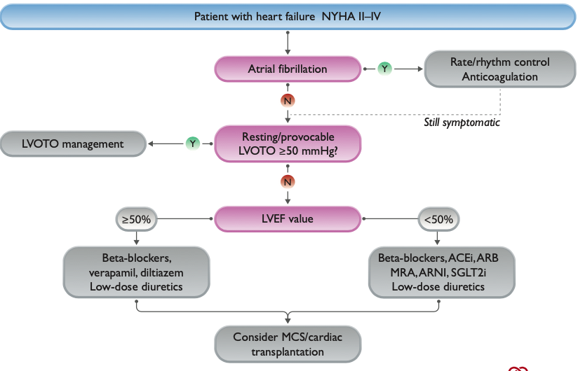
Algorithm for the treatment of heart failure in hypertrophic cardiomyopathy
ACEi - angiotensin-converting enzyme inhibitor; ARB - angiotensin receptor blocker; ARNI - angiotensin receptor neprilysin inhibitor; LVEF - left ventricular ejection fraction; LVOTO - left ventricular outflow tract obstruction; MCS - mechanical circulatory support; MRA - mineralocorticoid receptor antagonist; NYHA - New York Heart Association; SGLT2i - sodium–glucose co- transporter 2 inhibitor.Imag

Slide 34
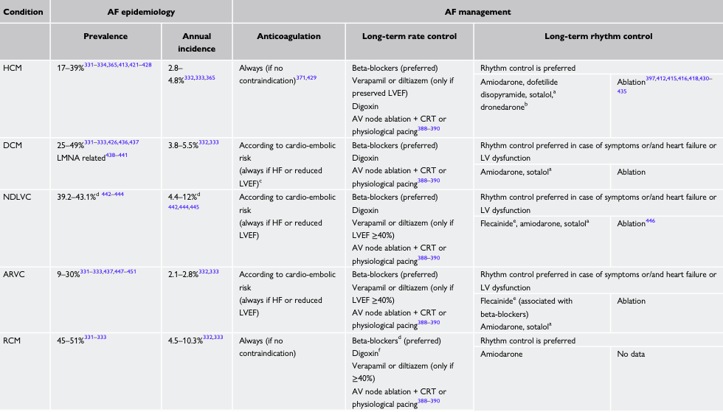
Atrial fibrillation burden and management in cardiomyopathies (1)
AF - atrial fibrillation; ARVC - arrhythmogenic right ventricular cardiomyopathy; AV - atrioventricular; CrCl - creatinine clearance; CRT - cardiac magnetic resonance; DCM - dilated cardiomyopathy; HCM - hypertrophic cardiomyopathy; HF - heart failure; HFpEF - heart failure with preserved ejection fraction; LMNA - lamin A/C; LV - left ventricular; LVEF - left ventricular ejection fraction; NDLVC - non-dilated left ventricular cardiomyopathy; QRS, Q, R, and S waves of an ECG; RCM - restrictive cardiomyopathy.

Slide 35
Atrial fibrillation burden and management in cardiomyopathies (2)
AF - atrial fibrillation; ARVC - arrhythmogenic right ventricular cardiomyopathy; AV - atrioventricular; CrCl - creatinine clearance; CRT - cardiac magnetic resonance; DCM - dilated cardiomyopathy; HCM - hypertrophic cardiomyopathy; HF - heart failure; HFpEF - heart failure with preserved ejection fraction; LMNA - lamin A/C; LV - left ventricular; LVEF - left ventricular ejection fraction; NDLVC - non-dilated left ventricular cardiomyopathy; QRS, Q, R, and S waves of an ECG; RCM - restrictive cardiomyopathy.

Slide 36
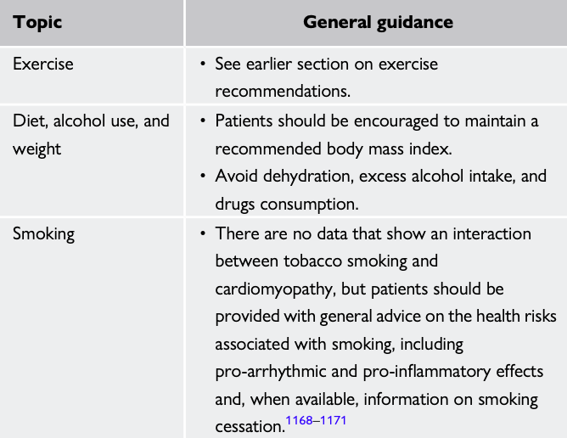
General guidance for daily activity for patients with cardiomyopathies (1)

Slide 37
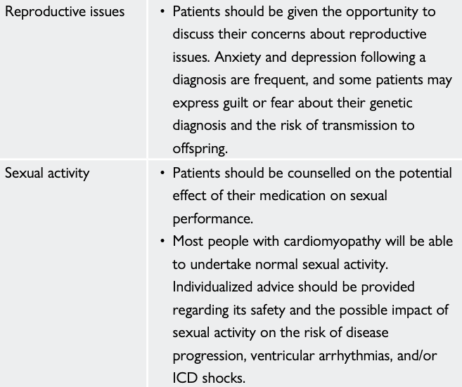
General guidance for daily activity for patients with cardiomyopathies (2)

Slide 38
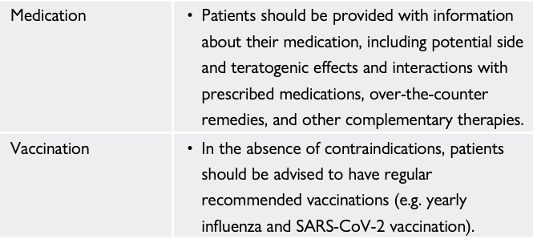
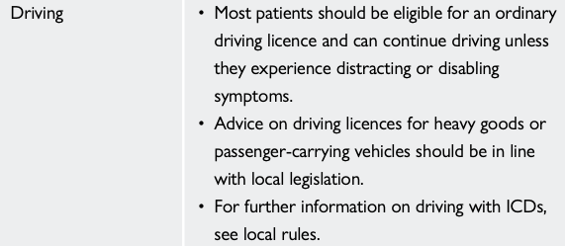
General guidance for daily activity for patients with cardiomyopathies (3)

Slide 39
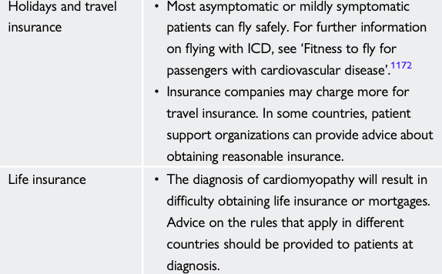
General guidance for daily activity for patients with cardiomyopathies (4)

Slide 40
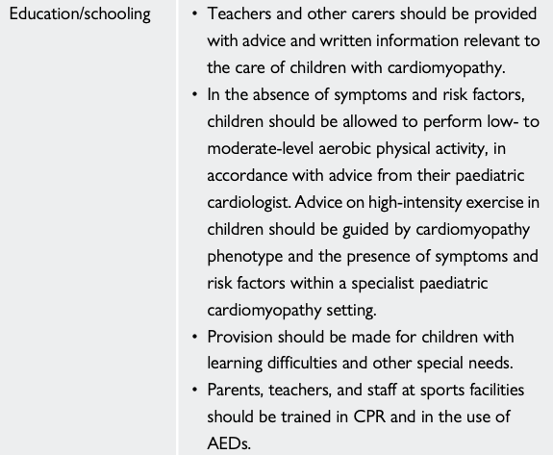
General guidance for daily activity for patients with cardiomyopathies (5)

Slide 41
Key messages (1)
Cardiomyopathies are more common than previously thought and they typically require nuanced management that may differ from the conventional approach to patients with arrhythmia or heart failure.
Etiology is fundamental to the management of patients with heart muscle disease and careful and systematic description of the morphological and functional phenotype is a crucial first step in the diagnostic pathway.
An approach to nomenclature and diagnosis of cardiomyopathies that is based on the predominant phenotype at presentation is recommended.
Patients with cardiomyopathy may seek medical attention due to symptoms onset (HF or arrhythmia related), incidental abnormal findings, or as a result of family screening following the diagnosis in a relative.
Multimodality imaging to characterize the cardiac phenotype (morphology and function) including tissue characterization for non-ischaemic myocardial scar detection is necessary, in combination with a detailed personal and family history, clinical examination, electrocardiography, and laboratory investigations.

Slide 42
Key messages (2)
Imaging results should always be interpreted in the overall clinical context, including genetic testing results, rather than in isolation.
Tissue characterization by CMR is of value in diagnosis, monitoring of disease progression and risk stratification in each of the main cardiomyopathy phenotypes.
The presence of non-ischaemic ventricular scar or fatty replacement on cardiac CMR and/or pathological examination, which can occur with or without ventricular dilatation and/or systolic dysfunction, can be the sole clue to the diagnosis of a cardiomyopathy and can have prognostic significance that varies with etiology.
The aim of this multiparametric and systemic approach is to generate a phenotype-based etiological diagnosis, interpreting available data with a cardiomyopathy-oriented mindset that combines cardiological assessment with non-cardiac parameters.
Symptom management, identification, and prevention of disease-related complications (including SCD, heart failure, and stroke) are the cornerstone of management of all cardiomyopathies.

Slide 43
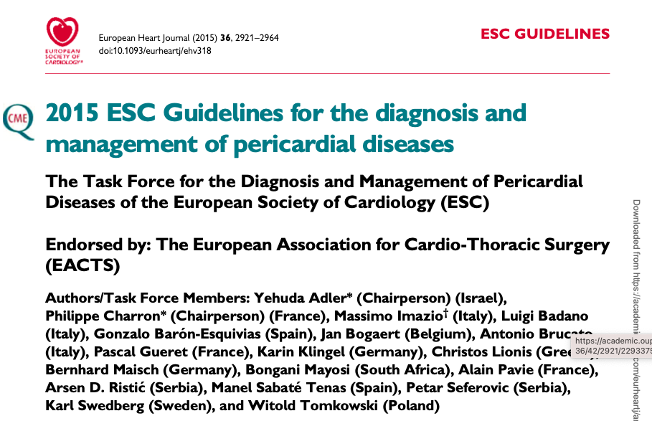
Guidelines

Slide 44
Definitions of pericardial diseases
The pericardium (from the Greek p1ri ́, ‘around’ and ka ́rdion, ‘heart’) is a double-walled sac containing the heart and the roots of the great vessels. The pericardial sac has two layers, a serous visceral layer (also known as epicardium when it comes into contact with the myocardium) and a fibrous parietal layer. It encloses the pericardial cavity, which contains pericardial fluid. The pericardium fixes the heart to the mediastinum, gives protection against infection and provides lubrication for the heart.
Pericardial diseases may be either isolated disease or part of a systemic disease. The main pericardial syndromes that are encountered in clinical practice include pericarditis (acute, subacute, chronic and recurrent), pericardial effusion, cardiac tamponade, constrictive pericarditis and pericardial masses. All medical therapies for pericardial diseases are off-label, since no drug has been registered until now for a specific pericardial indication.

Slide 45
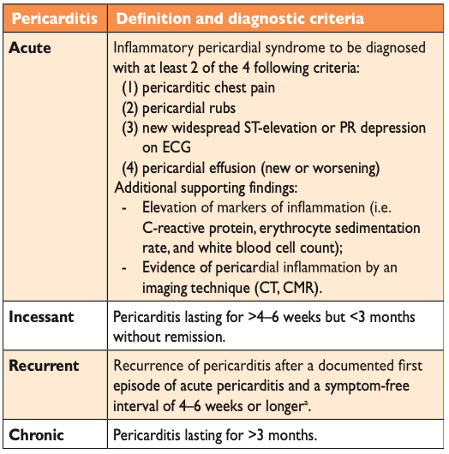
Definitions and diagnostic criteria for pericarditis

Slide 46
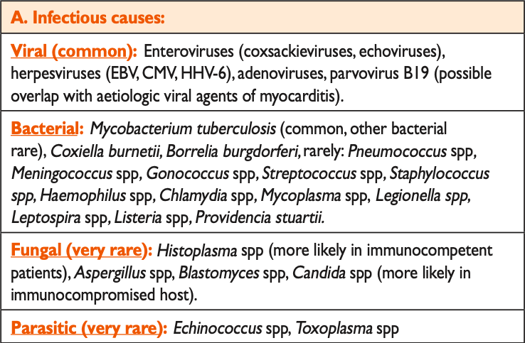
Etiology of pericardial diseases. Infectious causes.

Slide 47
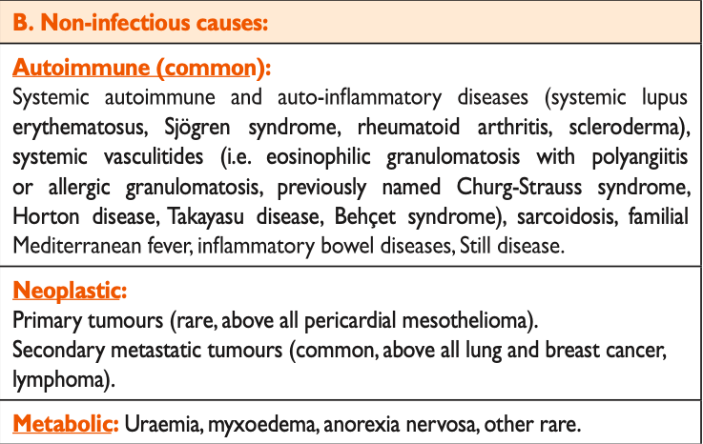
Etiology of pericardial diseases. Non-infectious causes.

Slide 48
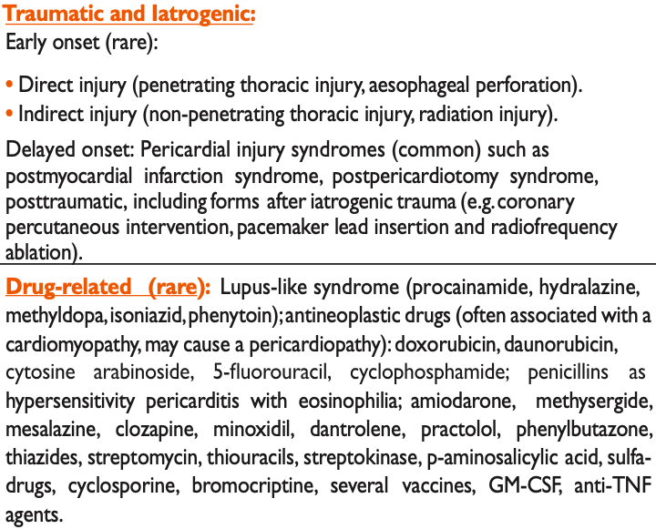
Etiology of pericardial diseases. Traumatic and Iatrogenic. Drug-related (rare).
CMV - cytomegalovirus; EBV - Epstein-Barr virus; GM-CSF - granulocyte-macrophage colonystimulating factor; HHV - human herpesvirus; spp - species; TNF - tumor necrosis factor.

Slide 49
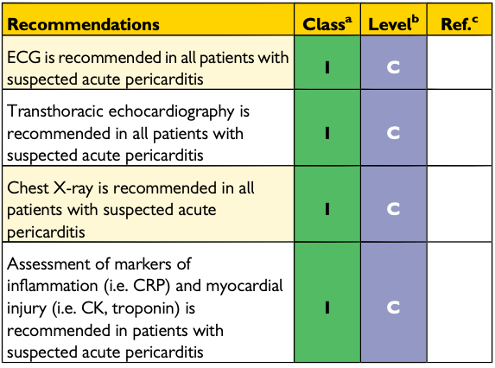
Recommendations for diagnosis of acute pericarditis

Slide 50
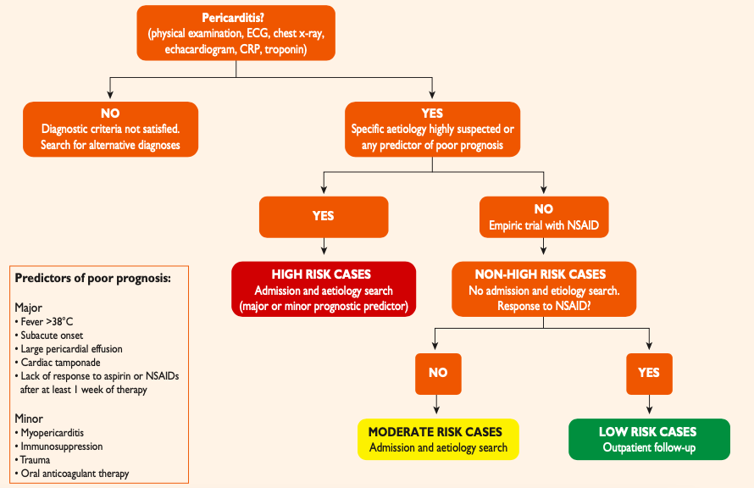
Proposed triage of pericarditis

Slide 51
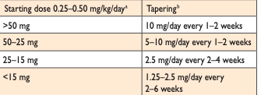
Commonly prescribed anti-inflammatory therapy for acute pericarditis
Tapering of corticosteroids35 (dosage information is provided for prednisone)

Slide 52
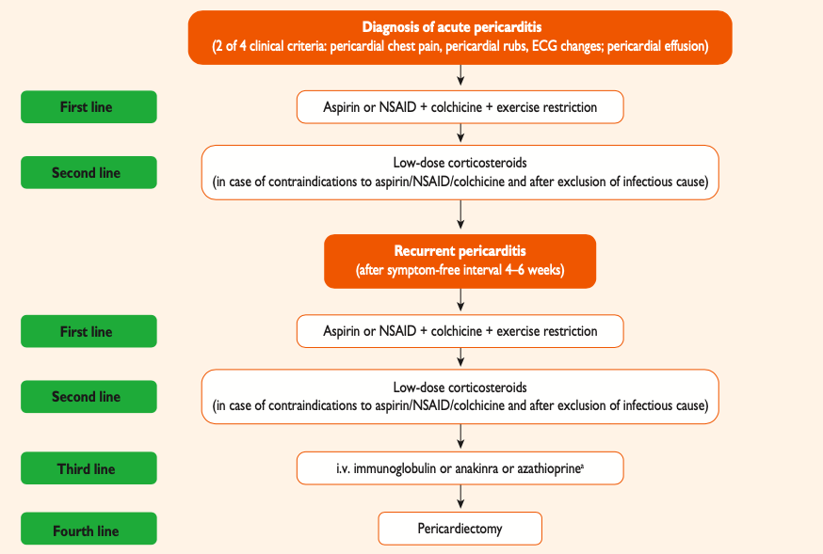
Therapeutic algorithm for acute and recurrent pericarditis

Slide 53
Recommended literature
Bauersachs J, König T, van der Meer P, Petrie MC, Hilfiker-Kleiner D, Mbakwem A, et al. Pathophysiology, diagnosis and management of peripartum cardiomyopathy: a position statement from the Heart Failure Association of the European Society of Cardiology Study Group on peripartum cardiomyopathy. Eur J Heart Fail 2019; 21:827–843. https://doi.org/10.1002/ejhf.1493
Davis MB, Arany Z, McNamara DM, Goland S, Elkayam U. Peripartum cardiomyopathy: JACC state-of-the-art review. J Am Coll Cardiol 2020;75:207–221. https://doi. org/10.1016/j.jacc.2019.11.014
Castrini AI, Skjolsvik E, Estensen ME, Almaas VM, Skulstad H, Lyseggen E, et al. Pregnancy and progression of cardiomyopathy in women with LMNA genotypepositive. J Am Heart Assoc 2022;11:e024960. https://doi.org/10.1161/JAHA.121.024960
Castrini AI, Lie OH, Leren IS, Estensen ME, Stokke MK, Klaeboe LG, et al. Number of pregnancies and subsequent phenotype in a cross-sectional cohort of women with arrhythmogenic cardiomyopathy. Eur Heart J Cardiovasc Imaging 2019;20:192–198. https://doi.org/10.1093/ehjci/jey061
Pelliccia A, Borrazzo C, Caselli S, Lemme E, Musumeci MB, Maestrini V, et al. Neither athletic training nor detraining affects LV hypertrophy in adult, low-risk patients with HCM. JACC Cardiovasc Imaging 2022;15:170–171. https://doi.org/10.1016/j.jcmg. 2021.08.012
Kim EJ, Holmes BB, Huang S, Lugo R, Al Aboud A, Goodman S, et al. Outcomes in patients with cardiac amyloidosis and implantable cardioverter-defibrillator. Europace 2020;22:1216–1223. https://doi.org/10.1093/europace/euaa094

Slide 54
Thank you for your attention!

