Slide 1
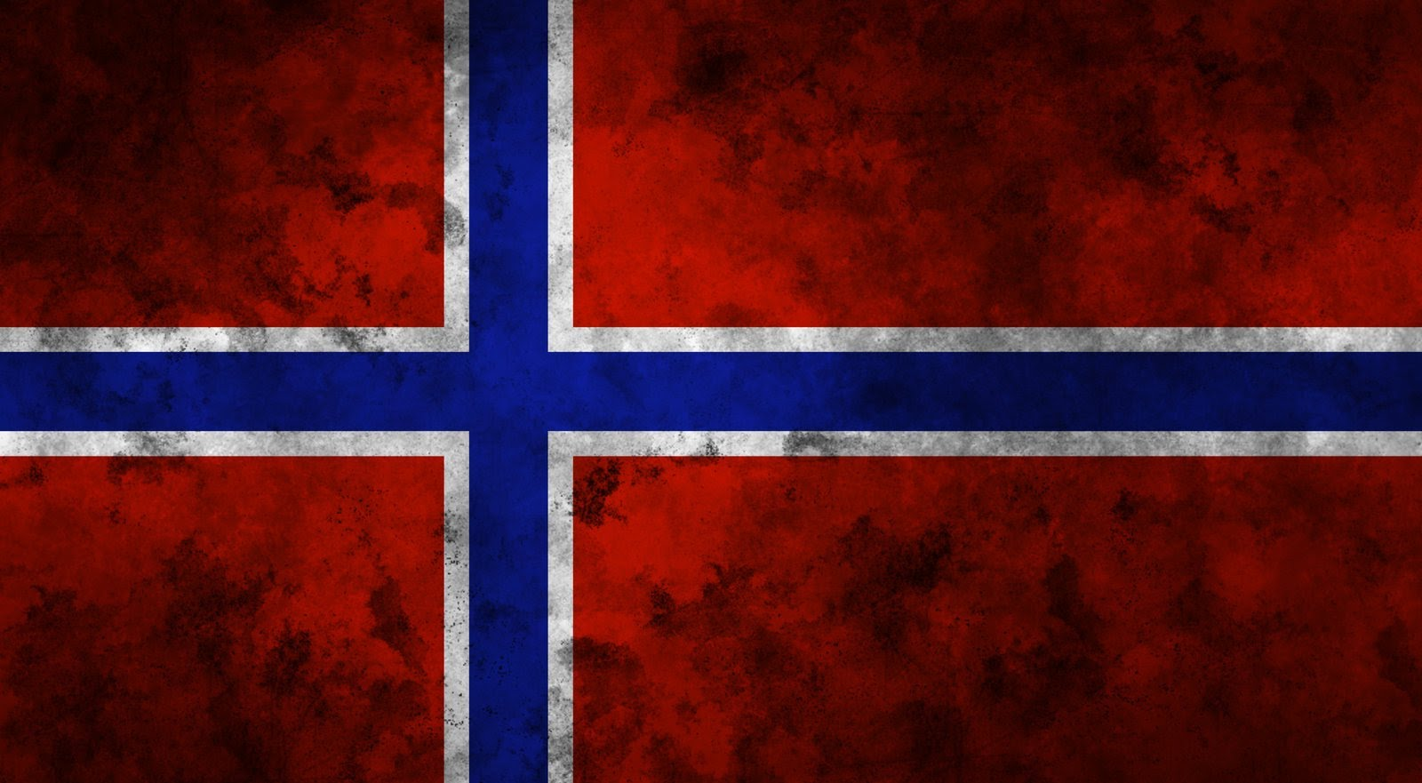
Health care system in Norway

Slide 2
The distinctive features of Norwegian health care are financing mainly through taxes, which are the highest in the world.
Every Norwegian citizen has the right to social benefits for illness.
The national insurance system provides citizens with the following rights:
*) The national insurance system provides citizens with the following rights: partial or full payment of doctor's consultation;
*) free hospital care;
*) free medical care for pregnant women, women in childbirth and parturient women;
*) full payment of medicines for patients with chronic pathology;
*) 100% payment of sick leave;
*) 100% payment of maternity leave within 42 weeks;
*) disability pension;
*) free treatment for children under 7 years;
*) free treatment of industrial injuries.

Slide 3
The government undertakes to pay the bulk of the cost medical services - at the level of 95 percent. In case pregnancy and childbirth will be provided free of charge.
Drug supply in Norway
*) Children under 18 receive all medical care, including dental care, absolutely free.
*) Of adults, only those who earn more than a certain threshold amount are paid. A significant part of citizens generally exempt from payment for medical services, including chronic patients.

Slide 4
The leading role in primary health care is played by General practitioners, mostly grouped into groups of 2-6 persons with assistants, the number of which depends on the funds allocated by the municipality. As a rule, General practitioners specialize in General or family medicine. Most General practitioners are municipal employees or private practitioners working under a contract with the municipalities.

Slide 5
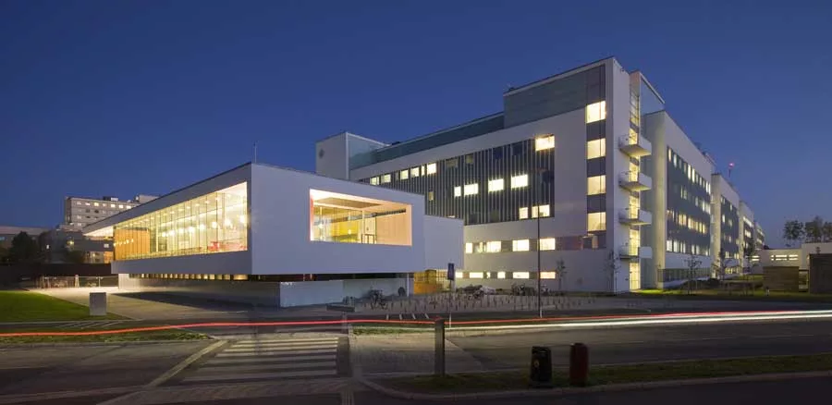
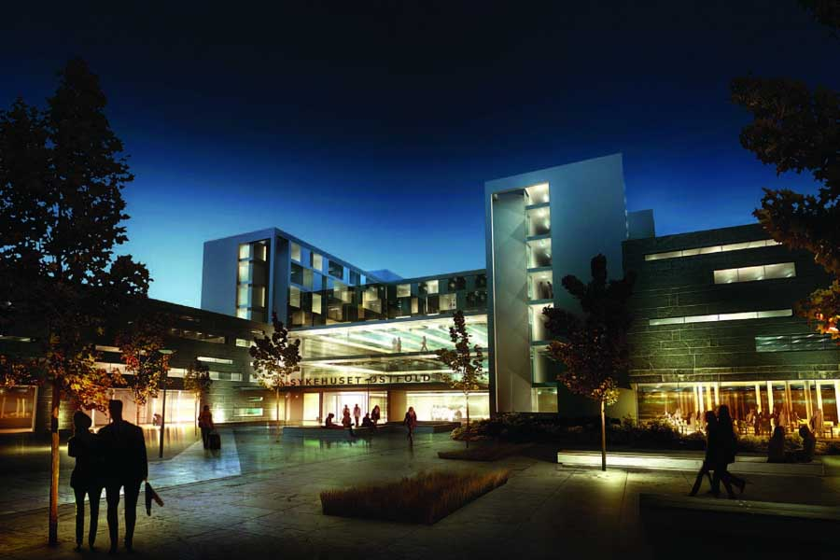
Challenges and prospects
To the negative point of the health care system of Norway can be attributed to the too great spaciousness of hospitals, which is not conducive to the best conditions of stay in them of patients.
In General, health care in Norway has achieved great success since the beginning of its reform, but in the future it will have to solve new problems.
For example, the regulation of public health care.
In addition, in the future, it is planned to introduce new methods of management and new forms of ownership of hospitals, to provide medical personnel to all areas of the country, to clearly separate the functions of the Central authorities and the financing of hospitals.

