Slide 1
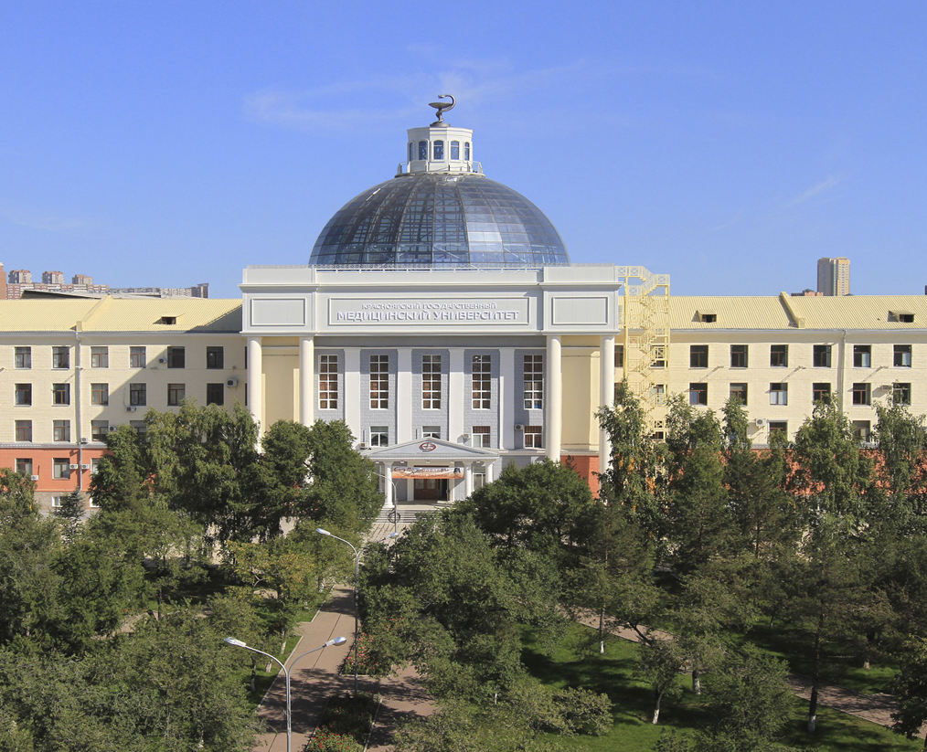
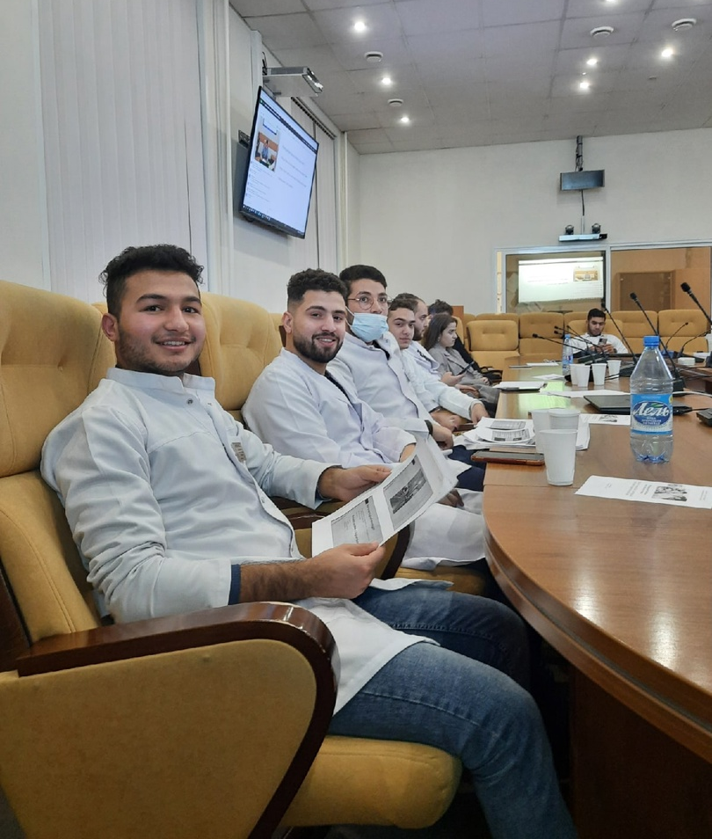
Krasnoyarsk State
Medical University
Krasnoyarsk, Russia
est. 1942

Slide 2
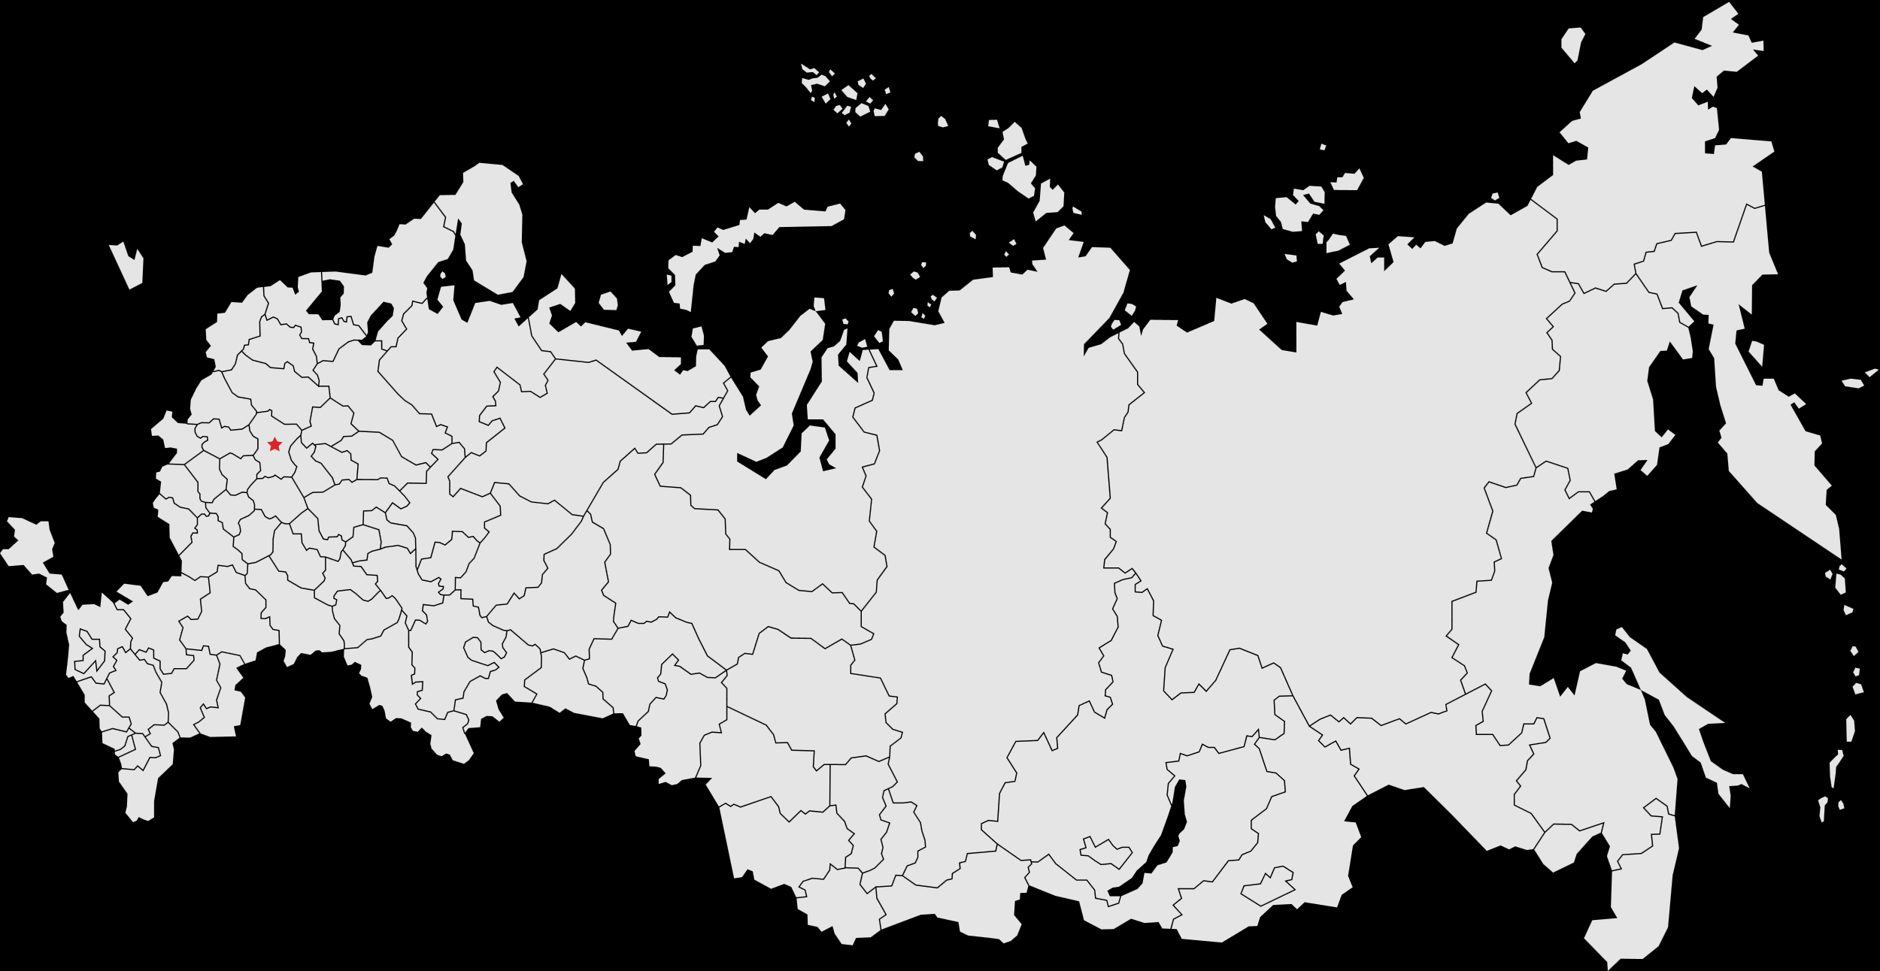
Description
KrasSMU is the leading university in Siberia in training high-qualified medical professionals.
Students from all over the world (Egypt, Nigeria, Iran, Syria, Mongolia, Latin America, etc.) choose our English language programs.
Exotic Siberian climate, beautiful mountainous nature of our region, friendly Russian people, relatively low cost of education are key factors that attract foreign students to KrasSMU.
Professors at KrasSMU are qualified medical experts and top-level doctors of Krasnoyarsk region. They are all trained in English language to provide you with high quality medical education.
Moscow
Krasnoyarsk

Slide 3
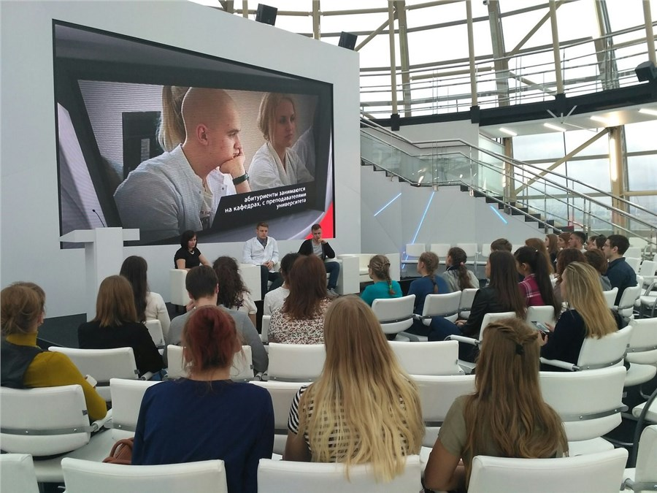
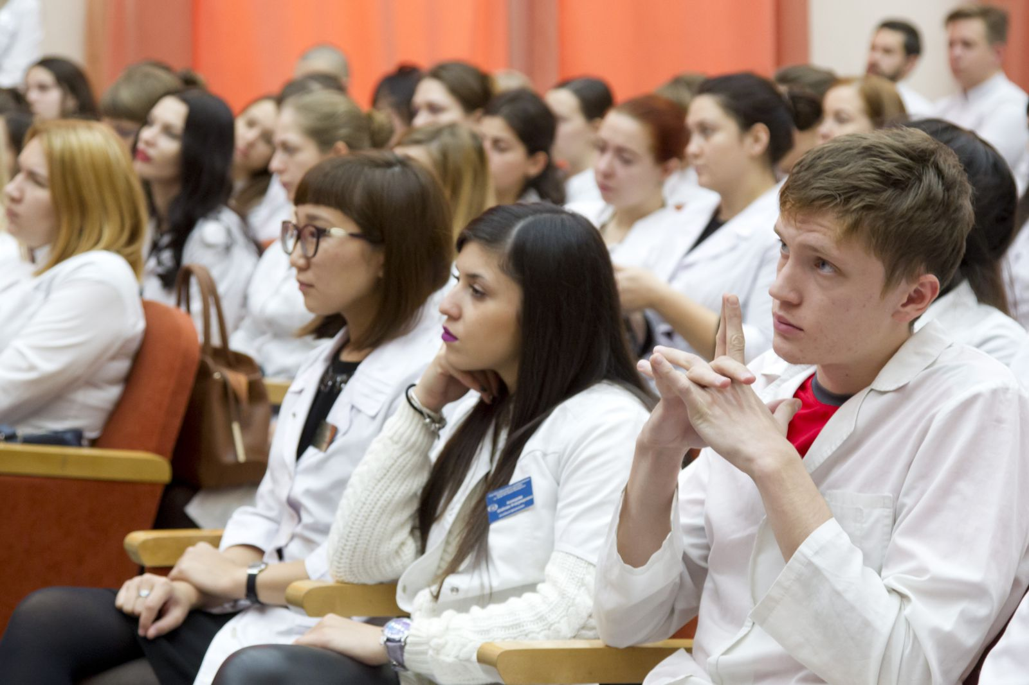
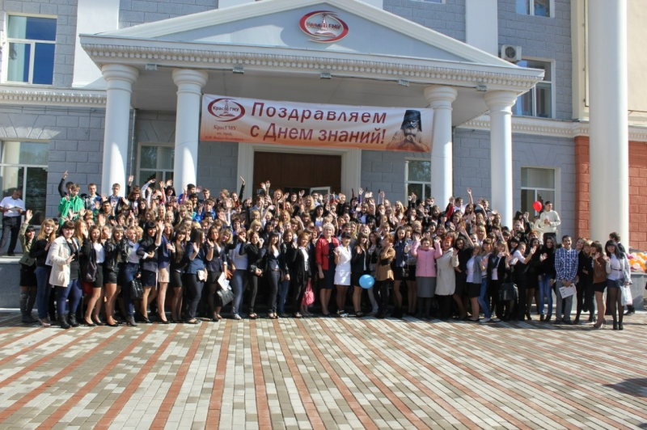
Facts and figures
>4000 students
>300 foreign students
3 programs in English language
Professors are experienced medical specialists and scientists trained to teach in English

Slide 4
Specialist’s degree is equivalent to bachelor’s degree
Programs in English (specialist's degree)
Specialist’s degree equals to bachelor’s degree in Europe. It allows to work as a general practitioner (General Medicine) or general dental practitioner (Dentistry)
Students do practical training at the regional hospitals under the supervision of experienced specialists
First two years all subjects are taught in English. From the 3rd year, there is a gradual transition to the Russian language
Along with the professional training, students receive language training

Slide 5
Programs in English (specialist's degree)
General Medicine
6 years
Dentistry
5 years
262 900 rubles/year
(since the 2nd year, the cost decreases)
262 900 rubles/year
(since the 2nd year, the cost decreases)

Slide 6
ADMISSION PROCEDURE & DEADLINES - 2022
Documents for admission :
STEP 1 | STEP 2
Application Student fills in the application and sends documents to the University Register at the website https://abit.krasgmu.ru/ Fill in the application form on the website Attach all the required documents | Entrance exams online Student receives information about the entrance exams (link, day, time) by the e-mail. Biology Chemistry https://krasgmu.ru/index.php?page[common]=content&id=19661
13.06.2022-18.09.2022 | 19.09.2022-24.09.2022
Document submission deadlines
Даты
Submission Form
Online

Slide 7
ADMISSION PROCEDURE & DEADLINES - 2022
Documents for admission :
STEP 3 | STEP 4 | STEP 5
Results & Payment Student receives exam results by the e-mail and pays the tuition fee In case of successful passing of the exams, student sends the agreement to enrollment and is given the bank account details for payment of the tuition fee. Receipt from the bank is sent to pk@krasgmu.ru | Getting visa Student receives invitation from the University and gets a visa at his local embassy The University prepares all the necessary documents and sends them to the embassy Student receives invitation by the e-mail and goes to the local embassy to get visa | Buying tickets and coming to Russia Student buys tickets and arrives to Russia Upon receiving visa, the student buys tickets to Russia, Krasnoyarsk, and sends them 7 days before the flight to foreigncitizens@krasgmu.ru (This is necessary for state registration for crossing the border)
25.09.2022-30.10.2022
Document submission deadlines
Даты
Submission Form
Online

Slide 8
ADMISSION PROCEDURE & DEADLINES - 2022
Documents for admission :
STEP 6
Registration and Accommodation Student arrives to Krasnoyarsk, gets registered and receives a place in the dormitory Upon arrival to Krasnoyarsk, student goes to the main building of the University (Партизана Железняка 1) to the office 1-70 and submits original documents for the registration and long-term visa: Passport Migration card (student receives it at the border) Vaccine certificate Photo 3x4 Then student gets a referral to the dormitory and starts his studies
Before 01.11.2022
Document submission deadlines
Даты
Submission Form
Online

Slide 9
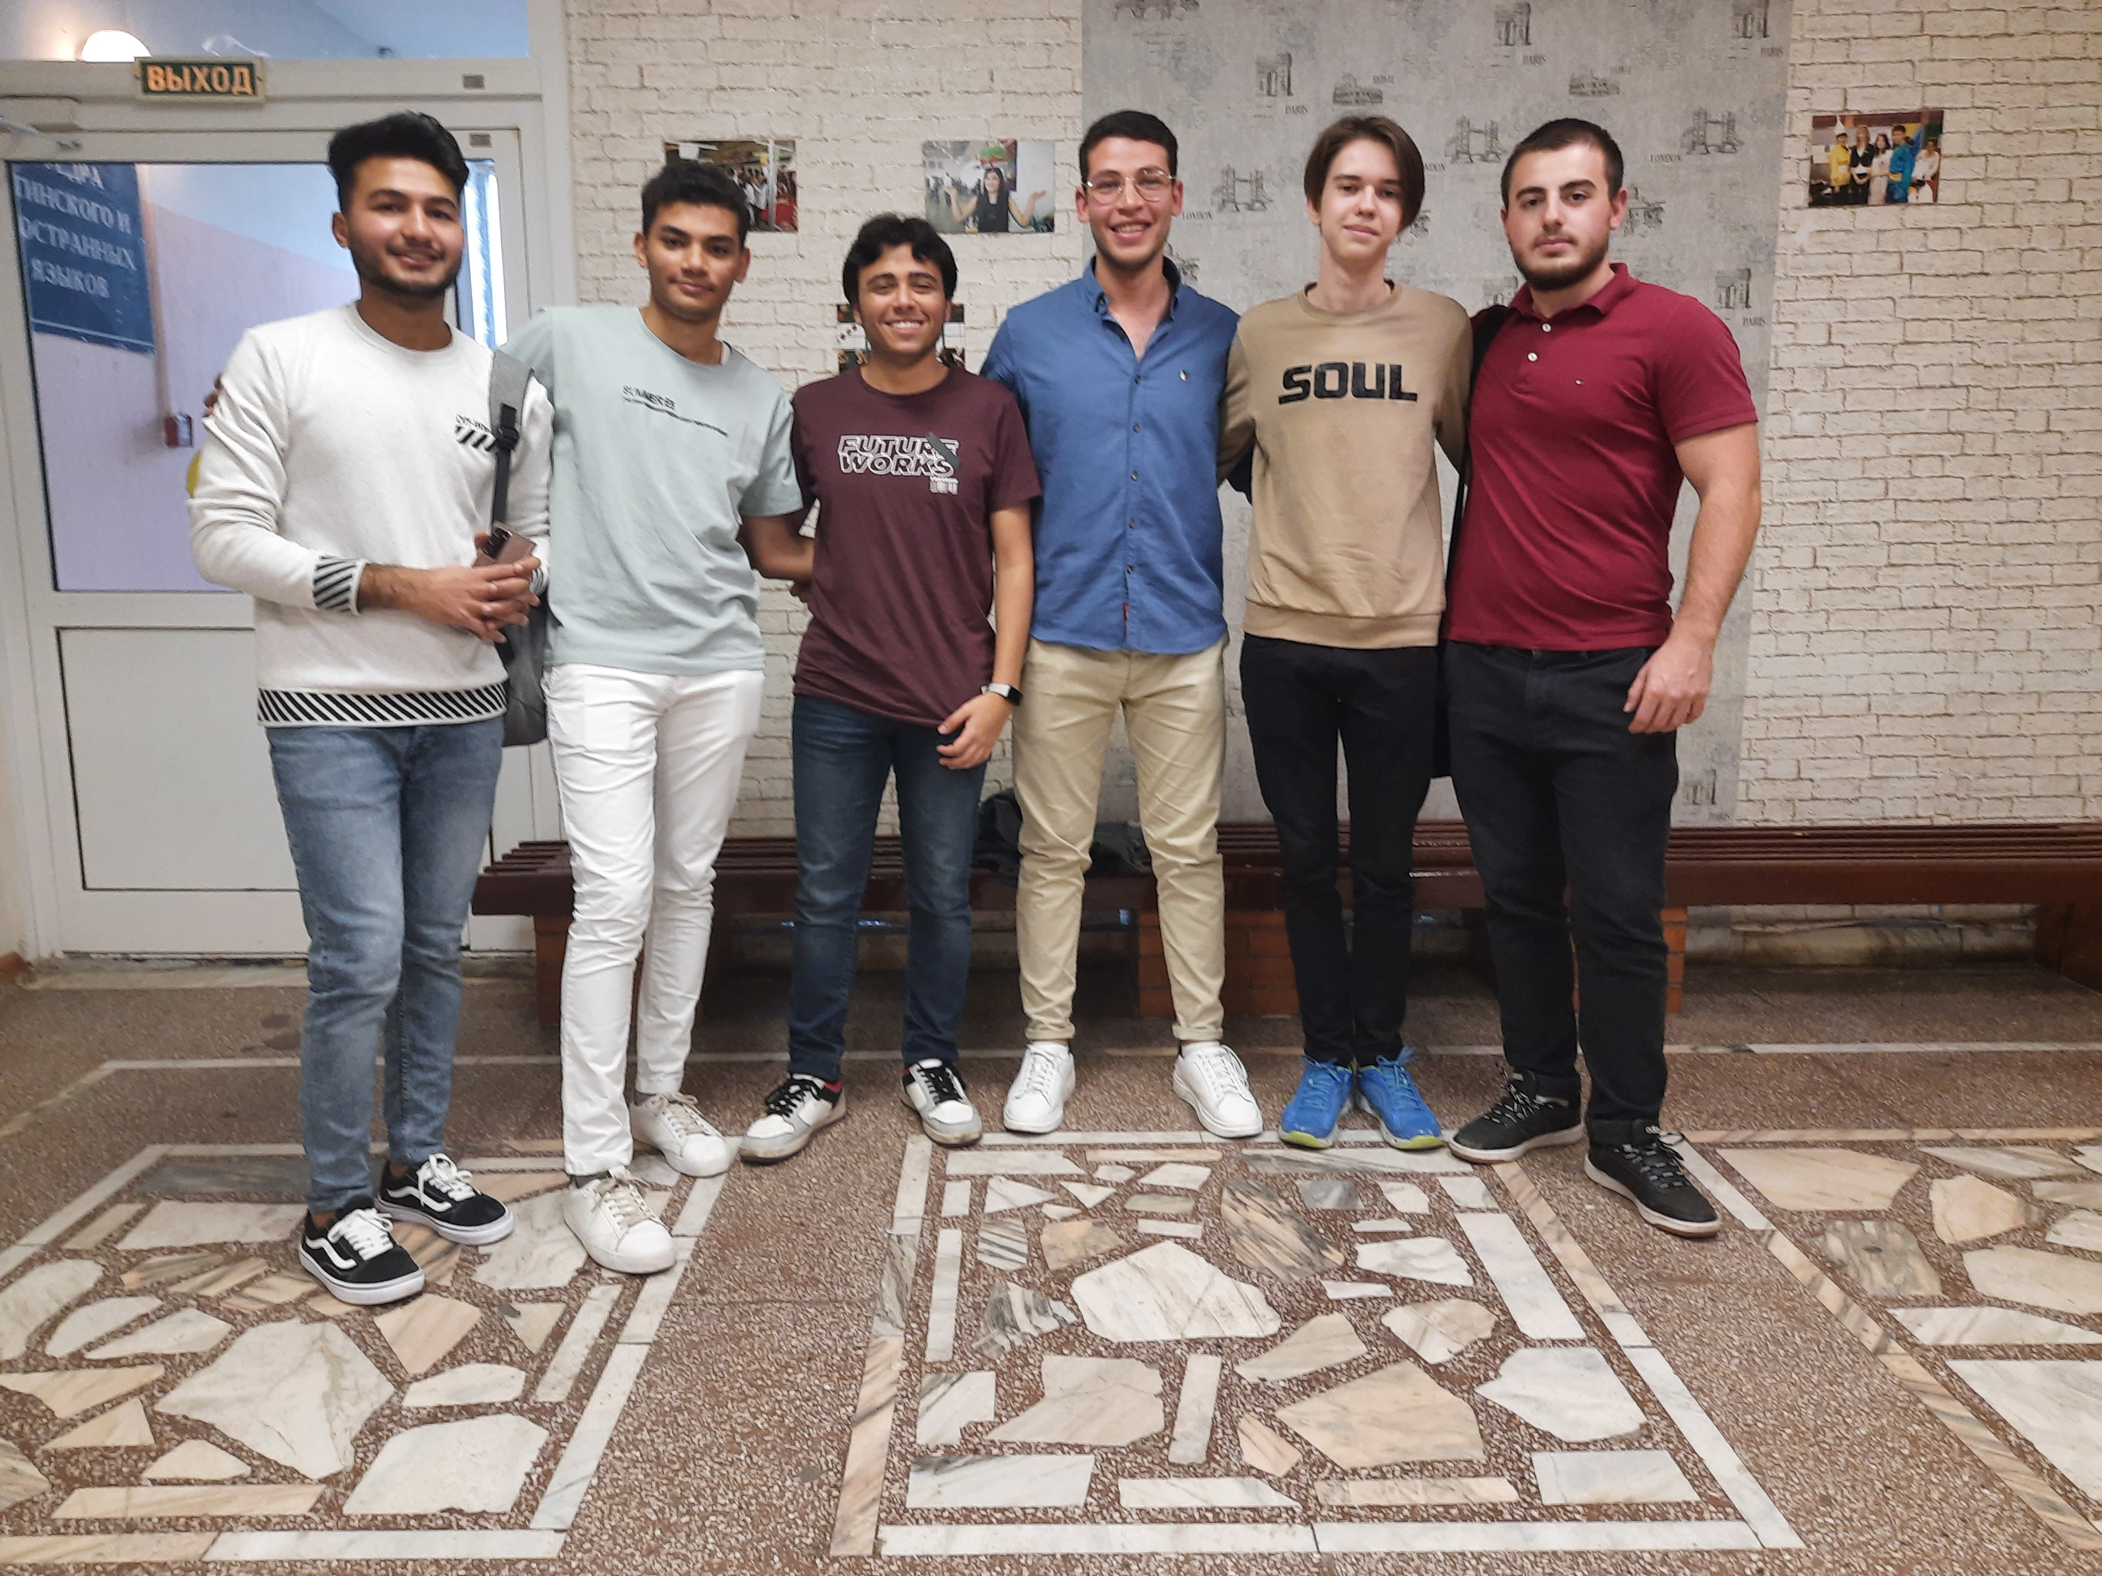
Preparatory course
• Russian language intensive course (from 0 to B1)
• Biology, Chemistry, Physics – only useful knowledge that will help you successfully pass entrance exams to any medical university in Russia
• In the end of the course all students receive academic certificates
Preparation to entrance exams & Russian language course
from December 1 to July 30
130000/full course

Slide 10
Preparatory department - 2022
Documents for admission :
STEP 1 | STEP 2
Application Student sends the following documents to the email preparatory@krasgmu.ru Passport (with notarized translation into Russian) School-leaving certificate (with notarized translation into Russian) Application (with signature by hand) https://krasgmu.ru/index.php?page[common]=content&id=207814 | Contract & Payment Student receives the contract by the e-mail and pays the tuition fee.
Until 01.11.2022 | Until 07.11.2022
Document submission deadlines
Даты
Submission Form
Online

Slide 11
ADMISSION PROCEDURE & DEADLINES - 2022
Documents for admission :
STEP 3 | STEP 4
Getting visa Student receives invitation from the University and gets a visa at his local embassy When the student the University prepares all the necessary documents and sends them to the embassy Student receives invitation by the e-mail and goes to the local embassy to get visa | Buying tickets and coming to Russia Student buys tickets and arrives to Russia Upon receiving visa, the student buys tickets to Russia, Krasnoyarsk and sends them 7 days before the flight to foreigncitizens@krasgmu.ru (This is necessary for state registration for crossing the border)
Until 30.11.2022 | Until 30.11.2022
Document submission deadlines
Даты
Submission Form
Online

Slide 12
ADMISSION PROCEDURE & DEADLINES - 2022
Documents for admission :
STEP 5
Registration and Accommodation Student arrives to Krasnoyarsk, gets registered and receives a place in the dormitory Upon arrival to Krasnoyarsk, student goes to the main building of the University (Партизана Железняка 1) to the office 1-70 and submits original documents for the registration and long-term visa: Passport Migration card (student receives it at the border) Vaccine certificate Photo 3x4 Then student gets a referral to the dormitory and starts studying on 01.12.2022
Until 30.11.2022
Document submission deadlines
Даты
Submission Form
Online

Slide 13
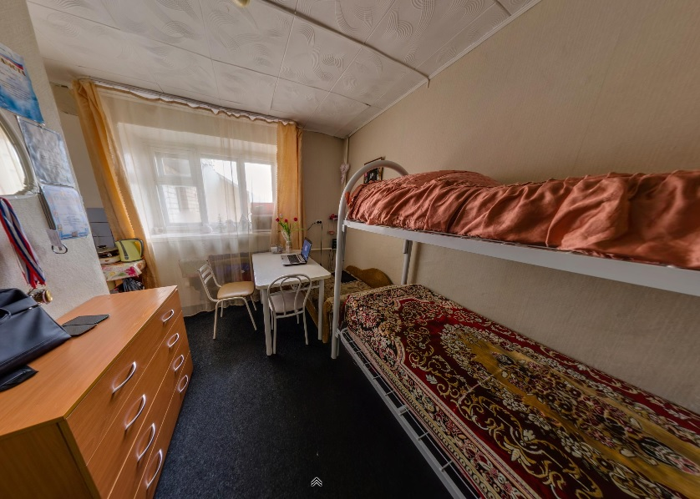
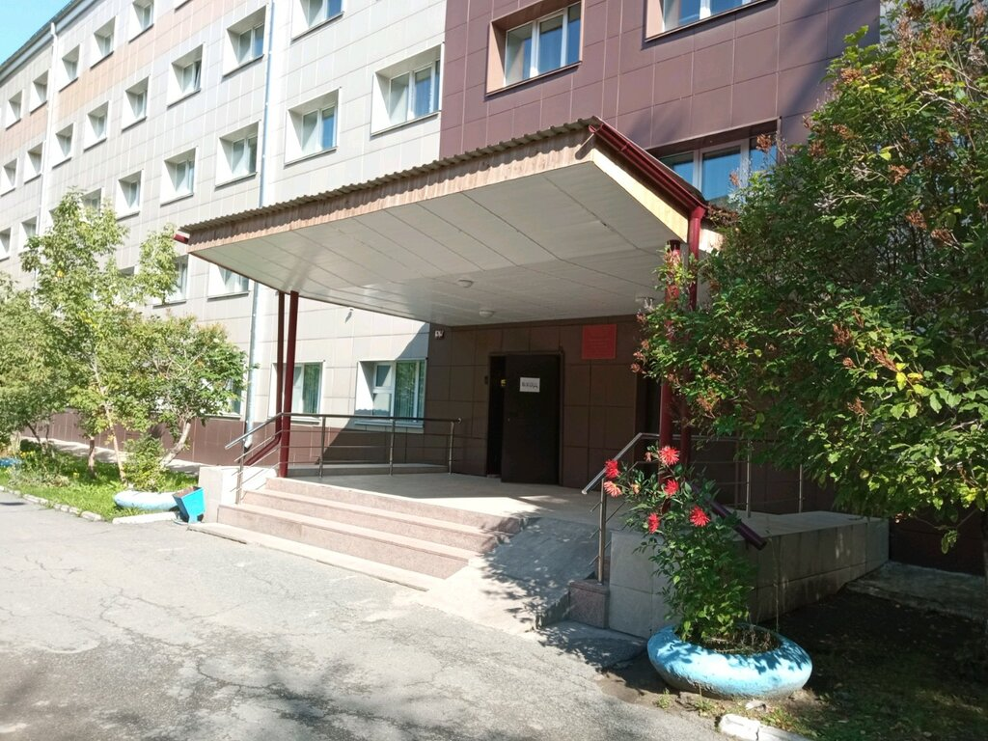
Dormitory
Cost: from 800 to 2000 rubles per month

Slide 14
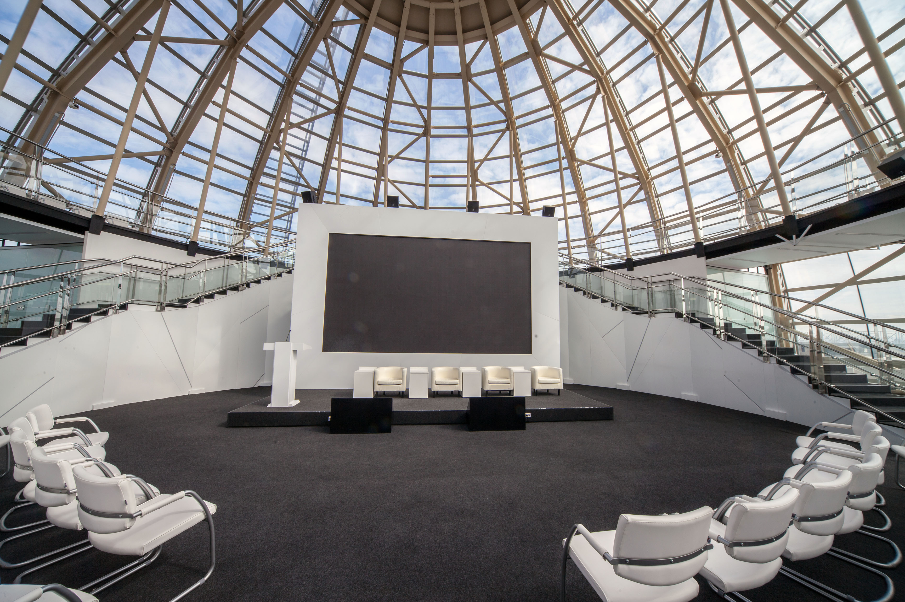
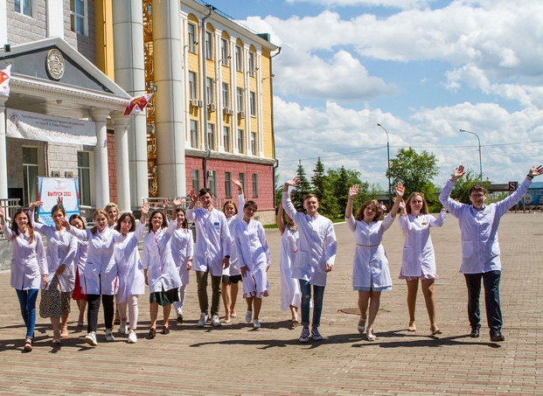
Campus/classrooms

Slide 15
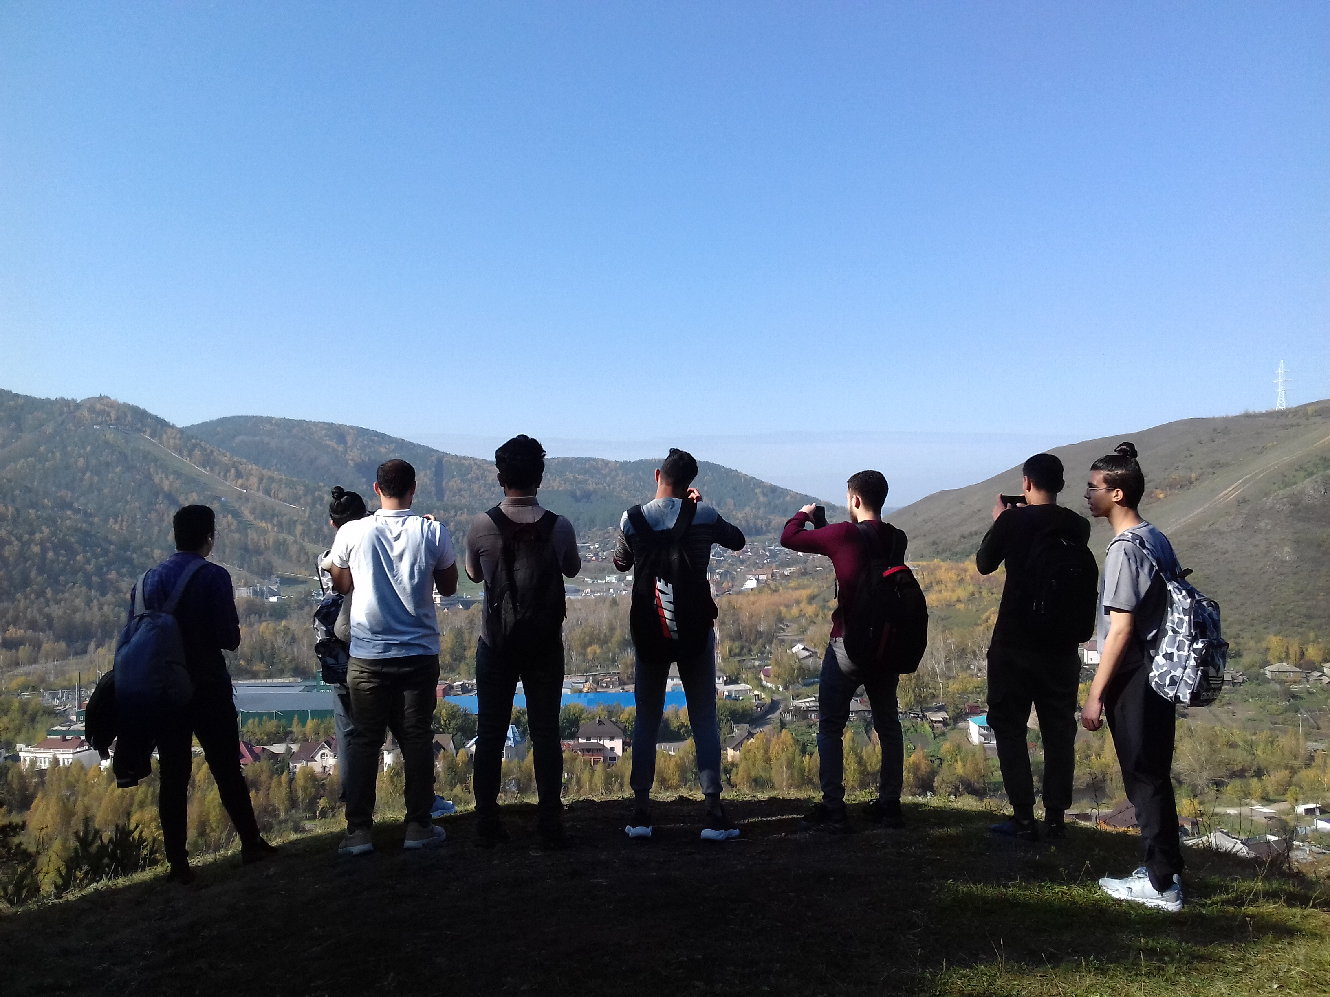
Extracurricular activities
The University organizes various extra-curricular activities for the international students:
Excursions, sightseeing
Hiking
Events & celebrations

Slide 16
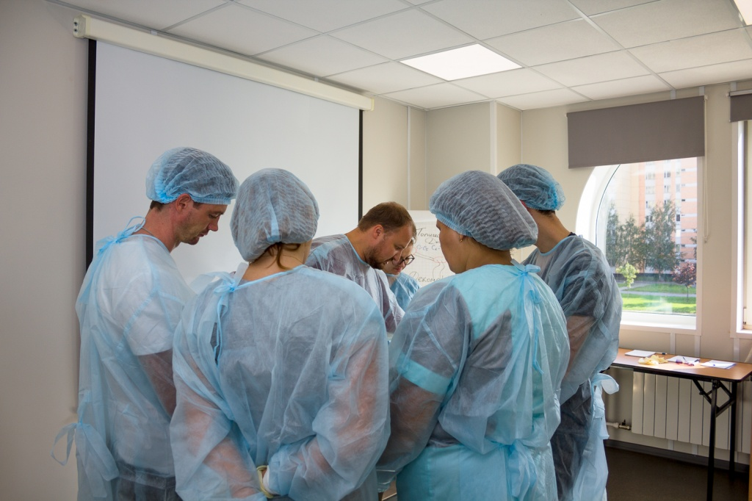
Internship/Employment Opportunity
Starting from the 1st year, students get a practical training at the real hospital. They learn about the organization of work at various hospital departments and receive skills of working with patients at all stages.

Slide 17
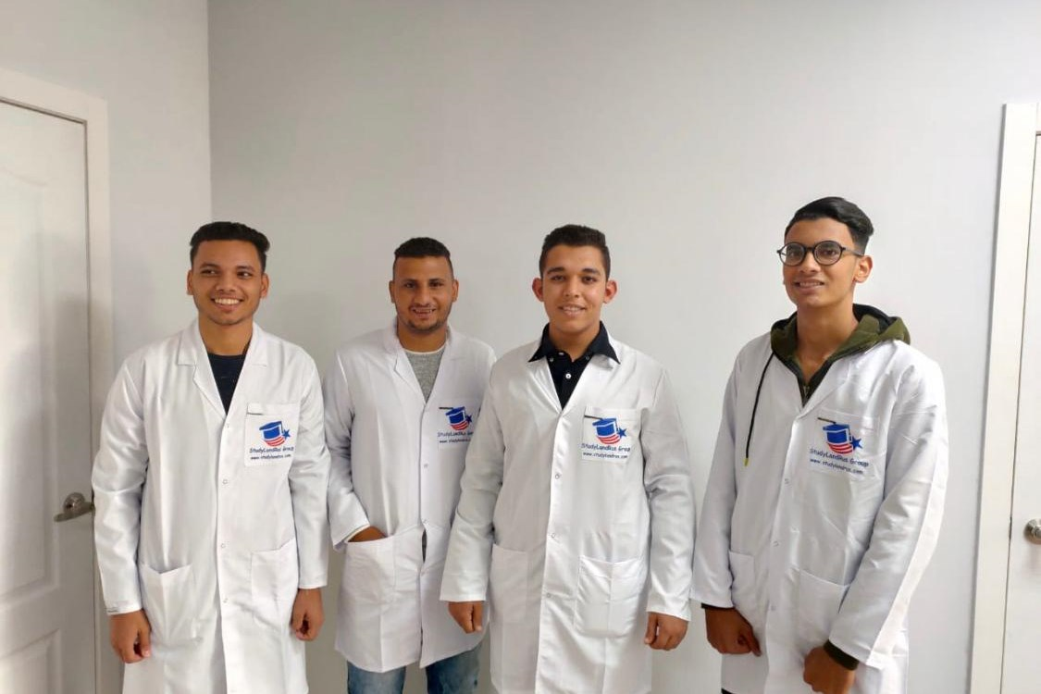
Living costs (per month)
≈ 13-15 $
Transport
≈ 60-80 $
Food
≈ 50-60 $
Entertainment
≈ 120-150 $
Total per month

Slide 18
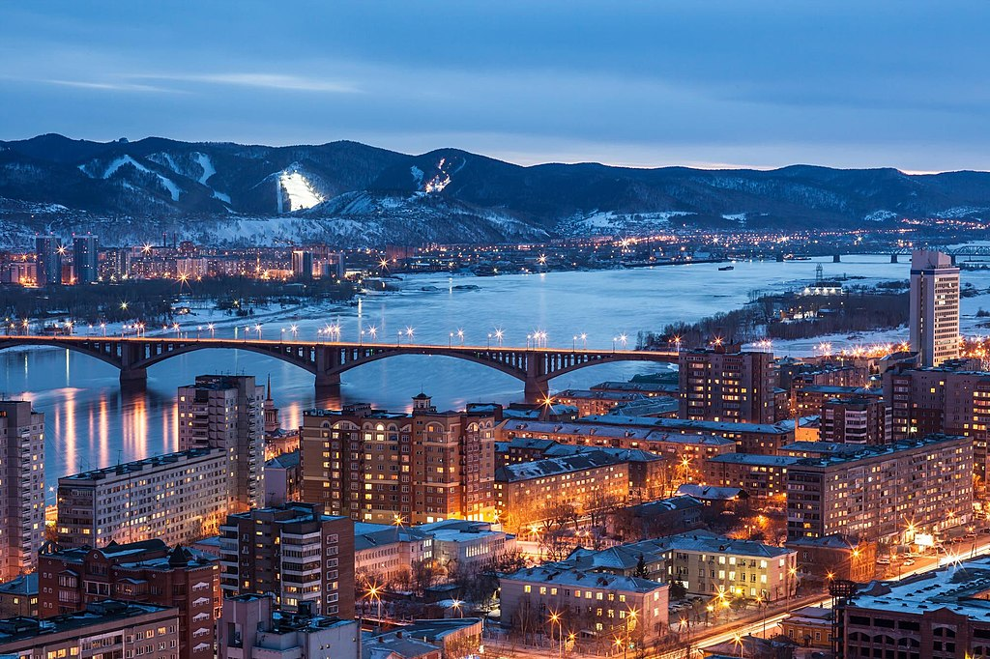
Krasnoyarsk
is the largest city and administrative center of Krasnoyarsk Krai, Russia. It is situated along the Yenisey River, and is the third-largest city in Siberia after Novosibirsk and Omsk, with a population of over 1 million.
The city is known for its natural landscape. Krasnoyarsk is a major educational centre in Siberia.

