Slide 1
Prof. V.F. Voino-Yasenetsky Krasnoyarsk State Medical University
Topic: Enzymes. Classification, structure, properties, biological functions.
Lecture No. 1 on the discipline "biochemistry" for 2nd year students
Lecturer: Panina Yu.A.
Krasnoyarsk, 2022

Slide 2
Lecture plan:
Relevance of the topic.
Introduction to the course of biochemistry. Discipline requirements
What is biochemistry?
What are the enzymes?
Enzyme structure, functions of coenzymes and apoenzymes.
Enzyme classifications.
Properties.
Conclusion

Slide 3
Who is the Biochemistry Discipline for?
For future clinicians of any specialty
For future pharmacists
For future employees of departments and teachers at KrasSMU
For future doctors-researchers and researchers of the departments of KrasSMU
For general literacy and effective collaboration of future specialists of any profile related to medicine with clinicians (specialists in the field of medical cybernetics, health managers, etc.)

Slide 6
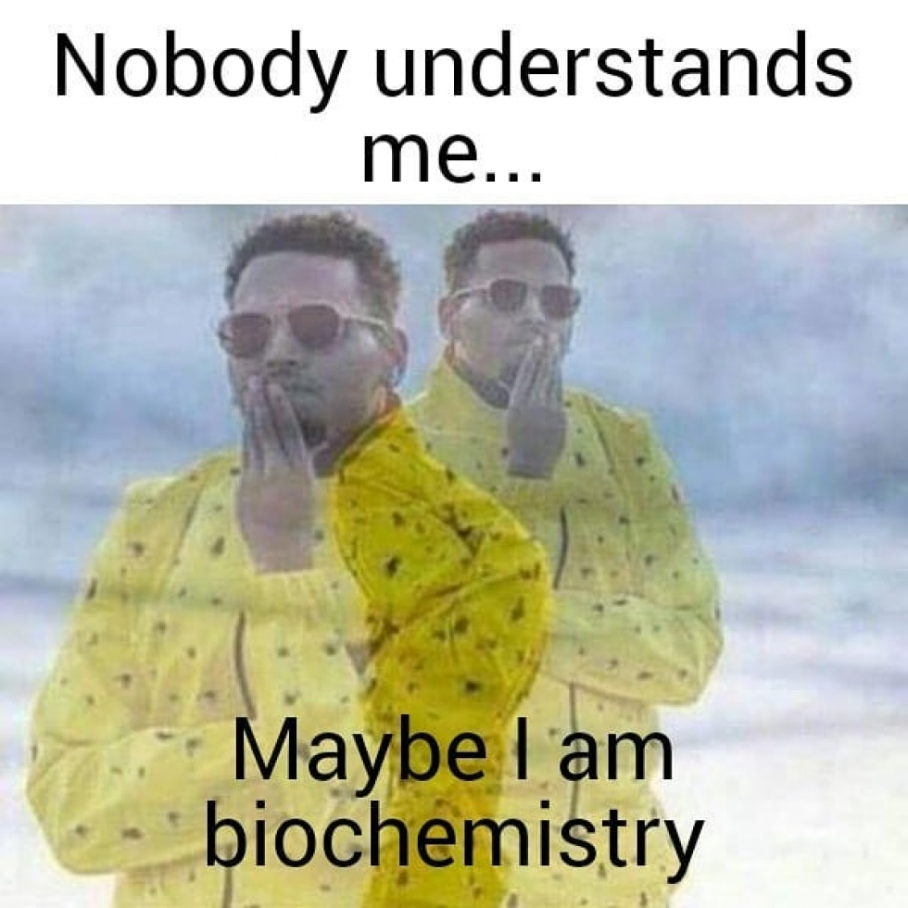
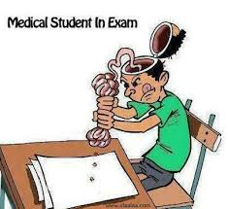

Slide 7
Requirements for the discipline :
Attendance of all lectures and practical classes without delay (in case of missing 50% or more of the lectures, points will be deducted from the overall rating)
Preparation for all practical exercises, execution and defense of all laboratory work
Pass the control works for a positive mark (if you miss a control lesson without a good reason or do not pass it on time minus 1 point from the mark)
Requirements for the appearance and behavior of students
Skipping single lectures can be worked out (submit notes of missed lectures to a lecturer or your teacher)

Slide 8
Requirements for the discipline :
Laboratory building, 4th floor
http://med2mir.ru/upload/iblock/d53/950_white_1.jpg
http://sbmkd.ru/images/stories/_thumbs/forma.jpg
http://http://medzakaz.com.ua/images/products/medicinskaja_obuvj/Leon_PU115.png

Slide 9
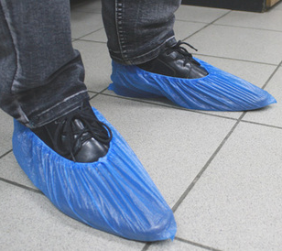
Not allowed!!!:
http://img0.liveinternet.ru/images/attach/c/11/116/825/116825460_5634411_d4f624487565.jpg
http://kombez64.ru/d/383363/d/kolpak_yevro.jpg
http://moskovskaya-obuv.com/wp-content/uploads/2015/02/tLCXlxgygCc-924x784.jpg
http://вседлячистоты.рф/d/296420/d/IMAG0270.jpg
https://phunukieuviet.com/giay-dep/4-mau-giay-cao-got-dep-2015.html

Slide 10
Where you can find lecture presentation?

Slide 12
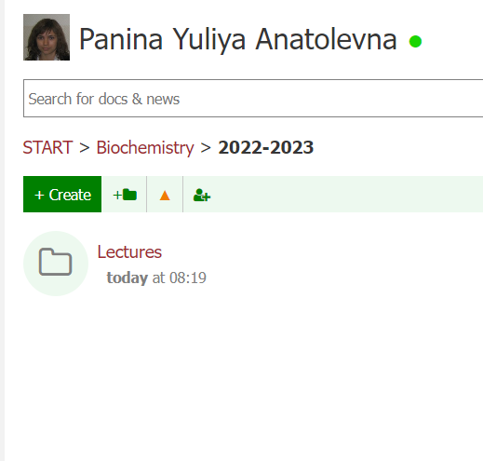

Slide 13
What is Biochemistry?
a science that describes the structure and functions of living organisms in the "language" of chemistry

Slide 15
Biochemistry helps:
To understand the mechanisms of development of diseases;
to develop methods for effective diagnosis of diseases;
To create new methods of treating diseases

Slide 16
Why will you study biochemistry:
Basis of General Pathology, Pharmacology, Clinical Laboratory Diagnostics, Molecular Medicine, Clinical Biochemistry
Biochemical logic (without it, your thinking will never become medical)

Slide 17
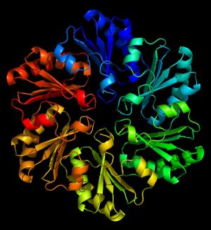
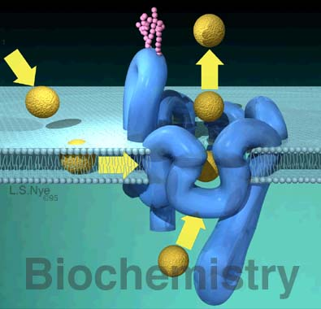
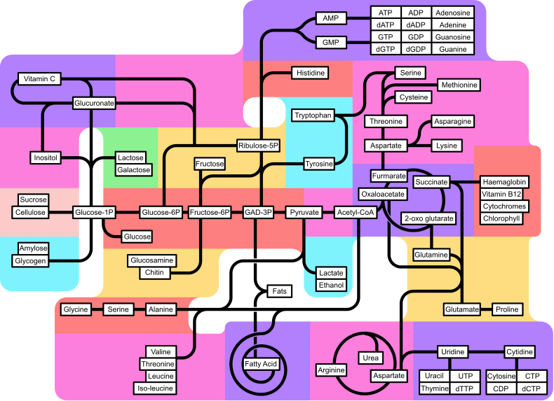
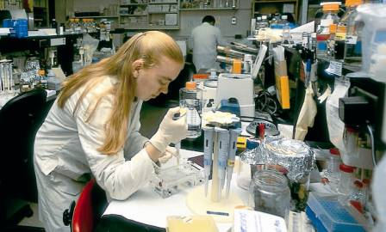

Slide 19
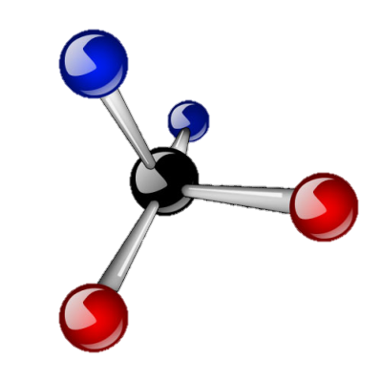
Parts of biochemistry
Static biochemistry
studies the chemical composition of organisms
Dynamic biochemistry
studies chemical reactions that represent metabolism (metabolism)
Functional biochemistry
studies the biochemical reactions underlying physiological functions
and the structure of their constituent molecules (carbohydrates, proteins, lipids, nucleic acids, their monomers and derivatives, vitamins, hormones)
one of its sections (bioenergy) is a section that studies the patterns of formation, accumulation and consumption of energy in biological systems
and the relationship between molecules, chemical structure, physicochemical properties of compounds and their biological activity

Slide 20
Medical biochemistry
Medical biochemistry (human biochemistry) is a part of medical science that studies biomolecules, causes of pathological conditions, medical diagnostics taking into account biochemical criteria.
Normal biochemistry
Pathological biochemistry
Clinical biochemistry

Slide 21
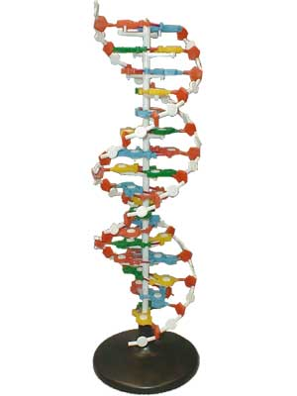
Normal biochemistry is a branch of medical science that studies biomolecules (their structure, functions, synthesis, decay, interconversion, ways of entering the body and excretion) under normal conditions.

Slide 22
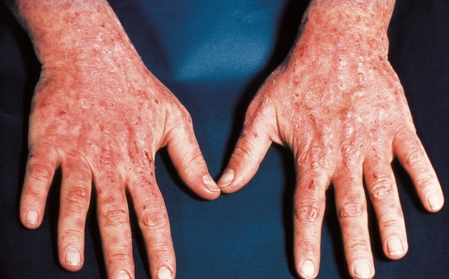
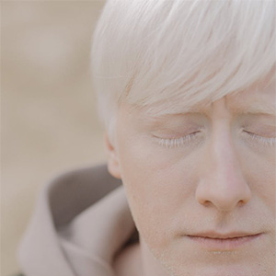
Pathobiochemistry is a branch of medical science that, with the help of biochemical methods at various levels (from molecular to the organism as a whole), studies the etiology, pathogenesis, course of diseases, and the peculiarities of the process of recovery and rehabilitation.
Patient with porphyria
Patient with albinism
https://www.medicina.ru/patsientam/zabolevanija/porfiriya/
https://www.ldc-mrt.com/pacientam/novosti/albinizm.html

Slide 23
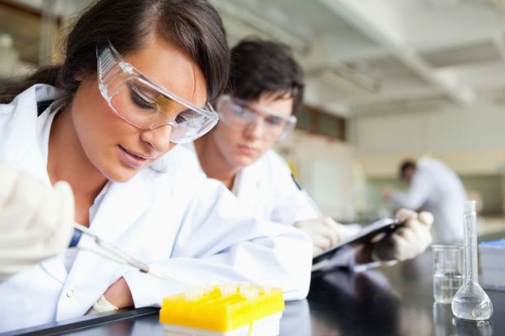
Clinical biochemistry makes it possible to significantly facilitate the scientifically grounded diagnosis, the choice of treatment and methods of preventing the disease.
It allows you to answer the questions:
-what to research?
-why?
- what can the obtained results testify to?
https://www.timeshighereducation.com/sites/default/files/styles/the_breaking_news_image_style/public/Pictures/web/p/n/i/young_scientists_at_work.jpg?itok=t0YQRfs8

Slide 24
Biochemistry research objects
Molecular level
biochemistry of lipids, carbohydrates, proteins, nucleic acids
medical enzymology
Subcellular and cellular levels
cell pathobiochemistry
cellular diseases
Tissue and organ levels
pathobiochemistry of organs and tissues (myocardium, liver, pancreas, kidneys, blood, immune system, endocrine system, nervous system, gastrointestinal tract, connective tissue, musculoskeletal system, respiratory system)
clinical neurochemistry
Organism level
metabolism (carbohydrate, lipid, protein, nitrogenous, energy, vitamins, water-mineral and acid-base metabolism)
toxicology and monitoring of medicines, pathobiochemistry of nutrition, age-related pathobiochemistry

Slide 25
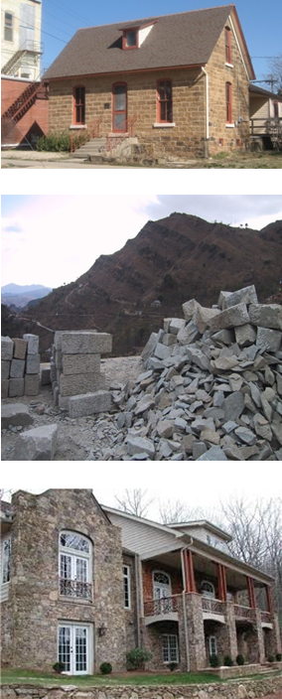
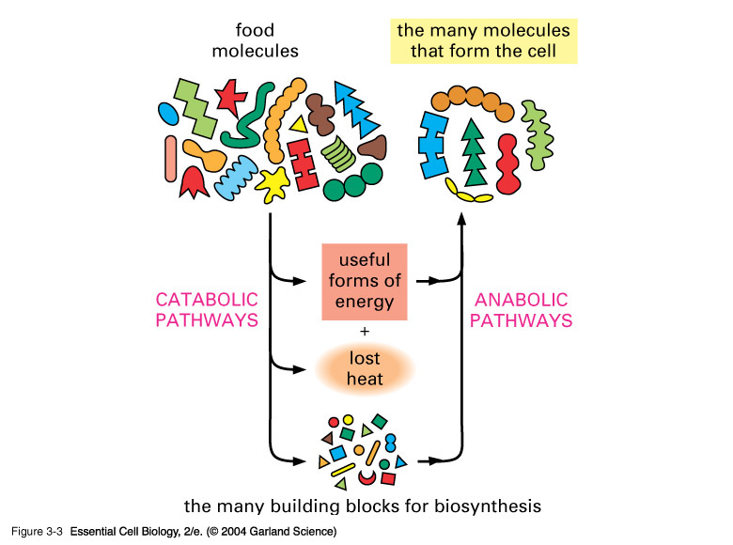
Catabolism and Anabolism

Slide 26
Features of the body as an open system:
Enzymes
Macroergs
Biomembranes
Polymers
Self-regulation

Slide 27
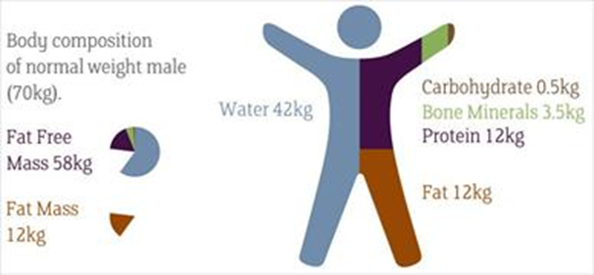
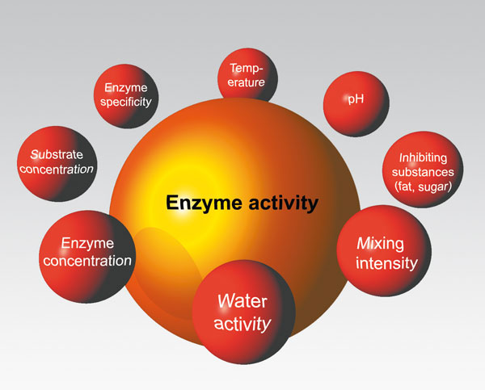
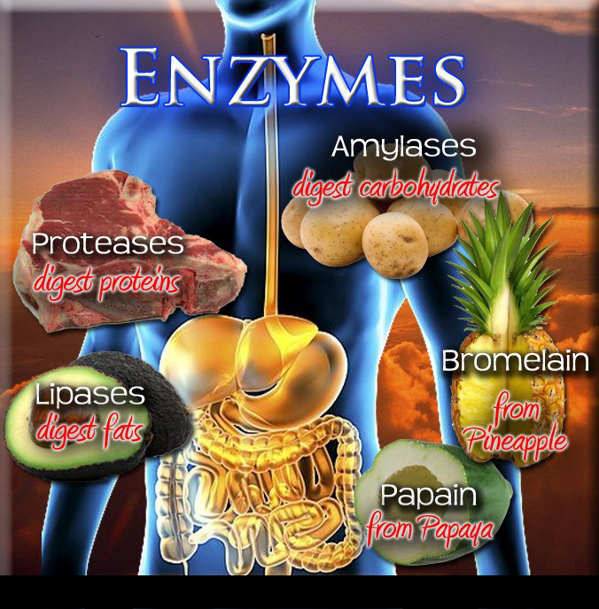
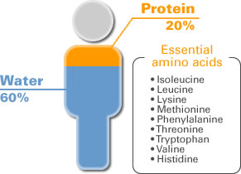
RELEVANCE OF THE TOPIC
Biomedical significance

Slide 28
Enzymes

Slide 29
DEFINITION
Biological catalysts of protein nature

Slide 30
https://www.researchgate.net/figure/The-structure-of-enzyme_fig5_321291648

Slide 31
Types of enzymes
Protein part-
APOENZYME
Non-protein part
COFACTOR
organic or inorganic
SIMPLE
COMPOUND
consist only of amino acids
the enzyme contains an additional group of non-protein nature
Are simple proteins - proteins
Are complex proteins - proteids

Slide 35
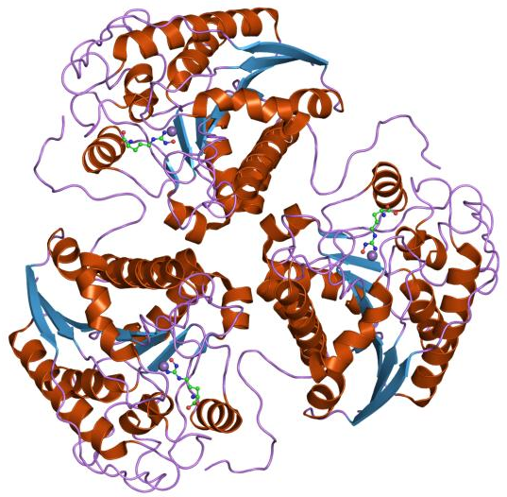
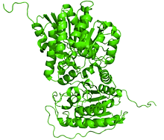
Apoenzyme functions:
enhancing the catalytic activity of the non-protein part;
specificity of enzyme action

Slide 36
Functions of cofactors:
stabilization of the active site of the enzyme;
stabilization of the substrate in the active site of the enzyme;
stabilization of the spatial structure of the enzyme;
the specificity of the action;
participation in a catalyzed reaction

Slide 39
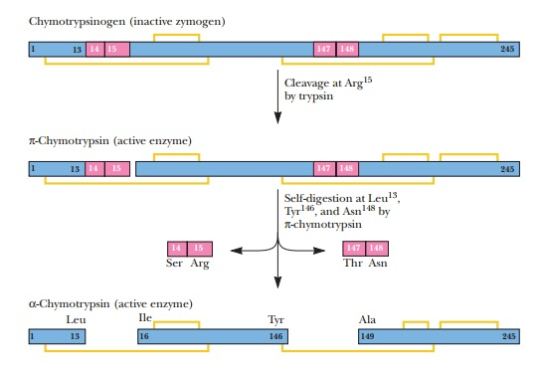
Proenzymes (zymogens) of the gastrointestinal tract and their activation by limited proteolysis
https://www.brainkart.com/article/Zymogens_27501/

Slide 40
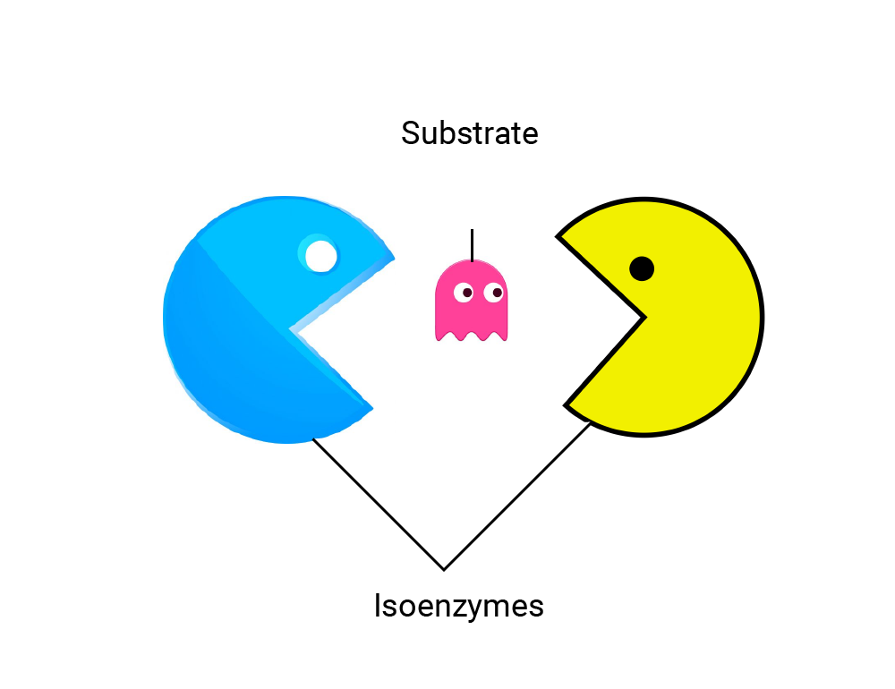
Isoenzymes
Isoenzymes are molecular forms of the same enzyme that result from genetic differences in the primary structure of the enzyme and have different physical properties.

Slide 44
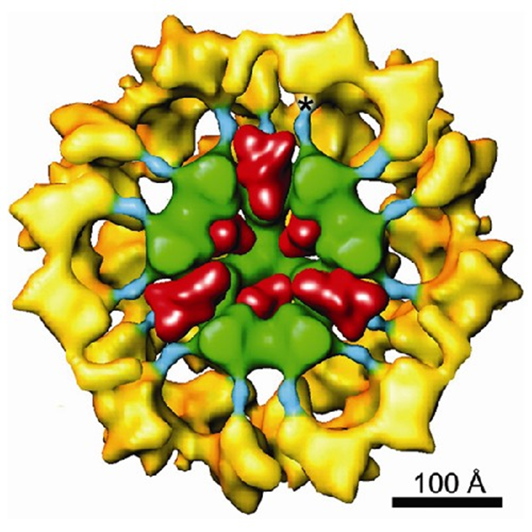
MULTI-ENZYME COMPLEXES
In a multi-enzyme complex, several enzymes are linked together into a single complex and carry out a series of sequential reactions, in which the reaction product is directly transferred to the next enzyme and is only its substrate.
For example, a pyruvate dehydrogenase complex (pyruvate dehydrogenase) that converts pyruvate to acetyl-CoA.
Pyruvate dehydrogenase (yellow), dihydrolipoamide acetyltransferase (green), dihydrolipoamide dehydrogenase (red)

Slide 45
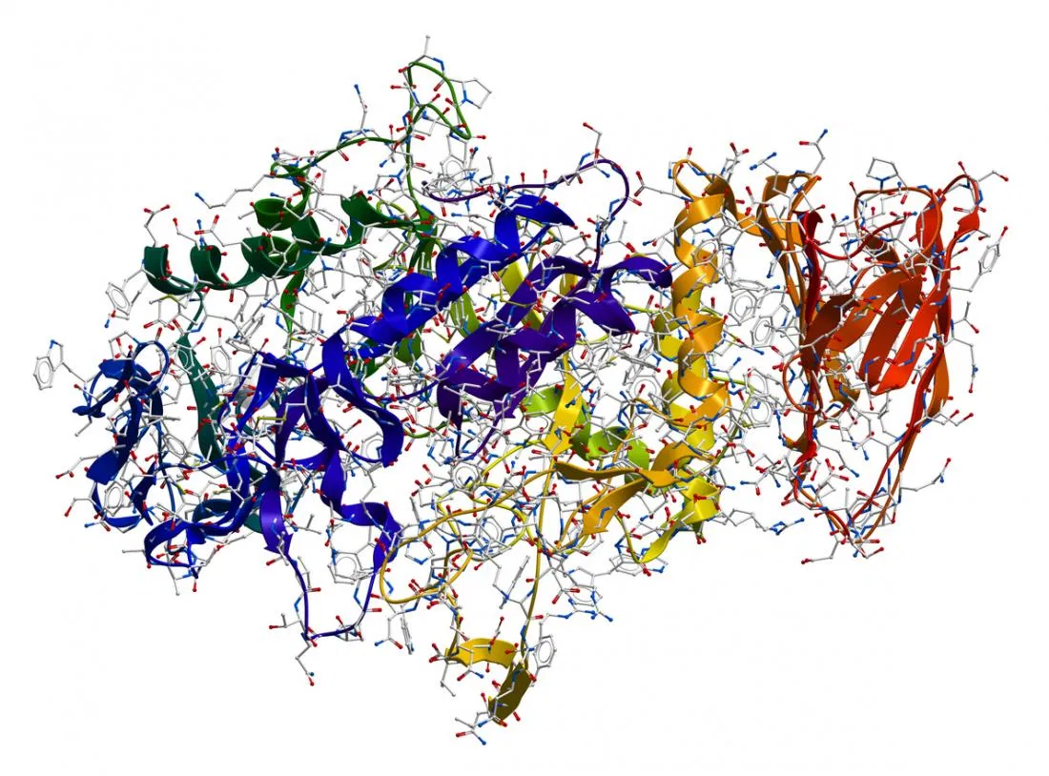
ENZYME CLASSIFICATION
Each enzyme is assigned a four-digit classification number, including the class, subclass, sub-subclass, and the ordinal number in the sub-subclass.

Slide 49
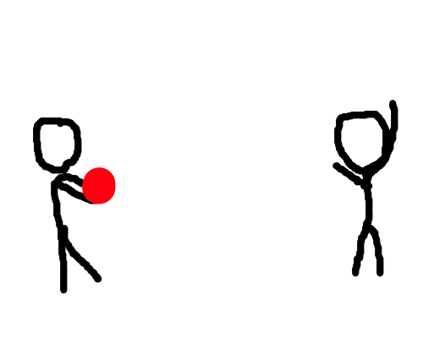
2 classes of transfer enzymes
Oxide reductase
Transferases (kinases)
ē
any groups

Slide 50
2 classes of enzymes cleaving
Hydrolases
Lyases
HOH

Slide 51
1 class of enzymes of synthesis ("crosslinkers")
Ligases (synthetases)
Lyases
(synthase subclass only)
АТP!

Slide 53
1 class of enzymes "transformation"
Isomerase

Slide 55
Subclasses of the class of oxidoreductases
Dehydrogenase - removal of H from the substrate
2. Reductases (hydrogenases) - attachment of H to the substrate
3. Oxygenase (hydroxylase) - the inclusion of O in the substrate
4. Oxidases - transfer of ē to О
5. Peroxidases and catalases - reactions of decomposition of hydrogen peroxide (it is as an acceptor ē)
SH₂ - 2H —> S
S + 2H —> SH₂
SH₂ + 1/2 O₂ —> SH-OH
SH₂ + 1/2 O₂ —> S + H₂O

Slide 56
Isomerase class subclasses
1. Racemases - conversion of D- and L- isomers
2. Epimerases - conversion of isomers with more than one isomeric center (anomers, different ketoses into other ketoses / aldoses, etc.)
3. Cis-trans-isomerases - transformations of cis- and trans-isomers
4. Mutases (intramolecular transferases)) - transformations of cis and trans isomers
5. Intramolecular oxidoreductases - transformations of cis and trans isomers
6. Intramolecular lyases - transformations of cis and trans isomers
D-C  L-C
α-C  β-C; A  B
cis-В  trans-В
A-B-C-D  A-D-C-B
Aox-Bred Ared-Box
A-B=C-D  A-B-C-D

Slide 57
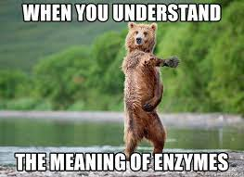
Enzymes - biocatalysts, have similarities and differences from inorganic catalysts

Slide 58
General properties of enzymes and inorganic catalysts
Catalyze only thermodynamically possible reactions
Not consumed during the reaction
They do not change the equilibrium position of reversible reactions (catalyze both direct and reverse reactions), accelerate the achievement of the equilibrium position
Increase reaction speed by decreasing activation energy

Slide 59
Differences between enzymes and inorganic catalysts

Slide 60
Stages of enzymatic catalysis

Slide 62
ENZYMATIVE CATALYSIS HAS ITS FEATURES
In an enzymatic reaction, the following stages can be distinguished:
0. Activation of the enzyme (E) and recognition of the substrate (S)
1. Attachment of the substrate (S) to the enzyme (E) with the formation of the enzyme-substrate complex (E-S): some authors here distinguish 2 stages: the formation of an inactive E-S complex (using weak bonds); the formation of an active E-S complex.
2. Conversion of the enzyme-substrate complex into one or more transition complexes (E-X) in one or more stages.
3. Conversion of the transition complex into an enzyme-product complex (E-P).
4. Separation of end products from the enzyme.

Slide 63
Stages of enzymatic catalysis

Slide 64
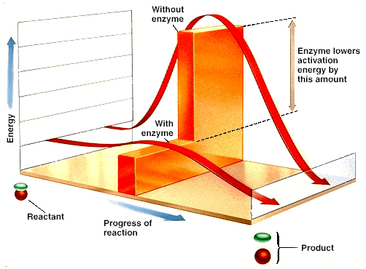
The enzyme helps to overcome the "activation barrier" ("energy barrier", "wall")

Slide 65
The rate of the biochemical reaction depends on:
Enzyme working environment (temperature, pressure, pH of the medium)
Substrate concentration
Enzyme concentration
Time of catalysis
Microenvironment of the active center of the enzyme

Slide 66
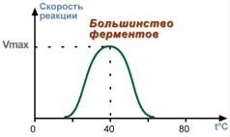
TEMPERATURE DEPENDENCE OF REACTION RATE
An increase in temperature by 10 degrees increases the reaction rate by 2-4 times, however, with a greater increase in temperature, the enzyme denatures and irreversibly loses its activity
With a decrease in temperature, the activity of enzymes decreases, but does not disappear altogether.

Slide 67
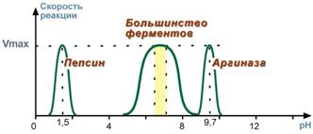
DEPENDENCE OF RATE OF REACTION ON pH
For each enzyme, there is a certain narrow pH range of the medium, which is optimal for the manifestation of its highest activity.

Slide 68
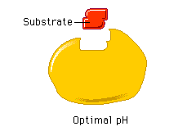

Slide 69
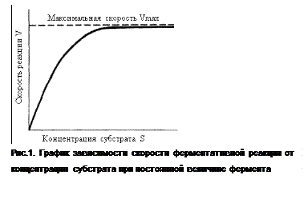
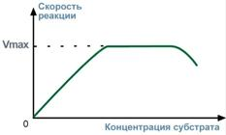
DEPENDENCE OF THE RATE OF REACTION ON THE CONCENTRATION OF THE SUBSTRATE
With an increase in the concentration of the substrate, the reaction rate first increases according to the addition of new enzyme molecules to the reaction, then the saturation effect is observed when all enzyme molecules interact with the substrate molecules.

Slide 70
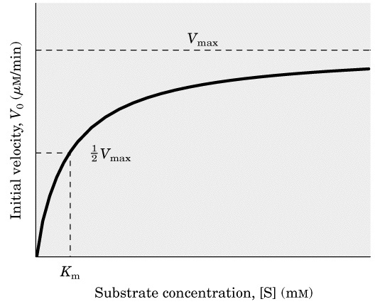
Dependence of the reaction rate (V) on the substrate concentration (S)

Slide 71
The constant is the concentration of the substrate at which half of the active sites of the enzyme are filled
For most enzymes, the Michaelis constant is 10-1 - 10-7 M
The Michaelis constant shows the affinity of an enzyme for a substrate: the lower its value, the higher the affinity
A low constant means strong binding,
high constant means weak binding
The smaller the constant, the more active the enzyme

Slide 72
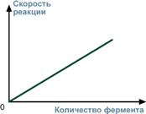
DEPENDENCE OF THE RATE OF REACTION ON THE CONCENTRATION OF THE ENZYME
With an increase in the number of enzyme molecules, the reaction rate increases continuously and is directly proportional to the amount of enzyme, because more enzyme molecules produce more product molecules.

Slide 73
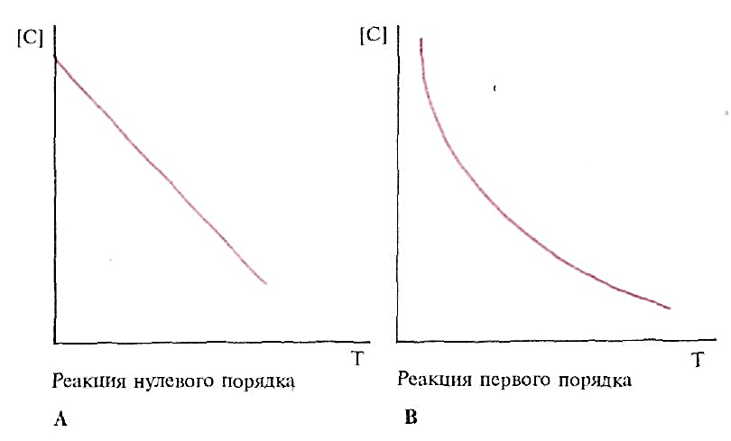
DEPENDENCE OF THE RATE OF REACTION ON TIME
The disappearance rate of the substrate remains constant throughout the reaction (zero order reaction)
Reactions take place with a decrease in the substrate per unit of time, proportional to the amount of substrate available at a given moment (first-order reactions)
Enzymatic reactions - predominantly first-order reactions

Slide 74
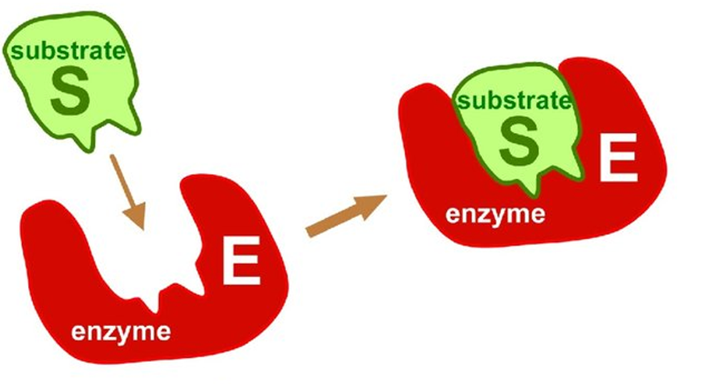
ENZYMES ARE SPECIFIC
Specificity (high selectivity of enzyme action) is based on the complementarity of the substrate structure and the active center of the enzyme
Specificity is the most important property of enzymes that determines their biological significance.

Slide 77
TYPES OF ENZYME SPECIFICITY
1. Stereospecificity - catalysis of one of the stereoisomers.
For example, specificity for L- or D-amino acids, specificity for cis- and trans-isomers.
Stereo specificity of aspartase for the trans substrate isomer

Slide 78
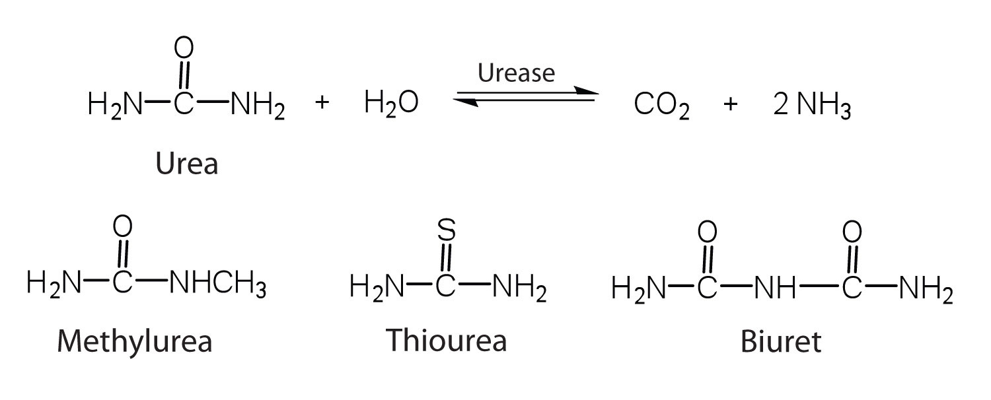
2. Absolute substrate specificity - the enzyme produces catalysis of only one substance. For example, the breakdown of urea by rease.

Slide 79
3. Relative substrate specificity - the enzyme produces catalysis of substances, the similarity is determined by the type of connection

Slide 80
3. Group substrate specificity - catalysis of substrates with common structural features, ie. in the presence of a certain bond or chemical group (for example, pepsin catalyzes the cleavage of a peptide bond formed by amino groups of aromatic amino acids).
4. Relative group suspension specificity - transformation of substrates with some common features (for example, cytochrome P450 oxidizes hydrophobic substances, which number about 7000).

Slide 83
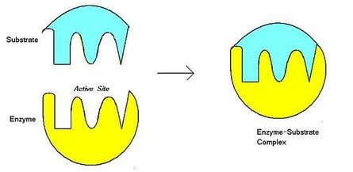
MECHANISMS SPECIFICITY
1. Fisher's theory (model of "rigid matrix", “lock and key model" - the active site of the enzyme strictly corresponds to the configuration of the substrate and does not change upon its attachment. This model explains the absolute substrate specificity.

Slide 85
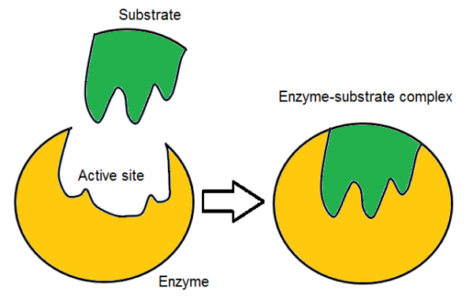
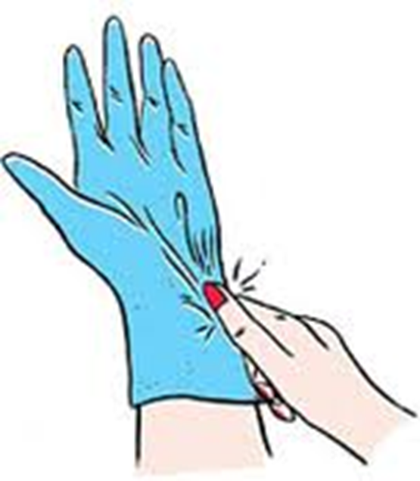
MECHANISMS SPECIFICITY
2. Koshland's induced fit theory - a model ("model of induced correspondence", "hand-glove") - implies the flexibility of the active site. The attachment of the substrate to the anchoring site of the enzyme causes a change in the configuration of the catalytic site so that its shape matches the shape of the substrate.

Slide 87
Conclusion
1. Enzymes - biocatalysts of protein nature, differing from inorganic catalysts in a number of properties.
2. The enzymes are characterized by absolute or relative substrate specificity.
3. In enzymatic catalysis, the reaction rate depends on temperature, pH of the medium, concentration of the substrate and enzyme, time, microenvironment of the active center.
4. Each enzyme has a unique combination of amino acids in the active site, providing a specific microenvironment for the substrate.
5. The interaction of enzyme and substrate implies mutual conformational changes

Slide 88
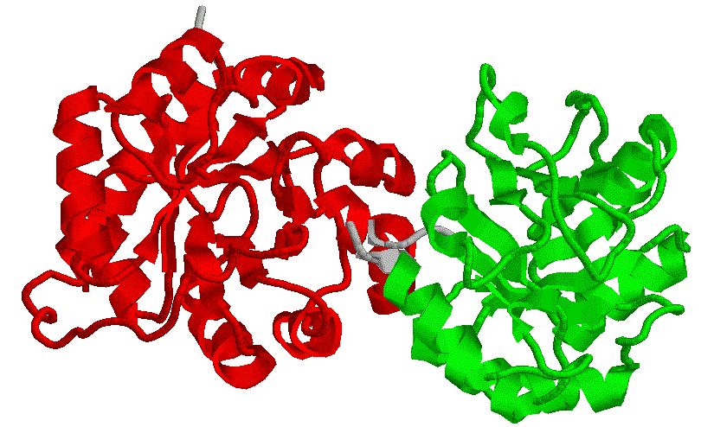
THANK YOU FOR THE ATTENTION!

Slide 89
What is the cofactor?

